Slide 1
ACCESS-CABLE for NWP(Numerical Weather Prediction): the needs, current work and next steps
Huqiang (Hugh) Zhang
Bureau of Meteorology
h.zhang@bom.gov.au
With contributions and discussions:
Imtiaz Dharssi, Yimin Ma, Vinod Kumar, Greg Roff (BoM)
Rachel Law, Jhan Srbinovsky, Lauren Stevens, Bernard Pak (CMAR)
How NWP system looks like?
What are the requirements from operational NWP?
What we are doing for ACCESS-CABLE for NWP applications?
What are the needs from NWP and operational perspectives?

Slide 2
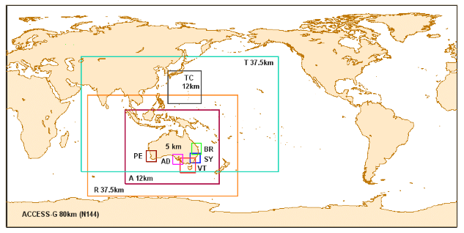
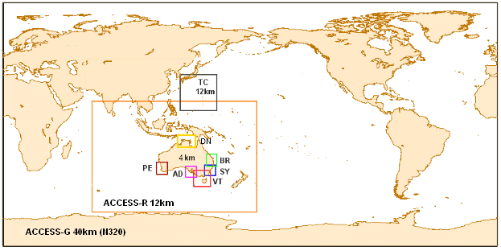

ACCESS NWP : (1) It continuously evolves and being
upgraded every 1-2 years!!! (from Fraser 2013)
APS0: 2009-2013
Global: 80km, 50L
Regional: 0.375°, 50L
Australia: 0.11°(12km), 50L
Tropical: 0.375°, 50L
TC: 0.11° (12km), 50L
City: 0.05° 5km, 50L
UM6.4
APS1: 2012/13
Global: 40km, 70L
Regional: 12km, 70L
TC: 12km, 50L
City: 4km, 70L
UM7.5
APS2: 2014/15
Global: 25km, 70L
Regional: 12km, 70L
TC: 12km, 50L
City: 1.5km, 70L
UM8.x

Slide 3
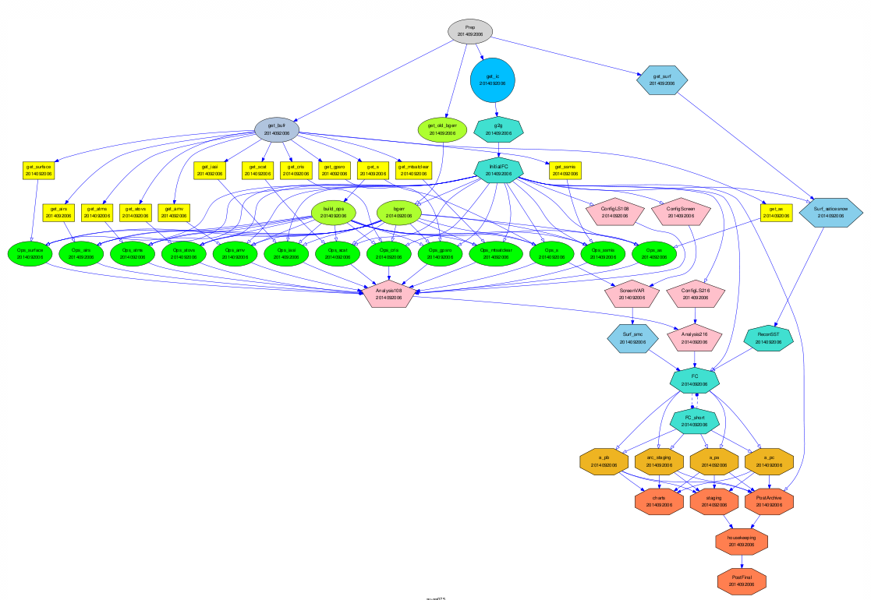
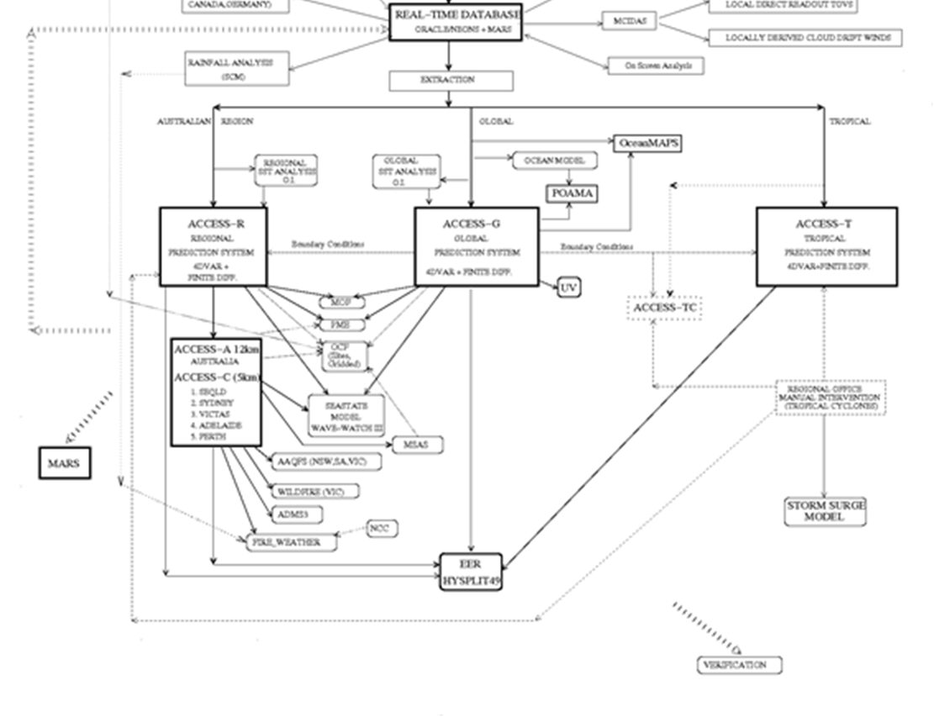
(2) NWP is a highly complex system
Observations Data Base (ODB)
OBS
Surface Analysis
ACCESS-R
ACCESS-G
ACCESS-T
Observation Process System (OPS)
A series of forecasting systems
ACCESS-C
(modified from a presentation by Xiao and Naughton 2014)
a forecasting cascade (taken from a 2010 WMO document)

Slide 4
(3) NWP is an operational system:
Demonstrated skill benefits: strict and standard NWP skill scores;
Reliability: system is run under 24/7 environment so stability/reliability is paramount;
Continuous communications, supports and feedbacks: back to the real word is my personal feeling at moment (one example is the high Td reported by forecasters and triggering a series of analysis/experiments to provide responses and potential fixes)

Slide 5
(4) Land-surface is critical for NWP
Following are some examples of the work by Imtiaz Daharssi on current operational NWP systems

Slide 6
Improvement of Urban Parameters and Tree Heights Surface verification over July 2013
(provided by Imtiaz Dharssi)
Old=Control
New=New Urban Parameters and Tree Heights
RMSD from Observed
 | Screen Temperature (K) |  |  | Screen Dew Point (K) |  | 10m Wind Speed (m/s)
Expermnt | Old | New | Imprv | Old | New | Old | New
Sydney | 2.09 | 1.87 | 11% | 2.00 | 1.98 | 1.98 | 1.93
VicTas | 1.80 | 1.75 | 3% | 1.67 | 1.64 | 2.12 | 2.04
Adelaide | 1.60 | 1.57 | 2% | 1.62 | 1.62 | 1.75 | 1.67
Perth | 1.70 | 1.58 | 7% | 2.06 | 2.04 | 1.84 | 1.79
Brisbane | 1.92 | 1.67 | 13% | 1.78 | 1.76 | 1.66 | 1.64
This change went operational in Winter 2014
We have reduced the urban heat capacity, albedo and roughness length in ACCESS NWP
We have used a global satellite derived dataset of tree heights
Testing in the ACCESS City models shows a significant improvement to 2m temperature forecasts, both in Winter and Summer

Slide 7
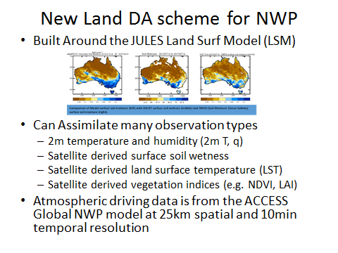
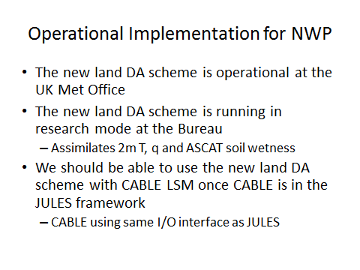
(provided by Imtiaz Dharssi)

Slide 8
Urban Parameters
(provided by Imtiaz Dharssi)
ACCESS NWP uses the MOSES2/JULES LSM
Has an urban tile
Uses a simple Urban Canopy model
Three parameters; heat capacity, albedo, roughness length
Parameters values are same everywhere
All cities/towns use exactly the same parameter values
New Urban Parameters
We have reduced the urban heat capacity, albedo and roughness length in ACCESS NWP
Testing in the ACCESS City models shows a significant improvement to 2m temperature forecasts
This change went operational in Winter 2014

Slide 9
(5) ACCESS-CABLE for NWP
An important step to make ACCESS a truly seamless forecasting system from weather, seasonal, climate to climate change;
Producing realistic "weather" in climate models has become an important part of climate model development and assessment;
A local model developed by local expertise/knowledge and extensively tested for local environment is a significant advantage
BUT
It needs significant further development, commitment and collaborations

Slide 10
At ~1.5km resolution for ACCESS-city, critical components are needed for CABLE itself. They need commitments from the CABLE community.
high quality soil/vegetation parameter datasets: impacts of tree height demonstrated such a need;
An urban model in CABLE: the impacts of urban parameters on city temperature forecasts demonstrated such a need;
A lake model in CABLE: currently forecasting models showed the impacts of unrealistic treatment of lakes;
A need for considering lateral water movement in soil column.
Comments: It would be desirable that modules within JULES and CABLE can be exchangeable so one can pick up the best from the two to form an optimized setup.

Slide 11
(6) Current work plan for testing ACCESS-CABLE for NWP:
Testing CABLE within JULES wrapper in single-site and global offline experiments (nearly done);
Testing ACCESS/CABLE climate setup in Transpose-AMIP experiment: running climate model with NWP mode (to start soon);
Testing CABLE within APS surface analysis and DA scheme (following the completion of GSWP2 offline tests);
ACCESS-G trial based on the experience of Transpose-AMIP.

Slide 12
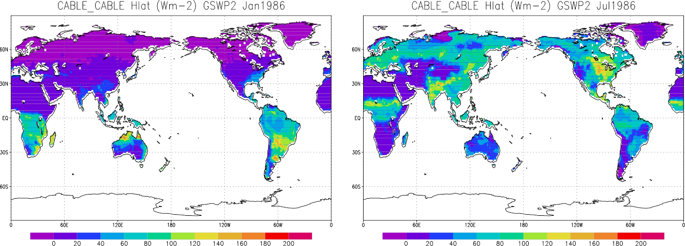
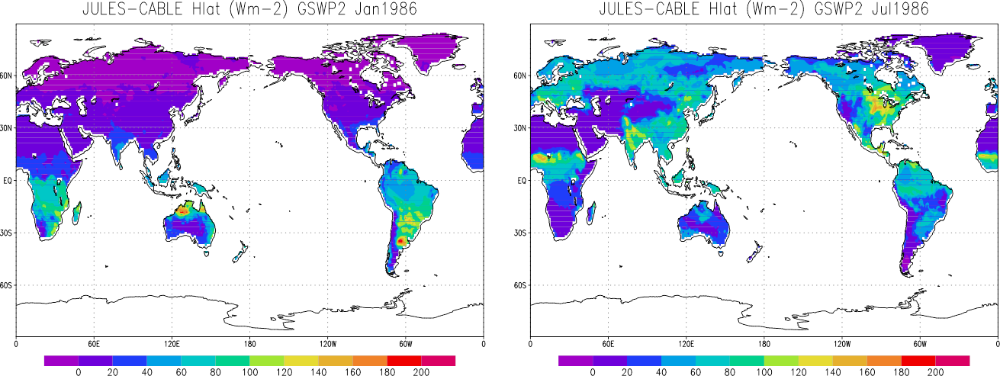
CABLE GSWP2 run using CABLE (CABLE-CABLE) and JULES (JULES-CABLE) namelists

Slide 13
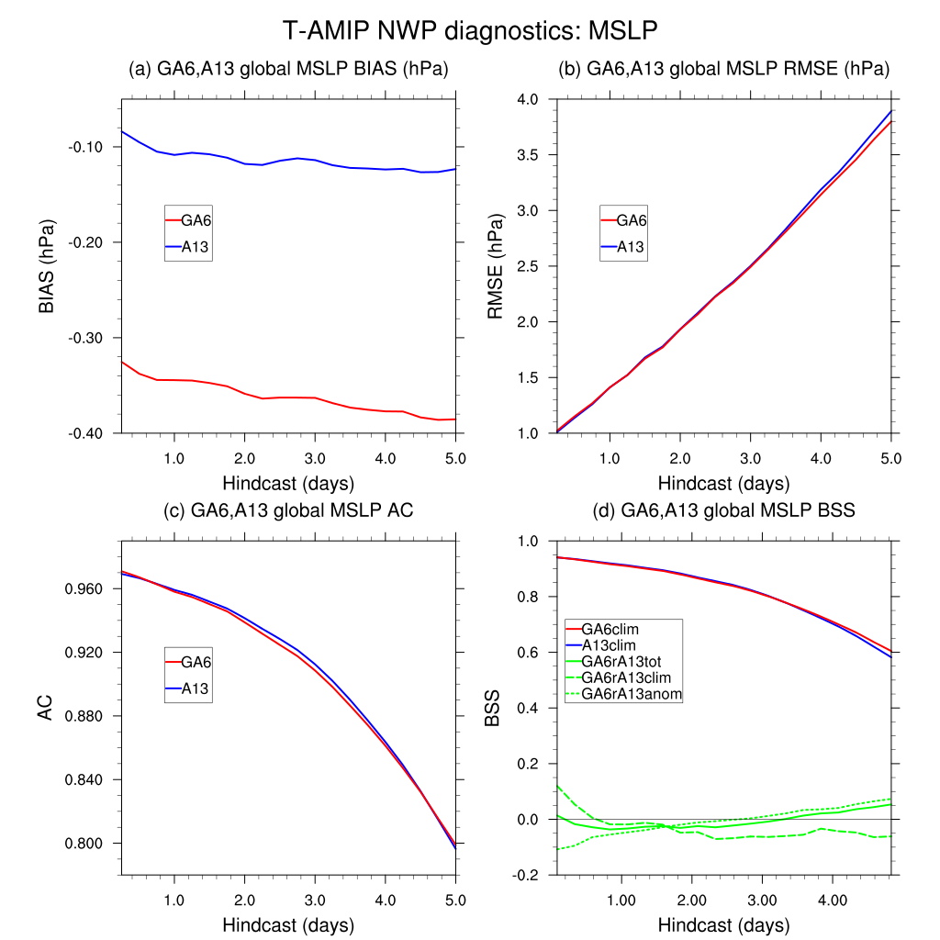
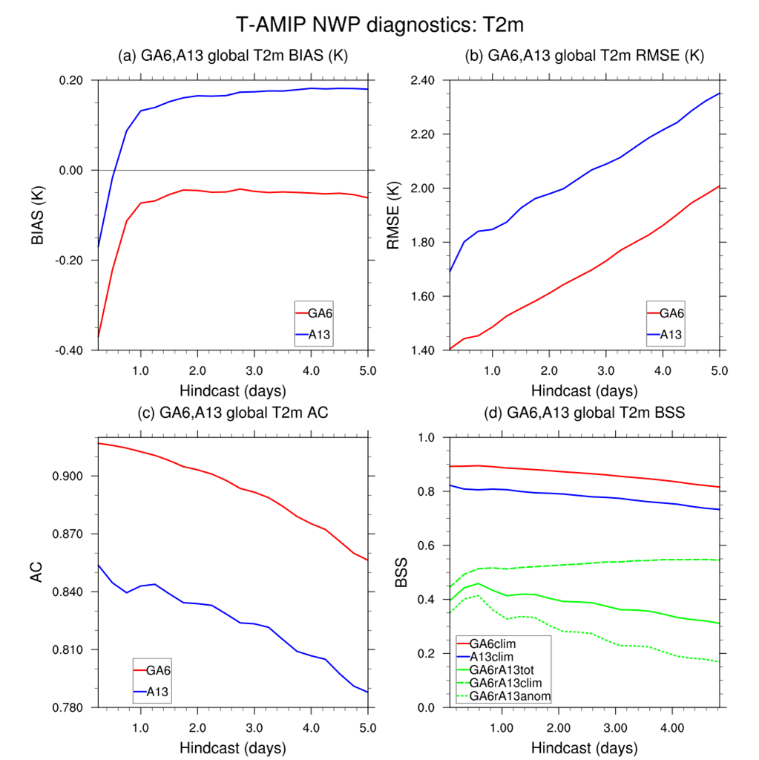
Transpose-AMIP setup by Greg Roff
Currently running UM GA6 N96L85 (um8.5+JULES) and ACCESS1.3 N96L38 (um7.3+CABLE);
5-day hindcast NWP forecasts (16 ensembles) for 15th Oct 2008, Jan/Apr/Jul 2009;
The setup and the preliminary results are encouraging!

Slide 14
Summary
Testing ACCESS-CABLE for NWP has begun and progresses have been made through generous collaborations/commitments;
Transpose-AMIP experiments with current setup UM8.5+CABLE (with JULES interface) will start soon as a transition for testing ACCESS-CABLE from climate to NWP;
Extra components in CABLE are needed for high resolution NWP applications;
We welcome any potential contribution/involvement from this community.

