Slide 1

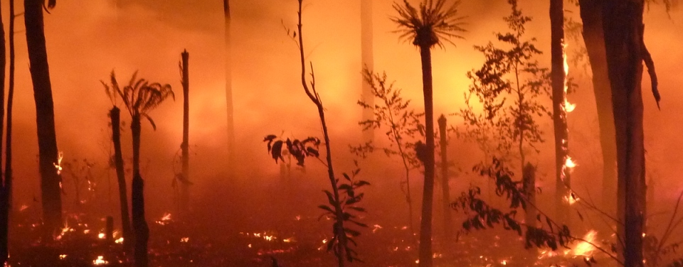
A fire model for CABLE
Lars Nieradzik, Peter Briggs, Vanessa Haverd
03 December 2014
CSIRO – Oceans & Atmosphere Flagship

Slide 2
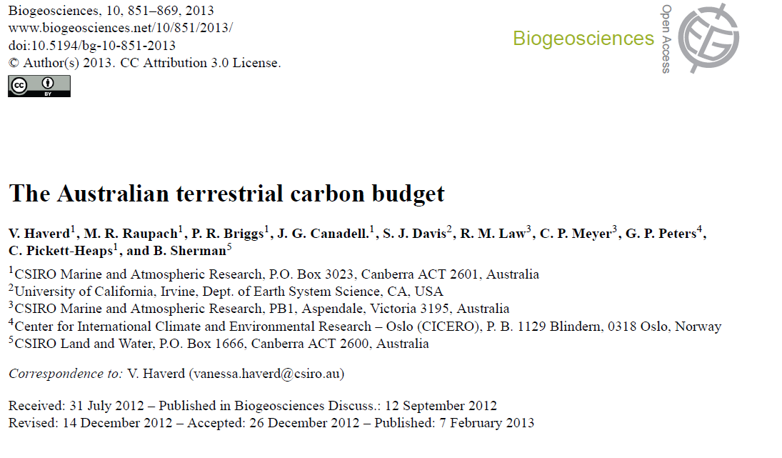


Slide 4
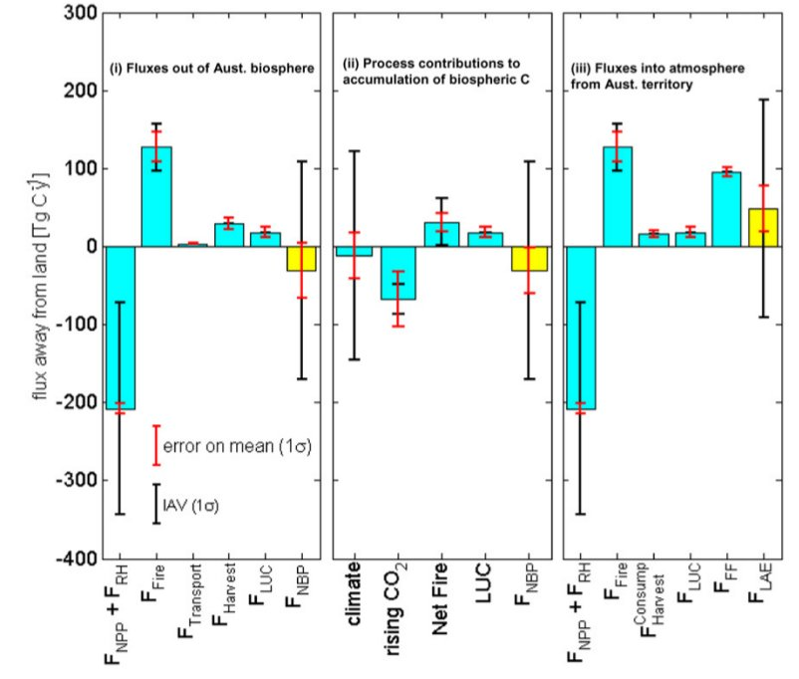
Fluxes

Slide 5
Gross Fire emissions of C-CO2 by region
Tropics and savanna account for 80% of the total emissions
South-eastern temperate region contributes significantly in years with extreme fire events such as 2003 (28 %) and 2006 (15 %).
Total gross fire emissions (127 Tg C y⁻¹) are comparable to Australian territorial emissions from the burning of fossil fuels (96 Tg Cy⁻¹)
The net C-CO2 emissions from biomass burning are much smaller (26 TgCy^{1,} mainly from clearing fires)
But what is the impact of changing fire regime on net emissions from fires???

Slide 6
Requirements for a fire model
- operate in concert with vegetation dynamics (POP)
- go along with inter-annual variations
- without putting too much computational burden

Slide 7
The Population-Order-Physiology model POP

Slide 8
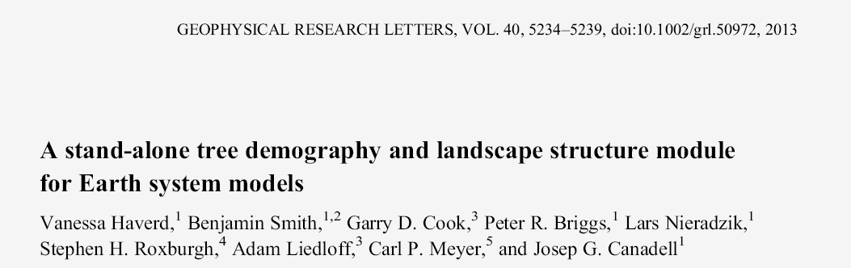
Stand-alone sub-model for coupling to CABLE or other land surface models
Forcing by whole-ecosystem stem biomass increment (fixed fraction of NPP) from CABLE
Simulate recruitment, allometric growth and mortality of age-size cohorts of generic trees in local stands
Mortality influenced by declining growth efficiency under crowding and with increased size
Fire Mortality based on tree-height and fire-line intensity (FLI)

Slide 9
The Fire - Model

Slide 10
Fire – model (structure)
Component | Specifications | Δ t | Input
IGNITION | SIMFIRE (Knorr 2014) BA [% grid cell] | a | pop. dens., avg. ann. FAPAR, landcover, Nesterov-Index
 | Observation based data sets (e.g. GFED) BA [m⁻²] | d-a | data set
FIRE | Compute Fire-Line-Intensity FLI [W/m], Flame-height... | d-a | litter (metb&str), U,T,RH,Precip
COMBUSTION | C-Pool turn-over from FullCAM combustion tables | d-a | tabulated TO_{i,j} (FLI)/g(C)_{i} from pool i -> j
 | C-Pool turn-over relative to POP fire-mortality (Haverd 2014) | a | as above but acc to POP C-TO for life pools
Ignition and combustion can be combined as desired; Δt set accordingly

Slide 11
Ignition

Slide 12
SIMFIRE (W. Knorr, Lund University) Knorr et al.,”Impact of human population density on fire frequency at the global scale”, Biogeosciences, 11, 1085–1102, 2014 doi:10.5194/bg-11-1085-2014
SIMple global FIRE model:
f fire “frequency” [frac. area burnt (AB)/a]
t year
i pixel
a-e global parameters optimised using PEST
l dominant land cover type
F multi-year average of annual max. FAPAR (2000-2010)
N max. annual Nesterov index
P population density

Slide 13
Fire Characteristics

Slide 14
Fire characteristics
Byram’s Law:
I Fire-Line Intensity
H heat yield (~ 20MJ/kg; Byram 1959; dep. on Fuel Moisture;
constant as in Liedloff 2007)
w available fuel [kg/m²]
use ~60% of litter, PEST optimised
ROS Rate-of-spread [m/s]
computed from U,T,RH,Precip (following McArthur
1967)
Notes:
Here, evtl. litter-ladder weg, dafuer sagen, dass es gePESTet wird!!!

Slide 15
Fire characteristics
Rate of spread:
F Mc Arthur Fire Index (Empirical function)
KBDI Keetch-Byram-Drought index (assumes top soil layer water capacity of 200mm and estimates total rainfall needed for saturation)
(DS)LR (Days Since) Last Rainfall (LR(24h))
RH rel. hum.
T Temperature
U Wind speed
Notes:
Neue pars

Slide 16
Combustion

Slide 17
Fire disturbance
Fire – Disturbance treatment in POP* ↔ FireModel
POP uses fire-frequencies (BA⁻¹) to distr. around normalized return-interval / randomize patches burnt
Compute Available Fuel from C-pools
Determine Fire-Line Intensity
Compute P_{survival}
Compute loss of Stem-Biomass
Compute Fluxes
G. Cook, pers. comm.
*Haverd et al., “A stand-alone tree demography and landscape structure module for Earth system models”, GRL, 2013
Notes:
There are a few more of these

Slide 18
C-Pool flux delivered by POP
OUTPUT:
Flux Above-ground biomass -> “Killed” biomass
NEEDED:
Fluxes between all affected pools.
Notes:
POPto,i into F_POP,i

Slide 19
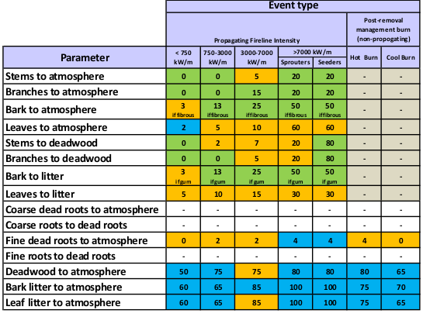
C-fluxes
Scale live fluxes by
1
5
Scale litter fluxes by
Burn grass by
10
Flux TO From | ATM | Litter str | CWD
Live Leaf | 4 | 8
Live Wood | 1-3 | 7 | 5,6
Lit metb | 11
Lit str | 12
CWD | 10
Revised FLI-dependent FullCAM parameters,
Surawski et al., “Combustion factors in fire affected Australian forests and woodlands: a review on research from 1966-2013”, 2014
Notes:
Suravski cite

Slide 20
C-fluxes delivered by fire model
Atmosphere
LEAF
met. Litter
str. Litter
Bark
CWD
WOOD
Stems & Branches
Deadwood
ROOT
Soil
Dead roots
Notes:
Was gibt es bei CASA ..?
Das wir nur Fineroots haben macht nix, da die die Uebergaenge quasi Null sind
Unterscheidung CWD/Deadwood?

Slide 21
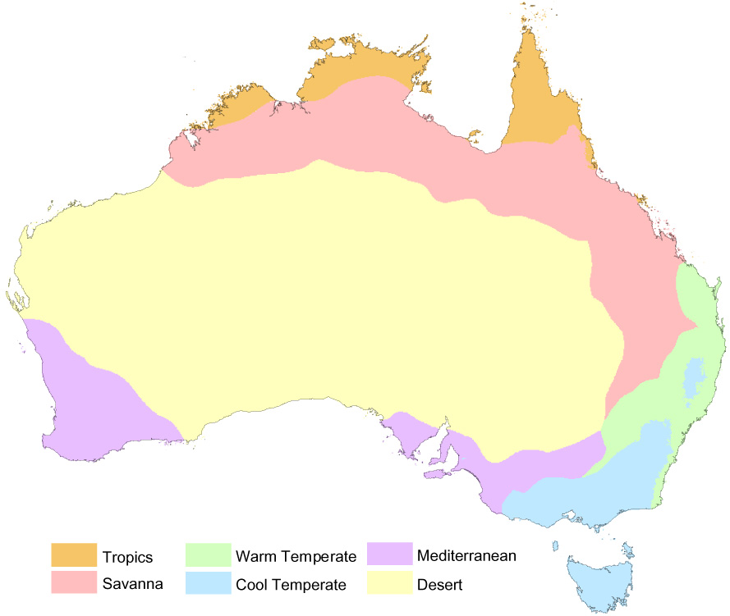
Test-case (BIOS2)
RECCAP – regions:
- 1000 random points
1900 – 2012
Rising CO₂

Slide 22
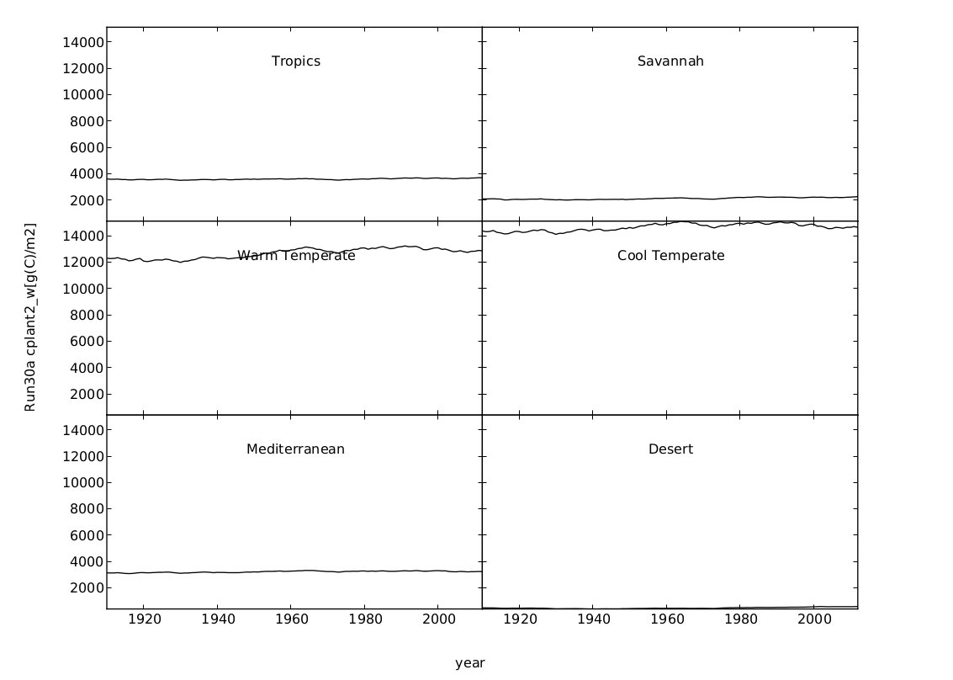
RECCAP 1000
Woody Biomass (POP-FIRE)
[g(C)/m²]
year

Slide 23
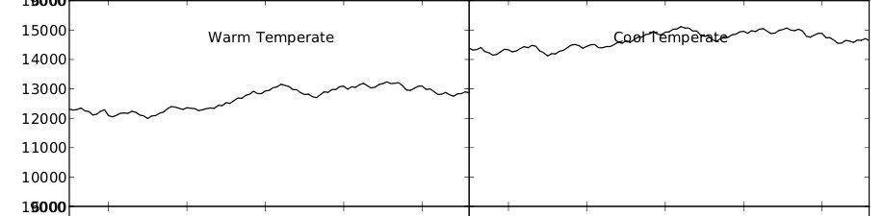
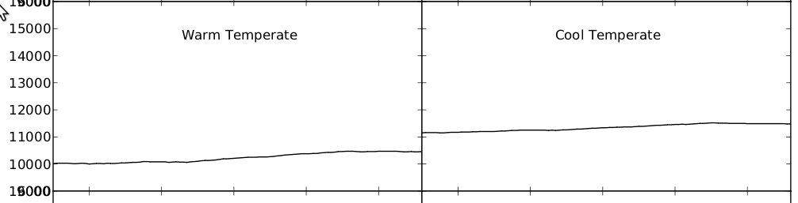
RECCAP 1000
Woody Biomass
[g(C)/m²]
BIOS2- POP-FIRE
[g(C)/m²]
BIOS2

Slide 24
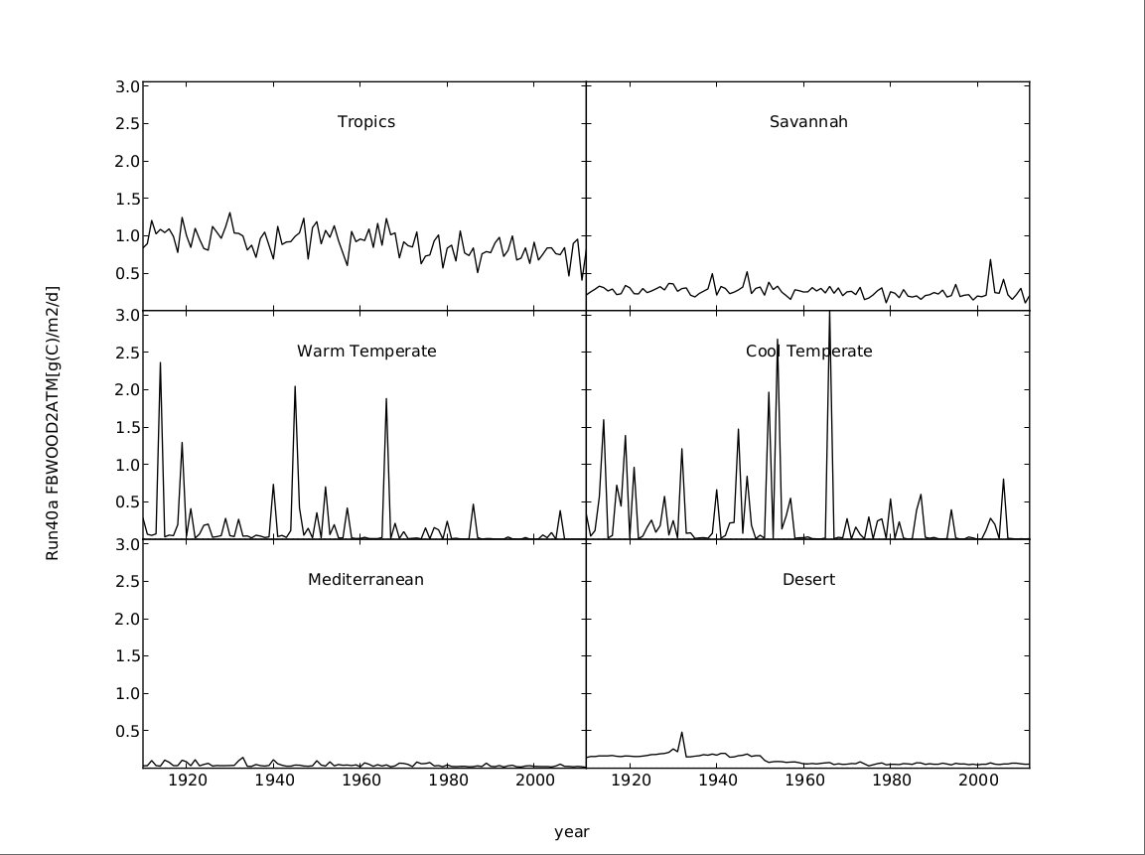
RECCAP 1000
Fire-induced flux Wood → Atmosphere
[g(C)/m²d]
year

Slide 25
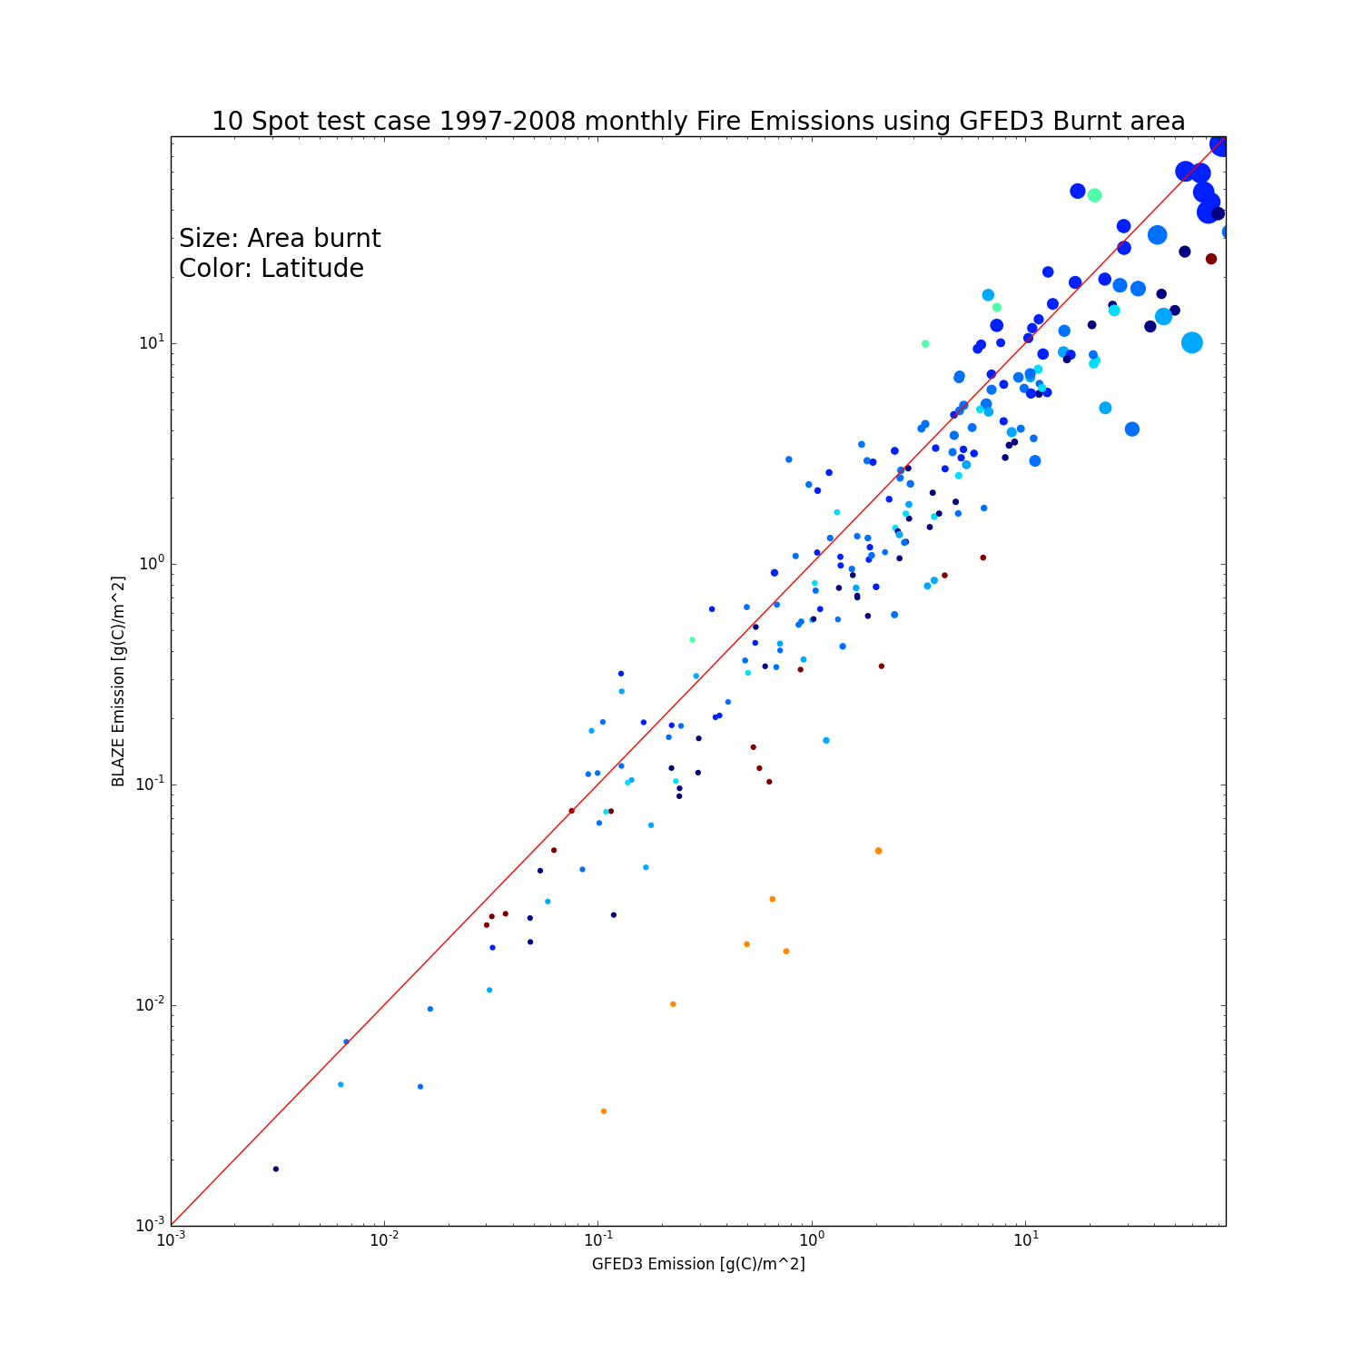
Fire – model (laugh test)
Size: Area Burnt
Color: Site
Significant deviations in NPP
Fire Model Emissions [g(C)/m²]
GFED3 Emissions [g(C)/m²]

Slide 26
Summary
Fire Model capable of reproducing fire emissions (GFED3.1)
Direct feedback via POP allowing assessment of impact on forest structure
Fine tuning (PEST) needs to be done for available Fuel
Validation and tuning against fuel load observations
Seasonality of fires (fire management)
Assessment of uncertainties

Slide 27
Thank you very much
CSIRO Oceans & Atmosphere Flagship
Lars Nieradzik
t +61 2 6281 8243
e lars.nieradzik@csiro.au
CSIRO – Oceans & Atmosphere Flagship

