Slide 1
Update on coupling CABLE to UM8.5/UM10 for ACCESS-CM2
Lauren Stevens
16 March 2016
CSIRO Oceans and Atmosphere

Slide 2
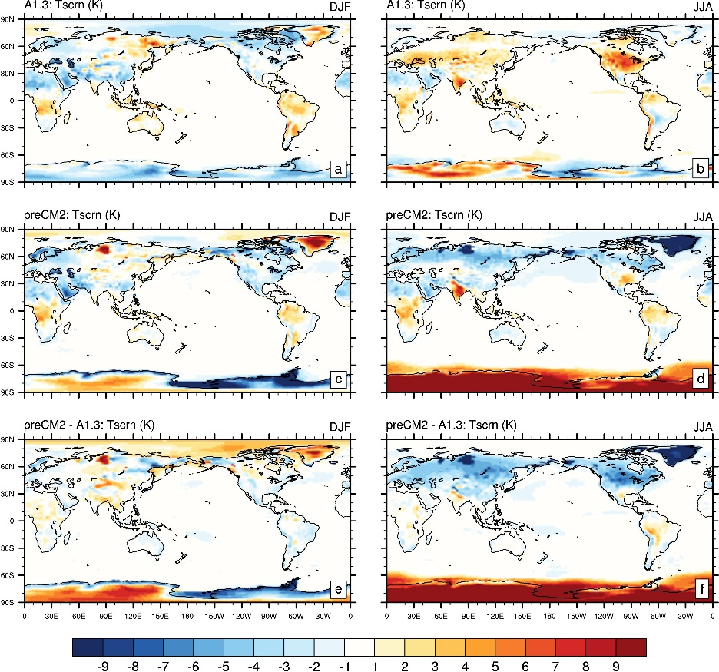
1.5m Temperature Bias with ERA-interim

Slide 3
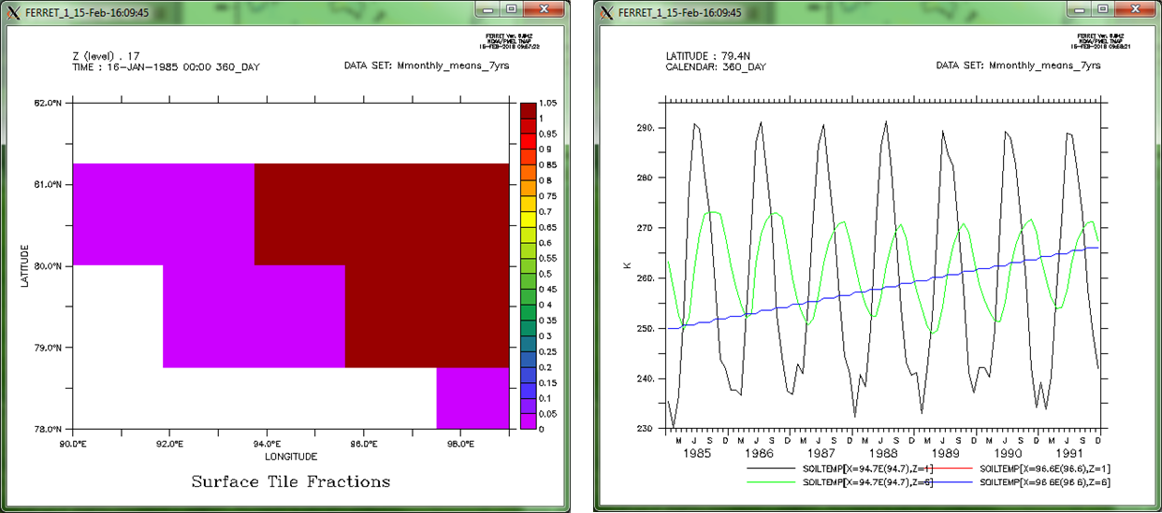
Soil Temperatures over Ice

Slide 4
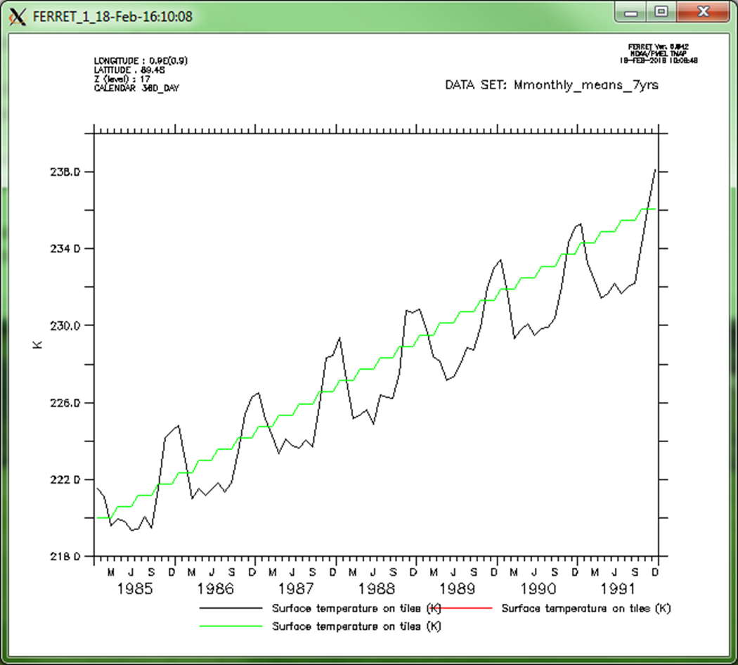
Snow temperatures: 3 levels

Slide 5
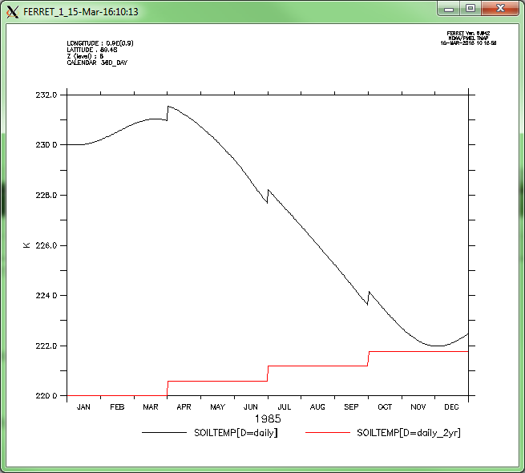
Code Fixes
Prognostic setup
cable_data_module_UM.F90
ssnow%wb & ssnow%wbice →
cable_um_init_subrs.F90
hard-wired at each restart
temporarily set wbice to frozen limit
investigate initialisation on restart
present in ACCESS 1.3/1.4
6 lev Soil Temp

Slide 6
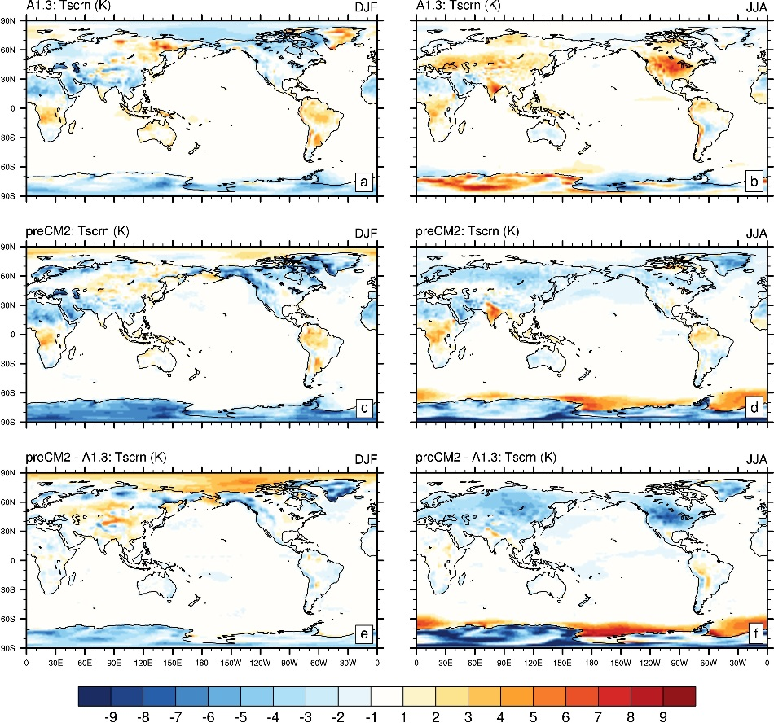
New 1.5m Temp Bias

Slide 7
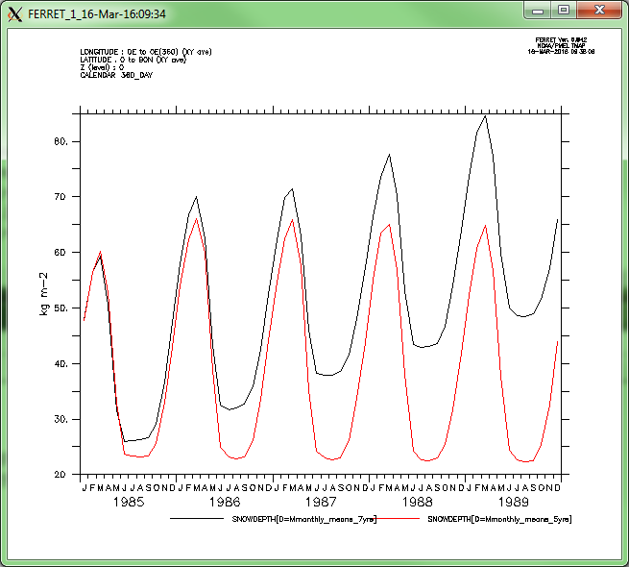
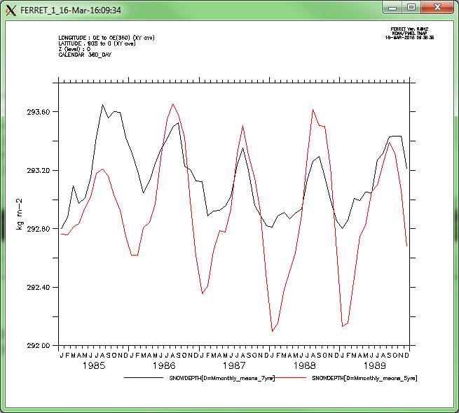
Snow Accumulation
[0:90] N
[-90:0] S

Slide 8
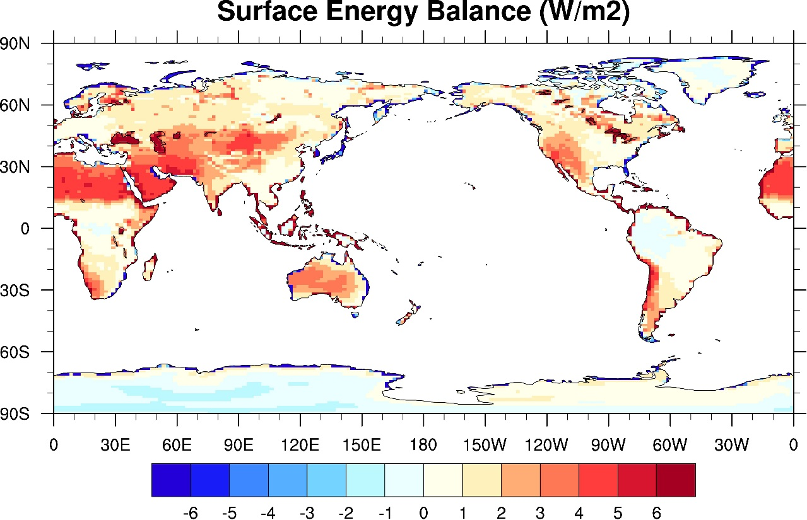
Annual SEB

Slide 9
What’s next ?
Bareground SEB
Flux correction terms in UM interface
fes_cor
fhs_cor

Slide 10
Thank you
CSIRO Oceans & Atmosphere
Lauren Stevens
t +61 3 9239 4667
e lauren.stevens@csiro.au
w www.csiro.au
CSIRO oceans and atmosphere

