Slide 1
A new land-use enabled Dynamic Global Vegetation Model (DGVM) version of the CABLE land surface model
Contribution to GCP 2016 and TRENDY-v5
Vanessa Haverd, Ben Smith, lars Nieradzik, peter Briggs, Cathy Trudinger, pep canadell

Slide 2
Talk Outline
Motivation
New CABLE components
Evaluation of new model configuration
Application for Global Carbon Budget 2016 and TRENDY-v5

Slide 3
Land Use Change and Residual Land Sink are important to global carbon balance*.
LUC source ~ 10% of C emissions: the balance between two large and uncertain gross fluxes: forest clearing and forest regrowth
Global C flux (Pg C yr⁻¹)
Residual Land Sink:
25% of C emissions are
taken up by terrestrial
ecosystems due to
surplus of photosynthesis
relative to respiration and
emissions from wildfires
ACCESS is currently missing LUC, and vegetation processes happening at time-scales > 1 year (i.e. dynamic mortality, establishment and disturbance). However recent developments have brought CABLE up to international state-of-the-art with dynamic vegetation and land-use functionality.
*Ciais et al. 2013. IPCC-AR5

Slide 4
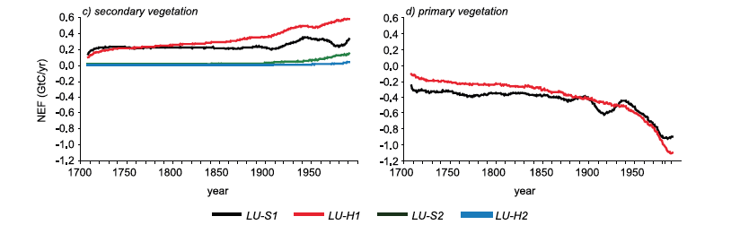
Importance of the Secondary Vegetation Sink
abandoned agricultural lands and intensified forestry, which produces a greater proportion of stands with younger trees still accumulating carbon through stem growth.
Physiological effects of rising CO₂ and climate change, mostly through changes in photosynthesis.
Secondary Forest Sink of 0.3-0.6 GT C y⁻¹ (1990s)
Shevliakova et al. 2009, GBC, 23

Slide 5
LUC-enabled CABLE builds on Multiple Developments, all now in Trunk:
POP module for tree demography and disturbance-mediated landscape heterogeneity (# 61)
LUC module (# 109)
Improved representations of coupled soil-canopy processes (drought response and effect of litter on soil evaporation) (# 93)
Climate module for tracking climate drivers of (#110)
Potential vegetation cover (required for LUC and biome migration)
Acclimation of autotrophic respiration
Phenology
Module for forcing with daily CRU-NCEP met (also annual N-deposition) (# 111, #94)
Multiple bug fixes (#108, #107, #73, #90)

Slide 6
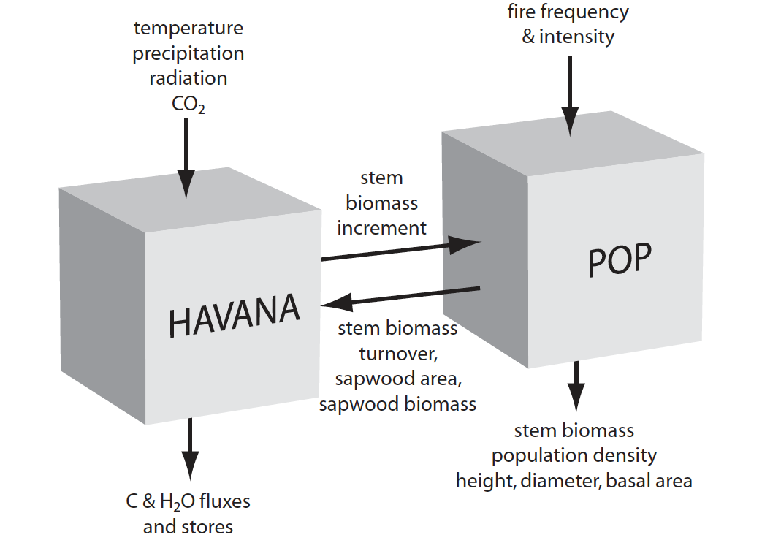
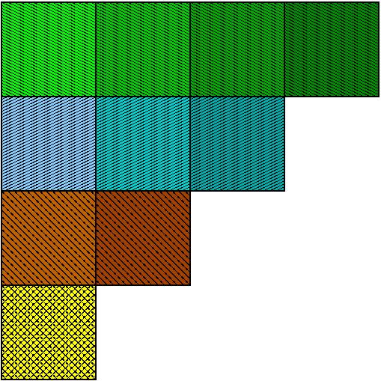
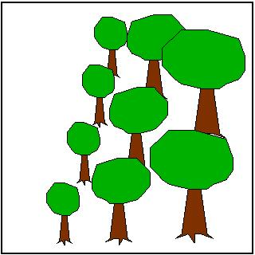
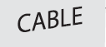
Populations-Order-Physiology (POP) is a module for tree demography and disturbance-mediated landscape heterogeneity.*
CABLE – POP Coupling
Recruitment, Growth, Mortality in each patch
Grid-cell (tile) represented by patches distinguished by time since last disturbance
*Haverd et al. 2013
Geophysical Research Letters 40: 5234-5239
Sapwood area and biomass dictate demographic effects on NPP
Notes:
The essential coupling elements are transfer of stem biomass increment of host LSM to POP and transfer of biomass turnover rate from POP to host LSM.
Forcing by whole-ecosystem stem biomass increment (fixed fraction of NPP) from CABLE
Simulate recruitment, allometric growth and mortality of age-size cohorts of generic trees in local stands
Partition total stem biomass increment among stands and cohorts as a declining proportion of current size
Mortality influenced by declining growth efficiency under crowding and with increased size
Upscaling to landscape (grid cell) by interpolation among stands of different age-since-disturbance
Two disturbance types:
catastrophic (e.g. cyclone), fixed longish return time (200 yr)
partial (wildfire), variable return time (1-10 yr)

Slide 7
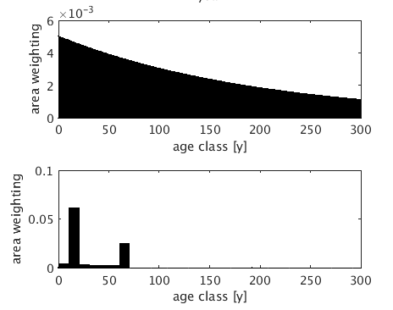
Interaction of Land Use with CABLE
LAND USE MODULE
Land-use transition matrix
wood harvest area
Area weights for each forest age class
PFT Area Fractions
Carbon Redistribution
Primary
CABLE
demography
Secondary

Slide 8
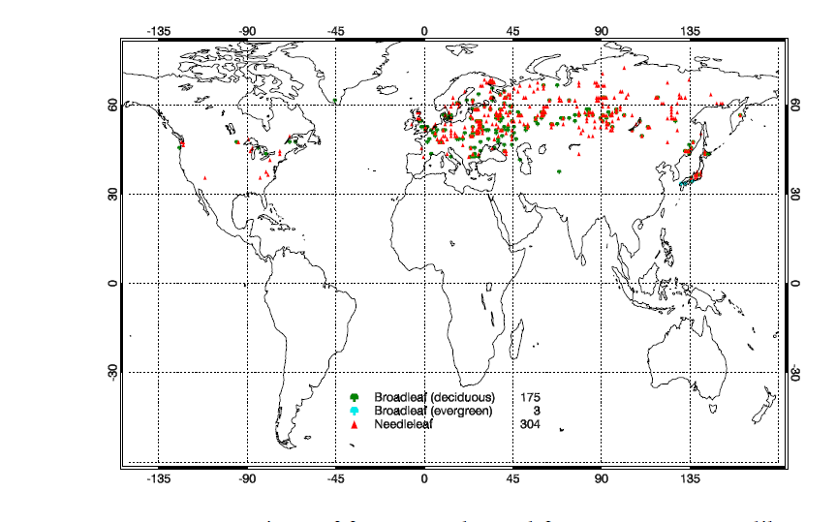
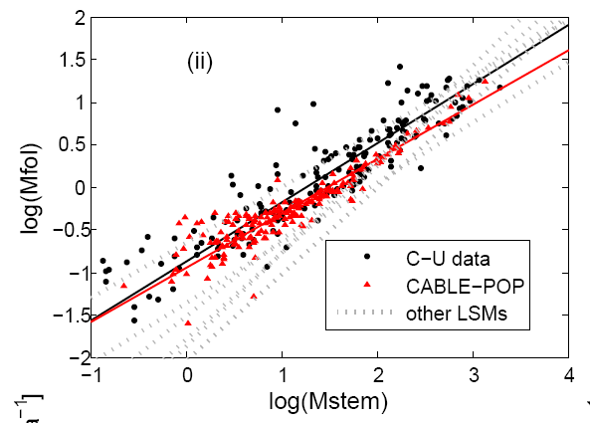
CABLE-POP reproduces observation-based leaf-stem allometry relation in boreal and temperate forests*
“Function”
Curve fits for
other LSMs:
Wolf et al. 2011
Global Biogeochem
Cycles 25
“Structure”
Relationship emerges because of known demographic effects on productivity and turnover
*Haverd et al., 2014 Biogeosciences 11: 4039-4055
Notes:
Structure-function relation: emerges
Ecological defensible way, based on known physilogy and demography

Slide 9
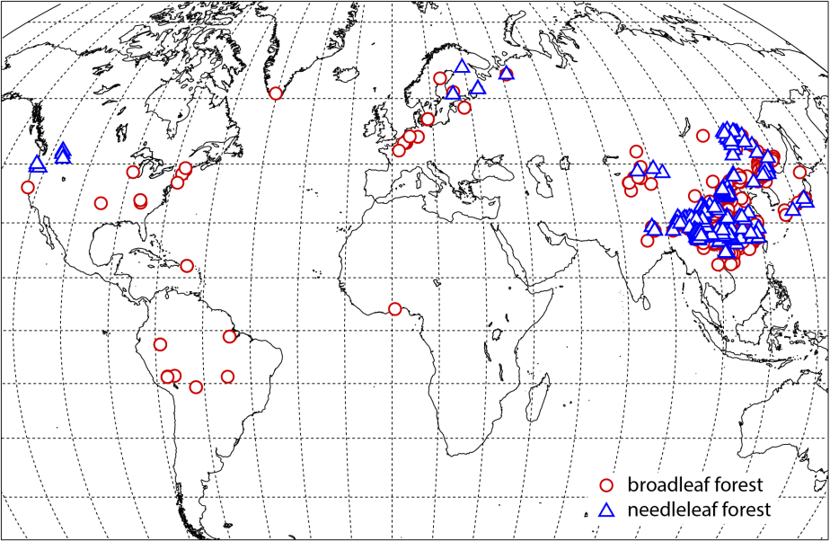
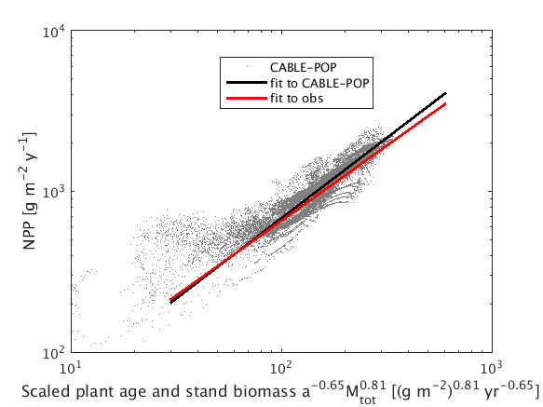
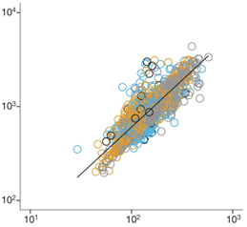
Climate controls NPP via biomass and age*
*Michaletz et al. 2014
Nature 512: 39-44
Net primary production
(g m⁻² yr⁻¹)
(stand age)^{-0.65} × biomass^{0.81}
Notes:
First age and biomass jumbled.
Then separate effects.
There is a direct control of climate on NPP: effect is modulated by the lagged sturcutal effects as reperesented by age and biomass

Slide 10
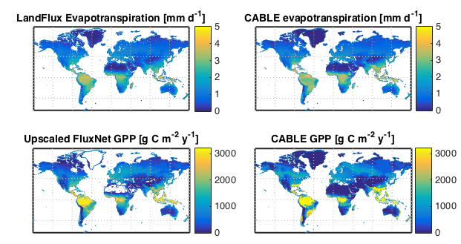
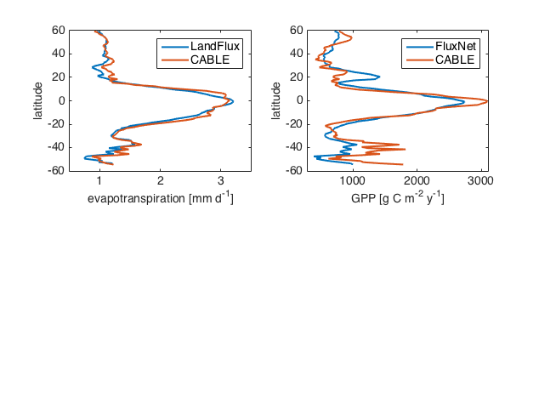
Evapotranspiration and GPP: comparison with obs-based products

Slide 11
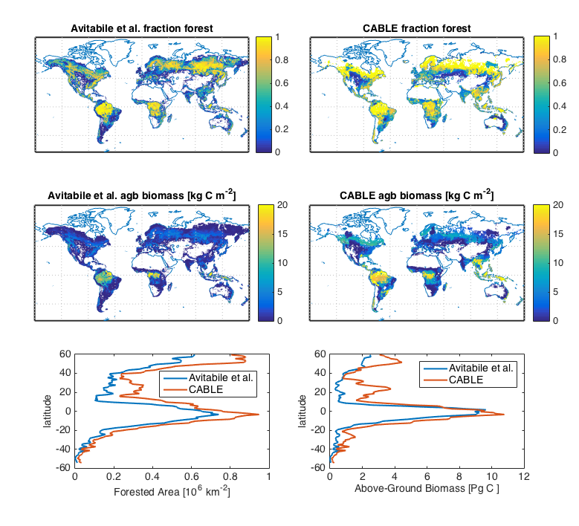
Fraction forested area and above-ground biomass: comparison with GEOCARBON global forest biomass map (Avatabile et a. GCB 2016). Forest areas according to the GLC2000 map.

Slide 12
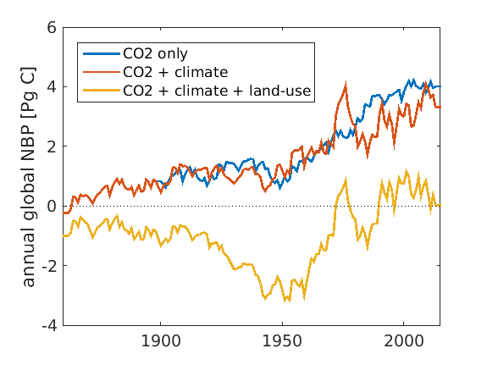
CABLE global Net Biome Productivity: results for GCP 2016 – TRENDY-v5

Slide 13
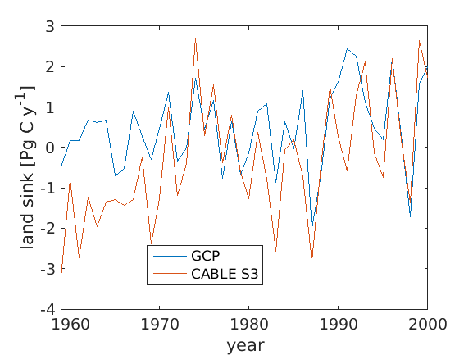
Net Land Sink Inferred from Global Carbon Budget and CABLE TRENDY S3 (dynamic land-use) simulation

Slide 14
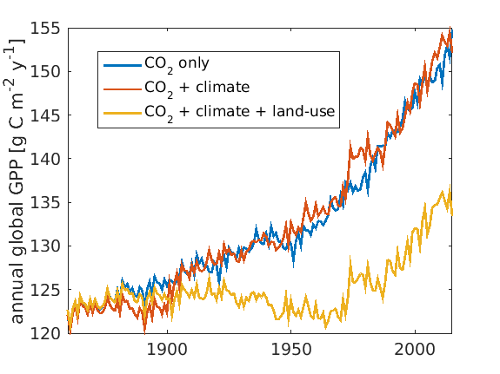
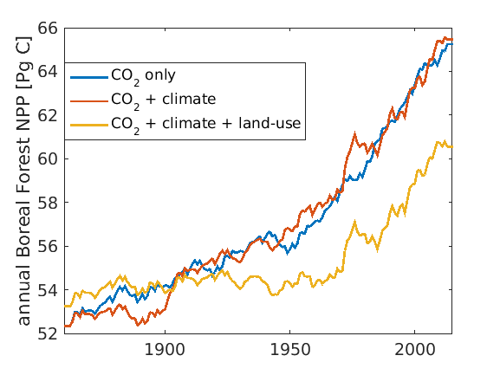
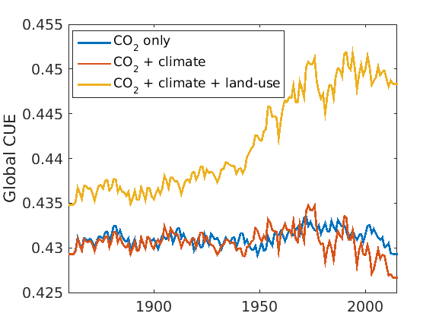
Global GPP, NPP and Carbon Use Efficiency

Slide 15
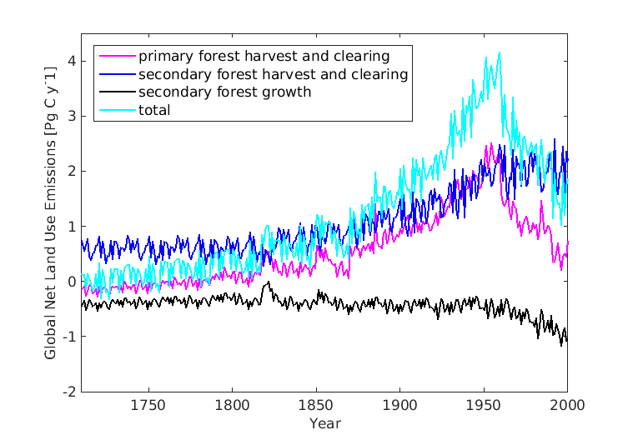
CABLE global land-use emissions, driven by LUH2 land-use forcing
Net land-use flux (~1.5 PgC y⁻¹) is large compared to residual land sink (~2.4 PgC y⁻¹)
Regrowth on abandoned agricultural lands and intensified forestry

Slide 16
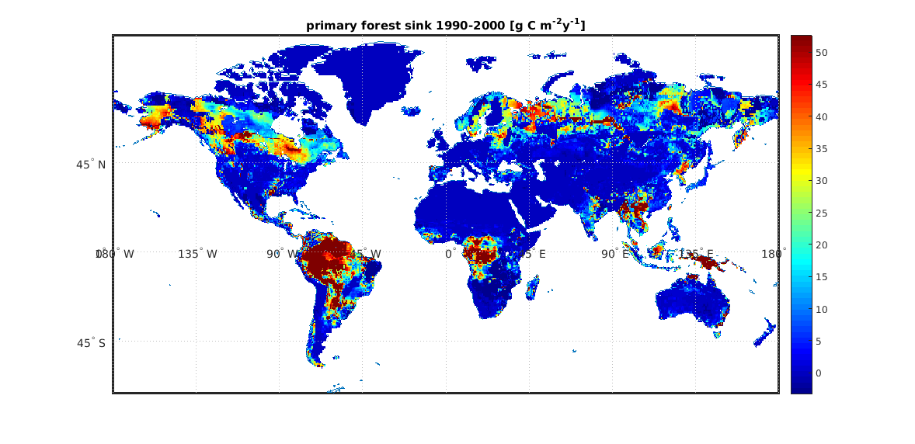
Primary Forest Carbon Sink 1990-2000
Physiological effects of rising CO₂ and climate change, mostly through changes in photosynthesis.
Notes:
Physiological effect of CO2 fertilisation and climate change, mostly through changes in photosynthesis.

Slide 17
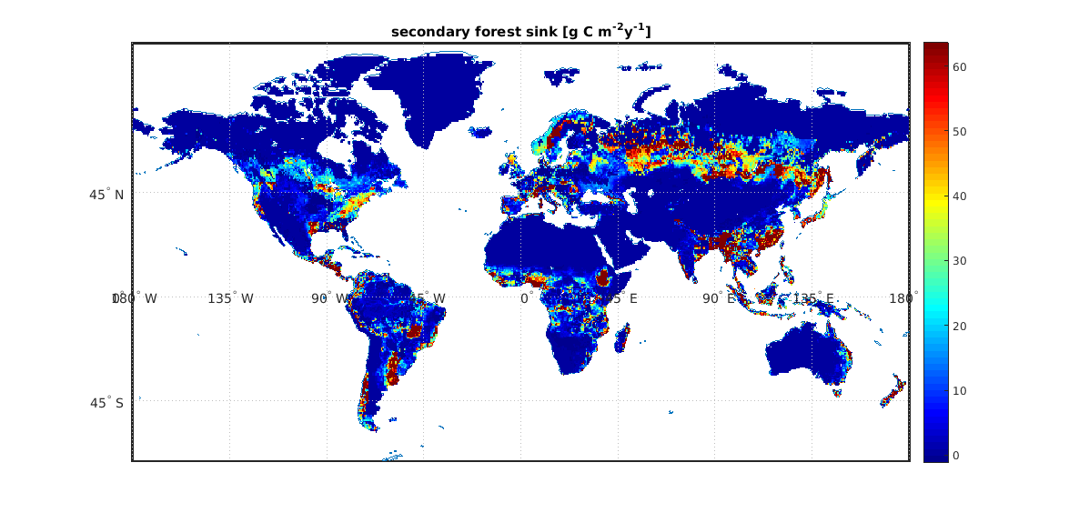
Secondary Forest Sink 1990-2000
Forest regrowth: abandoned agricultural lands and intensified forestry, which produces a greater proportion of stands with younger trees still accumulating carbon through stem growth.
Notes:
Forest regrowth: abandoned agricultural lands and intensified forestry, which produces a greater proportion of stands with younger trees still accumulating carbon through stem growth.

Slide 18
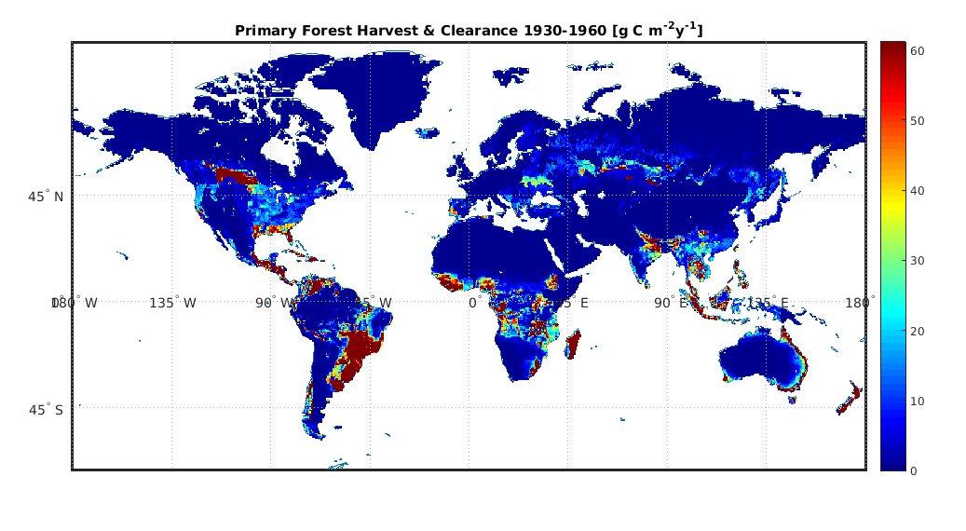
Primary Forest Harvest and Clearing 1930-1960
Land-use change: Deforestation

Slide 19
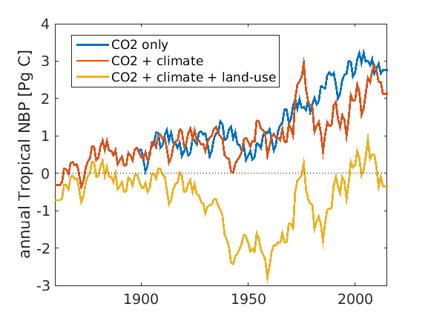
Tropical Net Biome Productivity

Slide 20
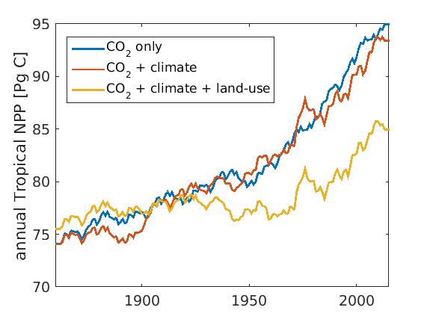
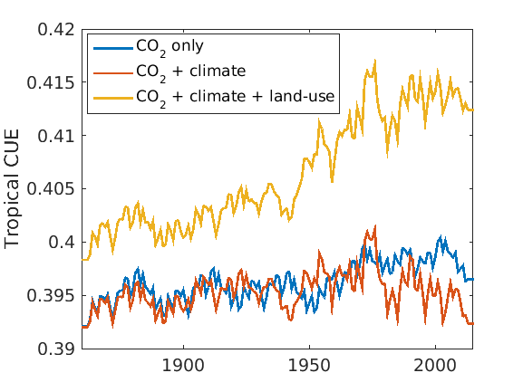
Tropical NPP, Carbon-Use Efficiency

Slide 21
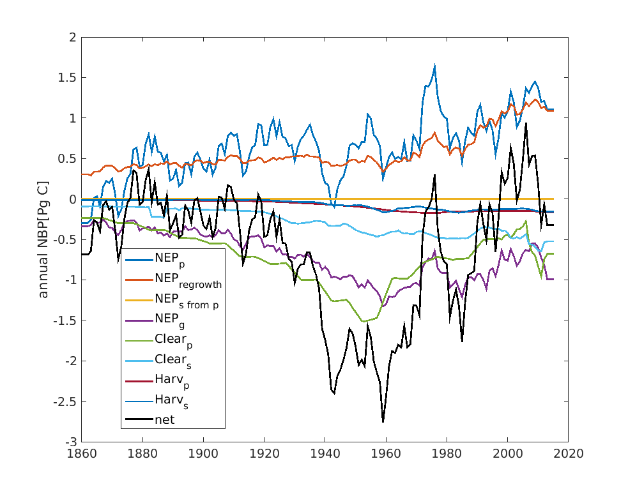
Net CO₂ Flux Attribution: Tropics

Slide 22
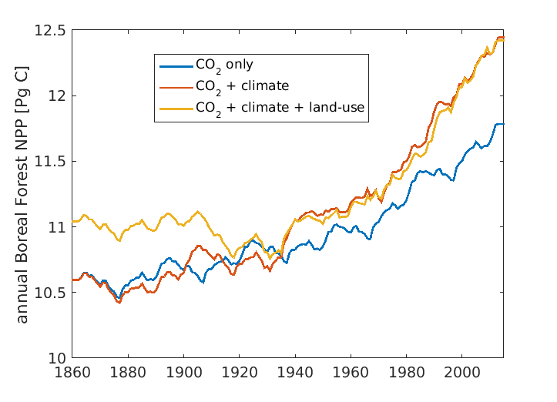
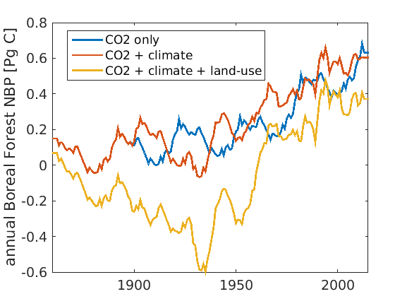
Boreal forest around the globe: Trends in Productivity
GPP Trends 1996:2015
Boreal Forest: 2.5 g C m⁻² y⁻¹
Cool Mixed Forest: 3.5 g C m⁻² y⁻¹
Temperate Deciduous Forest: 4.0 g C m⁻² y⁻¹
Notes:
model now extended globally: for example we can look at boreal forest around the globe. Kim was hypothesising there could be both a climate effect due to a longer growing season, and a CO2 fertilisation component. Indeed that’s what we see in our model for the whole boreal forest zone. Land use has no net effect on NPP after 1930, but deforestation and forest management still produces an increased decomposition of forest residues.

Slide 23
Recent global carbon terrestrial carbon balance
 | Global Synthesis by Schimel et al. 2015* (2000-2007) | CABLE (1990-2000)
Tropical Gross Deforestation | 2.9±0.5 | 2.0
Tropical Regrowth after deforestation | -1.6±0.5 | -1.0
Northern Extra-tropical uptake | -1.2±0.1 | -0.7
Tropical plus southern CO2 effect uptake | -1.4±0.4 | -1.0
Net land flux | -1.3 | -0.7
Schimel, D. et al.: Effect of increasing CO2 on the terrestrial carbon cycle, Proceedings of the National Academy of Sciences, 112, 436-441, 2015

Slide 24
Ongoing Work
Repeat TRENDY simulations with
Updated LUH2 forcing
Lower biomass in boreal forest (increased stem respiration)
Simple biome migration scheme to allow for climate effects on potential vegetation cover

Slide 25
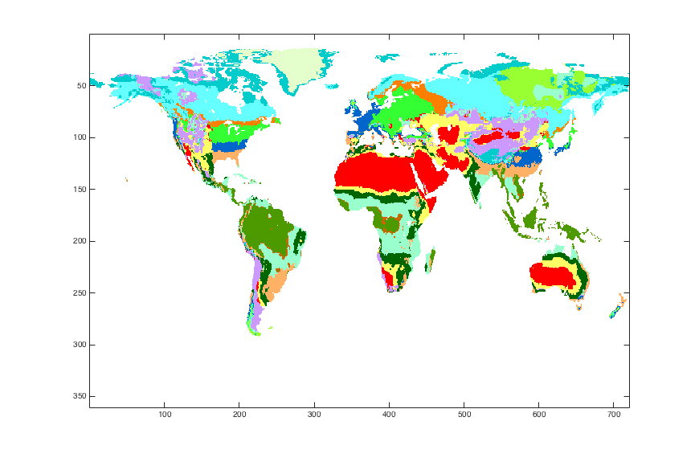
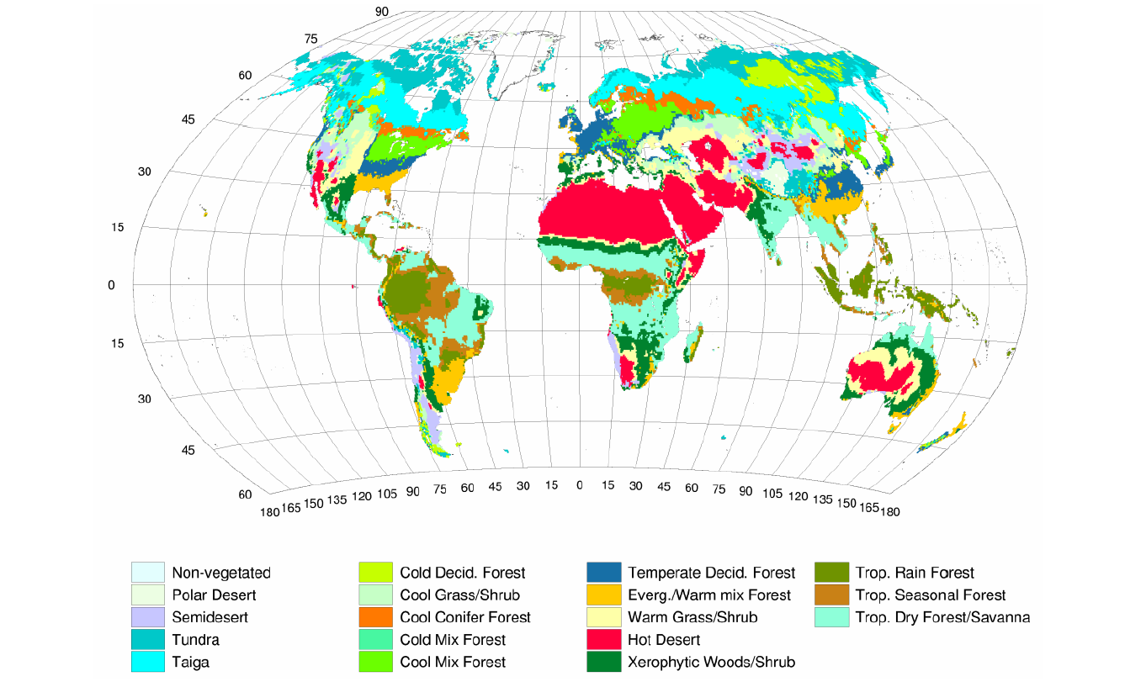
Climate-derived Potential Vegetation
CABLE-Climate
BIOME1 (Prentice et al. 1992)

