Slide 1

CUSTOMER CHURN ANALYSIS IN TELECOM DOMAIN
Team 1
Nikita Mhatre(1001967565)
Rohan Kumariya(1002007078)
Ankita Phadke(1001963837)
Alsafin Samnani(1001979027)
Date: 11/28/2021

Slide 2

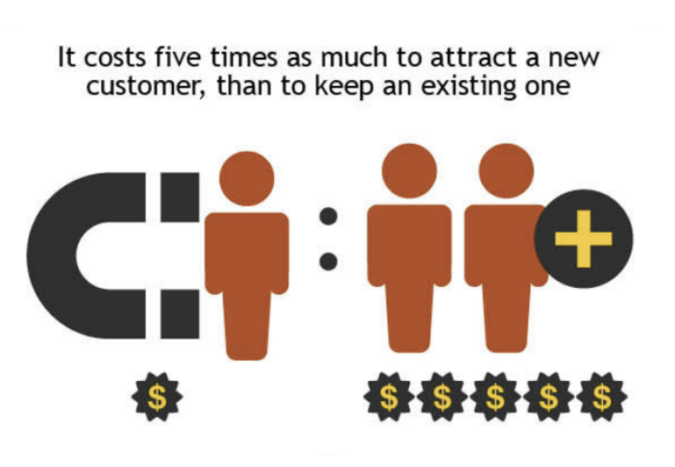

BUSINESS CONTEXT & PROBLEM STATEMENT
Business context:
The tele-communications industry is a crucial domain
Survival in the competitive environment is challenging
Business revenue is directly proportional to customer
base
More feasible to retain existing customer base than
acquiring new
Problem statement :
Analyze behavior to retain customers
Predict customer churn trends
Analyze all relevant customer data and develop focused
customer retention programs
Suggest actions to be taken to stop them from porting

Slide 3
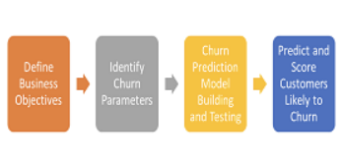
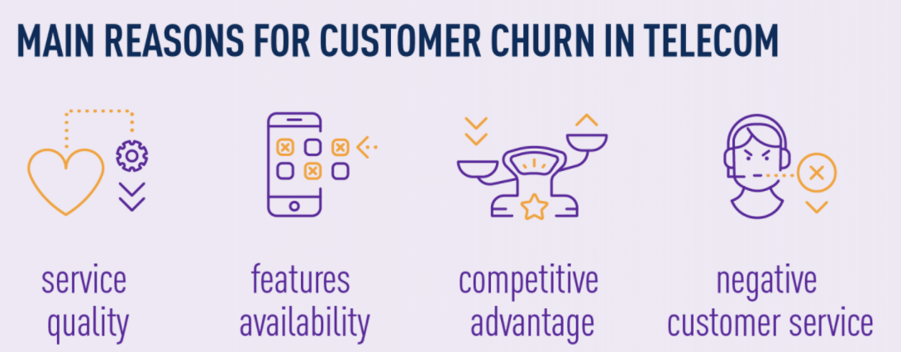
INITIAL APPROACH & PRIMARY PROBLEM SOLUTIONS
Set customer expectations and offerings catalog
Offer “surprises” to customers
Enhance trust through building relationships
Analyze customer benefits offered by competitor companies
Evaluate specific strengths, weaknesses and gaps within
own product lines and platforms
Measure customer lifetime value, target customer retention
even for new customers

Slide 4
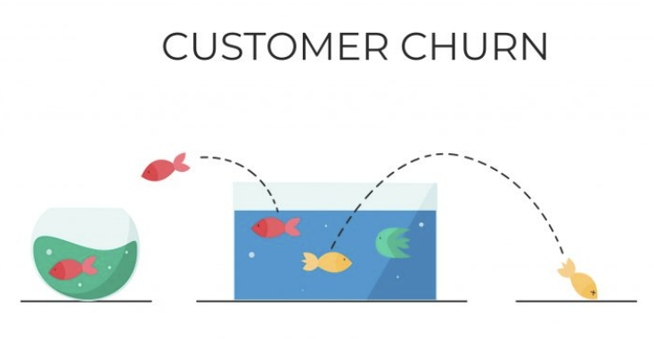
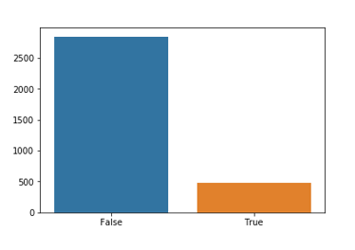
INITIAL FINDINGS
Description of the data
Number of observations = 3,333
Target variable = churn (14.49%)
Significant predictor variables
State (distributed across 50 states)
Account length (1 to 243 months)
Total domestic charges (USD 20 to 92.56 )
Total international charges (USD 0 to 5.4)
International plan subscription (9.6%)
Voicemail plan subscription (27.67%)
Customer service calls (0 to 9 calls per day)
Data transformation
Total domestic charges = day + evening + night call charges
Data mining models used
Logistic regression
Classification tree

Slide 5
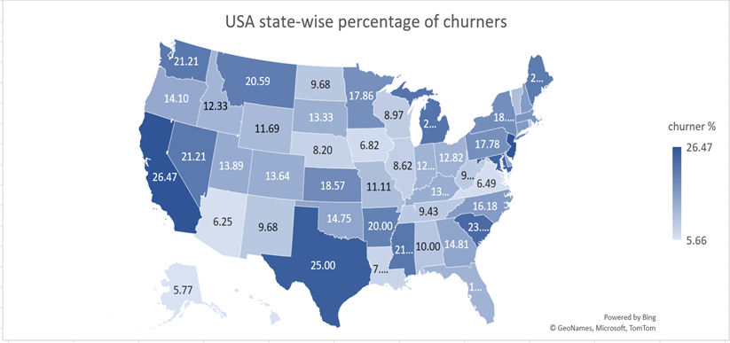
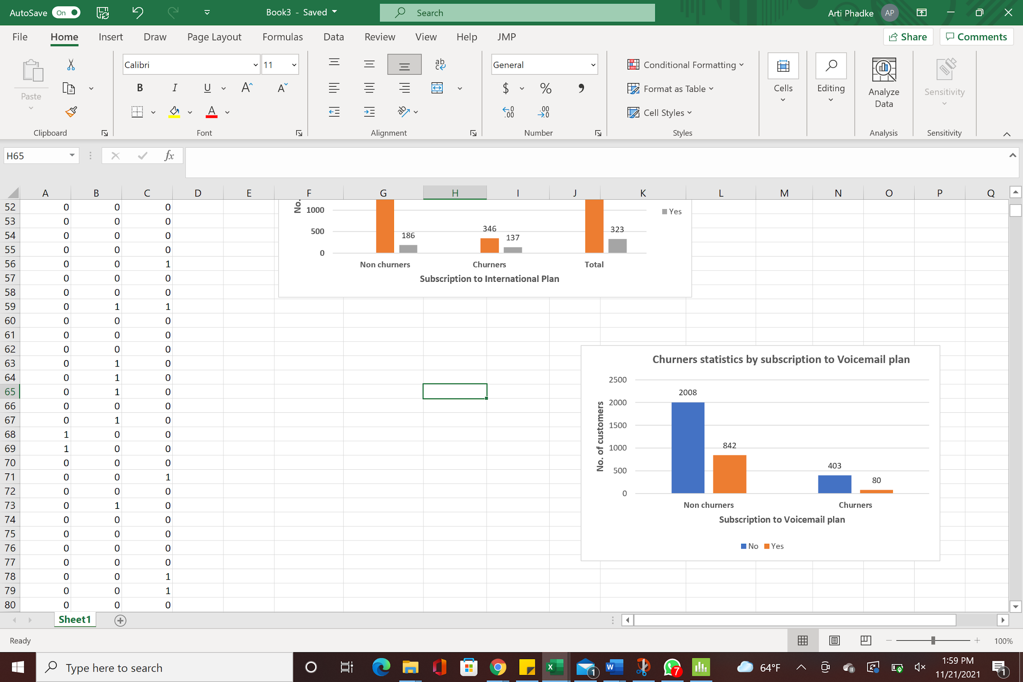
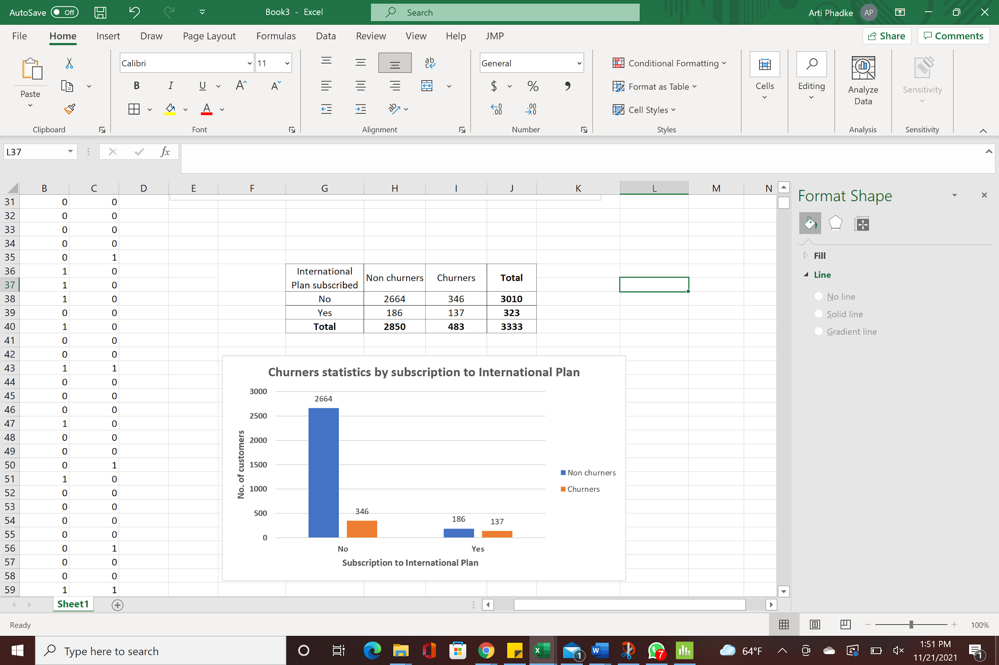
DATA VISUALIZATION
Top 3 States with churn rate > 25 %
CA: 26.47%
NJ: 26.47%
TX: 25.00%
42% Voice Mail subscribers are churners.
16% International subscribers are churners.

Slide 6
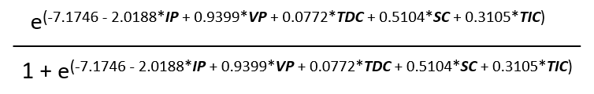
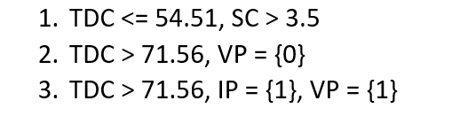
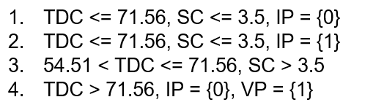
APPLIED MODELS
Logistic regression: 1 if churned, 0 otherwise
Classification tree: 1 if churned, 0 otherwise
Sr. No. | Input Variable Name
1. | Voicemail Plan (VP)
2. | International Plan (IP)
3. | Total Domestic Call Charges(TDC)
4. | Total International Call Charges(TIC)
5. | No. of Service Calls(SC)
P(Churn=1) =
{
Sr. No. | Input Variable Name
1. | Voicemail Plan (VP)
2. | International Plan (IP)
3. | Total Domestic Call Charges(TDC)
4. | No. of Service Calls(SC)
Churn = 1
{
Churn = 0

Slide 7
MODEL RESULTS & BEST FIT MODEL
Logistic Regression: Classification Tree:
Actual class
Predicted Class |  | 0 | 1 | Total
 | 0 | 2387 | 296 | 2683
 | 1 | 463 | 187 | 650
 | Total | 2850 | 483 | 3333
Actual class
Predicted Class |  | 0 | 1 | Total
 | 0 | 2659 | 191 | 2850
 | 1 | 76 | 407 | 483
 | Total | 2735 | 598 | 3333
Why CLASSIFICATION TREE is best fit model?
Sr. No. | Classification Type | Logistic Regression | Classification tree
1. | Misclassified as 0 | 11.03% | 6.70%
2. | Misclassified as 1 | 71.23% | 15.73%
3. | Overall Misclassification | 22.77% | 8.01%

Slide 8
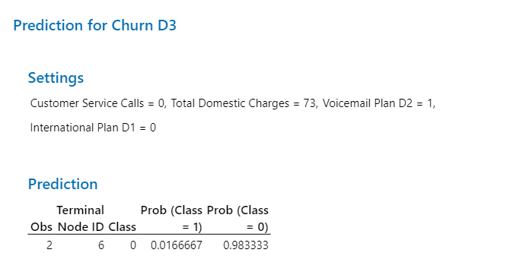
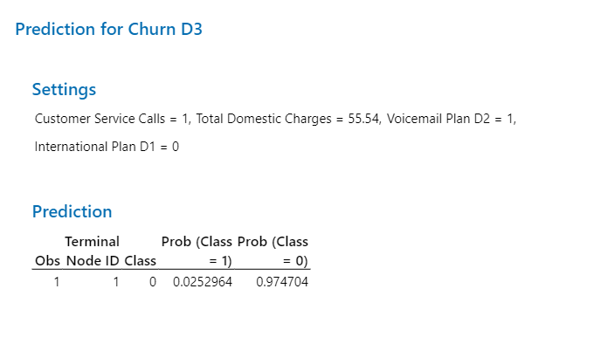
CHURN PREDICTION FOR NEW CUSTOMERS
Customer 3334:
Classified as a non churner
P(Churn=0) = 0.9833
Customer 3335:
Classified as a churner
P(Churn=1) = 0.9747

Slide 9

SOLUTIONS TO BUSINESS PROBLEM
Identify patterns to reduce churn rate using classification tree
output: TDC and SC Predictors
Target to bring down churn rate from 14.49% to less than
5% in 1st year
Incentive | Leaf Rule | % Customers | Incentive Offered | Incentive Benefits to Company
1. | TDC > 71.56, IP= {1}, VP= {1} | 0.15% | Customers Loyalty Program: For loyal customers (Minimum Account Length > 24 months), all call minutes after 700th minute are free. (Average daily minutes = 730, Average daily charge = $ 0.12) | 5 customers can be retained and converted to non churners @ a cost as low as total $4 per customer per month.
2. | TDC<= 54.51, SC > 3.5 | 3.51% | Customer Satisfaction Program: Identify customer’s complaints, group similar complaints and design custom solutions for clusters. Discounted handsets on monthly plan contract. Lower call rate for prepaid to postpaid conversion Creating brand value by offering subscription model | Continued customer association and customer retention for 36 months. Higher profits due to increased postpaid connections.
3. | TDC > 71.56, VP = {0} | 5.88% | No Cost Voice Mail Plan: For Customers having minimum bill amount of $75 per month, will get free upgrade to facility of voice mail plan and enrolment in family plan at no cost. | Continued customer association and customer retention for 12 months. Family plan would add new connections.

Slide 10

Thank you
For Your Attention!
Any Questions

