Slide 1
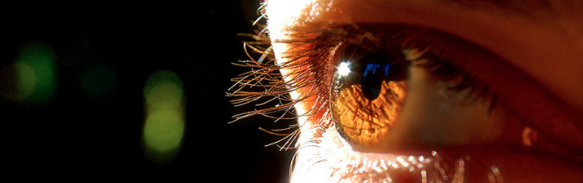
Reconocimiento de Patrones
Domingo Mery
Departmento de Ciencia de la Computación
Escuela de Ingeniería
Universidad Católica de Chile
Semestre 2018-1
Crossing Line Profiles
[ Capítulo 2 ]

Slide 2
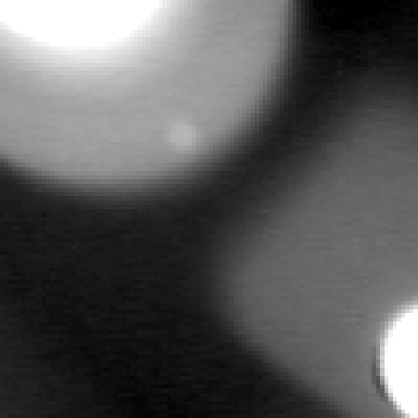

[ Crossing line profiles ]
Early work
D.Mery: Crossing Line Profile 2
Präsentation

Slide 3
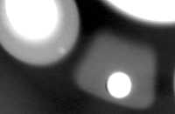
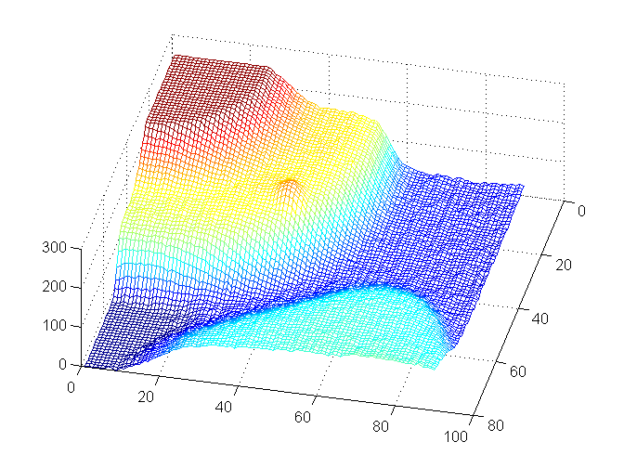
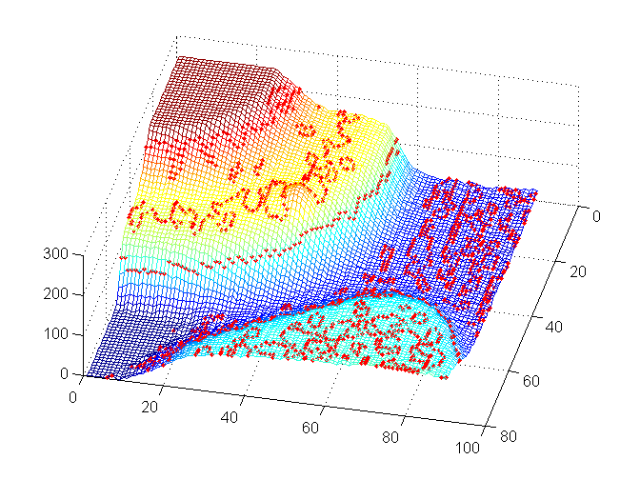
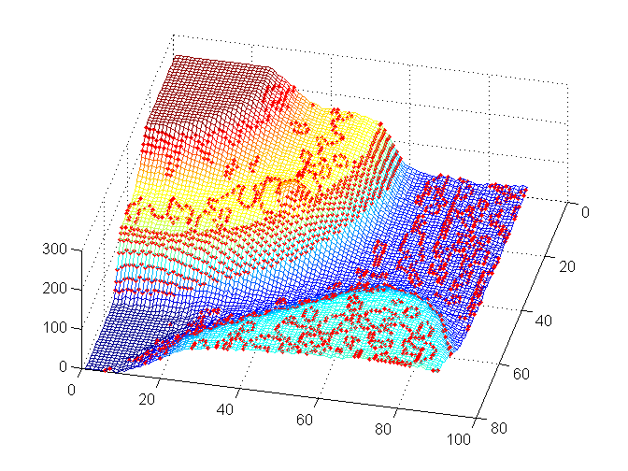
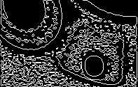
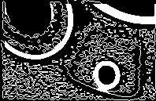
[ Segmentation of potential flaws ]
X-ray image in 3D
Edge detection with LoG
Edge detection with LoG + gradient
D.Mery: Crossing Line Profile 3
Präsentation

Slide 4
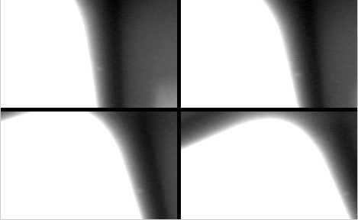
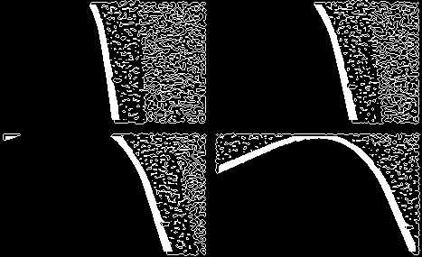
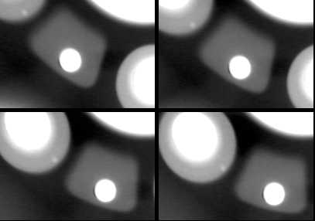
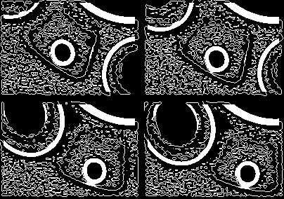
[ Segmentation of potential flaws ]
22.936 regions were segmented in 50 X-ray images
60 were real defects
22.876 were false alarms
[ ratio = 381:1 ]
D.Mery: Crossing Line Profile 4
Präsentation

Slide 5
[ Crossing line profiles ]
Early work
250
P
250
Q
200
200
150
150
250
K
Y
100
100
200
50
50
150
0
0
100
10
20
30
10
20
30
50
250
P
250
Q
0
10
20
30
40
50
60
200
200
Extracted features:
σ_{K}
Δ _{K}
150
150
Y
100
100
50
50
0
10
20
30
0
10
20
30
D.Mery: Crossing Line Profile 5
Präsentation

Slide 6
[ Crossing line profiles ]
Proposed approach
250
k=0
250
k=1
250
k=2
250
k=3
200
200
200
200
150
d
150
150
150
d
d
d
100
100
100
100
50
50
50
50
0
10
20
30
0
10
20
30
0
10
20
30
0
10
20
30
k=4
k=5
k=6
k=7
250
250
250
250
200
200
200
200
150
d
150
150
d
150
d
100
100
d_{min}
100
100
50
50
50
50
0
10
20
30
0
10
20
30
0
10
20
30
0
10
20
30
D.Mery: Crossing Line Profile 6
Präsentation

Slide 7
[ Crossing line profiles ]
Proposed approach
Selected
Crossing
Line Profile
Extracted
features:
Q
σ_{Q}
Δ _{Q}
F = DFT(Q)
P
Q
250
250
200
200
150
Y
150
100
d_{min}
100
50
50
0
10
20
30
0
10
20
30
D.Mery: Crossing Line Profile 7
Präsentation

Slide 8


[ 4. Performance analysis ]
Class distribution
class ‘regular
structure’
Ideal:
FN = 0
FP = 0
Sn = 100%
1-Sp = 0%
Az = 1
class ‘defect’
TN
TP
(a)
x
FN
θ
FP
ROC curve
Confusion matrix
the region is
100 %
θ = 0
classified
‘regular
the region is ↓ structure’ ‘defect’
Regular structure TN FP
defect FN TP
Area Az
as→
θ
θ → ∞
0
100 %
(b) (c)
D.Mery: Crossing Line Profile 8
Präsentation

Slide 9
[ 4. Performance analysis ]
ROC and class distribution for CLP feature for F₁
D.Mery: Crossing Line Profile 9
Präsentation

Slide 10
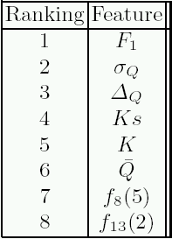
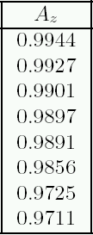
[ 4. Performance analysis ]
σ_{K}
Δ _{K}
Top six are based on CLP
D.Mery: Crossing Line Profile 10
Präsentation

Slide 11
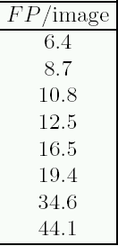
[ 4. Performance analysis ]
at S_{n} = 95%
proposed
CLP
σ_{K}
Δ _{K}
early work
texture features
D.Mery: Crossing Line Profile 11
Präsentation

Slide 12
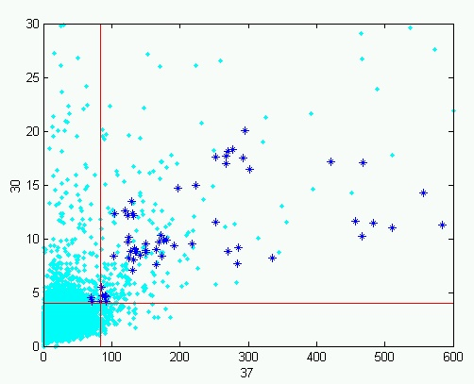


[ Classification ]
Threshold classifier
Sn = 95%
1-Sp = 1%
D.Mery: Crossing Line Profile 12
Präsentation

