Slide 1
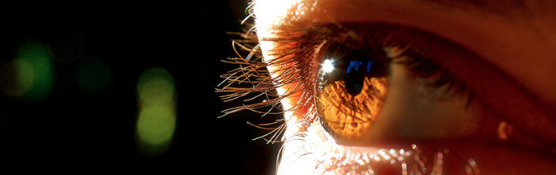
Reconocimiento de Patrones
Domingo Mery
Departmento de Ciencia de la Computación
Escuela de Ingeniería
Universidad Católica de Chile
Semestre 2018-1
Feature Extraction using Balu
[ Capítulo 2 ]

Slide 2
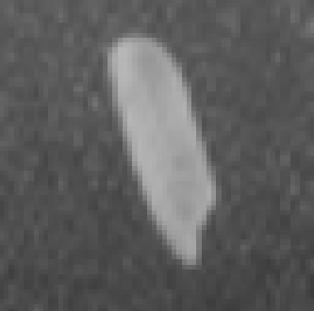
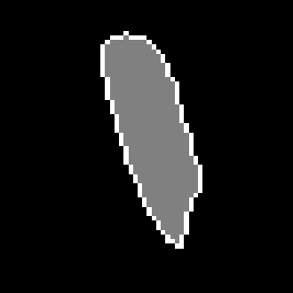
a) Grayscale image b) Segmentation c) 3D representation of a)
There are two categories of features: Geometric Features and
Intensity Features
Geometric Features give information about location, orientation, shape and size.
Intensity Features give information about how are the grayvalues.

Slide 3
How to extract
Geometric Features
with Balu

Slide 4
Command:
[X,Xn] = Bfx_name(R,options);
X: row vector of extracted features
Xn: name of each extracted feature
name: name of the group of features
R: binary image
options: options of features (if any)

Slide 5

Example: BASIC GEOMETRIC FEATURES
I = imread('onerice.bmp');
R = I>120;
[X,Xn] = Bfx_basicgeo(R);
Bio_printfeatures(X,Xn);
1 center of grav i [px] 29.299832
2 center of grav j [px] 33.705193
3 Height [px] 47.000000
4 Width [px] 22.000000
5 Area [px] 601.375000
6 Perimeter [px] 107.500000
7 Roundness 0.653941
8 Danielsson factor 2.253736
9 Euler Number 1.000000
10 Equivalent Diameter [px] 27.570347
11 MajorAxisLength [px] 48.089929
12 MinorAxisLength [px] 16.112265
13 Orientation [grad] -73.896848
14 Solidity 0.937206
15 Extent 0.577369
16 Eccentricity 0.942202
17 Convex Area [px] 637.000000
18 Filled Area [px] 597.000000

Slide 6
Example: HU MOMENTS
I = imread('onerice.bmp');
R = I>120;
[X,Xn] = Bfx_hugeo(R);
Bio_printfeatures(X,Xn);
1 Hu-moment 1 0.269010
2 Hu-moment 2 0.046196
3 Hu-moment 3 0.000291
4 Hu-moment 4 0.000081
5 Hu-moment 5 0.000000
6 Hu-moment 6 0.000013
7 Hu-moment 7 0.000000

Slide 7
Example: ELLIPSE
I = imread('onerice.bmp');
R = I>120;
[X,Xn] = Bfx_fitellipse(R);
Bio_printfeatures(X,Xn);
1 Ellipse-centre i [px] 33.691981
2 Ellipse-centre j [px] 28.915583
3 Ellipse-minor ax [px] 7.380073
4 Ellipse-major ax [px] 24.353387
5 Ellipse-orient [rad] -0.295048
6 Ellipse-eccentricity 0.303041
7 Ellipse-area [px] 564.637741

Slide 8
Example: SEVERAL GEOMETRIC FEATURES
% Input Image
I = imread('rice.png');
% Segmentation
[R,m] = Bim_segmowgli(I,ones(size(I)),40,1.5);
% Definition of features to be extracted
b(1).name = 'hugeo'; b(1).options.show=1; % Hu moments
b(2).name = 'basicgeo'; b(2).options.show=1; % basic geometric fetaures
options.b = b;
% Feature extraction
[X,Xn] = Bfx_geo(R,options);
% Processing after feature extraction
figure; hist(X(:,12));xlabel([Xn(12,:)]) % area histogram
ii = find(abs(X(:,20))<15); % rice orientation
K = zeros(size(R)); % between -15 and 15 grad
for i=1:length(ii);K=or(K,R==ii(i));end
figure; imshow(K);title('abs(orientation)<15 grad')

Slide 9
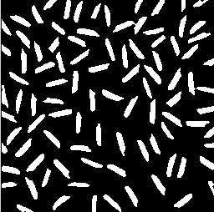
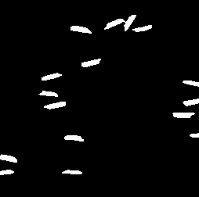

Slide 10
Example: HOW TO WRITE A NEW BALU FUNCTION (for feature extraction)
% [X,Xn] = Bfx_centroid(R,options)
%
% Toolbox: Balu
%
% Centroid of a region.
%
% options.show = 1 display mesagges.
%
% X(1) is centroid-i, X(2) is centroid-j
% Xn is the list of the n feature names.
%
% Example (Centroid of a region)
% I = imread('testimg1.jpg'); % input image
% R = Bim_segbalu(I); % segmentation
% imshow(R);
% options.show = 1;
% [X,Xn] = Bfx_centroid(R,options);
% Bio_printfeatures(X,Xn)
%
function [X,Xn] = Bfx_centroid(R,options)
if options.show == 1
disp('--- extracting centroid...');
end
[Ireg,Jreg] = find(R==1); % pixels in the region
ic = mean(Ireg);
jc = mean(Jreg);
X = [ic jc];
Xn = [ 'Centroid i '
'Centroid j ']; % 24 characters per name
if options.show == 1
clf
imshow(R)
hold on
plot(X(2),X(1),'rx')
enterpause
end
This example shows how to
compute the centers of mass

Slide 11
How to extract
Intensity Features
with Balu

Slide 12
Command:
[X,Xn] = Bfx_name(I,R,options);
X: row vector of extracted features
Xn: name of each extracted feature
name: name of the group of features
I: grayscale image
R: binary image -> [ ] for the whole image
options: options of features (if any)

Slide 13
Example: BASIC INTENSITY FEATURES
I = imread('onerice.bmp');
R = I>120;
options.mask = 5; % Gauss mask
options.show = 1; % Display results
[X,Xn] = Bfx_basicint(I,R,options);
Bio_printfeatures(X,Xn);
1 Intensity Mean 161.132328
2 Intensity StdDev 13.082633
3 Intensity Kurtosis 4.044382
4 Intensity Skewness -1.096439
5 Mean Laplacian -6.871022
6 Mean Boundary Gradient 41.875637

Slide 14

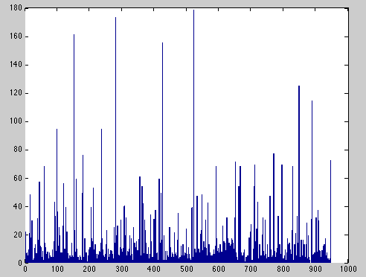
Example: LBP
I = imread(’faces_orl/face0304.bmp');
I = imresize(I,[110 90]);
options.vdiv = 4;
options.hdiv = 4;
options.samples = 8;
options.mappingtype = 'u2';
[X,Xn] = Bfx_lbp(I,[],options);
bar(X)

Slide 15
Example: SEVERAL INTENSITY FEATURES
See help Bfx_int

Slide 16
Graphic User Interface
Bfx_gui
It is used to extract features in many image
1. go to the folder of the images
2. Bfx_gui <Enter>

Slide 17
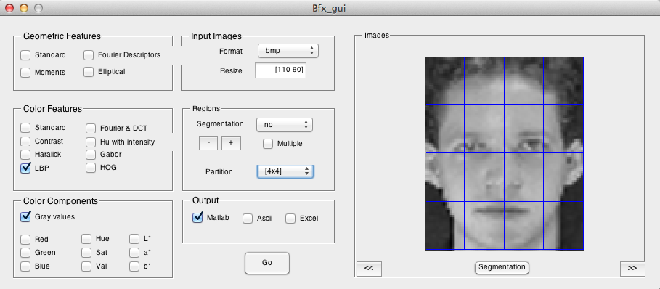
Press go, drink a coffee and wait!
The results will be stored in file Bfx_results.mat

