Slide 1
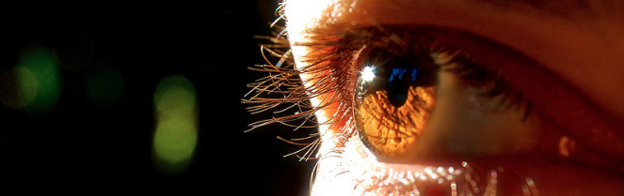
Reconocimiento de Patrones
Domingo Mery
Departmento de Ciencia de la Computación
Escuela de Ingeniería
Universidad Católica de Chile
Semestre 2018-1
Gabor
[ Capítulo 2 ]

Slide 2
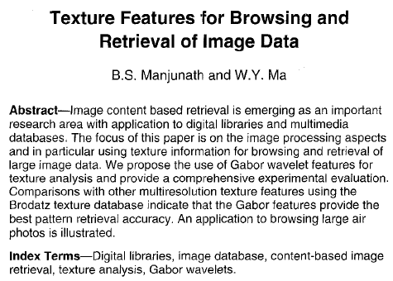
Funciones de Gabor

Slide 3
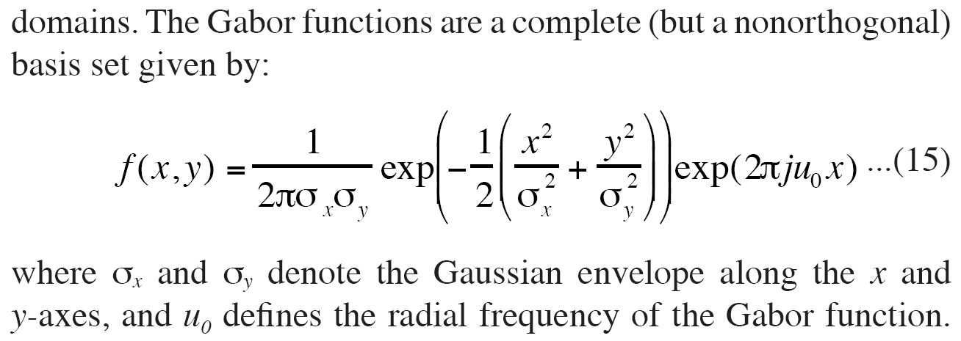
Funciones de Gabor
Gabor functions

Slide 4
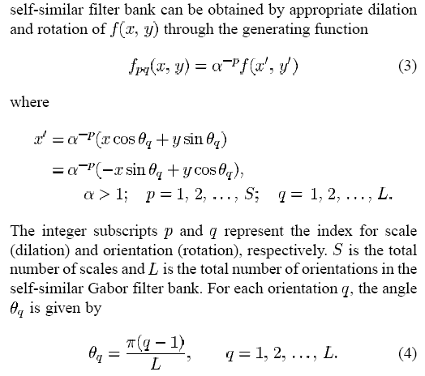
Funciones de Gabor

Slide 5
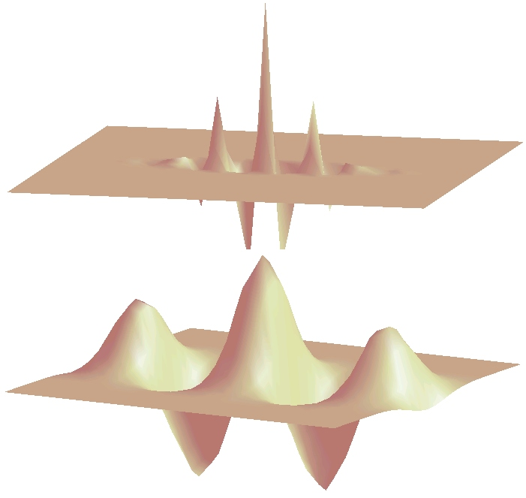
Funciones de Gabor
Gabor functions

Slide 6
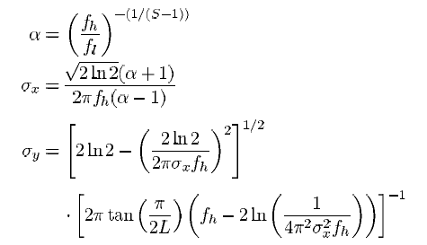
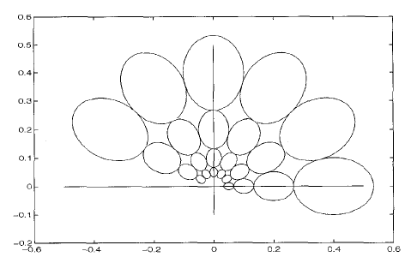
Funciones de Gabor
Se asegura así que la respuesta en frecuencia de los filtros Gabor escogidos no se traslapen.

Slide 7
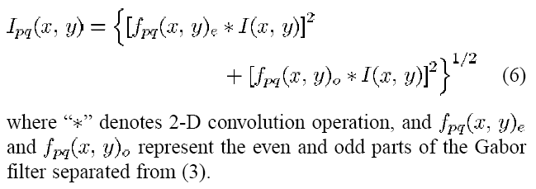
Funciones de Gabor
for p=1…S for q=1…L (S scales and L orientations)
g(p,q) = Ipq
J = (gmax – gmin) / gmin

Slide 8
Implementación en MATLAB
function gab = gaborfeatures(I,R,L,S,fh,fl,M)
alpha = (fh/fl)^(1/(S-1));
sx = sqrt(2*log(2))*(alpha+1)/2/pi/fh/(alpha-1);
sy = sqrt(2*log(2)-(2*log(2)/2/pi/sx/fh)^2)/(2*pi*tan(pi/2/L)*(fh-2*log(1/4/pi^2/sx^2/fh)));
u0 = fh;
g = zeros(S,L);
size_out = size(I)+[M M]-1;
Iw = fft2(I,size_out(1),size_out(2));
n1 = (M+1)/2;
[NN,MM] = size(I);
for p=1:S;
for q=1:L
f = gabor_pq(p,q,L,S,sx,sy,u0,alpha,M);
Ir = real(ifft2(Iw.*fft2(real(f),size_out(1),size_out(2))));
Ii = real(ifft2(Iw.*fft2(imag(f),size_out(1),size_out(2))));
Ir = Ir(n1:n1+NN-1,n1:n1+MM-1);
Ii = Ii(n1:n1+NN-1,n1:n1+MM-1);
Iout = sqrt(Ir.*Ir + Ii.*Ii);
g(p,q) = mean(Iout(k));
end;
end
gmax = max(g(:));
gmin = min(g(:));
J = (gmax-gmin)/gmin;
gab = [g(:); gmax; gmin; J];

Slide 9
Implementación en MATLAB
function f = gabor_pq(p,q,L,S,sx,sy,u0,alpha,M)
f = zeros(M,M);
sx2 = sx*sx;
sy2 = sy*sy;
c = (M+1)/2;
ap = alpha^-p;
tq = pi*(q-1)/L;
f_exp = 2*pi*sqrt(-1)*u0;
for i=1:M
x = i - c;
for j=1:M
y = j - c;
x1 = ap*(x*cos(tq)+y*sin(tq));
y1 = ap*(y*cos(tq)-x*sin(tq));
f(i,j) = exp(-0.5*(x1*x1/sx2+y1*y1/sy2))*exp(f_exp*x1);
end
end
f = ap*f/2/pi/sx/sy;

Slide 10
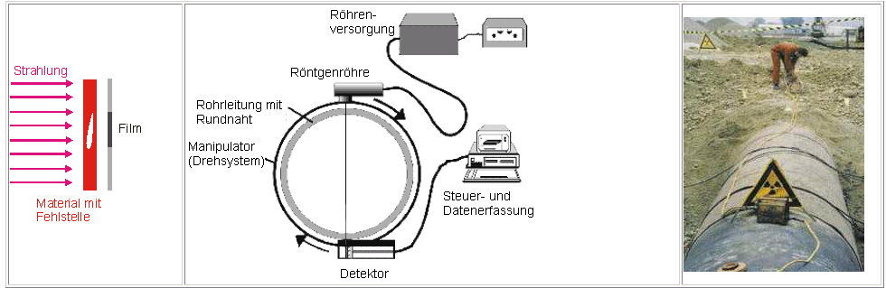
Detection of welding defects

Slide 11
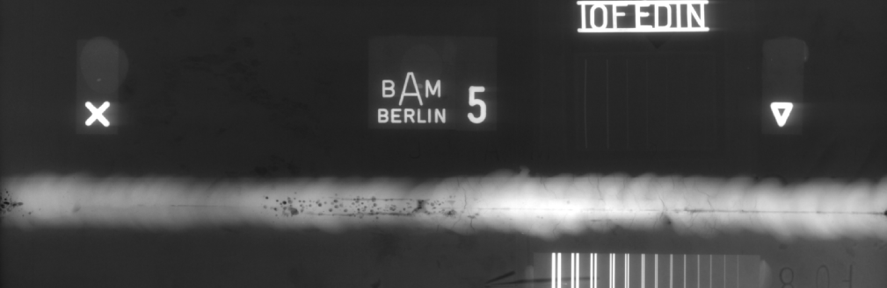
Detection of welding defects
[ 1146 x 3512 pixels ]

Slide 12
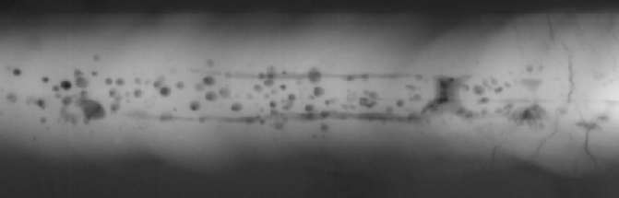
Detection of welding defects
[ 671 x 215 pixels ]

Slide 13
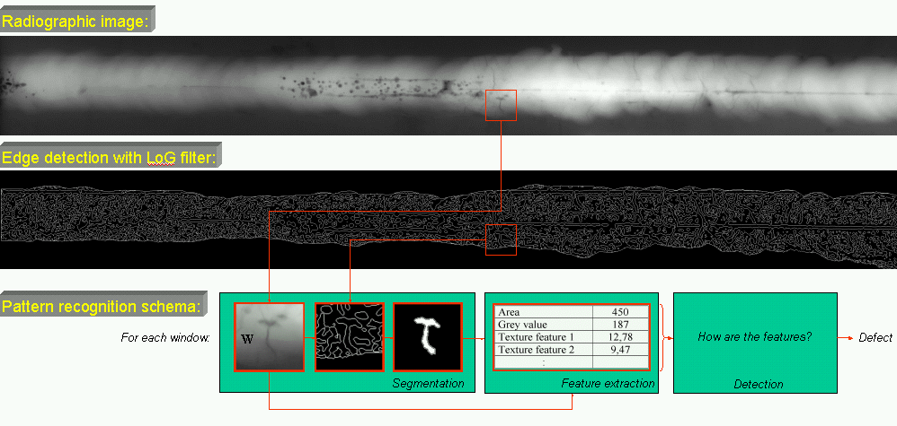
Detection of welding defects

Slide 14
Detection of welding defects
Feature extraction:
texture features (28 in 3 distances)
Gabor features (8 scales and 8 directions)
Crossing line profile features
Total: 158 features

Slide 15
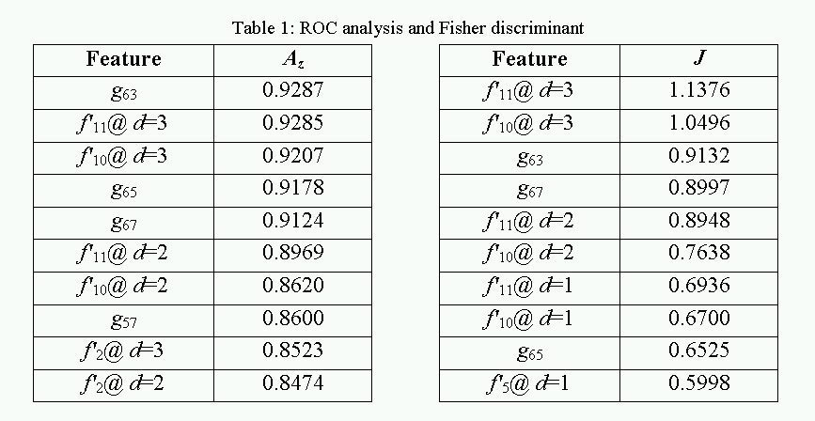
Detection of welding defects
CLP
F1 : Az = 0.9376
ROC analysis and Fisher discriminant

Slide 16
Detection of welding defects
ROC and class distribution

Slide 17
Detection of welding defects
defect
no defect
0.7
0.6
0.5
0.4
f₅₄
0.3
0.2
0.1
0
0.015
0.01
0.7
0.8
0.5
0.6
f₉₅
0.005
0.3
0.4
0.2
f₈₂
0
0
0.1

Slide 18
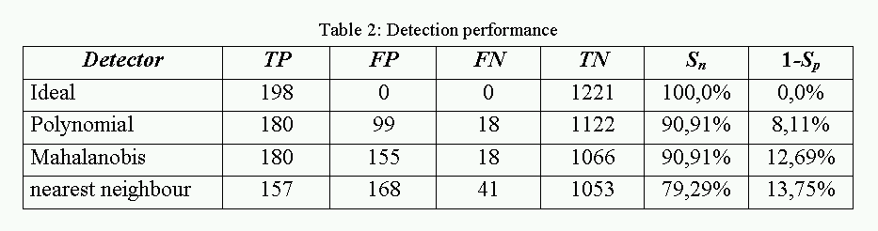
Detection of welding defects
Performance detection

