Slide 1
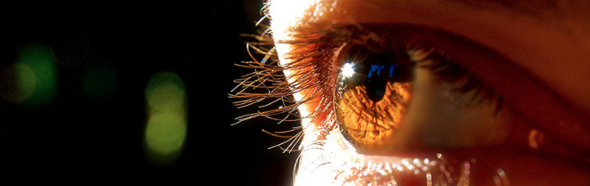
Reconocimiento de Patrones
Domingo Mery
Departmento de Ciencia de la Computación
Escuela de Ingeniería
Universidad Católica de Chile
Semestre 2017-1
Selección de Características
[ Capítulo 3 ]

Slide 2
5 reasons why to select features
To avoid non-discriminative features
To avoid correlated features
To simplify the testing stage
To avoid the curse of dimensionality
To avoid false correlations

Slide 3
Extracted features Selected features
m features
labels
p features
x₁ | x₂ | x₃ | x₄ | x₅ | x₅ | x₆ | x₇ | x₈ | x₉ | x₁₀
d
z₁ | z₂ | z₃
N samples
N samples

Slide 4
Frequency distributions
for class
Probability density functions
x
for class
x
x

Slide 5
Frequency distributions
for class
Probability density functions
…..
…..
…..
…..
…..
…..
……. . .
……. . .
x
Samples of class
for class
x
x
…..
…..
…..
…..
……..
….…….... .
Samples of class
……. . .

Slide 6
x₁
x₂
x₃
Bad separability Good separability Very good separability

Slide 7
Bad Good Very good
x
x
x

Slide 8
Bad Good Very good
…..
…..
…..
…..
……. . .
……. . .
…..
…..
…..
…..
……. . .
……. . .
x
x
x

Slide 9
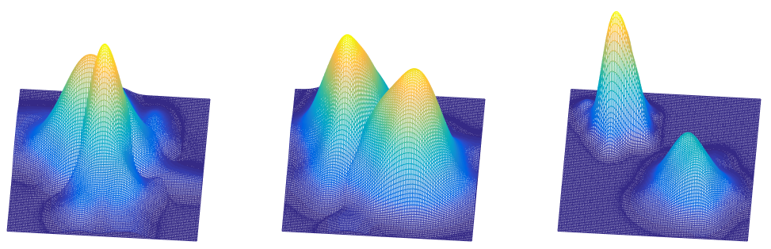
Bad Good Very good
x₂
x₂
x₂
x₁
x₁
x₁

Slide 10
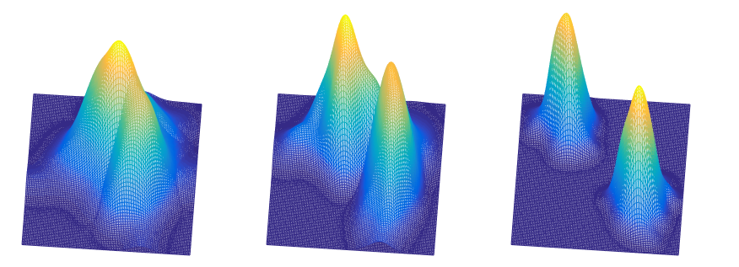
Bad Good Very good
x₂
x₂
x₂
x₁
x₁
x₁

Slide 11
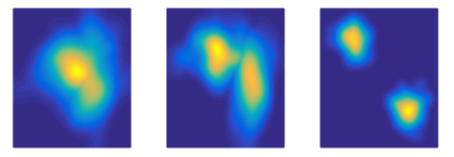
Bad Good Very good
x₂
x₂
x₂
x₁
x₁
x₁
x₂
x₂
x₂
x₁
x₁
x₁

Slide 12
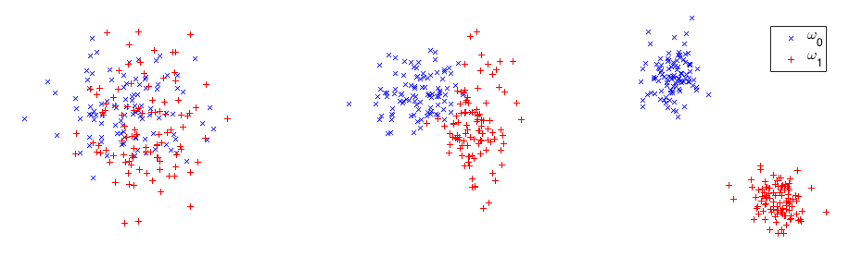
x₂
x₂
x₂
x₁
x₁
x₁
x₂
x₂
x₂
x₁
x₁
x₁

Slide 13
Selected features must be…
Can our objects of interest be everywhere?
yes
invariant to translation
Can our objects of interest be in any orientation?
yes
invariant to rotation
Can our objects of interest be of any size?
yes
invariant to scale

