Slide 1

Reconocimiento de Patrones
Domingo Mery
Departmento de Ciencia de la Computación
Escuela de Ingeniería
Universidad Católica de Chile
Semestre 2018-1
SVM
[ Capítulo 4 ]

Slide 2
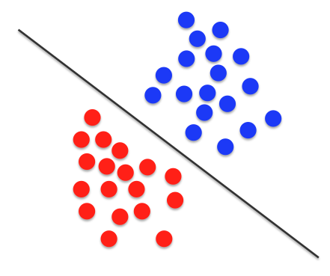
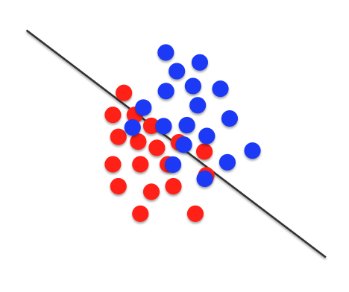
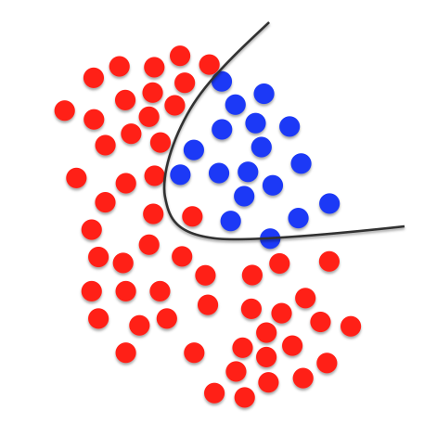
SVM: Support Vector Machines
1) Linear with perfect separation
2) Linear with no perfect separation
3) Non linear

Slide 3
SVM: Support Vector Machines
1) Linear with perfect separation
2) Linear with no perfect separation
3) Non linear

Slide 4
SVM: Support Vector Machines (two classes)
Class 1
Training data
Class 2

Slide 5
SVM: Support Vector Machines (two classes)
Line 1 separates the classes perfectly
Line 2 separates the classes perfectly
Decision Line 1
Line 3 separates the classes perfectly
Decision Line 2
Which one is better?
Decision Line 3

Slide 6
SVM: Support Vector Machines (two classes)
For a decision line, we define margin ‘b₁’ as the perpendicular distance of the line to the nearest sample of class 1.
Decision Line
And we define margin ‘b₂’ as the perpendicular distance of the line to the nearest sample of class 2.
.
b₂
.
b₁

Slide 7
SVM: Support Vector Machines (two classes)
KEY IDEAS OF SVM:
b₁ = b₂ = b.
Decision Line
.
b₂
.
b₁

Slide 8
SVM: Support Vector Machines (two classes)
KEY IDEAS OF SVM:
b₁ = b₂ = b.
Decision Line
.
b₂= b
.
b₁ = b

Slide 9
SVM: Support Vector Machines (two classes)
KEY IDEAS OF SVM:
b₁ = b₂ = b.
Decision Line
.
.
b
b

Slide 10
SVM: Support Vector Machines (two classes)
KEY IDEAS OF SVM:
b₁ = b₂ = b.
b must be maximized.
Decision Line
.
.
b
b

Slide 11
SVM: Support Vector Machines (two classes)
KEY IDEAS OF SVM:
b₁ = b₂ = b.
b must be maximized.
Decision Line
.
.
.
b_{max}
b_{max}

Slide 12
SVM: Support Vector Machines (two classes)
KEY IDEAS OF SVM:
b₁ = b₂ = b.
b must be maximized.
Decision Line
.
.
Support Vectors
.
b_{max}
b_{max}

Slide 13
SVM: Support Vector Machines (two classes)
Decision Line
b_{max}
b_{max}

Slide 14
SVM: Support Vector Machines (two classes)
Decision Line
Testing data
?

Slide 15
SVM: Support Vector Machines (two classes)
Decision Line
Testing data

Slide 16
SVM: Support Vector Machines
1) Linear with perfect separation
2) Linear with no perfect separation
3) Non linear

Slide 17
SVM: Support Vector Machines (two classes)
How to define the decision line when there is no perfect separation?

Slide 18
SVM: Support Vector Machines (two classes)
How to define the decision line when there is no perfect separation?
We consider only the miss-classified samples

Slide 19
SVM: Support Vector Machines (two classes)
How to define the decision line when there is no perfect separation?
We consider only the miss-classified samples

Slide 20
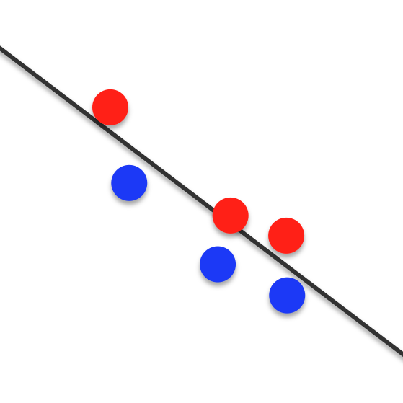
SVM: Support Vector Machines (two classes)
How to define the decision line when there is no perfect separation?
We consider only the miss-classified samples
.
.
Support Vectors
.
.
.
.

Slide 21
KEY IDEA OF SVM:
.
Find the decision line so that
e = Σ e_{i} ➔ min
e₁
.
Support Vectors
e₄
e_{i}: errors
.
e₂
.
.
e₅
e₃
.
e₆

Slide 22
SVM: Support Vector Machines
1) Linear with perfect separation
2) Linear with no perfect separation
3) Non linear

Slide 24
1
a
2
b
c
d
e
3
4
5

Slide 25
1
New coordinate system
a
2
b
c
d
e
3
4
5

Slide 26
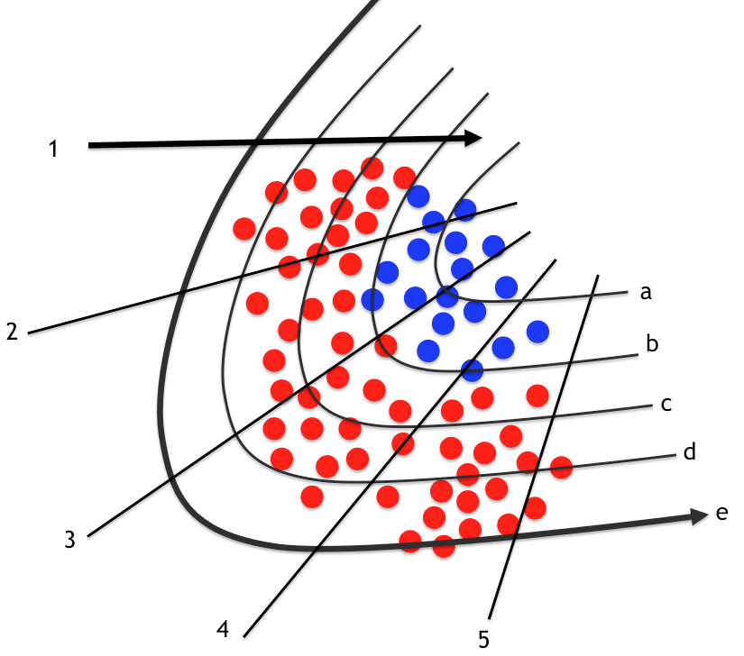
Non linear geometric transformation
a
b
c
d
e
1
2
3
4
5

Slide 28
Linear SVM in new coordinate system
Non linear geometric transformation

Slide 29
Decision line

Slide 30
SVM: Support Vector Machines (two classes)
Decision Line
b_{max}
b_{max}

Slide 31
SVM: Support Vector Machines (two classes)
Decision Line
We don’t need , we only need the kernel

Slide 32
SVM: Support Vector Machines (Kernels)
linear
polynomial
radial basis
neural network

Slide 33
SVM: Support Vector Machines
1) Linear with perfect separation
2) Linear with no perfect separation
3) Non linear

Slide 34
Read more… http://svms.org/tutorials/

