Slide 1

Reconocimiento de Patrones
Domingo Mery
Departmento de Ciencia de la Computación
Escuela de Ingeniería
Universidad Católica de Chile
Semestre 2018-1
Confusion Matrix
[ Capítulo 5 ]

Slide 2
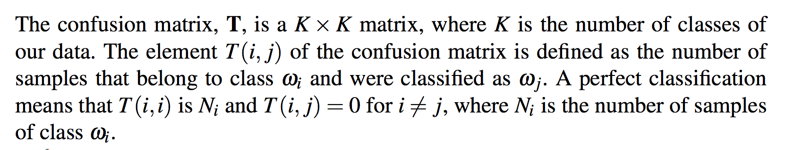
[ CONFUSION MATRIX ]

Slide 3
[ CONFUSION MATRIX ]
predicted
 |  |  |  | ...
:
actual

Slide 4
[ CONFUSION MATRIX ]
predicted
 |  |  |  | ...
 | 1230 | 90 | 78 |  | 9
 | 66 | 890 | 120 |  | 5
 | 59 | 95 | 1527 |  | 90
:
 | 40 | 67 | 129 |  | 912
actual
Example: there are 78 samples of class 1 that have been classified as class 3.

Slide 5
[ CONFUSION MATRIX: TWO CLASSES ]
predicted
actual

Slide 6
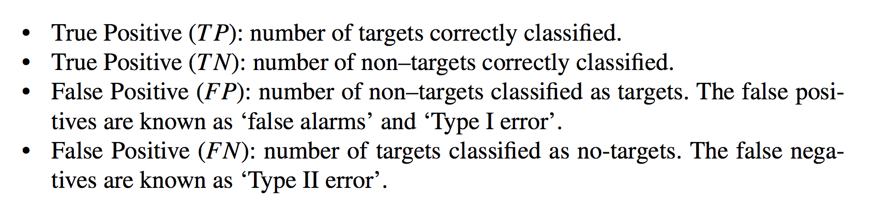
[ CONFUSION MATRIX: TWO CLASSES ]
predicted
 | TP | FN
 | FP | TN
actual
Negative (FN):

Slide 7
[ CONFUSION MATRIX: TWO CLASSES ]
predicted
 | TP | FN
 | FP | TN
P = TP+FN (positive instances)
actual
N = FP+TN (negative instances)
D = TP+FP (detections)
Negative (FN):

Slide 8
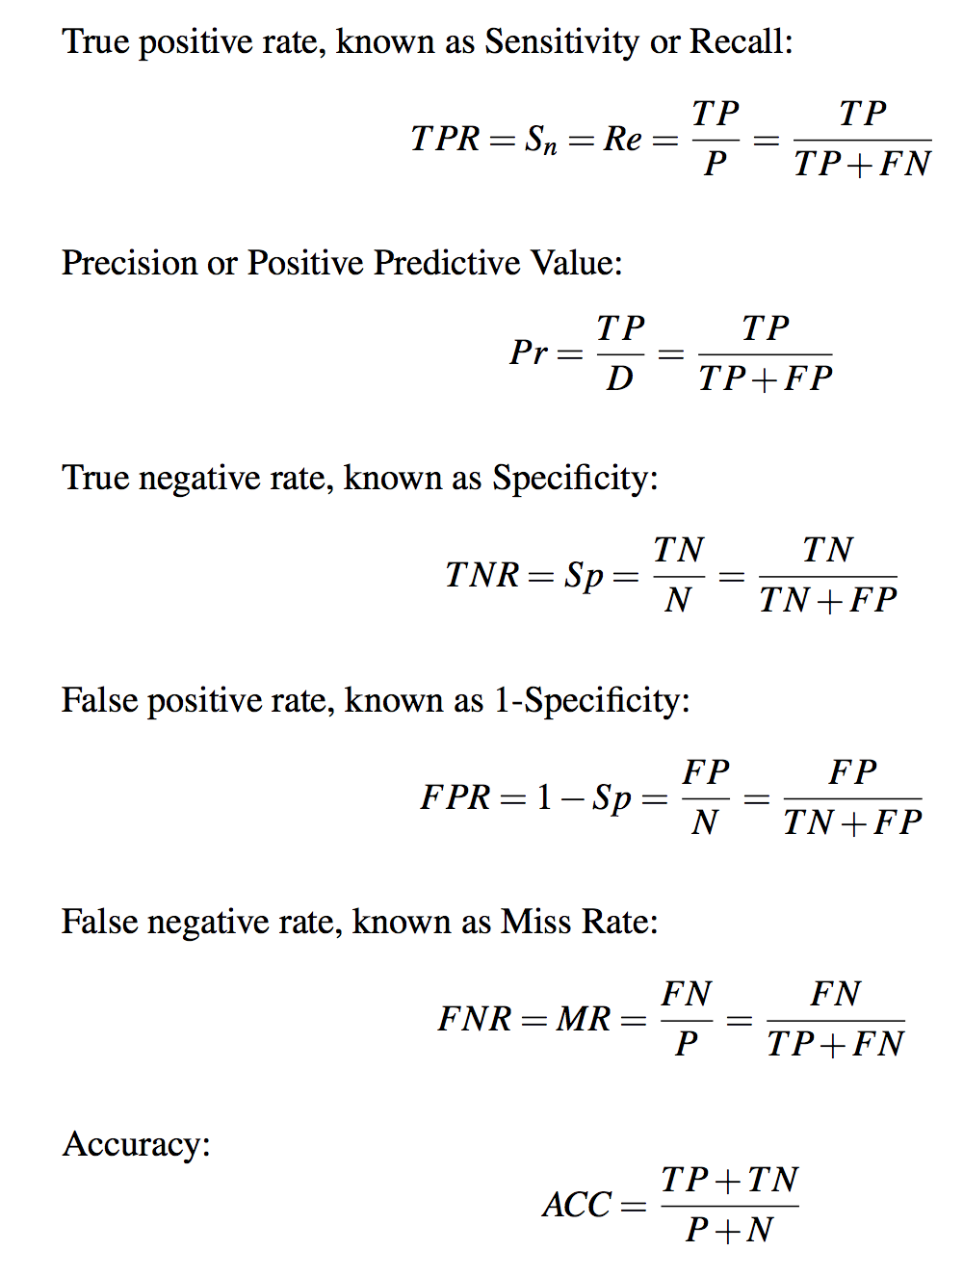
[ DEFINITIONS ]

Slide 9
[ EXAMPLE ]

Slide 10
[ EXAMPLE ]
Red pixels: Positive instances (P)
White pixels: Negative instances (N)
Target
Manual Segmentation (Ground Truth)

Slide 11
[ EXAMPLE ]
Automatic Segmentation

Slide 12
[ EXAMPLE ]
Blue pixels: Detection (D)
Automatic Segmentation

Slide 13
Magenta pixels: True positives (TP)
Blue pixels: False positives (FP)
Red pixels: False negatives (FN)
White pixels: True negatives (TN)
[ EXAMPLE ]

Slide 14
Magenta pixels: True positives (TP)
Blue pixels: False positives (FP)
Red pixels: False negatives (FN)
White pixels: True negatives (TN)
[ EXAMPLE ]
FN
TP
FP
TN

Slide 15
Magenta pixels: True positives (TP)
Blue pixels: False positives (FP)
Red pixels: False negatives (FN)
White pixels: True negatives (TN)
[ EXAMPLE ]
Pr
Pr = TP/(TP+FP)
Re = TP/(TP+FN)
Re
FN
Precision-Recall curve
TP
FP
TN

Slide 16
Magenta pixels: True positives (TP)
Blue pixels: False positives (FP)
Red pixels: False negatives (FN)
White pixels: True negatives (TN)
[ EXAMPLE ]
Pr
Pr = TP/(TP+FP)
Re = TP/(TP+FN)
TPR = TP/(TP+FN)
FPR = FP/(TN+FP)
Re
FN
Precision-Recall curve
TP
FP
TPR
TN
FPR
ROC curve

Slide 17
Magenta pixels: True positives (TP)
Blue pixels: False positives (FP)
Red pixels: False negatives (FN)
White pixels: True negatives (TN)
[ EXAMPLE ]
Pr
Pr = TP/(TP+FP)
Re = TP/(TP+FN)
TPR = TP/(TP+FN)
FPR = FP/(TN+FP)
Sensitivity = TPR
Specificity = 1-FPR
Re
FN
Precision-Recall curve
TP
FP
TPR
TN
FPR
ROC curve

Slide 18
[ ROC curve – Example ]

Slide 19
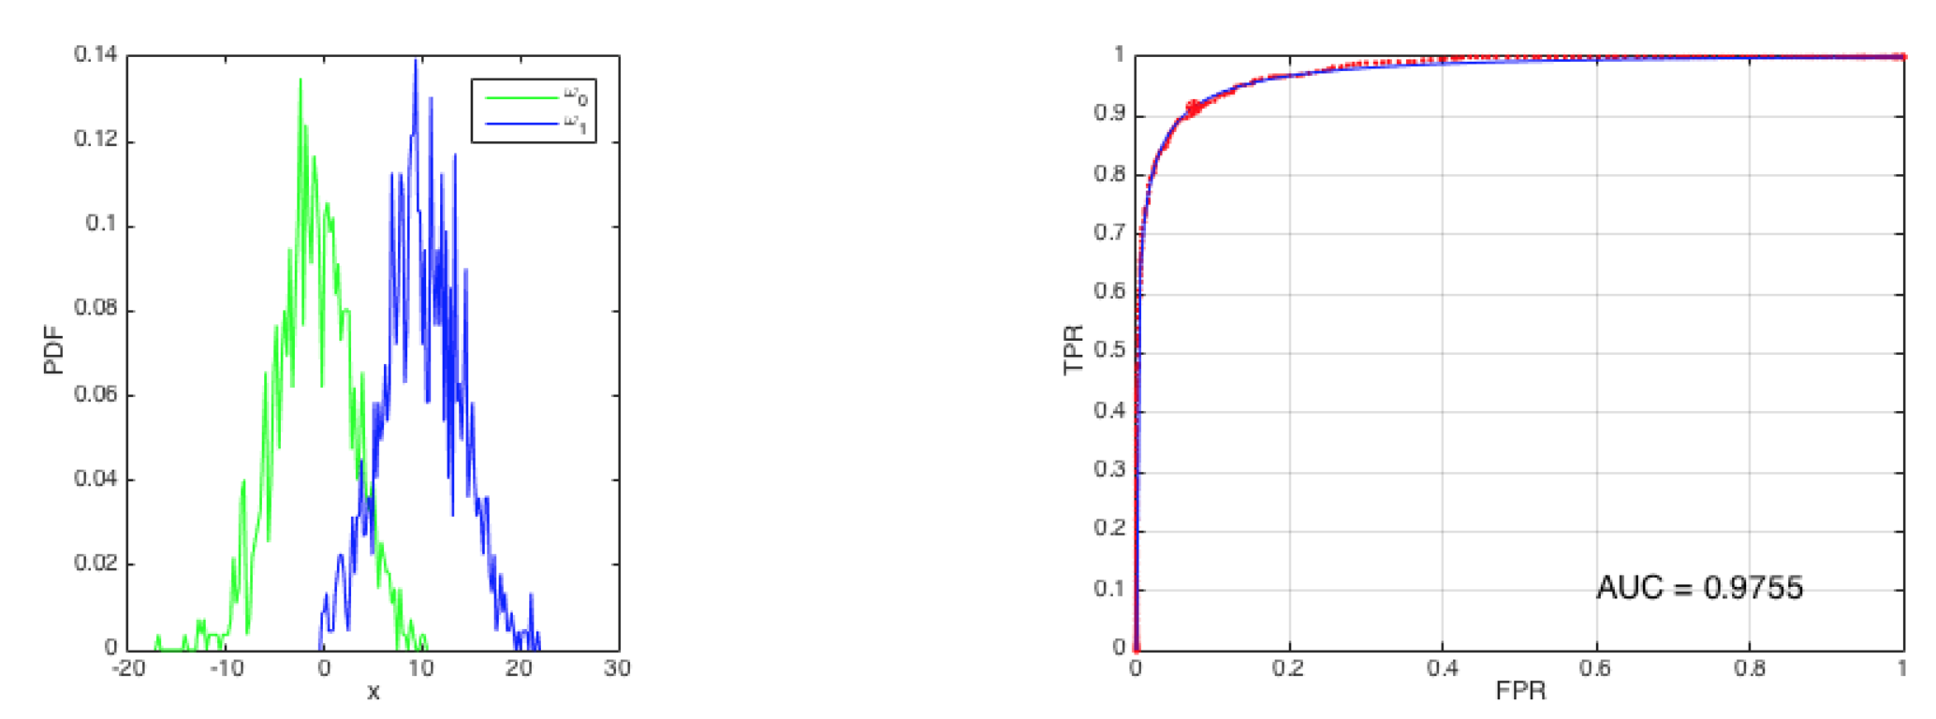
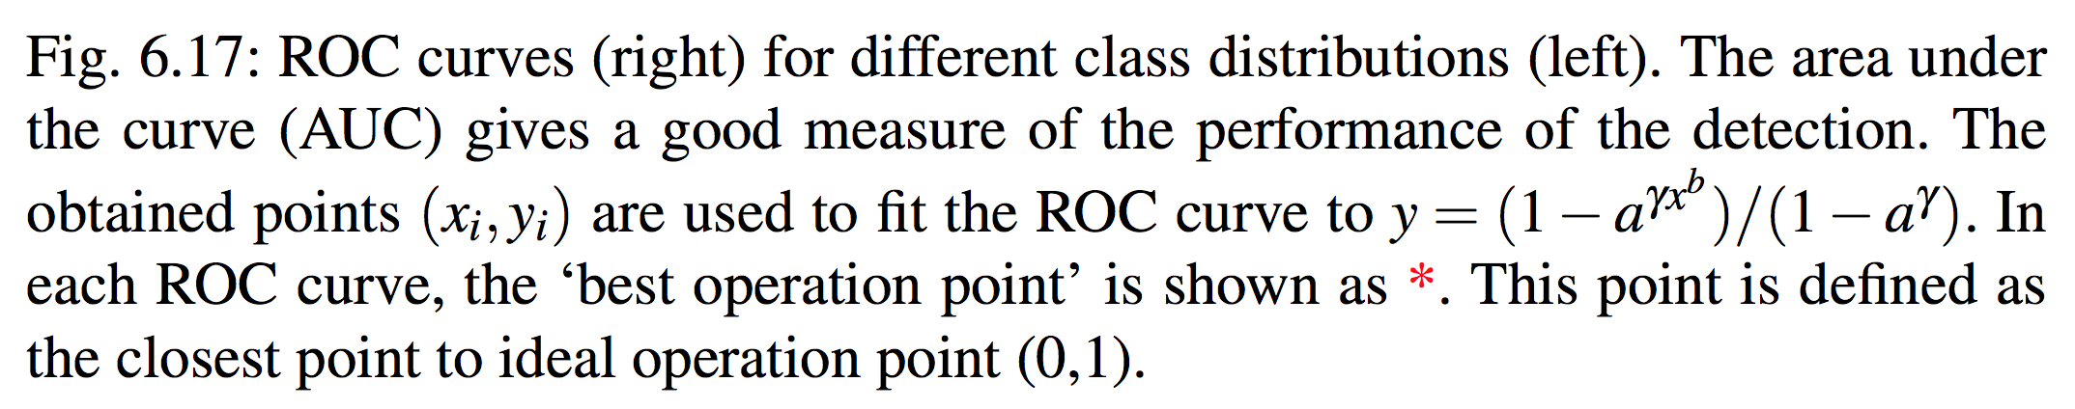
[ ROC curve – Example ]

Slide 20
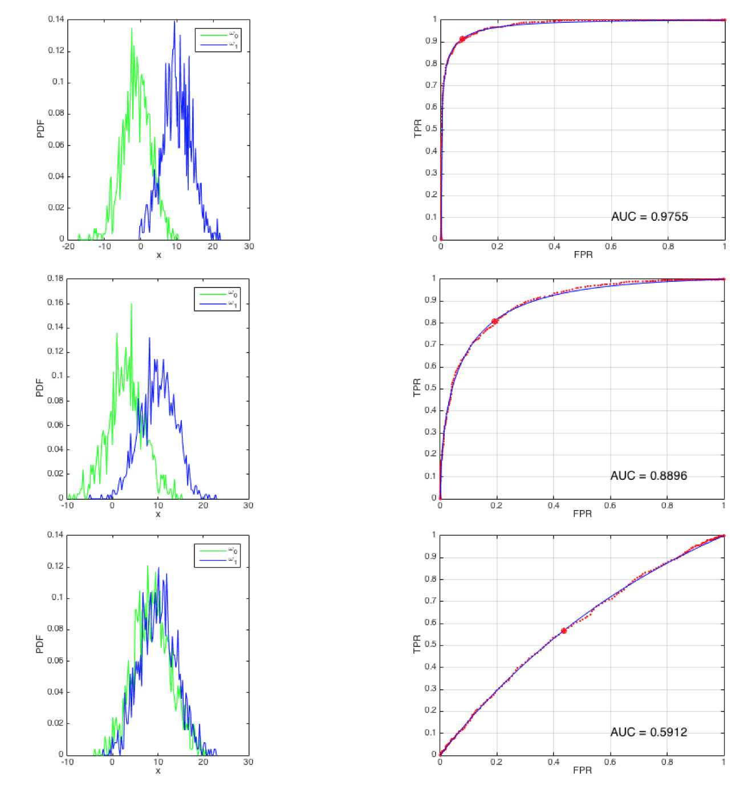
[ ROC curve – Example ]

