Slide 1
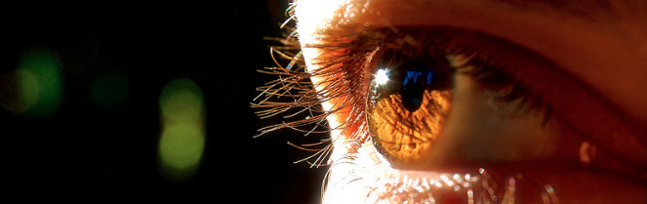
Reconocimiento de Patrones
Domingo Mery
Departmento de Ciencia de la Computación
Escuela de Ingeniería
Universidad Católica de Chile
Semestre 2018-1
Clustering: Mean Shift
[ Capítulo 6 ]

Slide 3
1. Select a point

Slide 4
1. Select a point
2. Compute neighborhood

Slide 5
1. Select a point
2. Compute neighborhood
3. Compute centroid

Slide 6
1. Select a point
2. Compute neighborhood
3. Compute centroid
4. Compute mean shift

Slide 7
1. Select a point
2. Compute neighborhood
3. Compute centroid
4. Compute mean shift
5. Update neighborhood

Slide 8
1. Select a point
2. Compute neighborhood
3. Compute centroid
4. Compute mean shift
5. Update neighborhood

Slide 9
1. Select a point
2. Compute neighborhood
3. Compute centroid
4. Compute mean shift
5. Update neighborhood
:
repeat until convergence

Slide 10
1. Select a point
2. Compute neighborhood
3. Compute centroid
4. Compute mean shift
5. Update neighborhood
:
repeat until convergence

Slide 11
1. Select a point
2. Compute neighborhood
3. Compute centroid
4. Compute mean shift
5. Update neighborhood
:
repeat until convergence

Slide 12
1. Select a point
2. Compute neighborhood
3. Compute centroid
4. Compute mean shift
5. Update neighborhood
:
repeat until convergence
we detected a mode

Slide 13
1. Select a point
2. Compute neighborhood
3. Compute centroid
4. Compute mean shift
5. Update neighborhood
:
repeat until convergence
we detected a mode

Slide 14
A new example:
1. Select a point
2. Compute neighborhood
3. Compute centroid
4. Compute mean shift
5. Update neighborhood
:
repeat until convergence

Slide 15
A new example:
1. Select a point
2. Compute neighborhood
3. Compute centroid
4. Compute mean shift
5. Update neighborhood
:
repeat until convergence

Slide 16
A new example:
1. Select a point
2. Compute neighborhood
3. Compute centroid
4. Compute mean shift
5. Update neighborhood
:
repeat until convergence

Slide 17
A new example:
1. Select a point
2. Compute neighborhood
3. Compute centroid
4. Compute mean shift
5. Update neighborhood
:
repeat until convergence

Slide 18
A new example:
1. Select a point
2. Compute neighborhood
3. Compute centroid
4. Compute mean shift
5. Update neighborhood
:
repeat until convergence

Slide 19
A new example:
1. Select a point
2. Compute neighborhood
3. Compute centroid
4. Compute mean shift
5. Update neighborhood
:
repeat until convergence

Slide 20
A new example:
1. Select a point
2. Compute neighborhood
3. Compute centroid
4. Compute mean shift
5. Update neighborhood
:
repeat until convergence

Slide 21
A new example:
1. Select a point
2. Compute neighborhood
3. Compute centroid
4. Compute mean shift
5. Update neighborhood
:
repeat until convergence

Slide 22
A new example:
1. Select a point
2. Compute neighborhood
3. Compute centroid
4. Compute mean shift
5. Update neighborhood
:
repeat until convergence
we detected a mode

Slide 23
Mean Shift Algorithm
For each sample point compute its mean shift mode
Cluster the sample points that have the same mean shift mode

Slide 27
Mean Shift Algorithm
For each sample point compute its mean shift mode
Cluster the sample points that have the same mean shift mode
Variation
When compute the centroid weight the distances according a kernel function (eg. Gaussian)

Slide 28
Example
Comaniciu, D., & Meer, P. (2002). Mean shift: A robust approach toward feature space analysis. IEEE Transactions on pattern analysis and machine intelligence, 24(5), 603-619. [ PDF ]

Slide 29
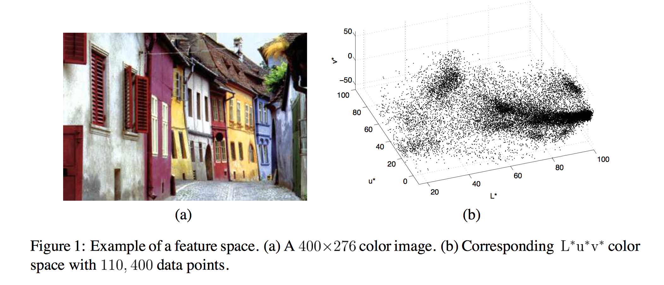

Slide 30
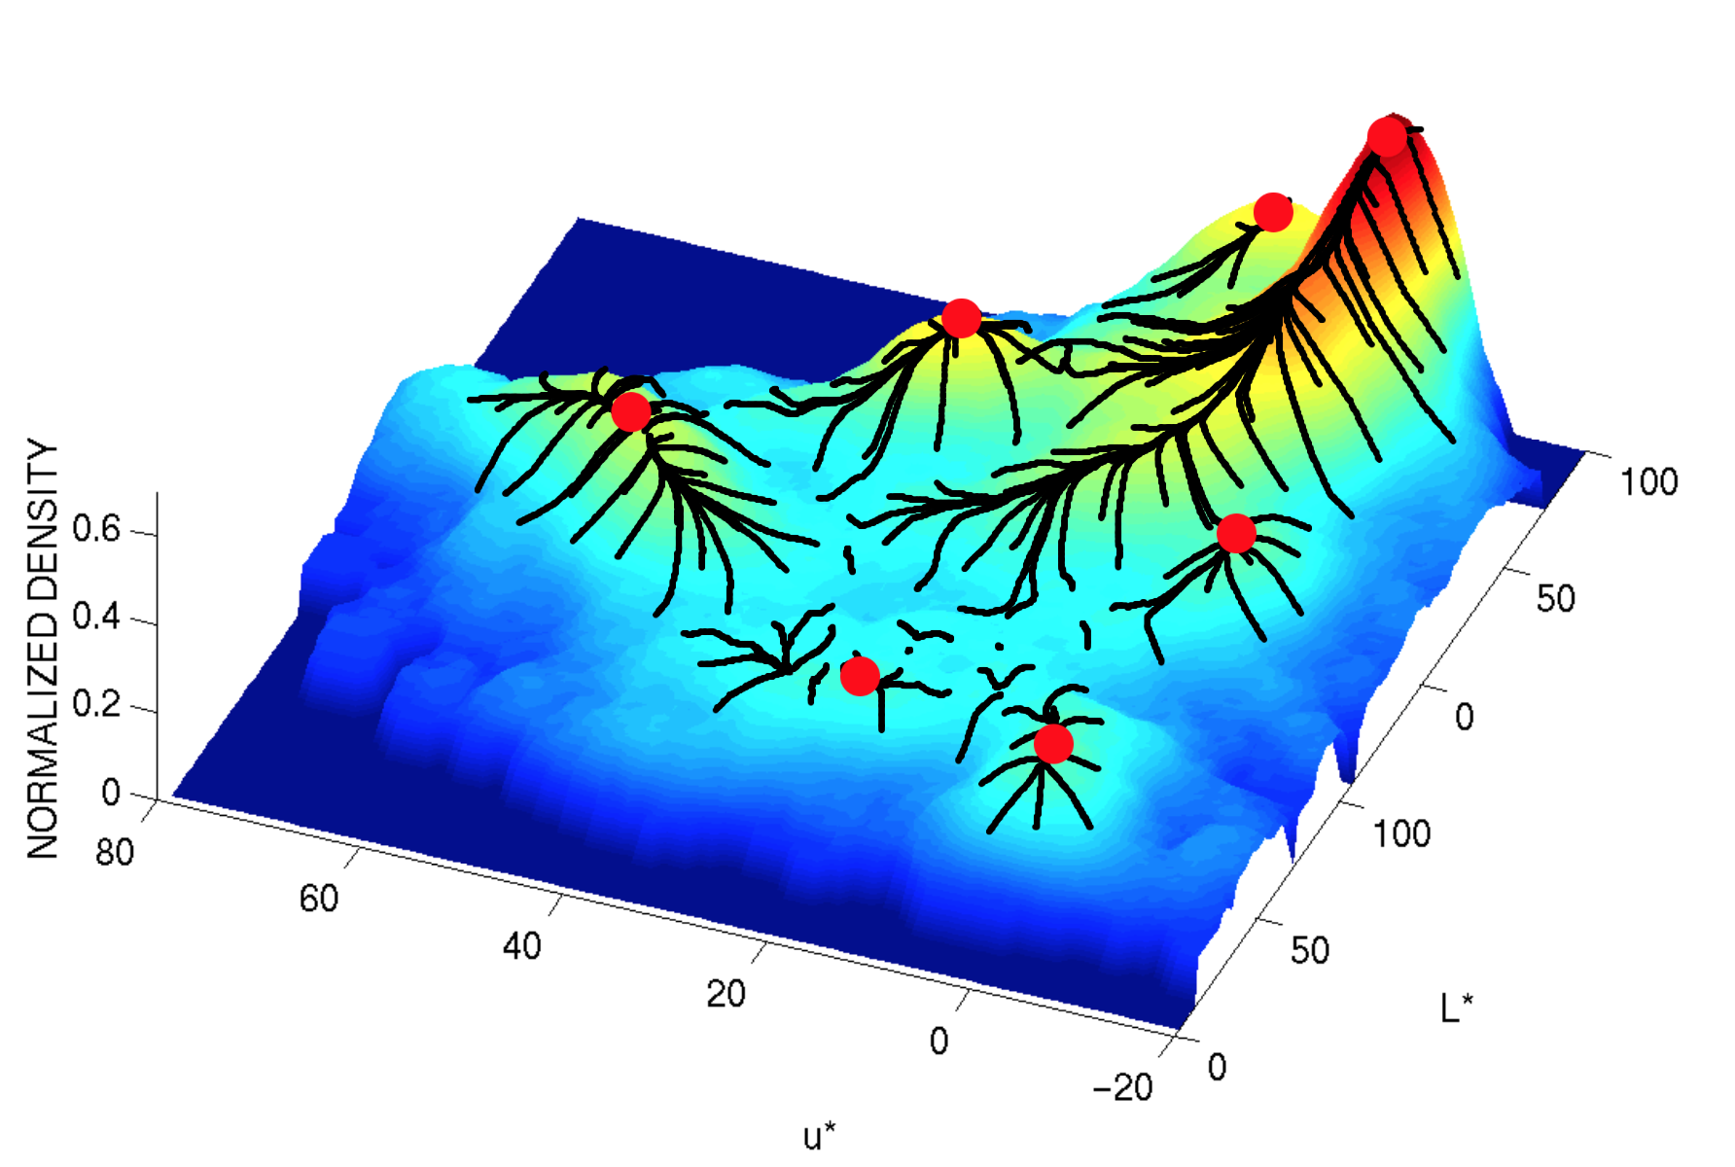

Slide 31
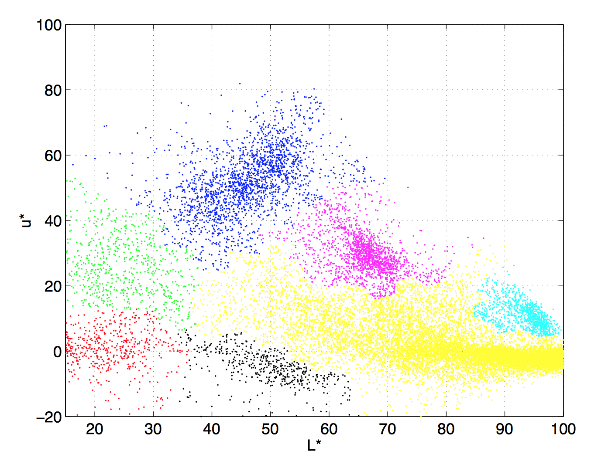

Slide 32
In Balu
Use function Bct_meanshift:
[X,d] = Bds_gaussgen([10 1;1 10;15 15],4*ones(3,3),100*ones(3,1)); figure(1) Bio_plotfeatures(X,d);
ds = Bct_meanshift(X,2); figure(2) Bio_plotfeatures(X,ds);

Slide 33
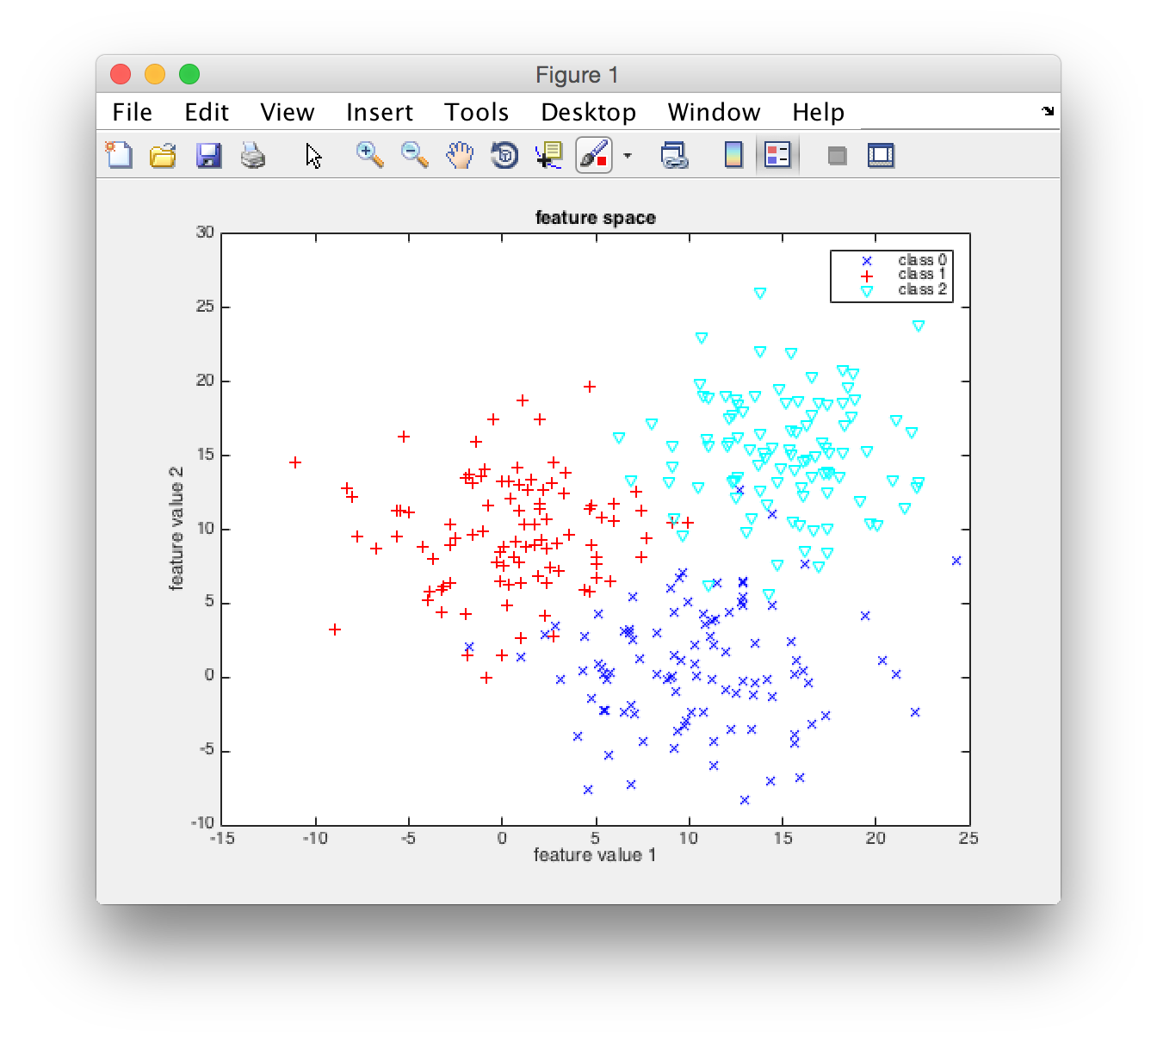
Original Samples

Slide 34
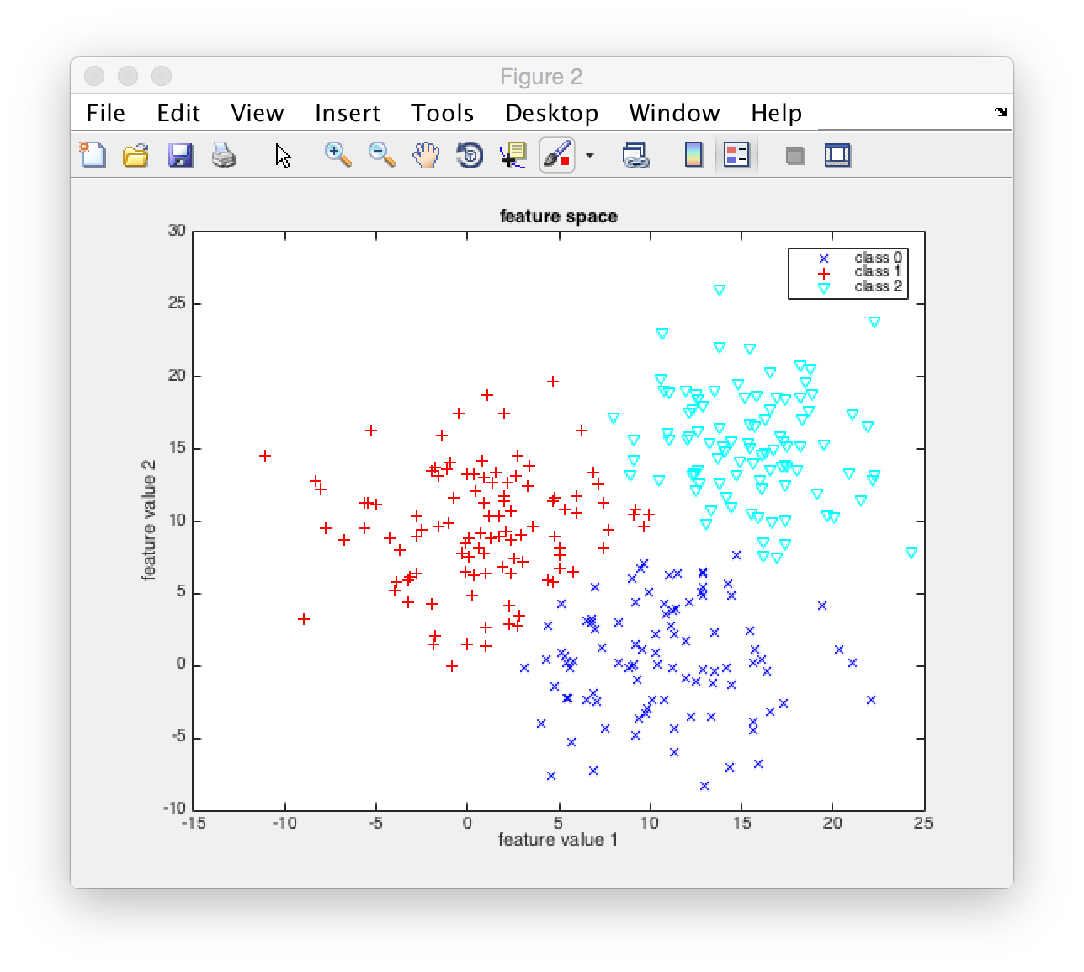
Clustered Samples

