Slide 1
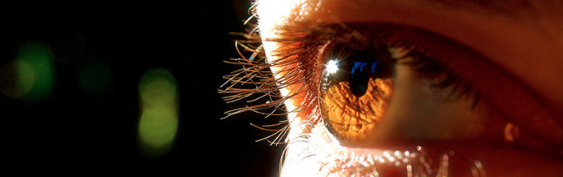
Reconocimiento de Patrones
Domingo Mery
Departmento de Ciencia de la Computación
Escuela de Ingeniería
Universidad Católica de Chile
Semestre 2018-1
Recognition of faces and face attributes
[ Capítulo 7 ]

Slide 2



Happy Sad Angry

Slide 3




class 1
class 2
class 3
:
:
:
description
description
description
classifier’s design
LEARNING
TESTING
description
classification
class
query image

Slide 4
This problem raises some interesting questions...
Are all parts of the face important?
Important for gender.
Important for race.
Important for expression.
Notes:
This problem gives rise to some interesting questions
This problem raises some interesting questions
Some interesting questions arise out of this problem

Slide 5
This problem raises some interesting questions...
Are all parts of the face important?
Important for Pei.
Notes:
This problem gives rise to some interesting questions
This problem raises some interesting questions
Some interesting questions arise out of this problem

Slide 6
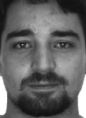

This problem raises some interesting questions...
Are all parts of the face important?
Important for Pei and Miguel.
Not important at all!!!
Important for Miguel.
Notes:
This problem gives rise to some interesting questions
This problem raises some interesting questions
Some interesting questions arise out of this problem

Slide 7
class 1
class 2
class 3
:
:
:
description
description
description
classifier’s design
LEARNING
TESTING
description
classification
class
query image

Slide 8
Agenda
Motivation
Proposed method
Experiments
Conclusions

Slide 9
SRC Sparse Representation Classification
Our method is based on...

Slide 10
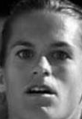
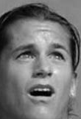
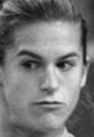
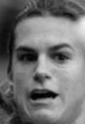
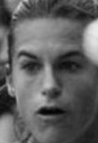
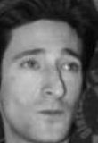
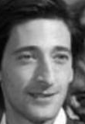
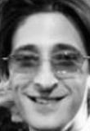
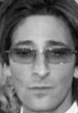
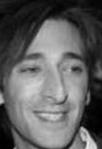
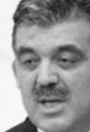
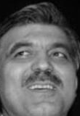
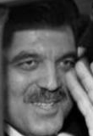
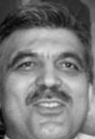
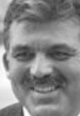
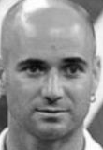
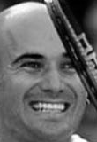
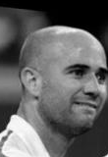
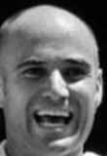
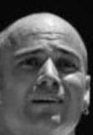
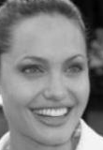
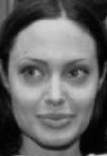
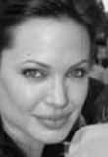
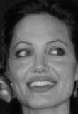
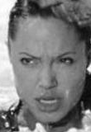
Gallery
Subject-1 Subject-2 Subject-3 Subject-4 Subject-k
. . .

Slide 11
Gallery = Dictionary
Subject-1 Subject-2 Subject-3 Subject-4 Subject-k
. . .

Slide 12
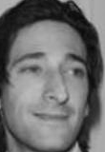
Gallery = Dictionary
Subject-1 Subject-2 Subject-3 Subject-4 Subject-k
. . .
Sparse
Representation
Query

Slide 13
Gallery = Dictionary
Subject-1 Subject-2 Subject-3 Subject-4 Subject-k
. . .
0.6
0.3
0.1
Sparse
Representation
Query

Slide 14
Gallery = Dictionary
Subject-1 Subject-2 Subject-3 Subject-4 Subject-k
. . .
0.6
0.3
0.1
Sparse
Representation
Query

Slide 15
Gallery
Subject-1 Subject-2 Subject-3 Subject-4 Subject-k
. . .
0.6
0.3
0.1
Sparse
Representation
+ +
0.3 0.6 0.1
Query
It is represented as a linear combination of few images of the gallery.

Slide 16
+ +
0.3 0.6 0.1
Query

Slide 17
+ +
0.3 0.6 0.1
Query
-
Not similar: reconstruction error is high

Slide 18
+ +
0.3 0.6 0.1
Query
-
Very similar: reconstruction error is very low

Slide 19
Query
Query is classified as this subject
In SRC, the query is classified as the subject with the lowest reconstruction error

Slide 20
ALSR Accumulative Local Sparse Representation [ PROPOSED METHOD ]

Slide 21
Our approach uses Patches!
description
selection
classification
ID
query image

Slide 22
class 1
class i
class k
. . . . . .
:
:
:
description
description
description
classifier’s design
LEARNING
TESTING
description
classification
class
query image

Slide 23
class 1
class i
class k
. . . . . .
:
:
:
description
description
description
dictionary 1
dictionary i
dictionary k
LEARNING
TESTING
description
sparse
representation
classification
class
query image
Notes:
Sparse representations have been widely used in many computer vision problems such as face recognition.
We build a dictionary from the gallery images.
We reconstruct the query image using a sparse combination of the dictionary.
We recognize the class by searching the minimal reconstruction error.

Slide 24
class 1
class i
class k
. . . . . .
:
:
:
description
description
description
dictionary 1
dictionary i
dictionary k
LEARNING
TESTING
description
SRC
class
query image

Slide 25
class 1
class i
class k
. . . . . .
:
:
:
:
:
:
description
description
description
dictionary 1
dictionary i
dictionary k
LEARNING
TESTING
description
SRC
class
query image

Slide 26
class 1
class i
class k
. . . . . .
:
:
:
:
:
:
description
description
description
dictionary 1
dictionary i
dictionary k
LEARNING
TESTING
description
SRC
class
query image

Slide 27
class 1
class i
class k
. . . . . .
:
:
:
:
:
:
description
description
description
dictionary 1
dictionary i
dictionary k
LEARNING
TESTING
for each test patch
:
:
description
SRC
majority vote
query image
class
for all test patches
Notes:
Huge dictionary
Sparse representation could be very time consuming

Slide 28
class 1
class i
class k
. . . . . .
:
:
:
:
:
:
description
description
description
dictionary 1
dictionary i
dictionary k
LEARNING
TESTING
for each test patch
:
:
description
selection
of best
dictionaries
SRC
majority vote
query image
class
for all test patches

Slide 29
class 1
class i
class k
. . . . . .
:
:
:
:
:
:
description
description
description
dictionary 1
dictionary i
dictionary k
LEARNING
TESTING
for each test patch
:
:
description
selection
of best
dictionaries
SRC
score
majority vote
query image
class
for all test patches

Slide 30

class 1
class i
class k
. . . . . .
:
:
:
:
:
:
Visual Vocabulary & Stop List
description
description
description
dictionary 1
dictionary i
dictionary k
LEARNING
TESTING
for each test patch
:
:
description
selection
of best
dictionaries
SRC
score
majority vote
query image
class
for all test patches
face mask

Slide 31
Gallery
Subject-1 Subject-2 Subject-3 Subject-4 Subject-k
. . .
For each image of the gallery:
Dictionary
. . .
Patches of
Subject-1
Patches of
Subject-2
Patches of
Subject-k
+ position (x,y) of each patch

Slide 32
Gallery
Class-1 Class-2 Class-3 Class-4 Class-k
. . .
. . .
Patches of
Class-1
Patches of
Class-2
Patches of
Class-k
General dictionary D

Slide 33
Dictionary
Query

Slide 34
0. Original dictionary
1. Selection of the nearest patches
(using (x,y) information)
2. Selection of the most similar patches
(using intensity information)
0.5
3. Sparse Representation
0.3
0.2
i
4.
Contribution s_{i}
0 | 0.8 | 0 | ... | 0.2
For patch i

Slide 35
0. Original dictionary
D
1. Selection of the nearest patches
(using (x,y) information)
D_{n}
2. Selection of the most similar patches
(using intensity information)
D_{s}
x_{i}
0.5
3. Sparse Representation of y_{i} using D_{s}
0.3
0.2
4.
Contribution i
s_{i}
0 | 0.8 | 0 | ... | 0.2
i
Patch y_{i}
Neighborhood of y_{i}
For patch i

Slide 36
Subject
Contribution of each patch:
1 | 2 | 3 |  | N
0.1 | 0.5 | 0 |  | 0.2
0 | 0.3 | 0 |  | 0.1
0.2 | 0.4 | 0 |  | 0
0.1 | 0.6 | 0 |  | 0.2
0 | 0.3 | 0 |  | 0
0.2 | 0 | 0 |  | 0
0 | 0 | 0.1 |  | 0
0 | 0.1 | 0 |  | 0
0 | 0.4 | 0 |  | 0
0 | 0.5 | 0.2 |  | 0.1
0 | 0.6 | 0.2 |  | 0.1
: | : | : |  | :
0.1 | 0.7 | 0 |  | 0.2
z
1.1 | 14.1 | 0.7 |  | 1.5
TOTAL
Query
classified as #2

Slide 37
Patches Contribution
p
1
2
3
4
5
6
7
8
9
10
11
12
1 | 2 | 3 | 4
0.2 | 0.1 | 0.2 | 0.3
0.1 | 0.3 | 0.2 | 0.1
0.1 | 0.4 | 0 | 0
0.1 | 0.6 | 0 | 0.1
0.2 | 0.2 | 0.1 | 0.2
0.3 | 0.1 | 0 | 0.1
0.1 | 0.6 | 0.1 | 0.2
0 | 0.3 | 0 | 0
0 | 0.1 | 0.7 | 0
0.1 | 0.5 | 0.2 | 0.1
0.2 | 0.1 | 0.1 | 0
0 | 0.1 | 0.2 | 0.3
1
12
Query

Slide 38
Patches Mask Contribution
p
1
2
3
4
5
6
7
8
9
10
11
12
q
0
1
1
0
1
1
1
1
0
1
1
0
1 | 2 | 3 | 4
0.2 | 0.1 | 0.2 | 0.3
0.1 | 0.3 | 0.2 | 0.1
0.1 | 0.4 | 0 | 0
0.1 | 0.6 | 0 | 0.1
0.2 | 0.2 | 0.1 | 0.2
0.3 | 0.1 | 0 | 0.1
0.1 | 0.6 | 0.1 | 0.2
0 | 0.3 | 0 | 0
0 | 0.1 | 0.7 | 0
0.1 | 0.5 | 0.2 | 0.1
0.2 | 0.1 | 0.1 | 0
0 | 0.1 | 0.2 | 0.3
x
x
Patches that are not discriminative can be removed
x
x
Query

Slide 39
Patches Mask Contribution
p
1
2
3
4
5
6
7
8
9
10
11
12
q
0
1
1
0
1
1
1
1
0
1
1
0
1 | 2 | 3 | 4
- | - | - | -
0.1 | 0.3 | 0.2 | 0.1
0.1 | 0.4 | 0 | 0
- | - | - | -
0.2 | 0.2 | 0.1 | 0.2
0.3 | 0.1 | 0 | 0.1
0.1 | 0.6 | 0.1 | 0.2
0 | 0.3 | 0 | 0
- | - | - | -
0.1 | 0.5 | 0.2 | 0.1
0.2 | 0.1 | 0.1 | 0
- | - | - | -
Patches that are not discriminative can be removed
Query

Slide 40
Patches Mask Contribution SCI
p
1
2
3
4
5
6
7
8
9
10
11
12
q
0
1
1
0
1
1
1
1
0
1
1
0
1 | 2 | 3 | 4
- | - | - | -
0.1 | 0.3 | 0.2 | 0.1
0.1 | 0.4 | 0 | 0
- | - | - | -
0.2 | 0.2 | 0.1 | 0.2
0.3 | 0.1 | 0 | 0.1
0.1 | 0.6 | 0.1 | 0.2
0 | 0.3 | 0 | 0
- | - | - | -
0.1 | 0.5 | 0.2 | 0.1
0.2 | 0.1 | 0.1 | 0
- | - | - | -
SCI
-
0.2
0.3
-
0.2
0.2
0.4
0.8
-
0.5
0.2
-
SCI: Sparsity Concentration Index (score)
Query

Slide 41
Patches Mask Contribution SCI
p
1
2
3
4
5
6
7
8
9
10
11
12
q
0
1
1
0
1
1
1
1
0
1
1
0
1 | 2 | 3 | 4
- | - | - | -
0.1 | 0.3 | 0.2 | 0.1
0.1 | 0.4 | 0 | 0
- | - | - | -
0.2 | 0.2 | 0.1 | 0.2
0.3 | 0.1 | 0 | 0.1
0.1 | 0.6 | 0.1 | 0.2
0 | 0.3 | 0 | 0
- | - | - | -
0.1 | 0.5 | 0.2 | 0.1
0.2 | 0.1 | 0.1 | 0
- | - | - | -
SCI
-
0.2
0.3
-
0.2
0.2
0.4
0.8
-
0.5
0.2
-
SCI: Sparsity Concentration Index > 0.25
Query

Slide 42
Patches Mask Contribution SCI
p
1
2
3
4
5
6
7
8
9
10
11
12
q
0
1
1
0
1
1
1
1
0
1
1
0
1 | 2 | 3 | 4
- | - | - | -
- | - | - | -
0.1 | 0.4 | 0 | 0
- | - | - | -
- | - | - | -
- | - | - | -
0.1 | 0.6 | 0.1 | 0.2
0 | 0.3 | 0 | 0
- | - | - | -
0.1 | 0.5 | 0.2 | 0.1
- | - | - | -
- | - | - | -
SCI
-
0.2
0.3
-
0.2
0.2
0.4
0.8
-
0.5
0.2
-
SCI: Sparsity Concentration Index > 0.25
Query

Slide 43
Patches Mask Contribution SCI
p
1
2
3
4
5
6
7
8
9
10
11
12
q
0
1
1
0
1
1
1
1
0
1
1
0
1 | 2 | 3 | 4
- | - | - | -
- | - | - | -
0.1 | 0.4 | 0 | 0
- | - | - | -
- | - | - | -
- | - | - | -
0.1 | 0.6 | 0.1 | 0.2
0 | 0.3 | 0 | 0
- | - | - | -
0.1 | 0.5 | 0.2 | 0.1
- | - | - | -
- | - | - | -
SCI
-
-
0.3
-
-
-
0.4
0.8
-
0.5
-
-
SCI: Sparsity Concentration Index > 0.25
Query

Slide 44
Patches Mask Contribution SCI max
p
1
2
3
4
5
6
7
8
9
10
11
12
q
0
1
1
0
1
1
1
1
0
1
1
0
1 | 2 | 3 | 4
- | - | - | -
- | - | - | -
0.1 | 0.4 | 0 | 0
- | - | - | -
- | - | - | -
- | - | - | -
0.1 | 0.6 | 0.1 | 0.2
0 | 0.1 | 0.3 | 0
- | - | - | -
0.1 | 0.5 | 0.2 | 0.1
- | - | - | -
- | - | - | -
SCI
-
-
0.3
-
-
-
0.4
0.8
-
0.5
-
-
max
-
-
0.4
-
-
-
0.6
0.3
-
0.5
-
-
Maximal value of each contribution
Query

Slide 45
Patches Mask Contribution SCI max Normalization
p
1
2
3
4
5
6
7
8
9
10
11
12
q
0
1
1
0
1
1
1
1
0
1
1
0
1 | 2 | 3 | 4
- | - | - | -
- | - | - | -
0.1 | 0.4 | 0 | 0
- | - | - | -
- | - | - | -
- | - | - | -
0.1 | 0.6 | 0.1 | 0.2
0 | 0.1 | 0.3 | 0
- | - | - | -
0.1 | 0.5 | 0.2 | 0.1
- | - | - | -
- | - | - | -
SCI
-
-
0.3
-
-
-
0.4
0.8
-
0.5
-
-
max
-
-
0.4
-
-
-
0.6
0.3
-
0.5
-
-
1 | 2 | 3 | 4
- | - | - | -
- | - | - | -
0.25 | 1.0 | 0 | 0
- | - | - | -
- | - | - | -
- | - | - | -
0.17 | 1.0 | 0.17 | 0.33
0 | 0.33 | 1.0 | 0
- | - | - | -
0.2 | 1.0 | 0.4 | 0.2
- | - | - | -
- | - | - | -
Each contribution is divided by its maximum
Query

Slide 46
Patches Mask Contribution SCI max Normalization
p
1
2
3
4
5
6
7
8
9
10
11
12
q
0
1
1
0
1
1
1
1
0
1
1
0
1 | 2 | 3 | 4
- | - | - | -
- | - | - | -
0.1 | 0.4 | 0 | 0
- | - | - | -
- | - | - | -
- | - | - | -
0.1 | 0.6 | 0.1 | 0.2
0 | 0.1 | 0.3 | 0
- | - | - | -
0.1 | 0.5 | 0.2 | 0.1
- | - | - | -
- | - | - | -
SCI
-
-
0.3
-
-
-
0.4
0.8
-
0.5
-
-
max
-
-
0.4
-
-
-
0.6
0.3
-
0.5
-
-
1 | 2 | 3 | 4
- | - | - | -
- | - | - | -
0.25 | 1.0 | 0 | 0
- | - | - | -
- | - | - | -
- | - | - | -
0.17 | 1.0 | 0.17 | 0.33
0 | 0.33 | 1.0 | 0
- | - | - | -
0.2 | 1.0 | 0.4 | 0.2
- | - | - | -
- | - | - | -
The normalized contributions must be greater than 0.2
Query

Slide 47
Patches Mask Contribution SCI max Normalization
p
1
2
3
4
5
6
7
8
9
10
11
12
q
0
1
1
0
1
1
1
1
0
1
1
0
1 | 2 | 3 | 4
- | - | - | -
- | - | - | -
0.1 | 0.4 | 0 | 0
- | - | - | -
- | - | - | -
- | - | - | -
0.1 | 0.6 | 0.1 | 0.2
0 | 0.1 | 0.3 | 0
- | - | - | -
0.1 | 0.5 | 0.2 | 0.1
- | - | - | -
- | - | - | -
SCI
-
-
0.3
-
-
-
0.4
0.8
-
0.5
-
-
max
-
-
0.4
-
-
-
0.6
0.3
-
0.5
-
-
1 | 2 | 3 | 4
- | - | - | -
- | - | - | -
0.25 | 1.0 | - | -
- | - | - | -
- | - | - | -
- | - | - | -
- | 1.0 | - | 0.33
- | 0.33 | 1.0 | -
- | - | - | -
- | 1.0 | 0.4 | -
- | - | - | -
- | - | - | -
The normalized contributions must be greater than 0.2
Query

Slide 48
Patches Mask Contribution SCI max Normalization
p
1
2
3
4
5
6
7
8
9
10
11
12
q
0
1
1
0
1
1
1
1
0
1
1
0
1 | 2 | 3 | 4
- | - | - | -
- | - | - | -
0.1 | 0.4 | 0 | 0
- | - | - | -
- | - | - | -
- | - | - | -
0.1 | 0.6 | 0.1 | 0.2
0 | 0.1 | 0.3 | 0
- | - | - | -
0.1 | 0.5 | 0.2 | 0.1
- | - | - | -
- | - | - | -
SCI
-
-
0.3
-
-
-
0.4
0.8
-
0.5
-
-
max
-
-
0.4
-
-
-
0.6
0.3
-
0.5
-
-
1 | 2 | 3 | 4
- | - | - | -
- | - | - | -
0.25 | 1.0 | - | -
- | - | - | -
- | - | - | -
- | - | - | -
- | 1.0 | - | 0.33
- | 0.33 | 1.0 | -
- | - | - | -
- | 1.0 | 0.4 | -
- | - | - | -
- | - | - | -
0.25 | 3.33 | 1.4 | 0.33
max
The query is classified according the maximal normalized contribution
Query

Slide 49

The code of the MATLAB implementation is available on our webpage:
http://dmery.ing.puc.cl > Material > ALSR

Slide 50
Agenda
Motivation
Proposed method
Experiments
Conclusions

Slide 51
Experiments
Face Recognition in LFW
Gender Recognition in AR
Expression Recognition in Oulu-CASIA

Slide 52
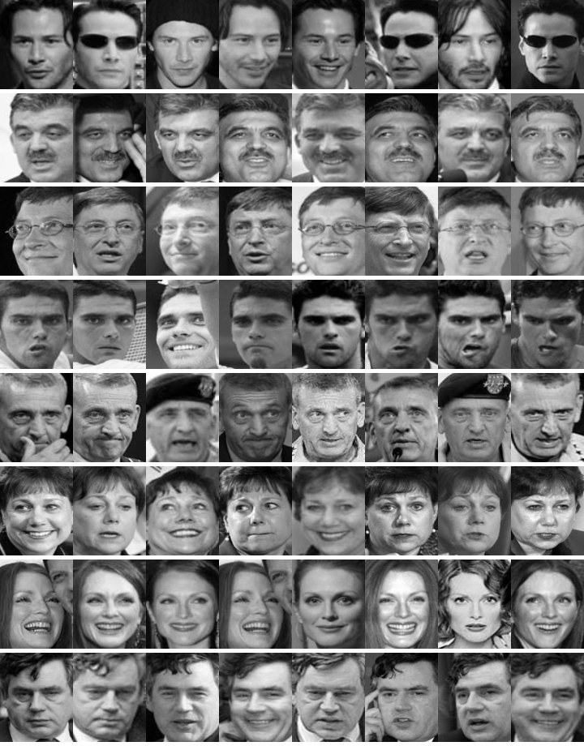
Face Recognition
in LFW
[ PROTOCOL ]
The gallery has 143 subjects with at least 11 images per subject (10 for training, the rest for testing). There are 1430 images for training and 2744 for testing.

Slide 53
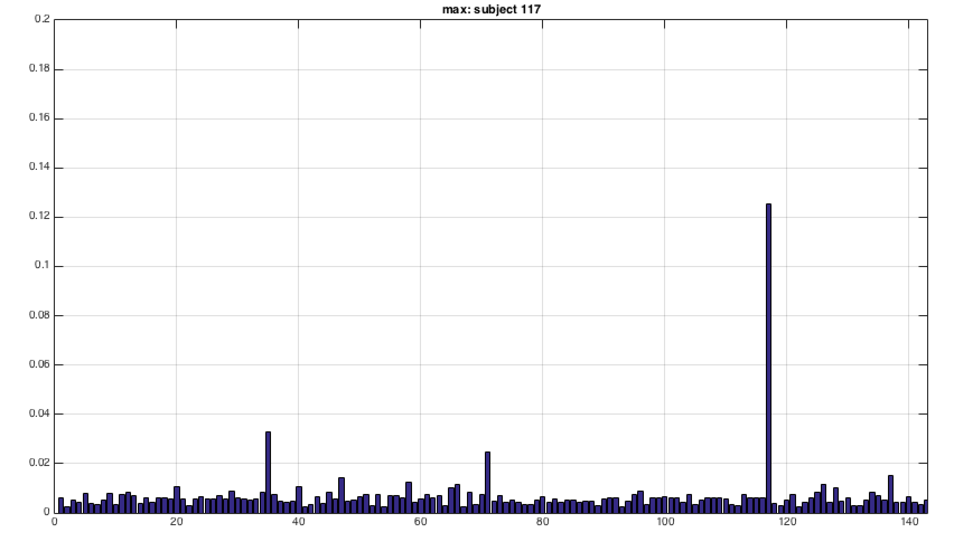
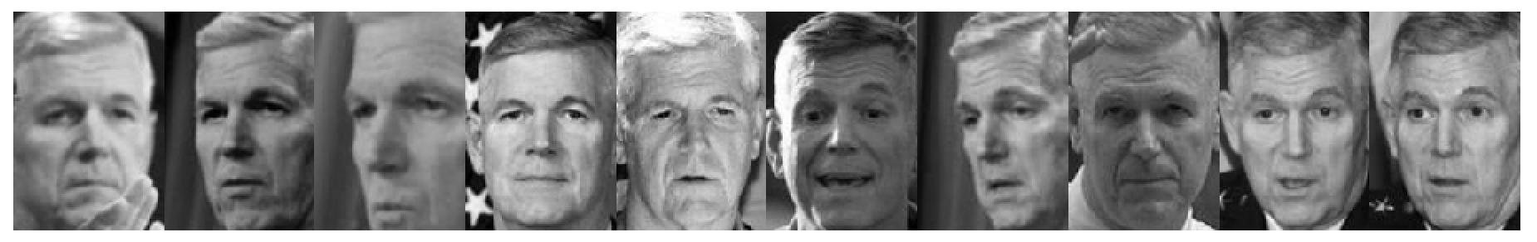
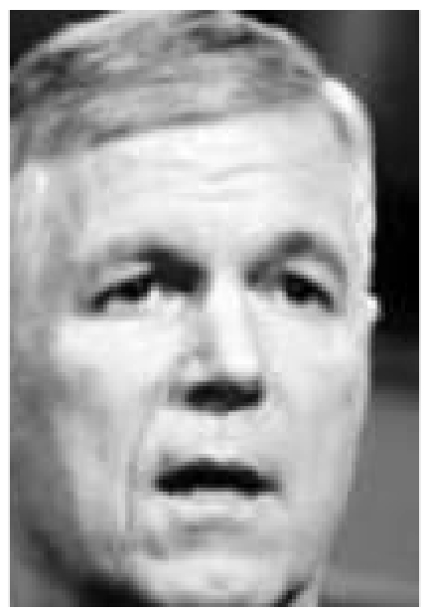
Example in LFW
Contributions per class
Images of the same subject in the gallery (subject #117).
Maximum for #117
Query image
Contributions per class
Maximum for #117
1 ... 143
1 ... 117 143

Slide 54
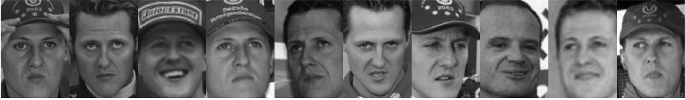
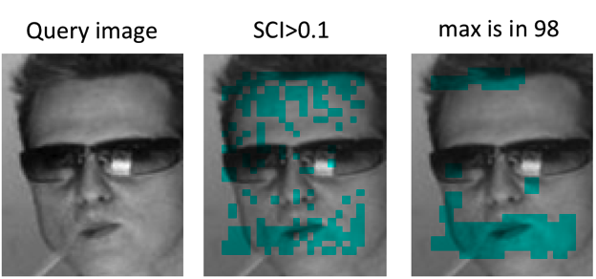
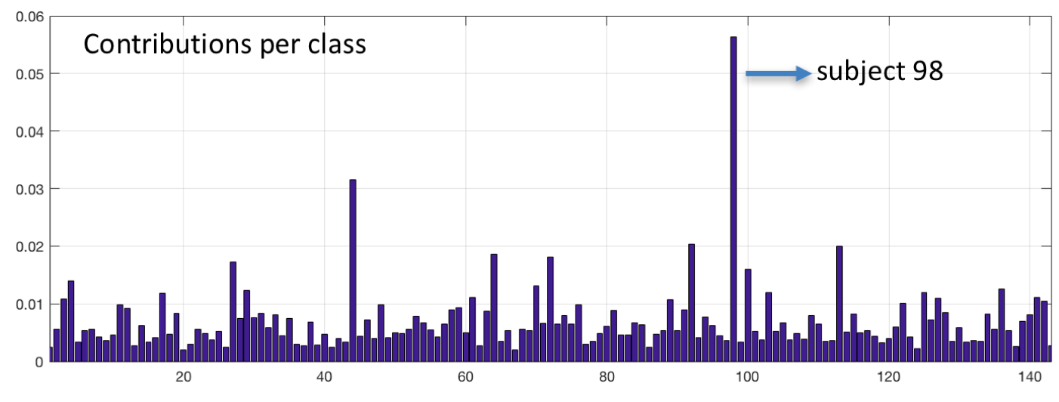
Example in LFW
Images of the same subject in the gallery (subject #98).
SCI >
1 ... 143

Slide 55
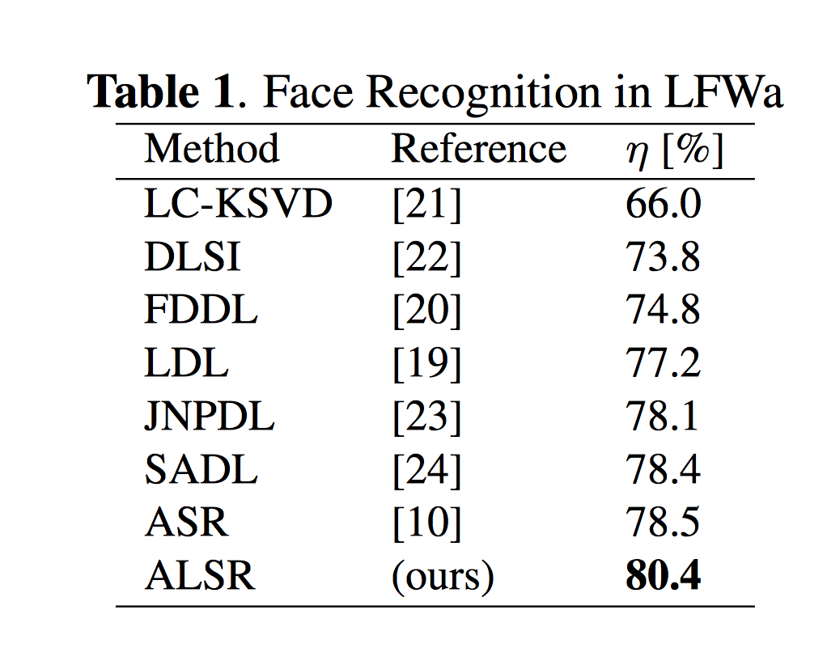
80.8
In this table, we do not report deep learning methods that require millions of training images (for the sake of truth, VGG-Face in this experiment achieves 97.7%)

Slide 56
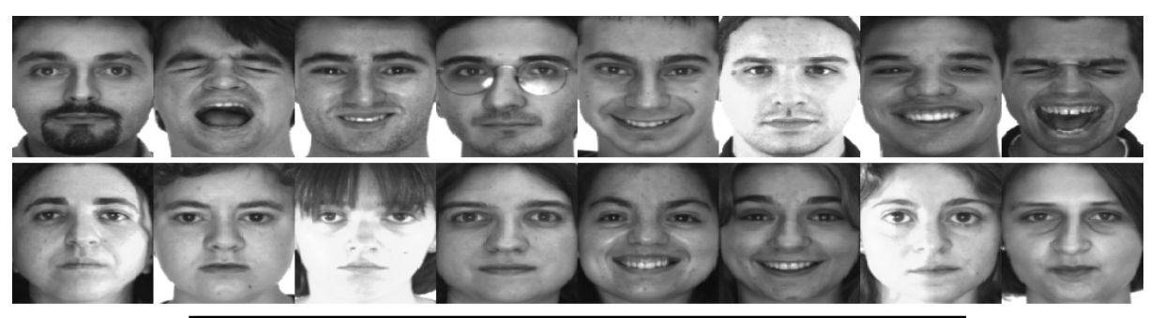
Gender Recognition
in AR
[ PROTOCOL ]
100 subjects (50 women and 50 men). For gender recognition, 14 non-occluded images per subject were used. In this experiment, the first 25 males and 25 females were used for training and the last 25 males and 25 females were used for testing.

Slide 57
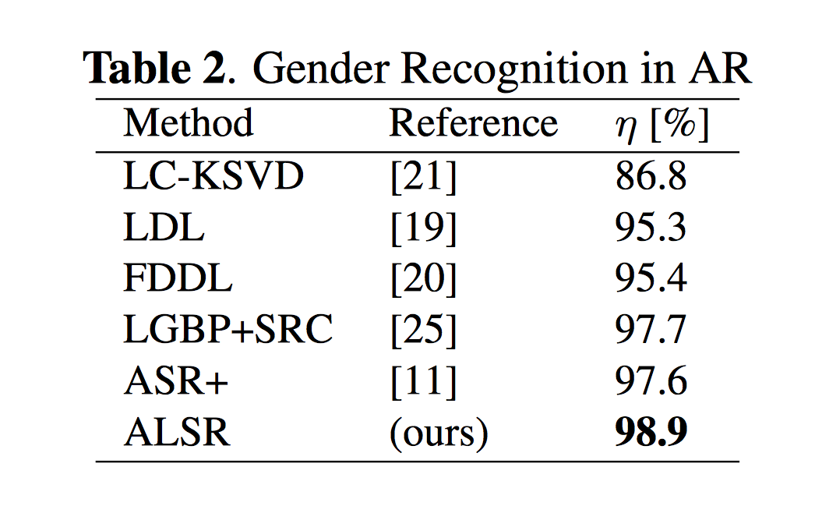

Slide 58
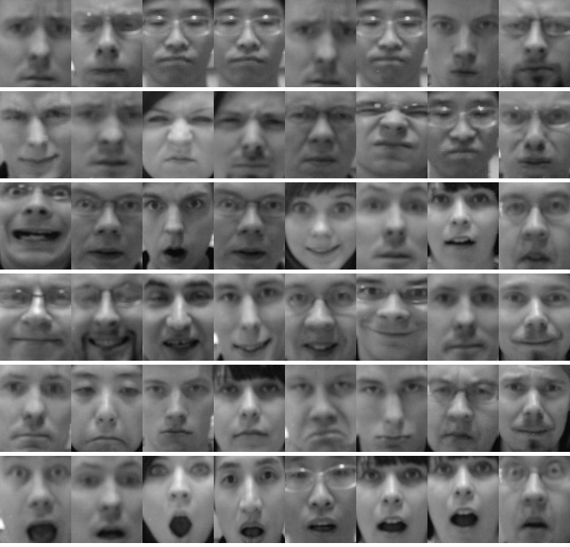
Expression
Recognition
in Oulu-CASIA
[ PROTOCOL ]
Six different facial expressions (surprise, happiness, sadness, anger, fear and dis- gust) under normal illumination from 80 subjects (59 males and 21 females) ranging from 23 to 58 years in age. The dataset contains 480 sequences: the first 9 images of each sequence are not considered, the first 40 individuals are taken as training subset and the rest as testing.

Slide 59
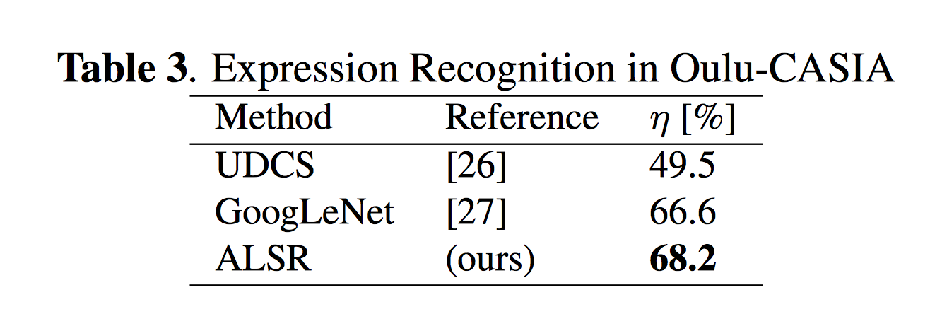

Slide 60
Recognition of Faces and Facial Attributes using Accumulative Local Sparse Representations
Domingo Mery
Department of Computer Science
Universidad Católica de Chile
Sandipan Banerjee
Department of Computer Science & Engineering
University of Notre Dame

Slide 61
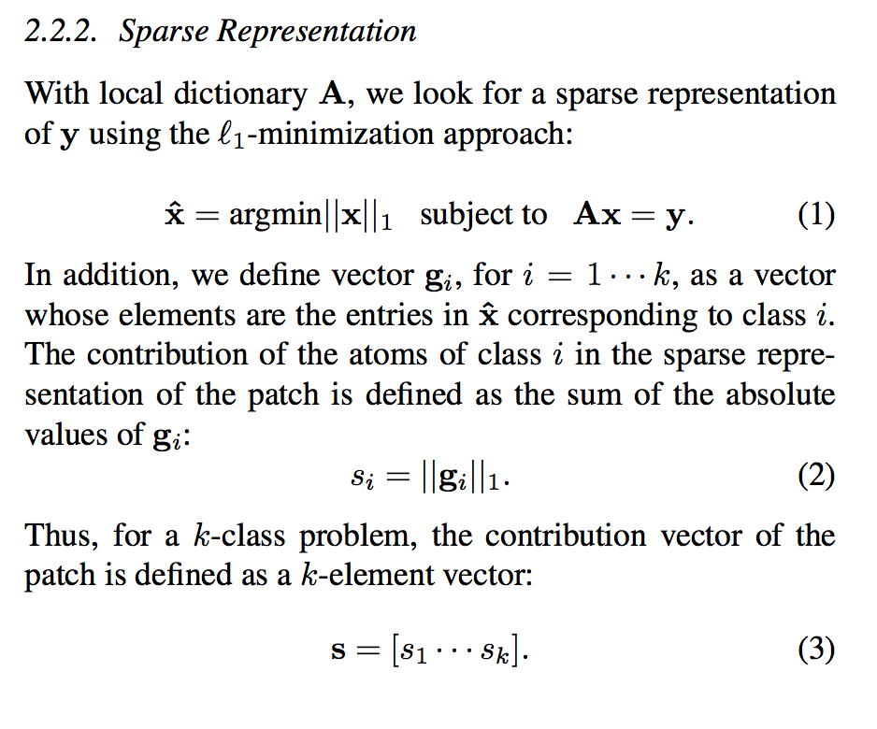
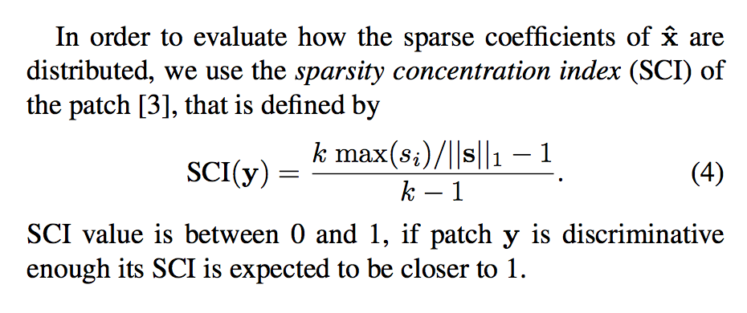

Slide 62
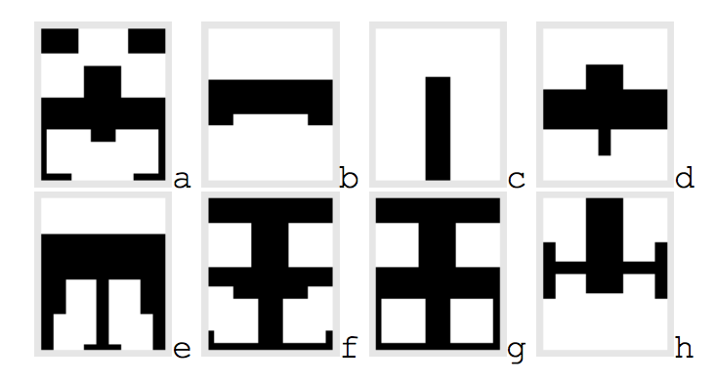
Face masks used in
our experiments

Slide 63
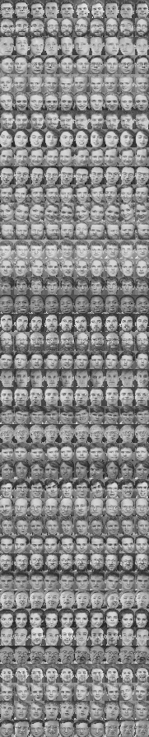

Sparse Representation Classification (SRC)
Wright, et. Al. Robust Face Recognition via Sparse Representation. PAMI 2009
In the training set there are k subjects.
For each subject we have n training images.
In this example there are 40 subjects with 9 images each.
Each image is downsampled to h x w = m pixels
Each downsampled image is represented as a vector v of m elements (by stacking its columns)
:
:
v =

Slide 64
Sparse Representation Classification (SRC)
Wright, et. Al. Robust Face Recognition via Sparse Representation. PAMI 2009
For each subject i (for i=1,…k) we have a dictionary
A_{i} = [v_{i1}, v_{i2}, …, v_{in}]
We define a new matrix A by concatenating all individual dictionaries
A = [A₁, A₂, …, A_{k}]
The size of A is m x (nk)
A is normalized (its columns have unit l² norm).

Slide 65

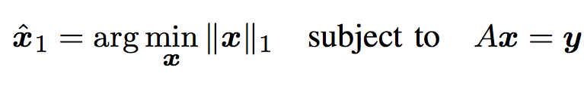




Sparse Representation Classification (SRC)
Wright, et. Al. Robust Face Recognition via Sparse Representation. PAMI 2009
How a test image is classified?
A new test image I^{t} is represented as vector y of m elements (using the same representation of the training images)
Now, we look for a sparse representation of y using l1-minimization approach:
I^{t}
We compute the residuals:
The identity of I^{t} is :
i

Slide 66

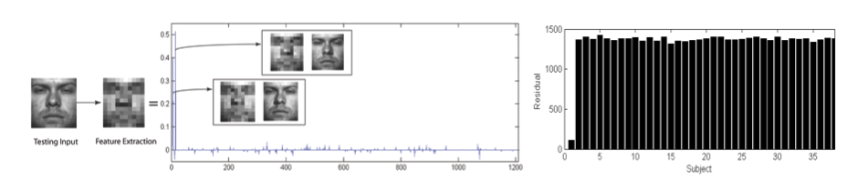
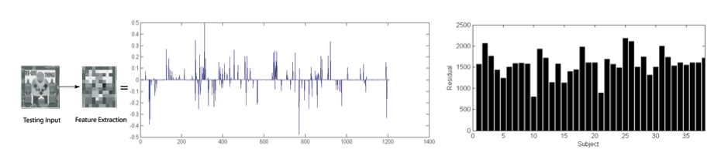
Sparse Representation Classification (SRC)
Wright, et. Al. Robust Face Recognition via Sparse Representation. PAMI 2009
How good is the classification?
We use the Sparsity Concentration Index (SCI)

