Slide 1
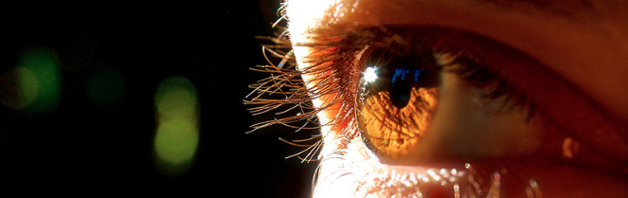
Reconocimiento de Patrones
Domingo Mery
Departmento de Ciencia de la Computación
Escuela de Ingeniería
Universidad Católica de Chile
HoG - Human Detection
[ Capítulo 2 ]

Slide 2

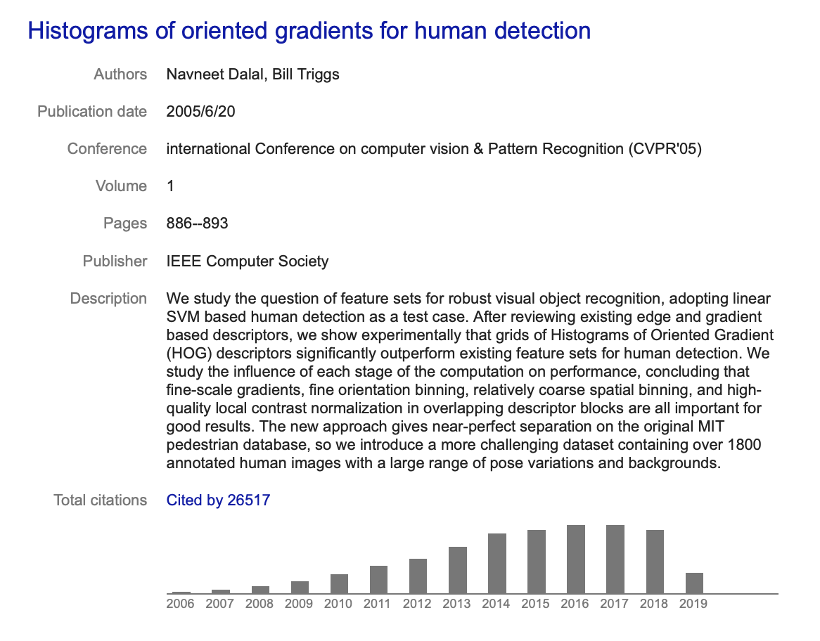
HoG: Histogram of oriented gradients
Navneet Dalal
N Dalal, B Triggs: Histograms of oriented gradients for human detection. Computer Vision and Pattern Recognition, (CVPR 2005).

Slide 3
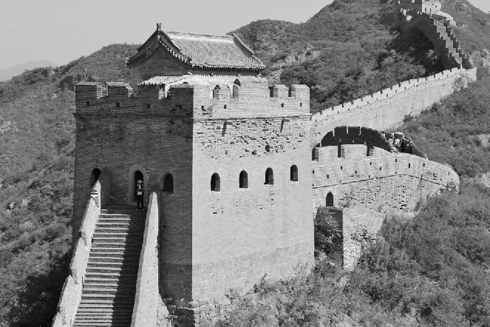
Histogram of Gradients
Gradient in x
direction
G_{x}
Gradient in y
direction
G_{y}

Slide 4
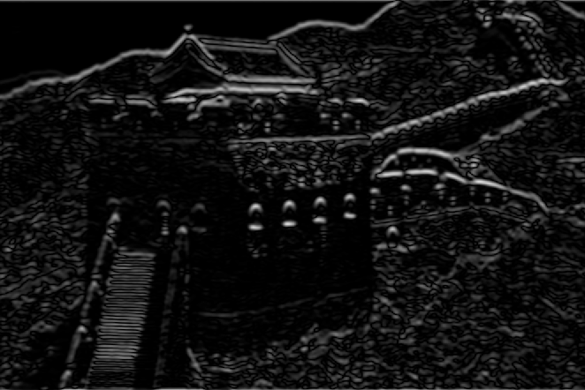
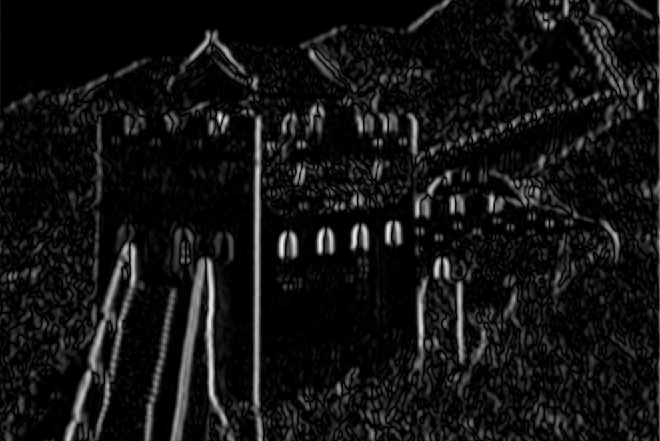
Histogram of Gradients
G_{x}: Gradient in x direction
Magnitude
R
= sqrt(G_{x}²+G_{y}²)
G_{y}: Gradient in y direction
Angle
A
= arctan(Gy/G_{x})

Slide 5
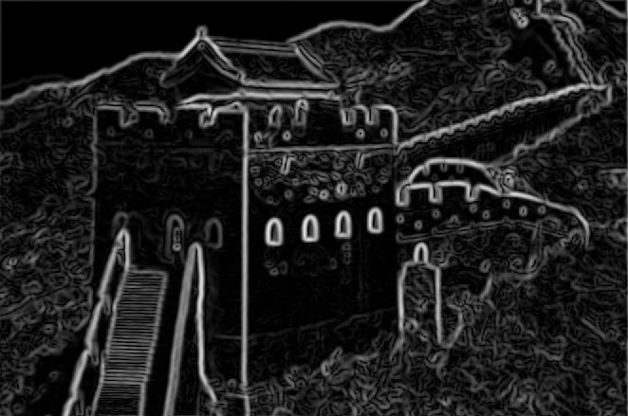
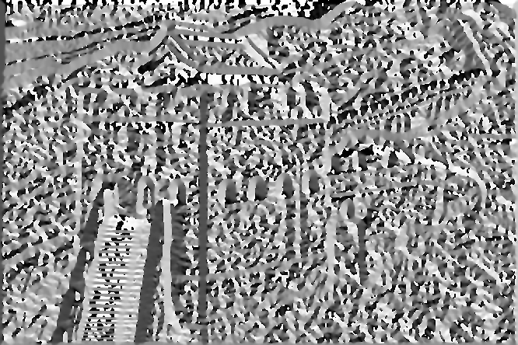
Histogram of Gradients
R: Magnitude
Histogram of 8 directions
3
4
2
A: Angle
5
1
6
8
7
1 2 3 4 5 6 7 8

Slide 6
Histogram of Gradients
R: Magnitude
Histogram of 8 directions
(computation of first bin)
3
4
2
A: Angle
5
1
6
8
7
1 2 3 4 5 6 7 8

Slide 7
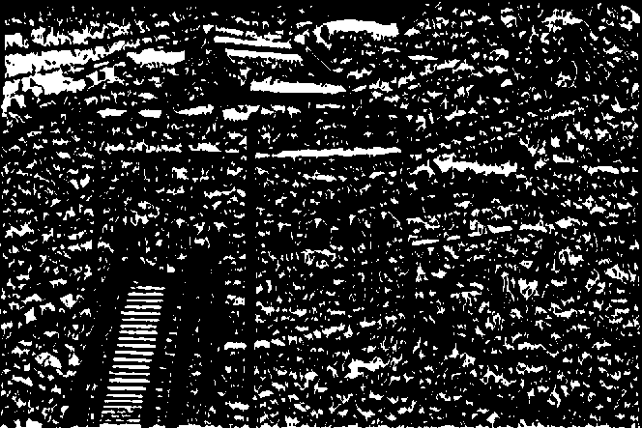
Histogram of Gradients
R: Magnitude
Histogram of 8 directions
(computation of first bin)
3
4
2
22.5º
A: Angle between -22.5º and 22.5º
5
1
-22.5º
6
8
7
1 2 3 4 5 6 7 8

Slide 8
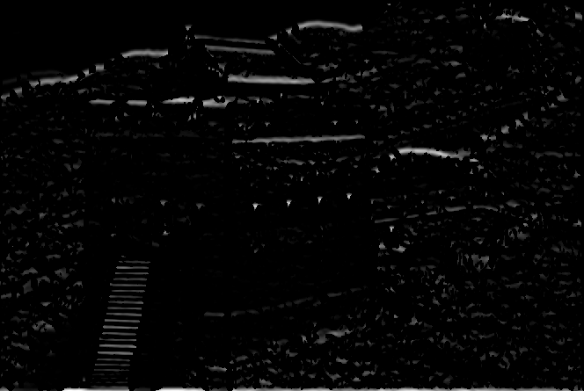
Histogram of Gradients
R: Magnitude in this direction
Histogram of 8 directions
(computation of first bin)
3
4
2
22.5º
A: Angle between -22.5º and 22.5º
5
1
Σ
-22.5º
6
8
7
1 2 3 4 5 6 7 8

Slide 9
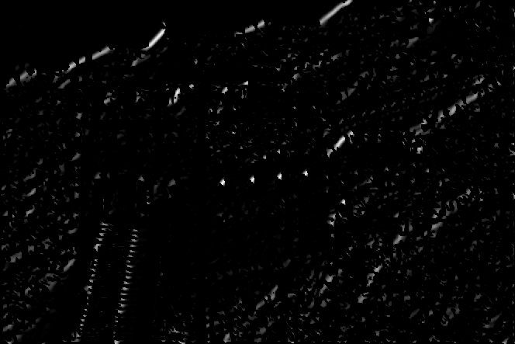
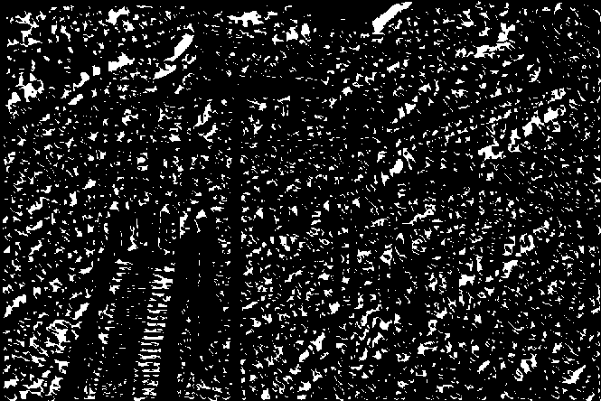
Histogram of Gradients
R: Magnitude in this direction
Histogram of 8 directions
(computation of second bin)
3
67.5º
4
2
22.5º
A: Angle between 22.5º and 67.5º
5
1
Σ
6
8
7
etc.
1 2 3 4 5 6 7 8

Slide 10
Histogram of Gradients
R: Magnitude
Histogram of 8 directions
3
4
2
A: Angle
5
1
6
8
7
1 2 3 4 5 6 7 8

Slide 11
Histogram of Gradients
R: Magnitude
Histogram of 8 directions
3
4
2
A: Angle
5
1
6
8
7
1 2 3 4 5 6 7 8

Slide 12
The descriptor proposed by the authors is a concatenation of HoG in different overlapped partitions

Slide 18


Slide 19
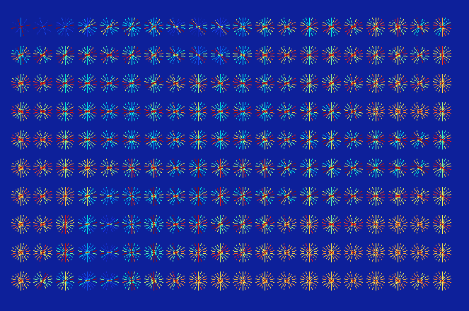

Slide 20
Example using Balu:
options.nj = 20; % 10 x 20
options.ni = 10; % histograms
options.B = 9; % 9 bins
options.show = 1; % show results
I = imread('testimg1.jpg'); % input image
J = rgb2gray(I);
figure(1);imshow(J,[]);
figure(2);
[X,Xn] = Bfx_hog(J,options); % HOG features (see gradients
% arround perimeter).

Slide 21
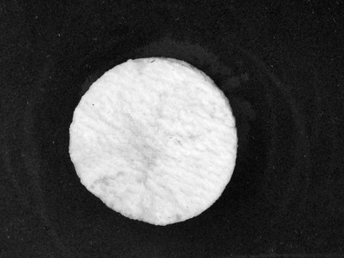
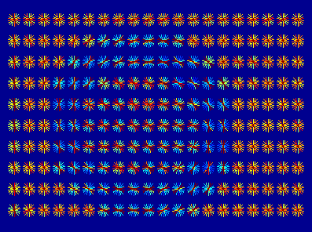
Example using Balu:

Slide 22
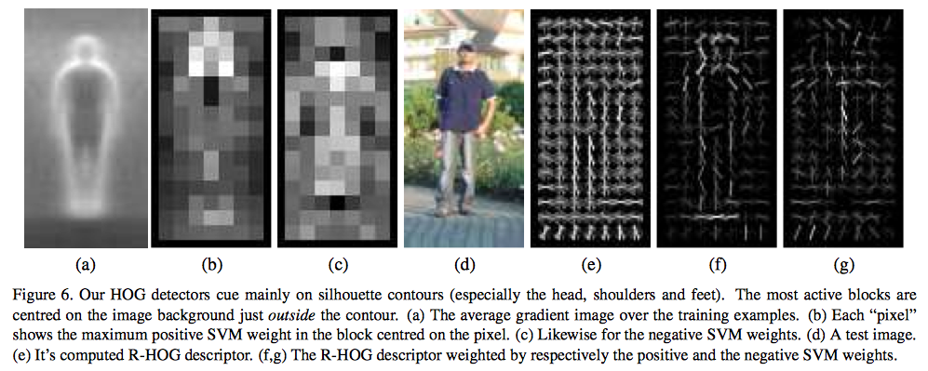
© Dalal & Triggs

