Slide 1
COMP1140 Assignment 2
Ziyang Liu
Adonis Mouti
Jay Chen

Slide 2
Checking state
Given a patch string, determine if it is valid
Check if patch is in bounds
Check who’s turn it is
Check if patch overlaps any other patches on board
Check if player can afford patch

Slide 3
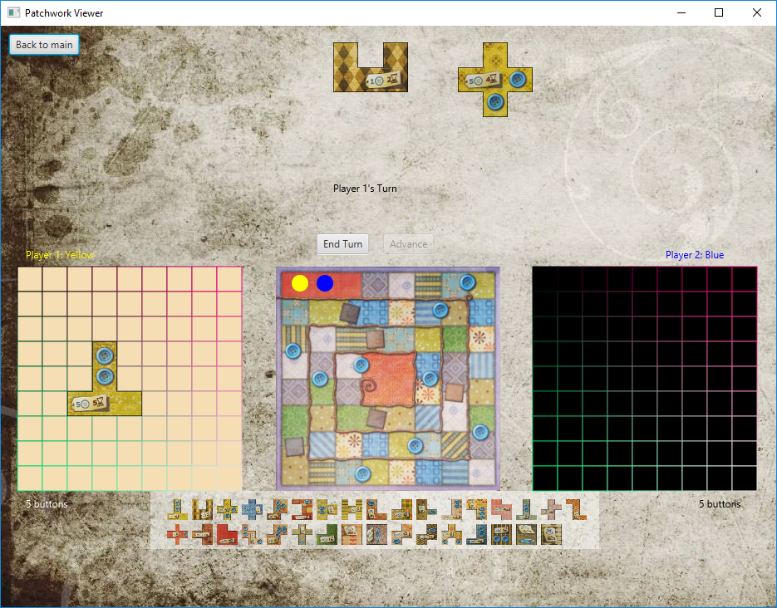

Slide 4
Special Events
“h Patch” Event
Decide which player the event applies to
Make sure h patch gets placed instead of other patches
Button Event

Slide 5
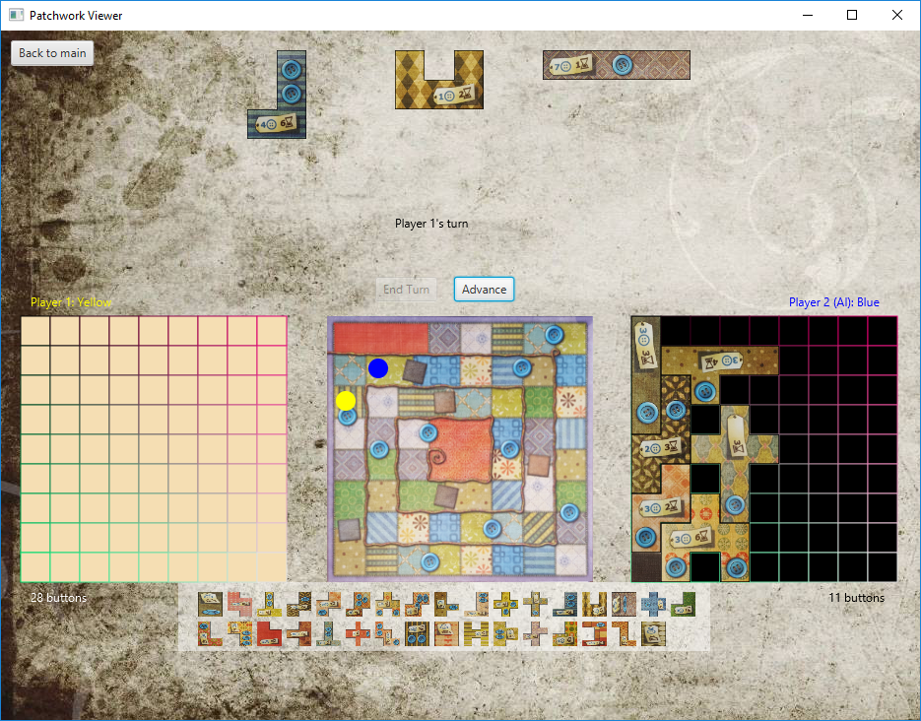

Slide 6
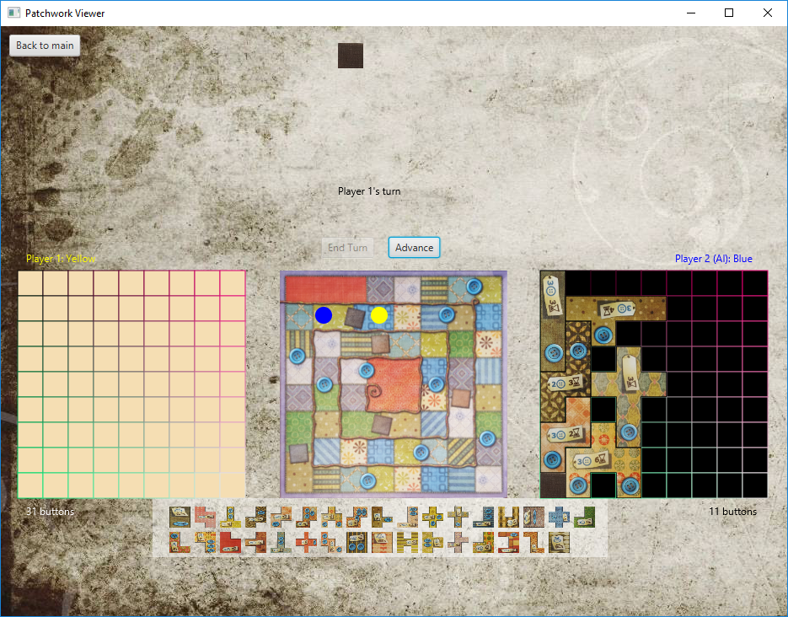

Slide 7
GUI
Start menu
Show main game
Update game based on user input
Including AI
Show scores and winner upon end game

Slide 8
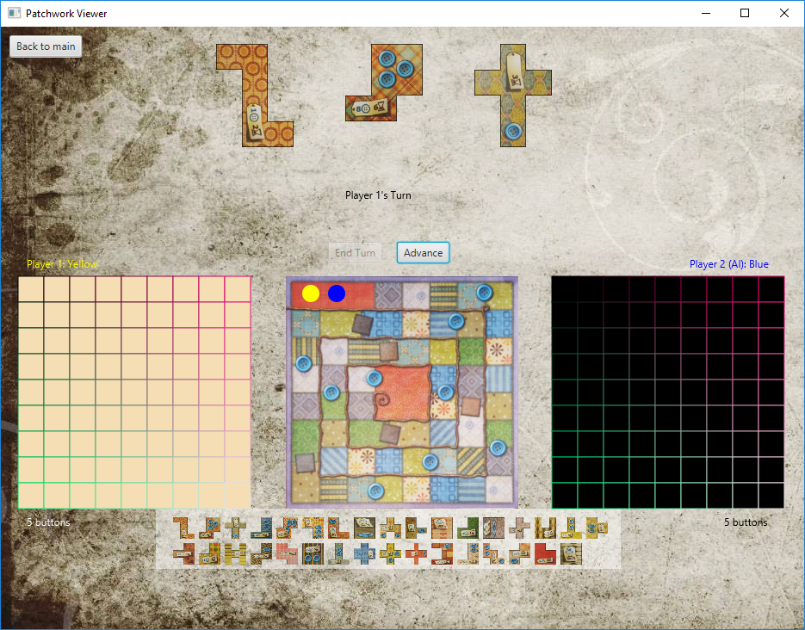

Slide 9
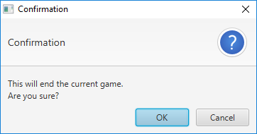

Slide 10
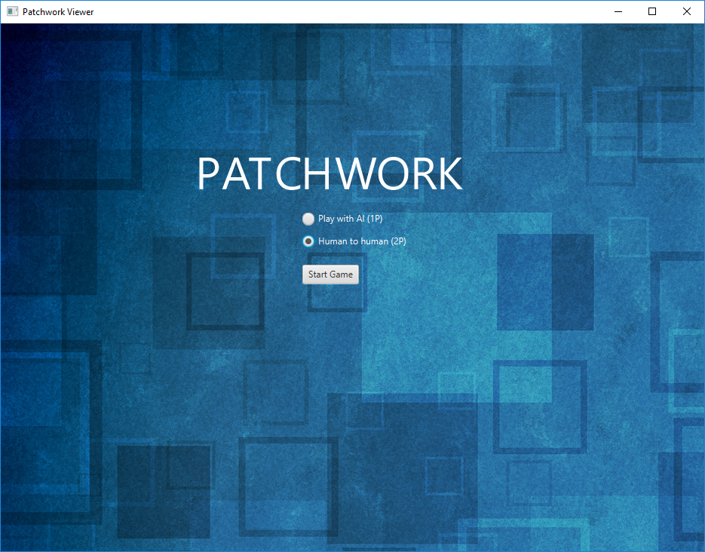

Slide 11
AI
Randomly Generated sequence
Brute Force AI
Improvised smarter AI
Monte Carlo Tree Search

Slide 12
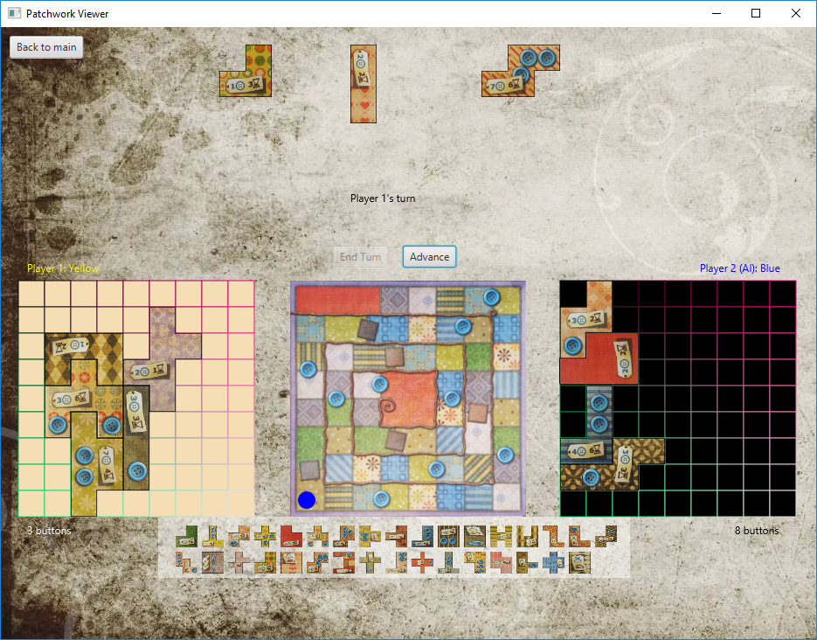

Slide 13


