Slide 1
COMP1140 Assignment 2
Ziyang Liu (u6210090)
Adonis Mouti (u6385898)
Jay Chen (u6309924)

Slide 2
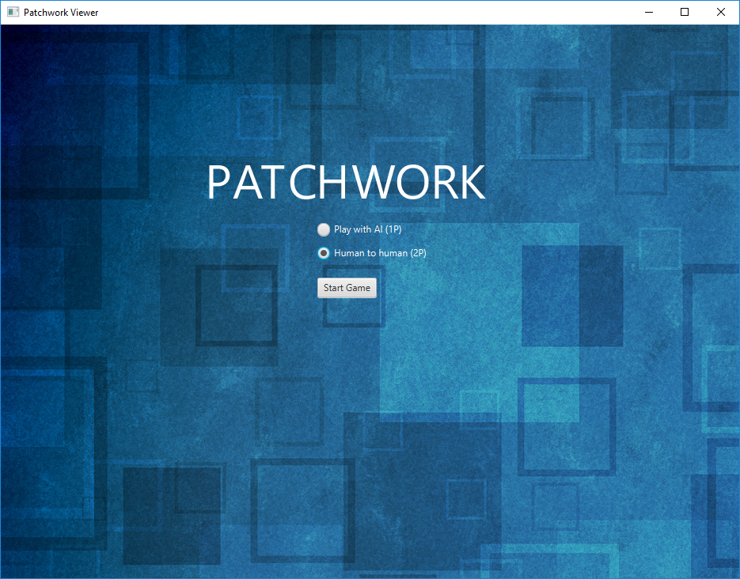
Demo of the Patchwork

Slide 3
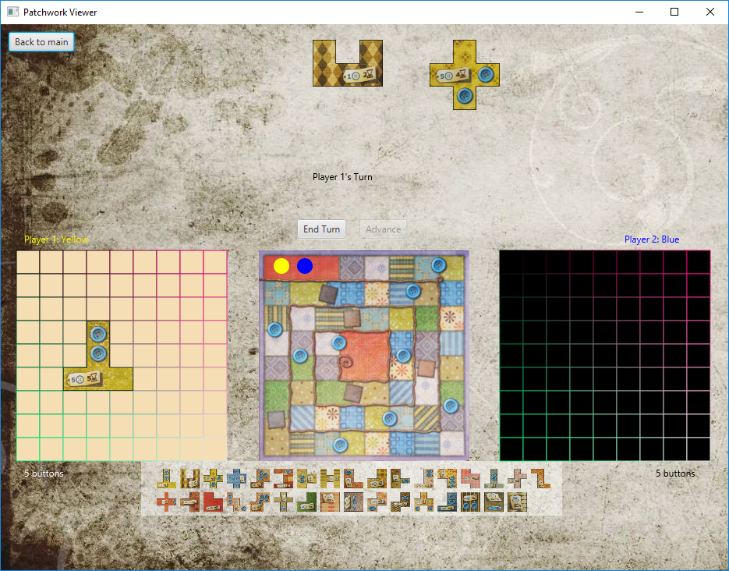

Slide 4
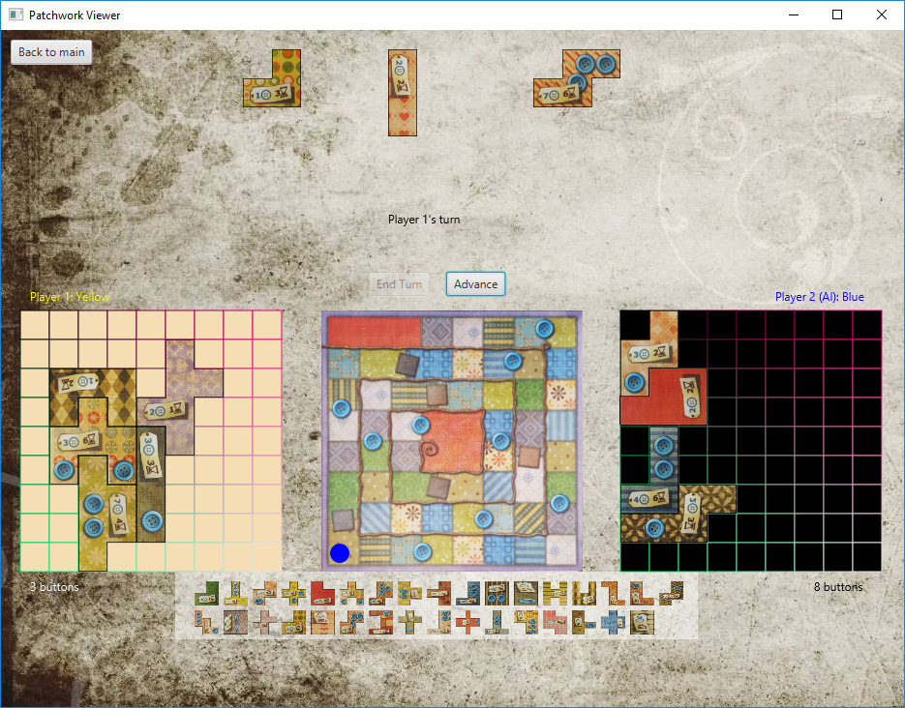

Slide 5
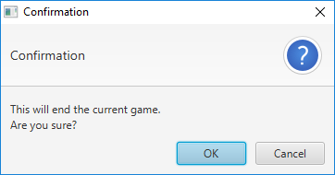

Slide 6
Design & Structure
1. PatchworkGame
2. State
3. PatchworkAI
4. Viewer
5. AITraining
*6. MCTS
*7. Matrix
*8. AITrainingMultiThreading

Slide 7
Methods
1. Data & logic process: Java8
2. GUI: JavaFx
*3. Nerual Network: Keras, Tensorflow(python framework)
*4. Monte-Carlo Tree Search: Java8

Slide 8
Inspirations & Reflection
1. Static field or Class field
Static field: esaier to access and maintain the data
e.g. three candidate tiles are stored as static
Class field: safer to access, data bounded together, but difficult to share the data to every method
e.g. Multithreads: objects are safer to deal with, but when trying to share the data, need to pass the reference of the object in the parameters...

Slide 9
Inspiration & Reflection
2. Less code: methods and variables makes less coding
  1. If some code are duplicate in doing configuration(e.g. JavaFx), extracts it as a method
  2. Variables + proper data structure

Slide 10
Inspiration & Reflection
3. Well documentation saves teamates’ time
  1. Comments about the method’s functionality and the role of the variable
  2. All of methods should be summerised in one document, easier for other developer to check

Slide 11
Inspiration & Reflection
4. Gitlab makes communication easier
  1. Well use of the Wiki
  2. Importance of issues
  3. Attention to the merge request unit

Slide 12
Inspiration & Reflection
5. Right use of Git
  1. Branch should be function-base, not developer-base
  2. Better to do the code review before merging

Slide 13
AI
Methods:
Inspired by AlphaGO, attempt to use Nerual Network and Reinforcement Learning

Slide 14
AI
Available methods:
0. Human simple algorithms
1. Nerual Network(Supervised Learning)
2. CNN
3. Q-Learning (Model-based RL)
4. Monte-Carlo Tree Search
5. Mone-Carlo Tree Search + Nerual Network

Slide 15
AI
0. Human simple algorithm
  OriginGenerator(): Gives the first available placement string by brute force searching
  SmarterGenerator(): Picks the best tile among three and get the first suitable position and rotation.
  RandomGenerator(): Gets all available placement strings and randomly choose one of it.

Slide 16
Data
Smart:Origin = 53%:47% (10765:9235, 20000 in total)
Smart:Random = 53%:47% (2657:2343, 5000 in total)
Random: Random = 52%:48%(10280:9720, 5000 in total)
Smart: Smart = 50%: 50%(10002:9998, 20000 in total)
*: All data stored in the project/data folder

Slide 17
Nerual Network Design
Two network:
  1. Learn to choose the tile
  2. Learn to place the tile

Slide 18
Supervised Learning on NN
By Learning on the winner’s choice of the tile in datasets and predict the best tile according to the generated feartures
Model config:
  1. Layers: 6(1 input, 1 output, 4 hidden layers)
  2. Activation Functions: ReLu, Softmax
  3. Features : 8 (Including player’s state and playboard state)

Slide 19
Supervised Learning on NN
Model result:
  1. Training sets: 300 samples
  2. Testing sets: 440297 samples
  3. Accuracy: 99.04%
  4. Accuracy on All player’s choice (not only winners’): 98.67%
  *DetailDataset06.csv
  5. Conclusion: Performance is the same as the simple human algorithm, abandonded.

Slide 20
Supervised Learning on NN
Learning to predict the best position
Model config:
  1. Layers: 6(1 input, 1 output, 4 hidden layers)
  2. Activation Functions: ReLu, Softmax
  3. Features : 170 (Including player’s state and playboard state, 8 previous feature and 81*2)

Slide 21
Model result:
  1. Training sets: 1000 samples
  2. Testing sets: 436032 samples
  3. Accuracy: 43.60%

Slide 22
Reinforcement Learning
Patchwork is a modeless game due to its large search space.
Don’t have a fixed reward matrix.
Use Monte-Carlo Tree Search instead of other methods(e.g. Q-learning)
The combination of MCTS and NN makes the AI possible to have a value function evaluating the action instead of searching the tree during the competition.

Slide 23
REFERENCE
[1] C.Szepesvari, 2009, Algorithm for Reinforcement Learning
[2] D.Silver, A.Huang et.al, 2016, Mastering the Game of Go with Deep Nerual Networks and Tree Search

