Slide 1


Intro to SNA
Center for Animal Disease Modeling and Surveillance (CADMS),
School of Veterinary Medicine, UC Davis
Jose Pablo Gomez, Jerome Baron, Shadira Gordon
Beatriz Martinez Lopez
Center for Animal Disease Modeling and Surveillance (CADMS)
Department of Medicine & Epidemiology
School of Veterinary Medicine
University of California, Davis
* Contact: jpgo@ucdavis.edu
https://cadms.vetmed.ucdavis.edu

Slide 2

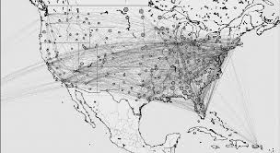

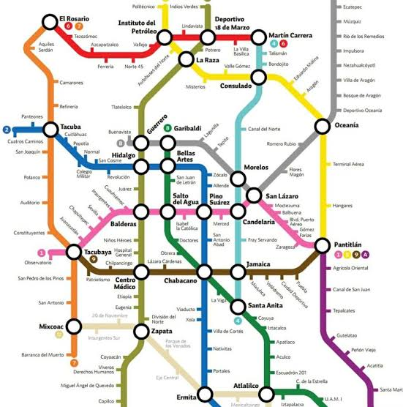
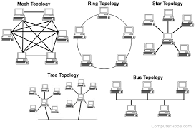
I.A - What is a network?
Notes:
Una red es una representacion de las interacciones entre individus en un Sistema
Nuestra sociedad misma es una red, las personas tienen diferentes tasas de interacción con otras, algunos interaccionan mas frequente o con mas personas que otras.
A grid of contacts or connections between individuals through physical or non-physiscal, Ephemeral vs permantent links. E.g. computers connected via internet, human social contac, hub and spoke, rail physical
Multiple applications, applied in many disciplines

Slide 3
Why represent events in a network?
To describe contact dynamics
Identify individuals that are very active
Identify individuals that are intermediate
Notes:
Identificar individuos mas activos:
Si tenemos una enfermedad en una poblacióntransmitida por contactos directos y recursos limitados, donde deberimos muestrear?
Identificar individuos intermediaries:
Si queremos implementar alguna medida de control, o vigilancia, en donde deberiamos enfocar los recursos?

Slide 4
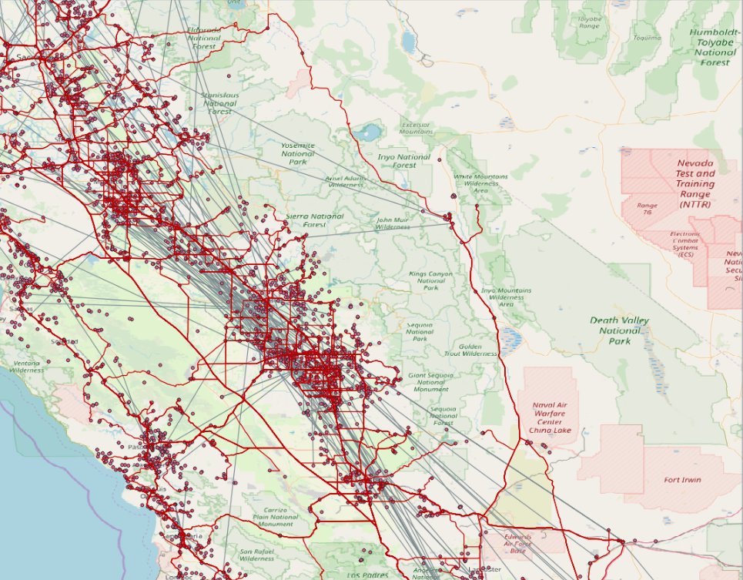
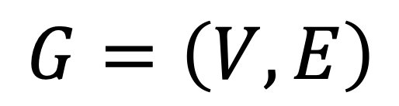
Graph theory
What is a graph? (in the context of network analysis)
“Mathematical repesentation of a network”
$$G=\left(V,E\right)$$
Where:
V = Vertice
E = Edge
Notes:
Analisis de redes sociales es aplicado en muchas areas y existen muchos diferentes nombres para los mismos terminos.

Slide 5
I.B - Elements of a network
Nodes (vertices)
Agents or individuals forming a network
V = {1, 2, 3, … , i}

Slide 6
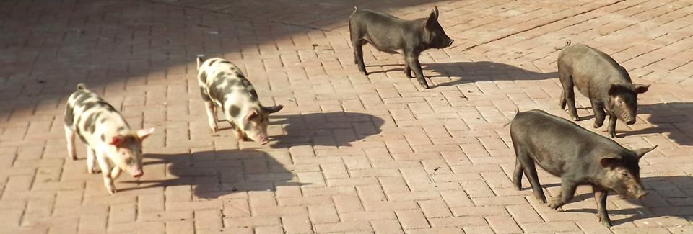
I.B - Elements of a network
Nodes (vertices)
Agents or individuals forming a network:
farms, animals, humans, markets
V = {1, 2, 3, … , i}

Slide 7
I.B - Elements of a network
Edges (links, contacts)
Connection between a pair of nodes (dyad)
E = {(1, 2), (1, 3), … , (i, j)}
In a network, connected nodes are considered as neighbours
Each of the connected nodes belongs to a neighborhood

Slide 8
I.B - Elements of a network
Atributes
Nodes: farm size, type…
Edges: movement size, cause…
1
V = {0, 1, 0, … , i}
0
E = {(1), (3), … , (x_{i})}

Slide 9
I.C.a - Data structure
Nodes dataset
ID | Farm | Farm size | Farm type
1 | Swine and company | 800 | fattening farm
2 | Les Cochonets | 1200 | sow farm
3 | The farmhouse | 50 | small-scale farm
4 | The Boar | 20 | reproductive males
5 | Ham & sausage | 65 | slaughterhouse
6 | The trading post | 0 | market
Edges dataset
ID_origin | ID_destination | Shipment size | Date | Reason
2 | 6 | 10 | 02-25-2018 | Sale of adult sows
2 | 1 | 15 | 03-12-2018 | Piglets for fattening
4 | 1 | 1 | 10-15-2017 | Insemination
1 | 5 | 100 | 06-30-2018 | Slaughter
6 | 3 | 2 | 07-10-2018 | Sale of adult sows
2 | 1 | 100 | 02-15-2018 | Piglets for fattening
Notes:
Spatial coordinates

Slide 10
General properties
Local properties
Notes:
Cuando describimos las caracteristias de la red, Podemos describer:
Caracteristicas generals, que nos daran una perspectiva general de como esta la red
Caracteristicas locales, que nos daran informacion a nivel de nodo o edge

Slide 11
II.B.a - General properties
Size
Diameter
Average path length
Density
Fragmentation
Clustering Coefficient

Slide 12
II.B.a - General properties
Size: Number of nodes in the network (1 to ∞)
Diameter: The shortest path between the most distant nodes (1 to ∞)
Average path length: Average length of shortest paths between every pair of nodes (1 to ∞)
Notes:
El tamaño de la red esta definido por el numero de nodos en la red
El Diametro es el camino mas corto entre

Slide 13

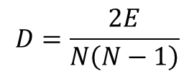


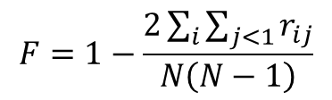
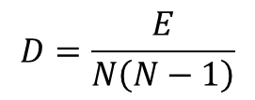

II.B.a - General properties
Density: Proportion of observed edges in network to all theoretical edges that could exist (0 to 1).
Fragmentation: Proportion of pairs of nodes that are not connected to each other (0 to 1). High fragmentation means more isolated nodes
$$D=\frac{E}{N\left(N−1\right)}$$
$$D=\frac{2E}{N\left(N−1\right)}$$
$$F=1−\frac{2\sum_{i}{\sum_{j<1}{r_{ij}}}}{N\left(N−1\right)}$$
$$D≈1$$
$$D≈0$$
F$≈ 0$
F$≈1$
Notes:
Existe una relación entre D y F, Redes altamente conectadas presentaran mayor densidad y menor fragmentación, redes poco conectadas presentaran mayor fragmentación y menor densidad.

Slide 14
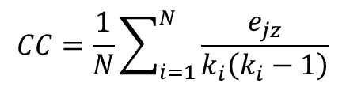
II.B.a - General properties
Clustering coefficient: The probability of individual nodes being connected
Values of 1 indicates that all nodes are directly connected to all others. Value of 0 indicates absence of contacts.
$$CC=\frac{1}{N}\sum_{i=1}^{N}{\frac{e_{jz}}{k_{i}\left(k_{i}−1\right)}}$$
Notes:
e_jz: number of nodes connecting node j and z, which are neighbours of node I
K_i degree of node i

Slide 15
General properties
Local properties
Notes:
Cuando describimos las caracteristias de la red, Podemos describer:
Caracteristicas generals, que nos daran una perspectiva general de como esta la red
Caracteristicas locales, que nos daran informacion a nivel de nodo o edge

Slide 16
II.B.b - Local properties
Connection measures:
Path length
Geodesic distance
Farness

Slide 17
II.B.b - Local properties
Path length Number of steps to get from node i to node j
Geodesic distance The shortest path length
3
i
j
1
Notes:
Most simple and intuitive, but not always most useful because…
Covid example at home

Slide 18
II.B.b - Local properties
Farness Sum of the shortest paths (in or out)
outF = 1+2+3+3+1+2 = 12
i
Notes:
Most simple and intuitive, but not always most useful because…
Covid example at home

Slide 19
II.B.b - Local properties
Centrality measures:
Degree
Betwenness
Closeness

Slide 20
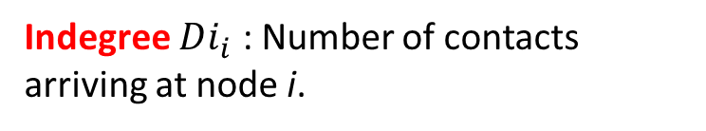
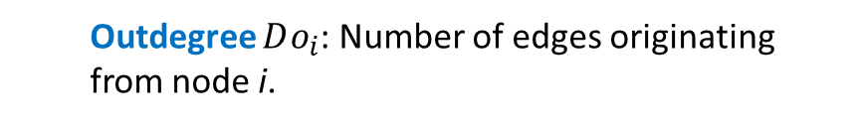
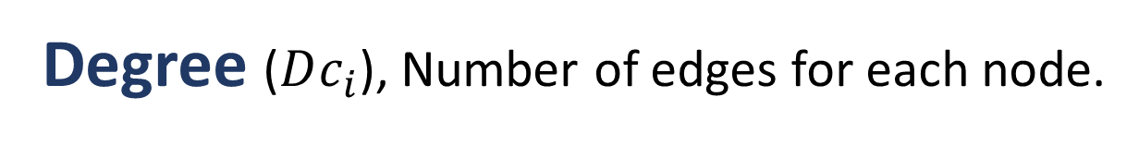
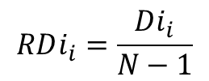
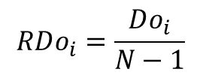
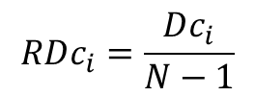
II.B.b - Local properties
Degree ($Dc_{i}$), Number of edges for each node.
Outdegree $Do_{i}$: Number of edges originating from node i.
Indegree $Di_{i}$ : Number of contacts arriving at node i.
Relative degree centrality
Outdegree = 3
$$RDc_{i}=\frac{Dc_{i}}{N−1}$$
$$RDi_{i}=\frac{Di_{i}}{N−1}$$
Indegree = 3
$$RDo_{i}=\frac{Do_{i}}{N−1}$$
Notes:
Most simple and intuitive, but not always most useful because…
Covid example at home

Slide 21
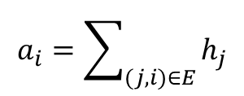
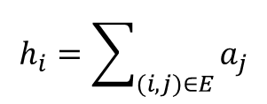
II.B.b - Local properties
Hubs and Authorities are nodes with high outedgree and high indegree.
Authority
Hub score
Authority score
$$a_{i}=\sum_{(j,i)∈E}{h_{j}}$$
$$h_{i}=\sum_{(i,j)∈E}{a_{j}}$$
Hub
Notes:
Expansion on the indegree and outdegree
A strong hub is connected to authoritative nodes
A strong authority is connected strong hub nodes
Mutually reinforcing
In disease control, authority is a good place for surveillance (as reveives a lot of contacts) and a hub is good for disease control (as it spreads a lot)

