Slide 1


Part I
Center for Animal Disease Modeling and Surveillance (CADMS),
School of Veterinary Medicine, UC Davis
Jose Pablo Gomez, Jerome Baron, Jose Manuel Diaz Cao
Beatriz Martinez Lopez
Center for Animal Disease Modeling and Surveillance (CADMS)
Department of Medicine & Epidemiology
School of Veterinary Medicine
University of California, Davis
Emails: jpgo@ucdavis.edu
jnbaron@ucdavis.edu
https://jpablo91.github.io
www.vetmed.ucdavis.edu/cadms

Slide 2
Contents
What is a network?
Elements of a network
Data sources
Sampling methods
Notes:
Cuando describimos las caracteristias de la red, Podemos describer:
Caracteristicas generals, que nos daran una perspectiva general de como esta la red
Caracteristicas locales, que nos daran informacion a nivel de nodo o edge

Slide 3

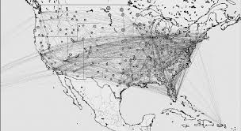
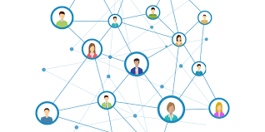
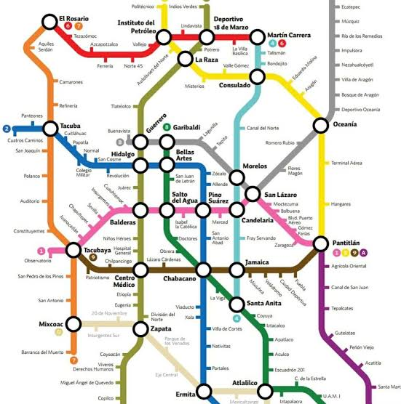
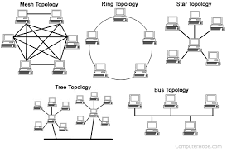
What is a network?
Notes:
Una red es una representacion de las interacciones entre individus en un Sistema
Por ejemplo Facebook
Redes computacionales
Red de aeropuertos
Nuestra sociedad misma es una red, las personas tienen diferentes tasas de interacción con otras, algunos interaccionan mas frequente o con mas personas que otras.

Slide 4
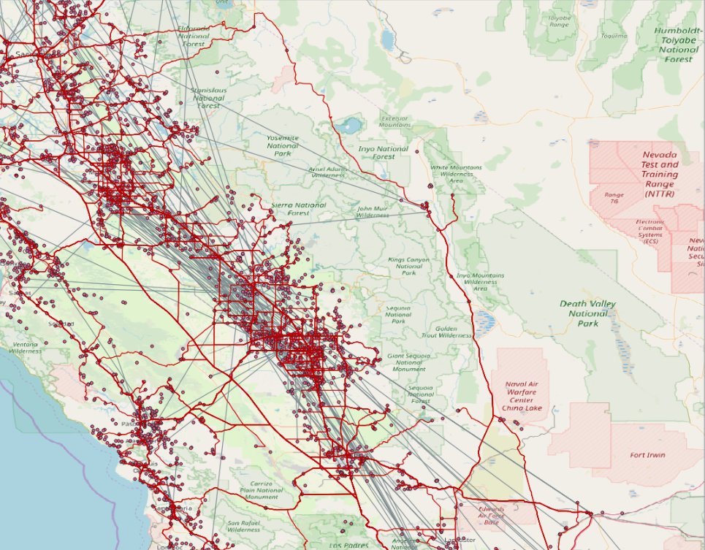
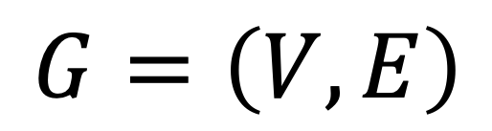
Graph theory
What is a graph? (in the contect of network analysis)
“Mathematical repesentation of a network”
$$G=\left(V,E\right)$$
Where:
V = Vertice
E = Edge
Notes:
Analisis de redes sociales es aplicado en muchas areas y existen muchos diferentes nombres para los mismos terminos.

Slide 5
Elements of a network
Nodes (vertices)
Agents or individuals forming a network
V = {1, 2, 3, … , i}

Slide 6
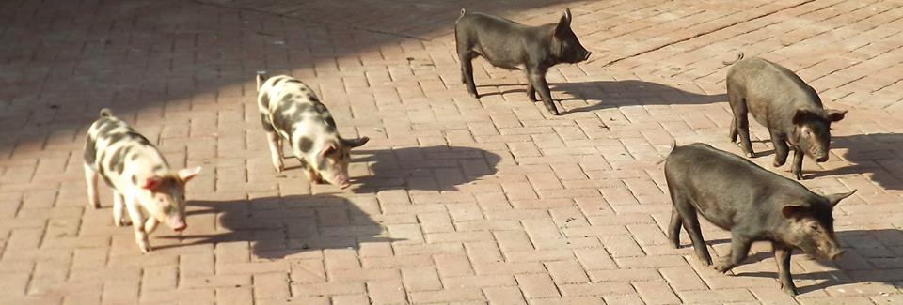
Elements of a network
Nodes (vertices)
Agents or individuals forming a network:
farms, animals, humans, markets
V = {1, 2, 3, … , i}

Slide 7
Elements of a network
Edges (links)
Connection between a pair of nodes (dyad)
E = {(1, 2), (1, 3), … , (i, j)}
In a network, connected nodes are considered as neighbours
Each of the connected nodes belongs to a neighborhood

Slide 8
Elements of a network
Edges (links)
Connection between a pair of nodes (dyad):
Animal shipments, human movements, social contacts
E = {(1, 2), (1, 3), … , (i, j)}
In a network, connected nodes are considered as neighbours
Each of the connected nodes belongs to a neighborhood

Slide 9
Elements of a network
Directionality
E = {(1→2), (1→3), … , (i →j)}
Notes:
Una red puede ser direccionadas o no direccionadas dependiendo del tipo de relacion entre los pares de nodos.
En redes no direcionadas, la relacion entre nodos puede ser en cualquier direccion.
En redes direccionadas existe un origen y destino, que explica la direccion de la relacion.

Slide 10
Elements of a network
Atributes
Nodes: farm size, type…
Edges: movement size, cause…
1
V = {0, 1, 0, … , i}
0
E = {(1), (3), … , (x_{i})}

Slide 11
Why represent events in a network?
To describe contact dynamics
Identify individuals that are very active
Identify individuals that are intermediate
Notes:
Identificar individuos mas activos:
Si tenemos una enfermedad en una poblacióntransmitida por contactos directos y recursos limitados, donde deberimos muestrear?
Identificar individuos intermediaries:
Si queremos implementar alguna medida de control, o vigilancia, en donde deberiamos enfocar los recursos?

Slide 12
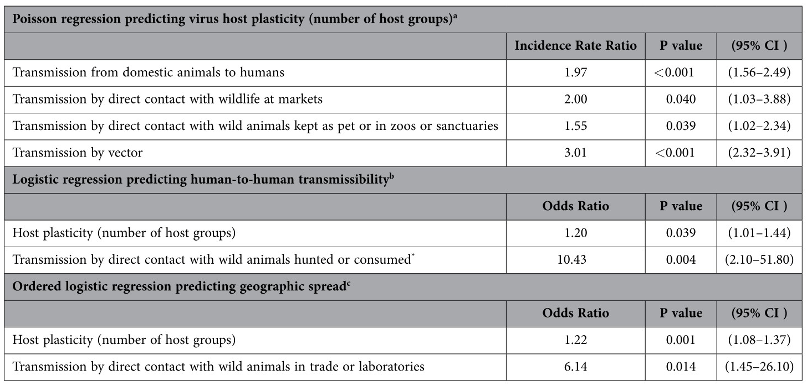
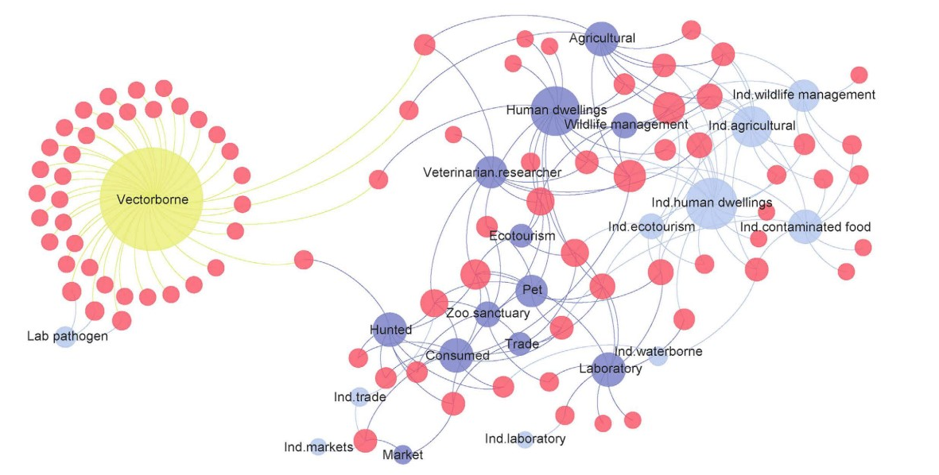
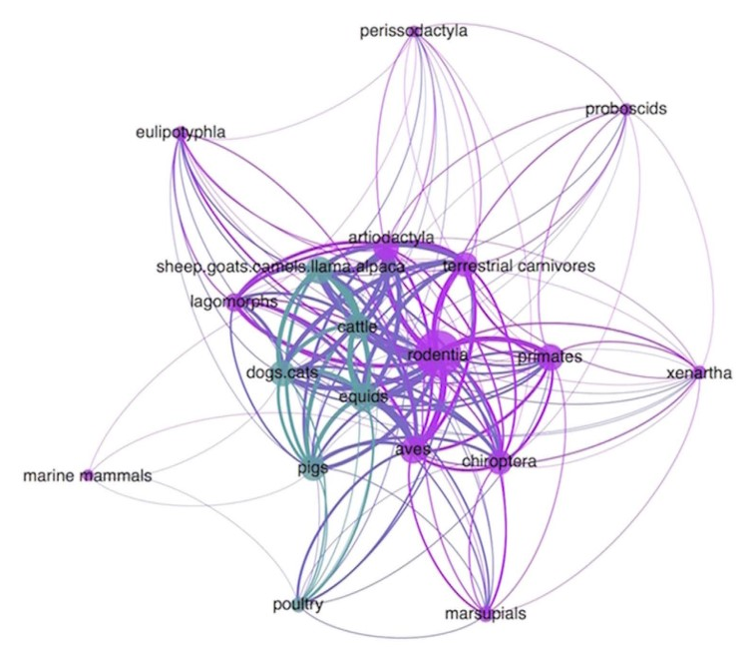
Example
Kreuder Johnson et al, 2015
Examin the transmission mechanisms and hosts involved in zoonotic transmission
Identify viruses with “high plasticity”

Slide 13
Why represent events in a network?
Model contact dynamics:
1
0
Inference: Associations between attributes and activities in a network
Prediction: Are there reproducible patterns that we can predict?
Notes:
Los individuos amarillos son mas propensos a iniciar los contactos que los individuos verdes?
Existe alguna asociación entre el numero de contactos y algún otro atributo?

Slide 14
Applications in Preventative Veterinary Medicine
Uses of Networks in Preventative Veterinary Medicine
Surveillance, Prevention and Control
Define strategic nodes for intervention
Surveillance: Diagnostic testing, road checks
Prevention: Education and information campaigns
Control: Vaccination or treatment campaigns
Define cost-effective risk-based targeted approaches
Modelling of disease introduction and spread
Risk Factor Analysis
Outbreak investigation
Traceability of the outbreak’s origin
Compartimentalization
Define high-risk groups?
Other uses in the animal world
Behavioral studies in social animals: i.e. contact patterns in a herd of cattle

Slide 15
Data sources
Define nodes:
What is the unit of analysis (e.g. farm, animal, etc)
Define edges:
Frequency of contacts
Duration of contacts
Notes:
Que tan bueno es nuestro Sistema de reportes?
Que tanto impacto tendran las subnotificaciones? (regiones con menor tasa de reportes).

Slide 16
Data sources
Passive Surveillance
Madatory movement registries
Population census
GPS data (entire population)
Complete network
Notes:
Que tan bueno es nuestro Sistema de reportes?
Que tanto impacto tendran las subnotificaciones? (regiones con menor tasa de reportes).

Slide 17
Data sources
Passive Surveillance
Madatory movement registries
Population census
GPS data (entire population)
Complete network
Impact of underreporting
Notes:
Que tan bueno es nuestro Sistema de reportes?
Que tanto impacto tendran las subnotificaciones? (regiones con menor tasa de reportes).

Slide 18
Data sources
Active surveillance
Surveys
Observation of a sample of the population
Subgraph sampling and incomplete network

Slide 19
Sampling method
Random Sampling Methods
Node induced
Sample a group of nodes
Identify all contacst between these nodes
Edge induced
Sample a group of edges
Identify all nodes connected to these edges

Slide 20
Sampling method
Egocentric Sampling
Sample a group 1 of nodes
Identify all contacts linked members of group 1
Identify all nodes (group 2) directly connected to group 1
identify all contacts between members of group 2

Slide 21
Sampling method
Link-tracing
(respondent driven sampling)
We follow a node of specific interests and record its previous contacts
Similar to Snowball sampling

Slide 22
Measuring the contacts
Retrospective
National movement records
Farm registry and population census
Surveys
Prospective
Visual observation
Tracking with GPS or PIT (Passive Intergrated Transporter) systems

Slide 23
Data
Nodes dataset
ID | Farm | Farm size | Farm type
1 | Swine and company | 800 | fattening farm
2 | Les Cochonets | 1200 | sow farm
3 | The farmhouse | 50 | small-scale farm
4 | The Boar | 20 | reproductive males
5 | Ham & sausage | 65 | slaughterhouse
6 | The trading post | 0 | market
Edges dataset
ID_origin | ID_destination | Shipment size | Date | Reason
2 | 6 | 10 | 02-25-2018 | Sale of adult sows
2 | 1 | 15 | 03-12-2018 | Piglets for fattening
4 | 1 | 1 | 10-15-2017 | Insemination
1 | 5 | 100 | 06-30-2018 | Slaughter
6 | 3 | 2 | 07-10-2018 | Sale of adult sows
2 | 1 | 100 | 02-15-2018 | Piglets for fattening

Slide 24
Questions?
Contact: jpgo@ucdavis.edu, jnbaron@ucdavis.edu
jpablo91.github.io

