Slide 1


Part II
Center for Animal Disease Modeling and Surveillance (CADMS),
School of Veterinary Medicine, UC Davis
Jose Pablo Gomez, Jerome Baron, Jose Manuel Diaz Cao
Beatriz Martinez Lopez
Center for Animal Disease Modeling and Surveillance (CADMS)
Department of Medicine & Epidemiology
School of Veterinary Medicine
University of California, Davis
Emails: jpgo@ucdavis.edu
jnbaron@ucdavis.edu
https://jpablo91.github.io
www.vetmed.ucdavis.edu/cadms

Slide 2
Static Network Analysis
Static Network Analysis
Network Type
Dynamic Network
Static Network
Time = t1
Time = t2
Time = t3
Time = t4

Slide 3
Contents
Network simplification
Network properties
General properties
Local properties
Weak and Strong component
Notes:
Cuando describimos las caracteristias de la red, Podemos describer:
Caracteristicas generals, que nos daran una perspectiva general de como esta la red
Caracteristicas locales, que nos daran informacion a nivel de nodo o edge

Slide 4
Network simplification
Network Simplification
Loops
Are they important?
Multiple Edges
Meaning? Social/Commercial relationship? Useful for modeling?
Directed or undirected
Is it relevant to disease transmission in a given context: direct animal contact vs shipment

Slide 5
Network properties
General properties
Local properties
Notes:
Cuando describimos las caracteristias de la red, Podemos describer:
Caracteristicas generals, que nos daran una perspectiva general de como esta la red
Caracteristicas locales, que nos daran informacion a nivel de nodo o edge

Slide 6
General properties
Size: Number of nodes in the network (1 to ∞)
Diameter: The shortest path between the most distant nodes (1 to ∞)
Notes:
El tamaño de la red esta definido por el numero de nodos en la red
El Diametro es el camino mas corto entre

Slide 7

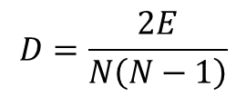


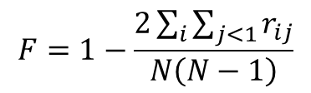
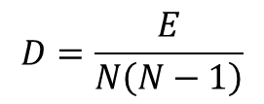

General properties
Density: Ratio of all observed edges in network to all theoretical edges that could exist (0 to 1)
Fragmentation: Proportion of pairs of nodes that are not connected to each other. High fragmentation means more isolated nodes
$$D=\frac{E}{N\left(N−1\right)}$$
$$D=\frac{2E}{N\left(N−1\right)}$$
$$F=1−\frac{2\sum_{i}{\sum_{j<1}{r_{ij}}}}{N\left(N−1\right)}$$
$$D≈1$$
$$D≈0$$
F$≈ 0$
F$≈1$
Notes:
Existe una relación entre D y F, Redes altamente conectadas presentaran mayor densidad y menor fragmentación, redes poco conectadas presentaran mayor fragmentación y menor densidad.

Slide 8
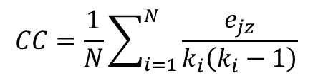
General properties
Clustering coefficient: The probability of individual nodes being connected
Values of 1 indicates that all nodes are directly connected to all others. Value of 0 indicates absence of contacts.
$$CC=\frac{1}{N}\sum_{i=1}^{N}{\frac{e_{jz}}{k_{i}\left(k_{i}−1\right)}}$$
Notes:
e_jz: number of nodes connecting node j and z, which are neighbours of node I
K_i degree of node i

Slide 9
Network properties
General properties
Local properties
Notes:
Cuando describimos las caracteristias de la red, Podemos describer:
Caracteristicas generals, que nos daran una perspectiva general de como esta la red
Caracteristicas locales, que nos daran informacion a nivel de nodo o edge

Slide 10
Local properties
Centrality measures:
Degree
Betwenness
Closeness

Slide 11
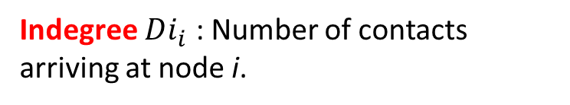
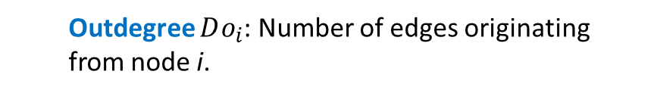
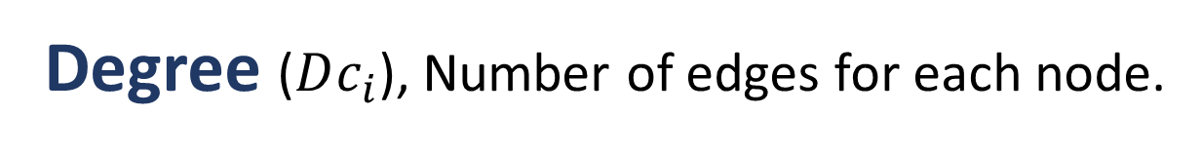
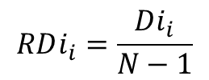
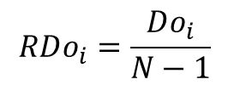
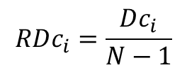
Local properties
Degree ($Dc_{i}$), Number of edges for each node.
Outdegree $Do_{i}$: Number of edges originating from node i.
Indegree $Di_{i}$ : Number of contacts arriving at node i.
Relative degree centrality
Outdegree = 3
$$RDc_{i}=\frac{Dc_{i}}{N−1}$$
$$RDi_{i}=\frac{Di_{i}}{N−1}$$
Indegree = 3
$$RDo_{i}=\frac{Do_{i}}{N−1}$$

Slide 12
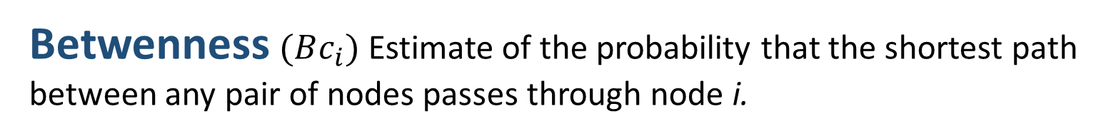
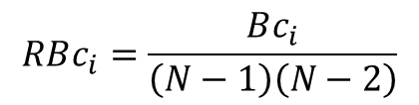
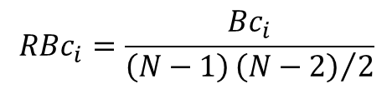
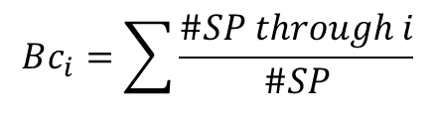
Local properties
Betwenness $(Bc_{i})$ Estimate of the probability that the shortest path between any pair of nodes passes through node i.
$$Bc_{i}=\sum{\frac{\#SP through i}{\#SP}}$$
Relative betweenness centrality
For non-directed networks
$$RBc_{i}=\frac{Bc_{i}}{\left(N−1\right){\left(N−2\right)}/2}$$
For directed networks
$$RBc_{i}=\frac{Bc_{i}}{\left(N−1\right)\left(N−2\right)}$$

Slide 13
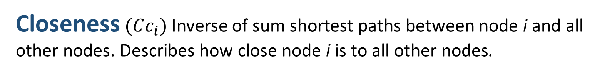

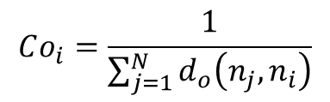
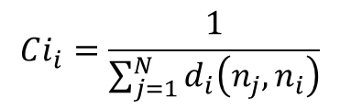
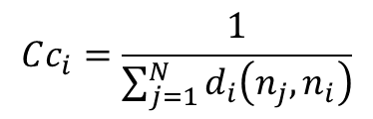
Local properties
Closeness$(Cc_{i})$ Inverse of sum shortest paths between node i and all other nodes. Describes how close node i is to all other nodes.
Non-directed networks:
Relative closeness centrality
$$Cc_{i}=\frac{1}{\sum_{j=1}^{N}{d_{i}\left(n_{j},n_{i}\right)}}$$
$$RCc_{i}=\left(N−1\right)×Cc_{i}$$
Directed networks:
In-closseness
Out-closseness
1 c
1 + 1 + 1 + 2
$$Ci_{i}=\frac{1}{\sum_{j=1}^{N}{d_{i}\left(n_{j},n_{i}\right)}}$$
$$Co_{i}=\frac{1}{\sum_{j=1}^{N}{d_{o}\left(n_{j},n_{i}\right)}}$$
1 c
1 + 2 + 2 + 3
Notes:
d(n_i, n_j) numero de nodos en la red

Slide 14
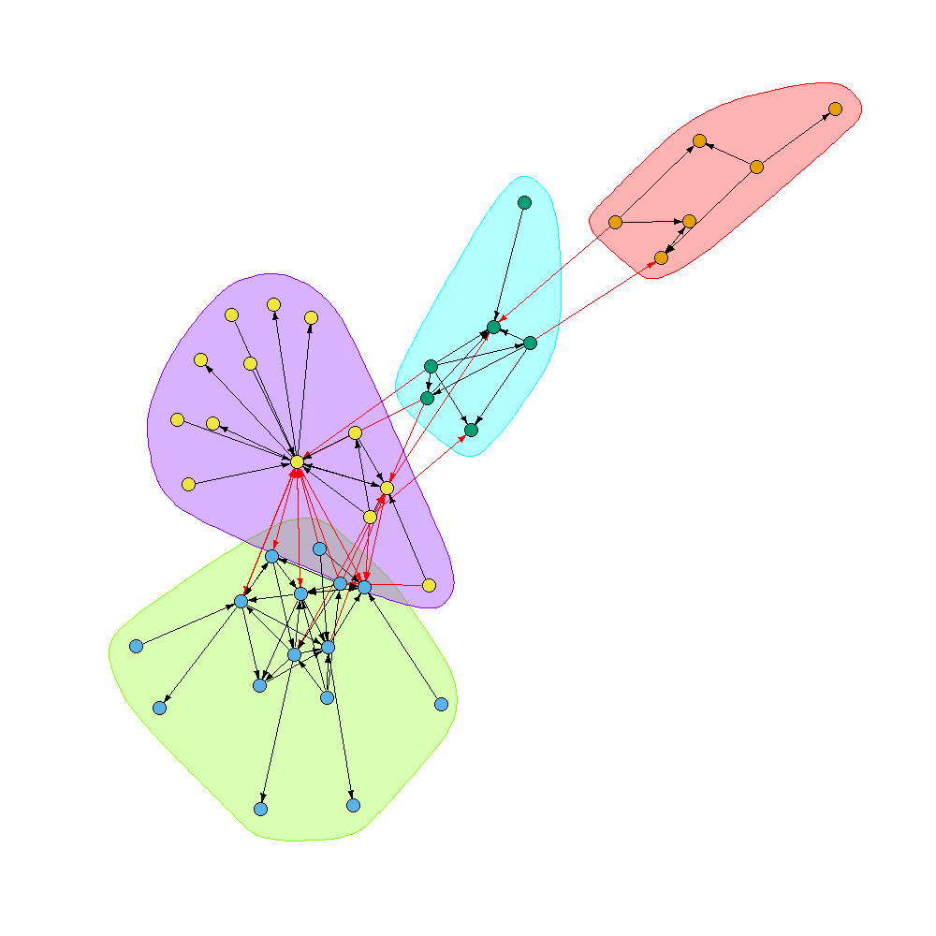
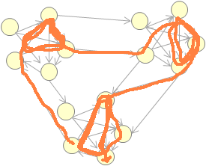
Detection of communities
Communities: Many intra-community contacts and few inter-community contacts
Strong Component
A subset of the network in which each pair of nodes i and j can be reached by all the others
There are many algorithms to detect communities, walktrap being one of the most popular.
I generates random paths between nodes to detect zones where it circulates more frequently within a group of nodes.
Notes:
Aplicacion practica: si una enfermedad es introducida en un nodo del strong component, es mas probable que se disemine entre la población.

Slide 15
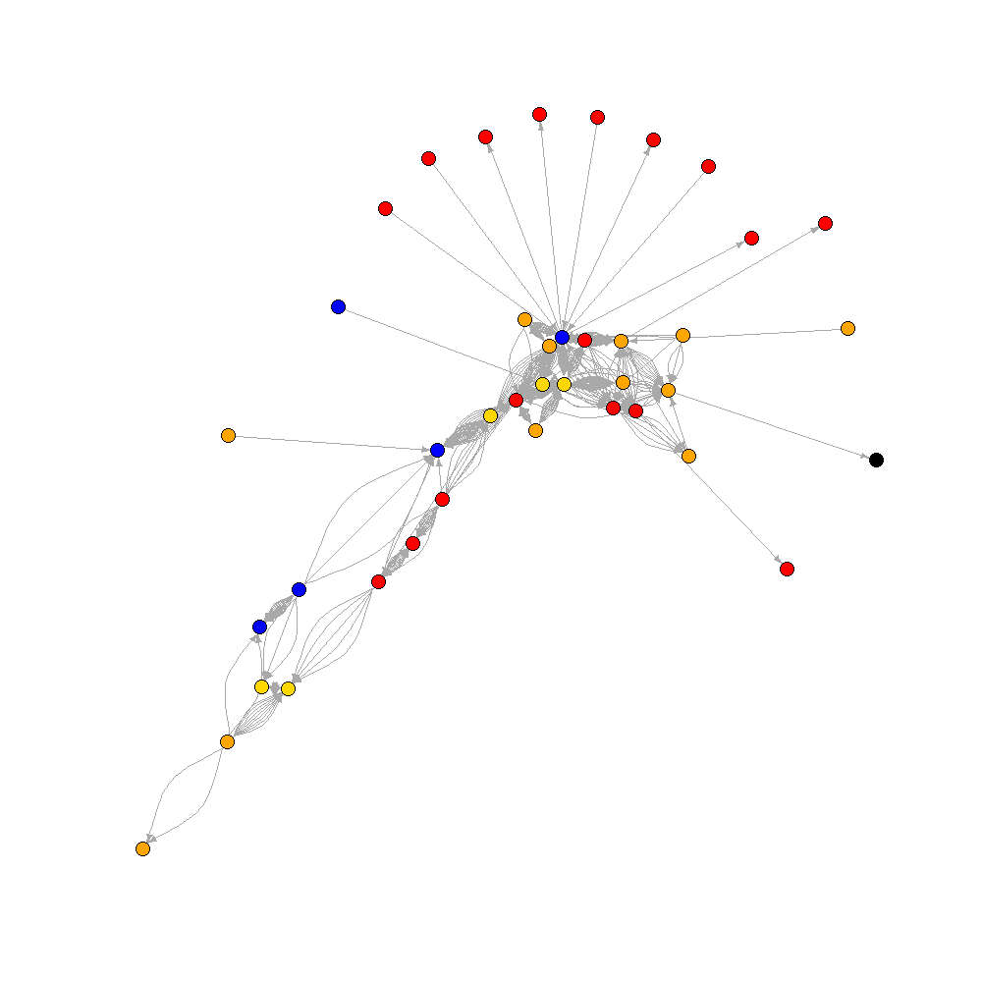
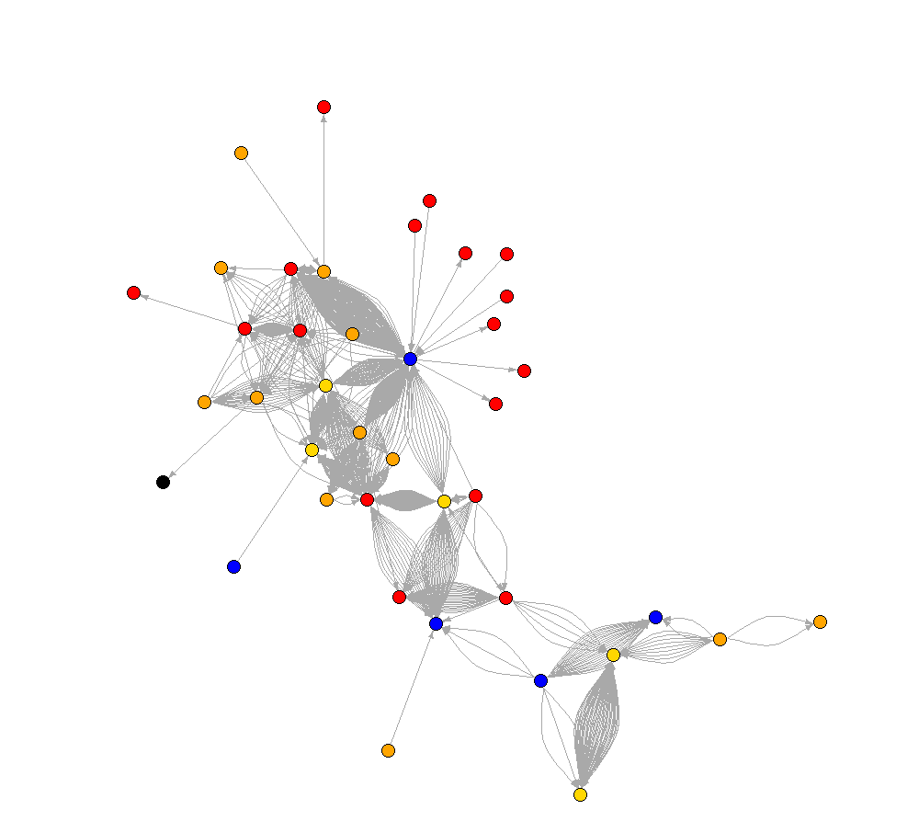
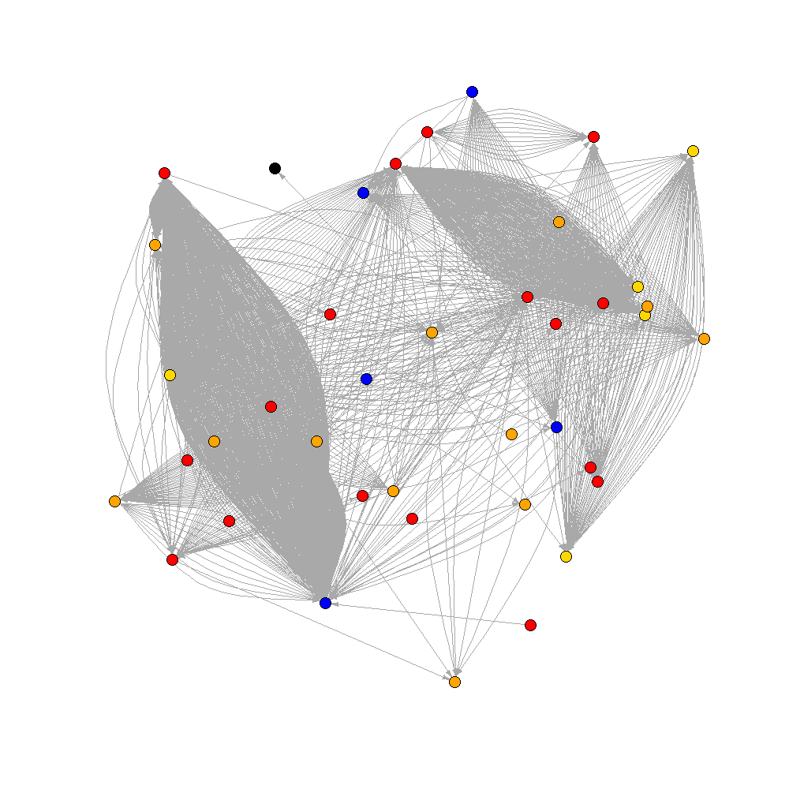
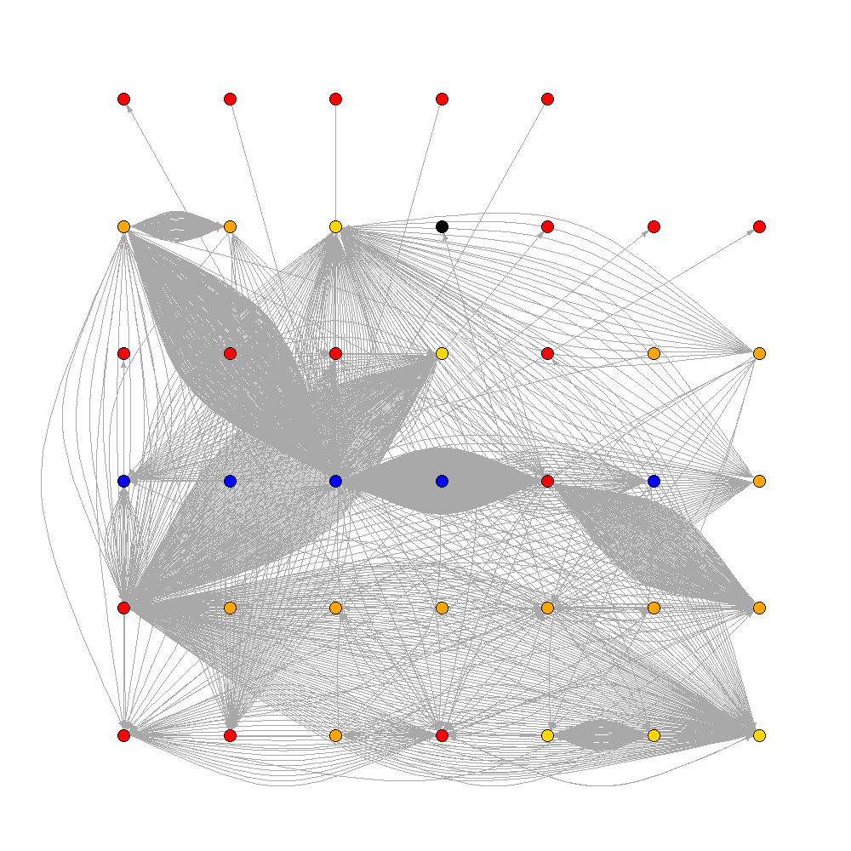
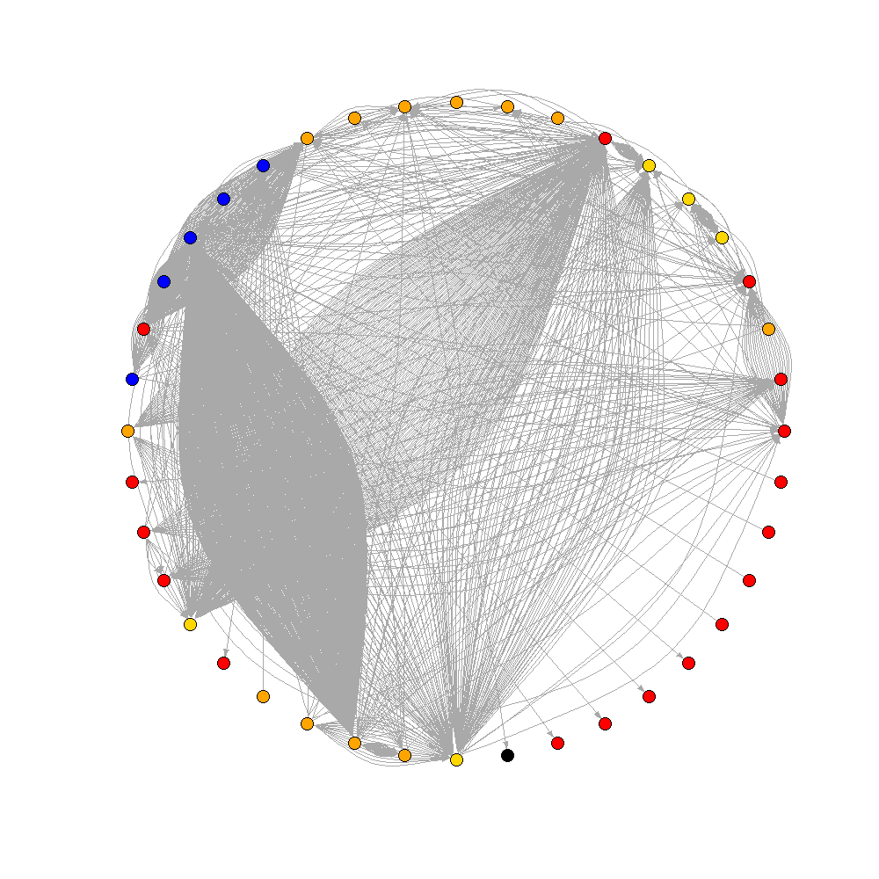
Layouts
Layout with kk
Random vs Force directed
Select based on appearance
Layout nicely
Grid
Random plot
Circle

Slide 16
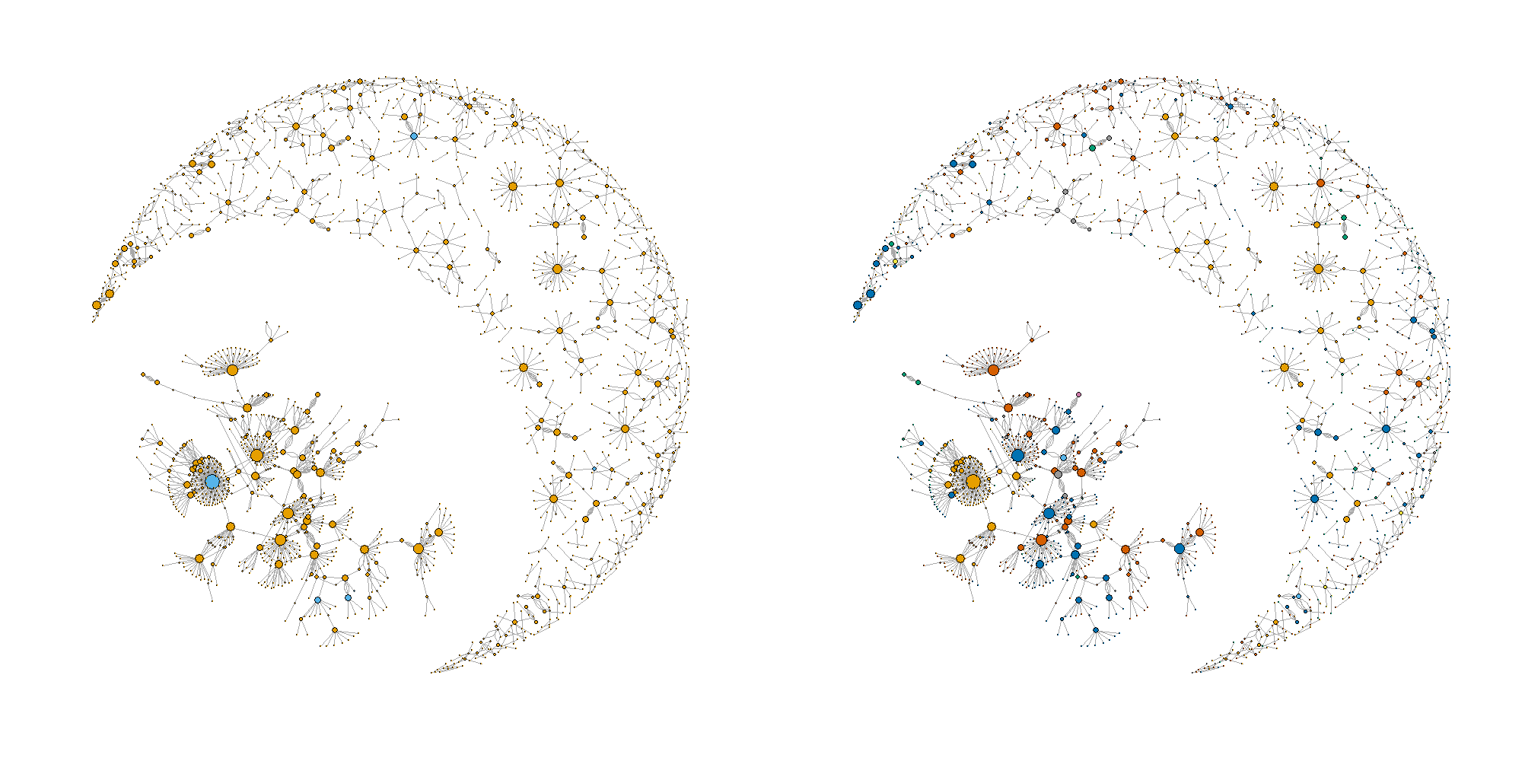
Network features
2
Farms
Markets
7
5
6
6
5
3
1
4
1 – a large community

Slide 17
Network features
2
Farms
Markets
7
5
6
6
5
3
1
4
2 – Rest of the network forming multiple smaller communities

Slide 18
Network features
2
Farms
Markets
7
5
6
6
5
3
1
4
3 – a star forming around a market which is central node

Slide 19
Network features
2
Farms
Markets
7
5
6
6
5
3
1
4 – a number of farms which only connect to one other in the community
4

Slide 20
Network features
2
Farms
Markets
7
5
6
6
5
3
1
4
5 – multiple connections between 2 nodes

Slide 21
Network features
2
Farms
Markets
7
5
6
6
5
3
1
4
6 – Stars forming around farms, trading with many smaller farms

Slide 22
Network features
2
Farms
Markets
7
5
6
6
5
3
1
4
7 – Mutualism

Slide 23
Limitations of graphing networks
Network size and legibility
No visible timeline in a static network
Doesn’t take into account spatial characteristics
Location based on network algorithm

Slide 24
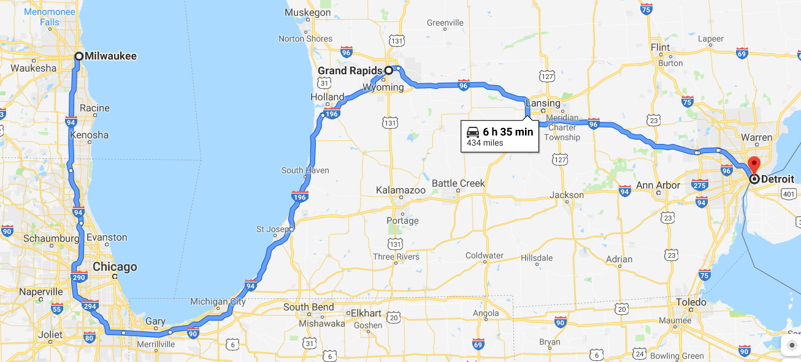
Spatial considerations
Distancia media
Eucledian vs real distance
Travel time
Spatial clustering
Of nodes
Of node attributes
Of edge extremities
Of traffic
Communities

Slide 25
Questions?
Contact: jpgo@ucdavis.edu, jnbaron@ucdavis.edu
jpablo91.github.io

