Slide 1
Software Environment Setup
Workshop on Delta Flow-Salinity Modeling Using Machine Learning
Pre-Workshop Setup Meeting, January 25, 2023
Raymond Hoang, Peyman Namadi, and Brad Tom
DWR Delta Modeling Section

Slide 2
Part B: Using Google Colaboratory (Colab)

Slide 3
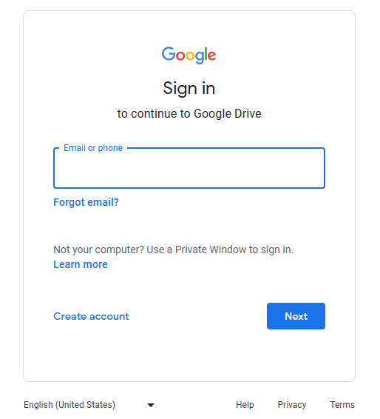
Step 1: Create a Google account or use an existing Google account and log in to your Google Drive at https://drive.google.com

Slide 4
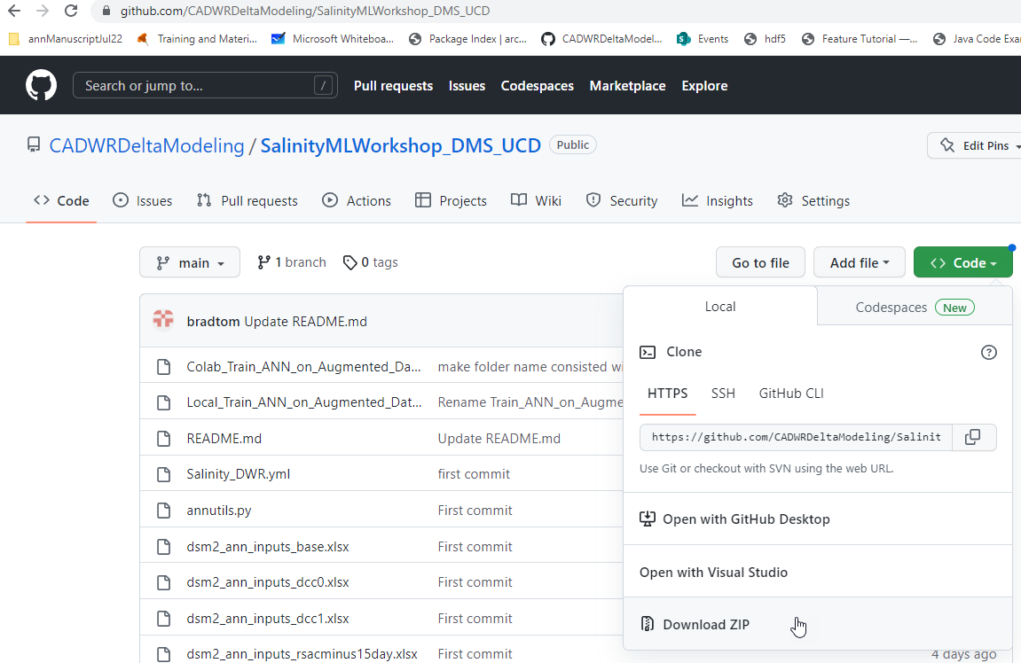
Step 2: Use this link to download the folder containing data and code: https://github.com/CADWRDeltaModeling/SalinityMLWorkshop_DMS_UCD
1
2

Slide 5
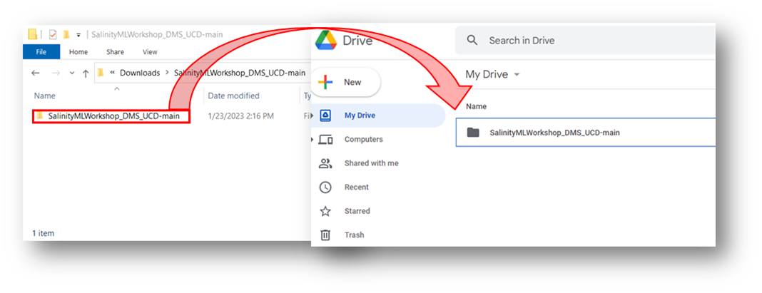
Step 3: Navigate to your download location and unzip the folder.
Step 4: Drag-and-drop the unzipped folder with the workshop content to your Google Drive’s top-level directory (i.e., My Drive/).
Note: Make sure to upload the folder containing the workshop content, not the upper-level folder containing another folder of the same name.

Slide 6
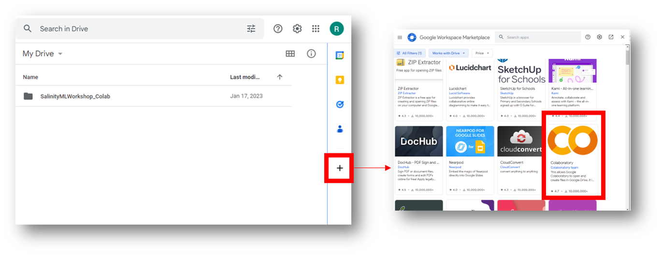
Step 5: Link the Google Colab Add-On to your Google Drive. See screenshot below. When complete, refresh your browser for the changes to take effect.
2
1

Slide 7
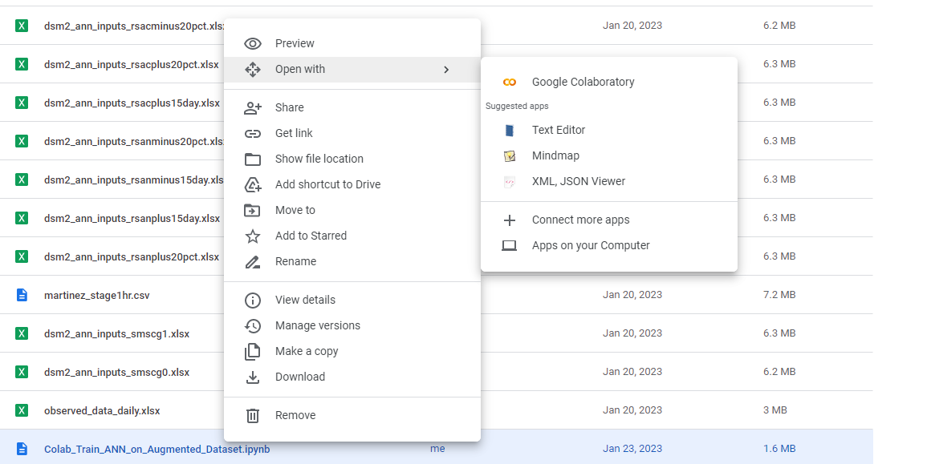
Step 6: Go into the “SalinityMLWorkshop_DMS_UCD-main” folder you uploaded and open Colab_Train_ANN_on_Augmented_Dataset.ipynb. Right-click and choose “Open With”, and then select “Google Colaboratory”.
Note: If Google Colaboratory does
not show up, you may need to refresh
your browser.
2
3
Right-Click
1

Slide 8
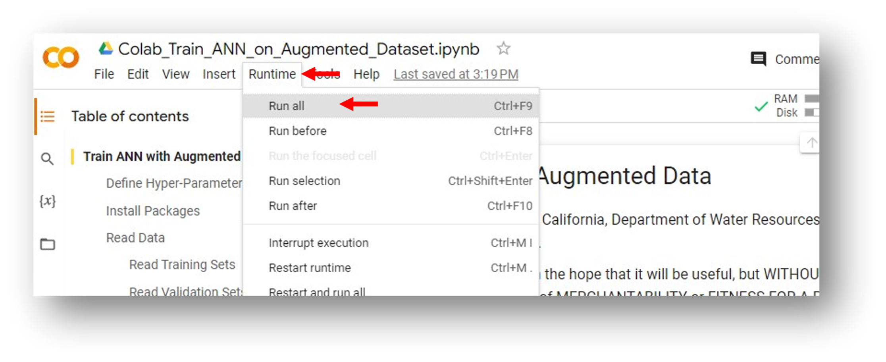
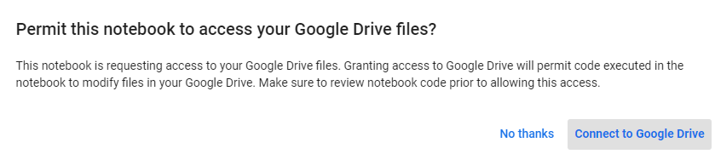
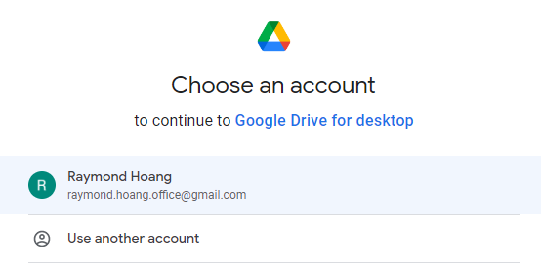
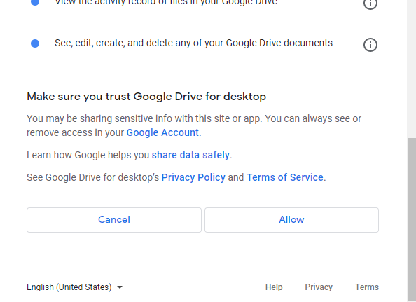
Step 7: With the script now open in Colab, run the script by clicking Runtime: Run All.
1
2
Note: during code runtime, Google Colab will request permission to access the folder – follow the prompts to allow access.
Your Account

Slide 9
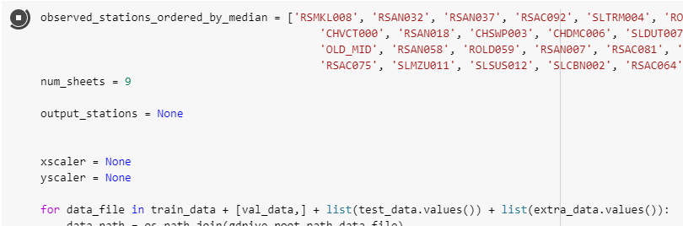
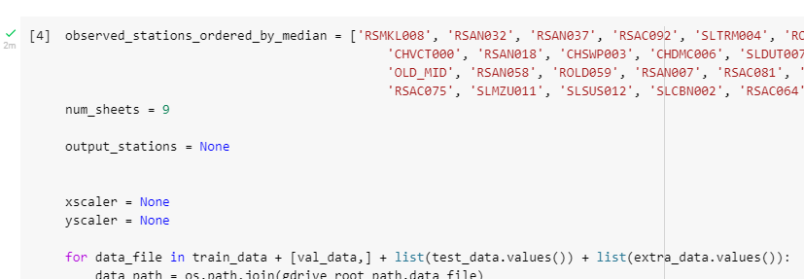
Each cell of the script should now commence running sequentially. The script will take about 10 minutes to run, depending on Colab resources.
This icon indicates the
cell is currently running
This icon indicates the
cell has completed running

Slide 10
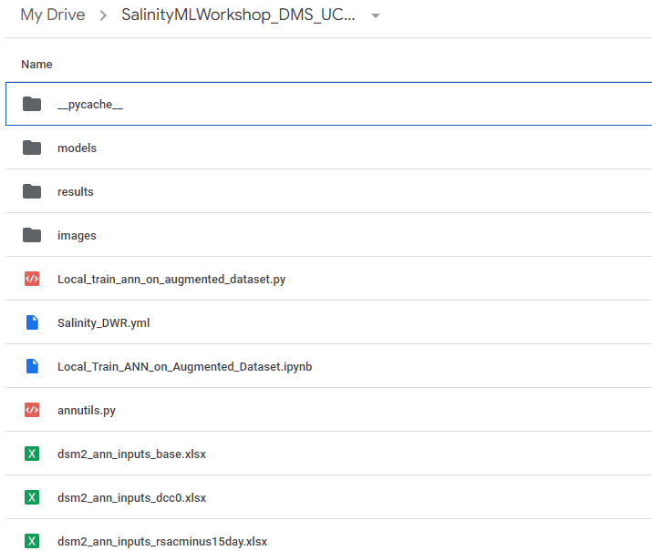
Post-Run:
Upon completion, the outputs will be in these three folders

Slide 11
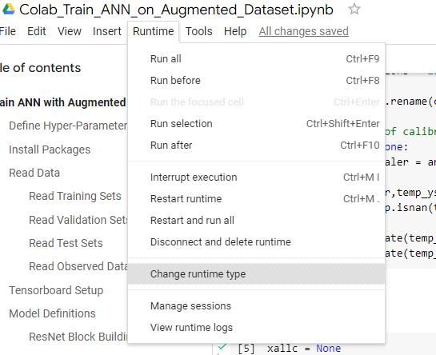
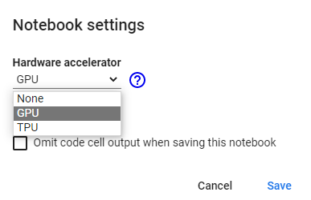
Optional Step: You may opt to use free GPU acceleration offered by Colab to decrease the run time by clicking Runtime: Change runtime type and selecting GPU. This can decrease runtimes by approximately 40%.
2
1
3
Repeat Step 7 after making these changes.

Slide 12
Questions?
Kevin.He@water.ca.gov

