Slide 1
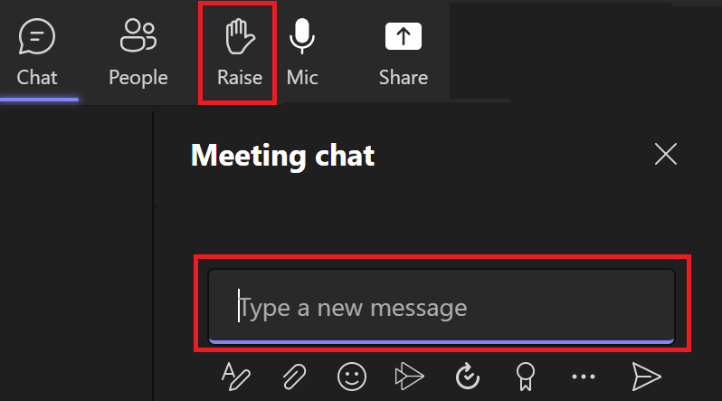
Software Environment Setup
January 25, 2023
Housekeeping Items
This meeting will be recorded in Teams
Questions
Please mute yourself if you are not talking
Workshop: 9:15am – 12:00pm, Friday, January 27
Contact: Kevin.He@water.ca.gov

Slide 2


Slide 3
Software Environment Setup
Workshop on Delta Flow-Salinity Modeling Using Machine Learning
Pre-Workshop Setup Meeting, January 25, 2023
Brad Tom, Raymond Hoang, and Peyman Namadi
DWR Delta Modeling Section

Slide 4
Part A: Local Computer

Slide 5
Prerequisites
Laptop or Desktop with Windows*
Administrative privileges
* The ML code will also run on Mac OS, Linux, and Google Colab

Slide 6
Overview
Install Miniconda¹
Create a conda environment²
Download ANN code and input data files
Run the Jupyter Notebook³ ANN code
1. Anaconda is a free, open-source platform that allows you to write and execute code in the Python programming language. Miniconda is a lightweight version of Anaconda. We recommend Miniconda because installation and setup take less time.
2. A conda environment is a folder containing a version of Python, and a specific set of python packages
3. Jupyter Notebook is a web application for creating and sharing computational documents

Slide 7
Install Miniconda/Anaconda
Miniconda: https://docs.conda.io/en/latest/miniconda.html
Anaconda: https://www.anaconda.com/products/distribution

Slide 8
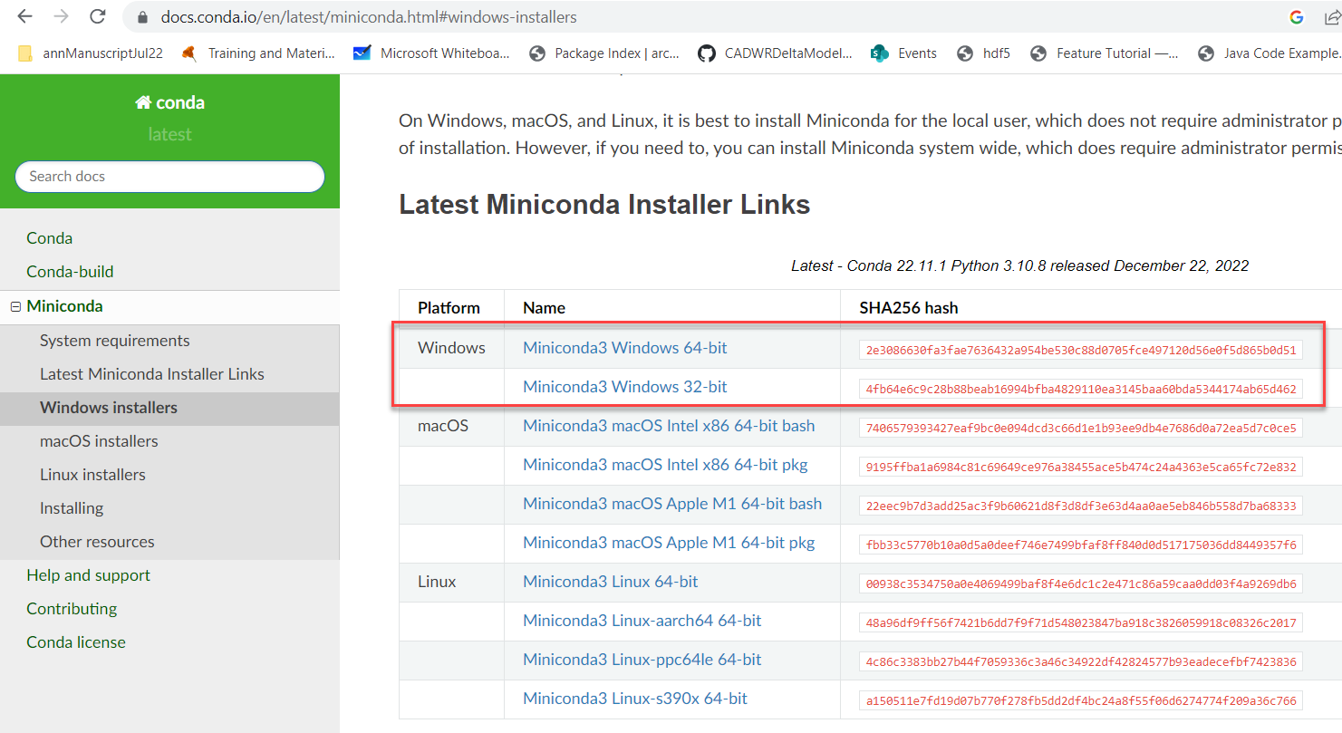
Downloading the Miniconda Installer

Slide 9
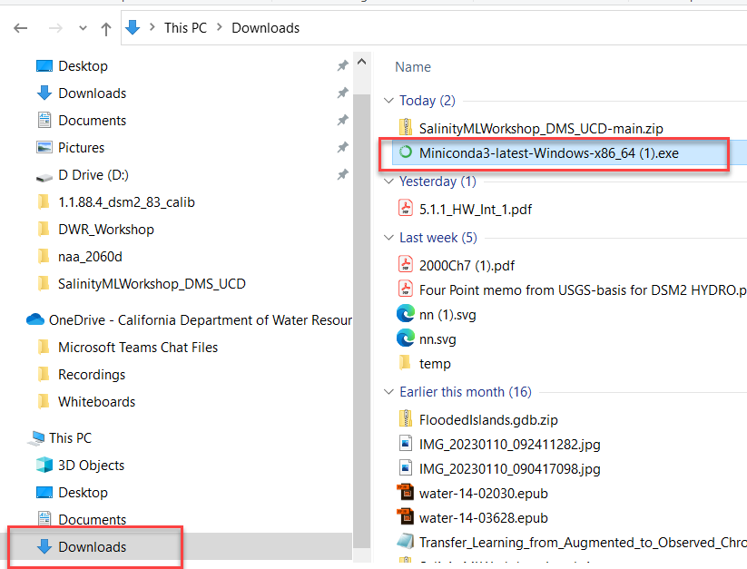
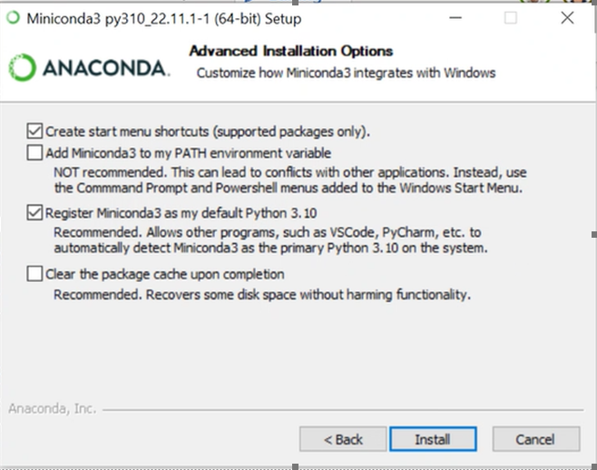
Install Miniconda

Slide 10
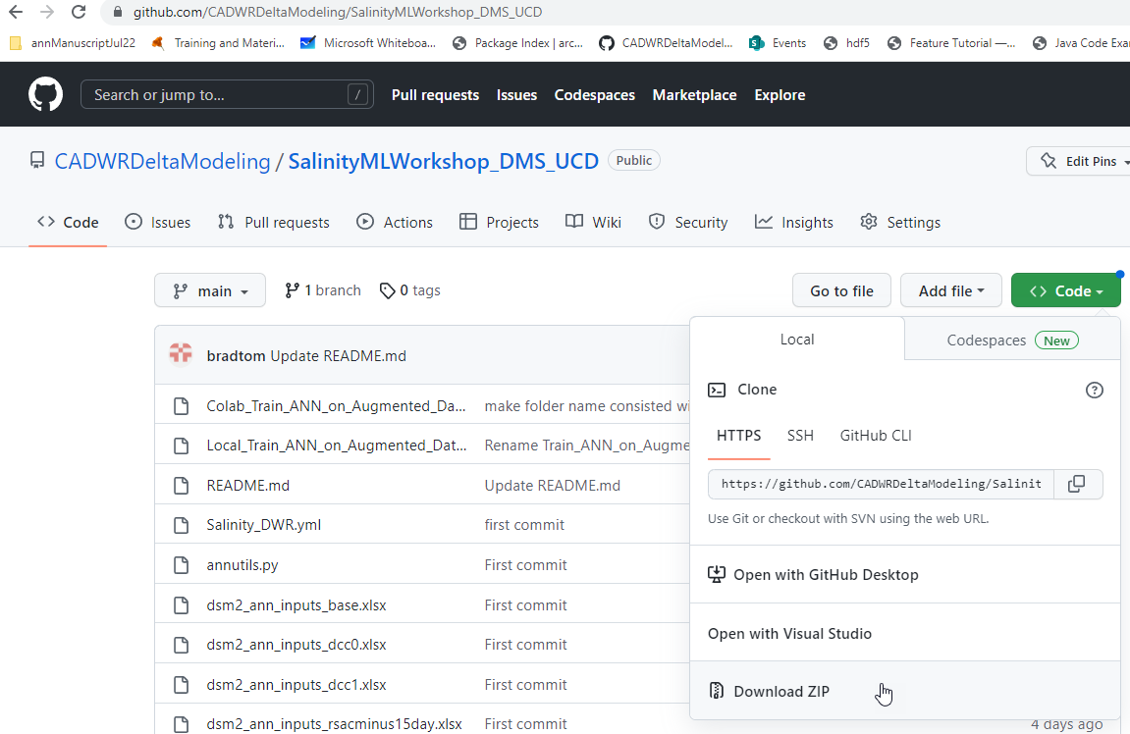
Download ML Code/Data
If you don’t have Git* installed
https://github.com/CADWRDeltaModeling/SalinityMLWorkshop_DMS_UCD
Git* is a free and open source distributed version control system

Slide 11
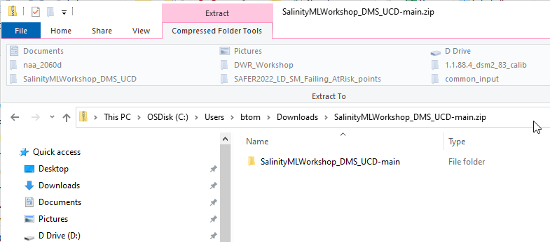
Download ML Code/Data
If you don’t have Git installed (cont)
Double click the zip file
Copy and paste the folder inside to another location

Slide 12
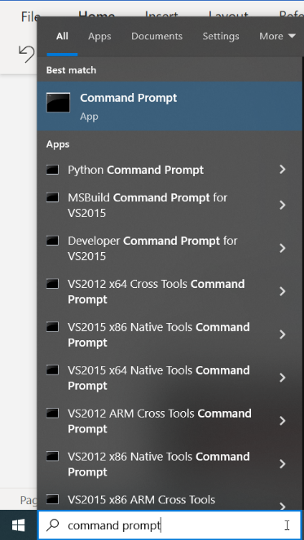
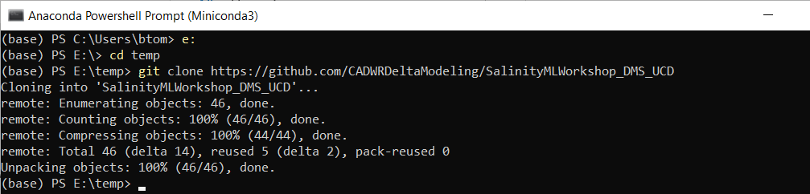
Download ML Code/Data
b) If you have Git installed
Open a command prompt window
Navigate to the location where you want to save files
git clone https://github.com/CADWRDeltaModeling/SalinityMLWorkshop_DMS_UCD

Slide 13
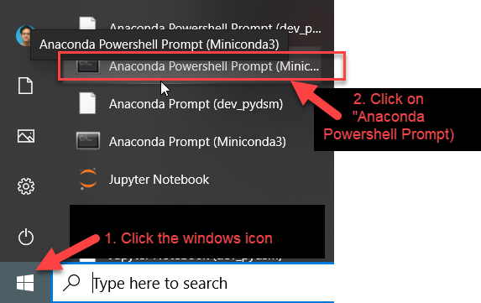
Open an Anaconda Powershell prompt

Slide 14
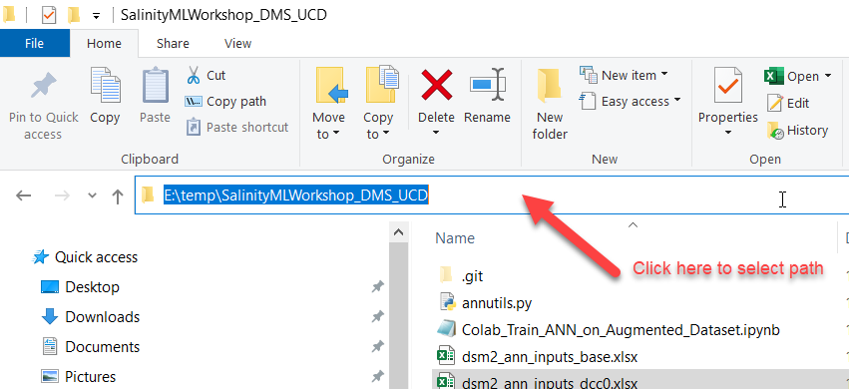
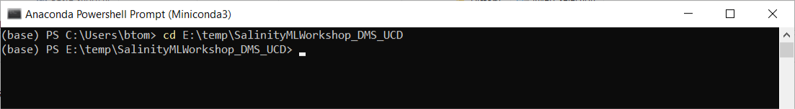
Create a conda environment
Use the “cd” command to navigate to the folder containing your code/data

Slide 15
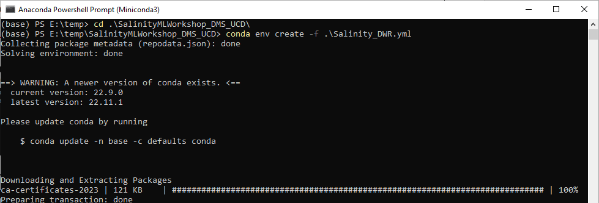
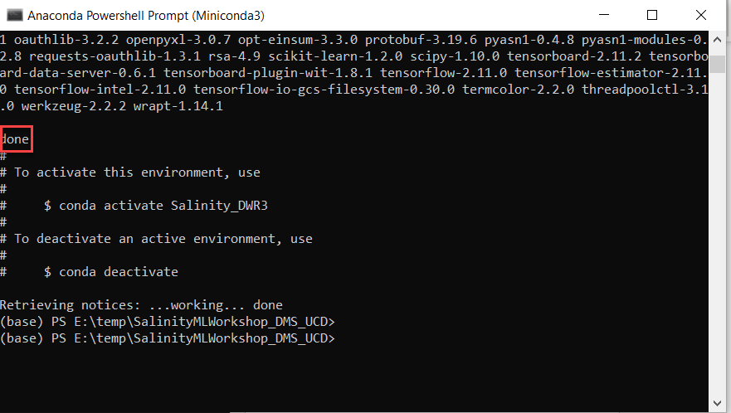
Create a conda environment
conda env create -f Salinity_DWR.yml

Slide 16
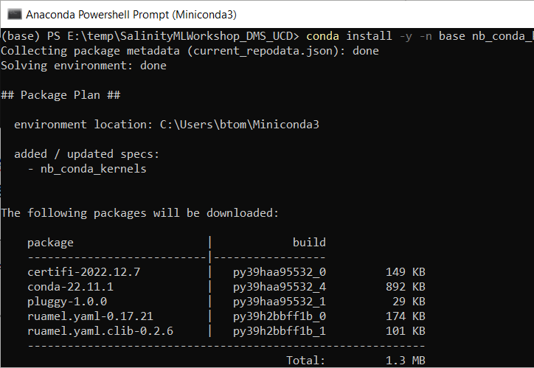
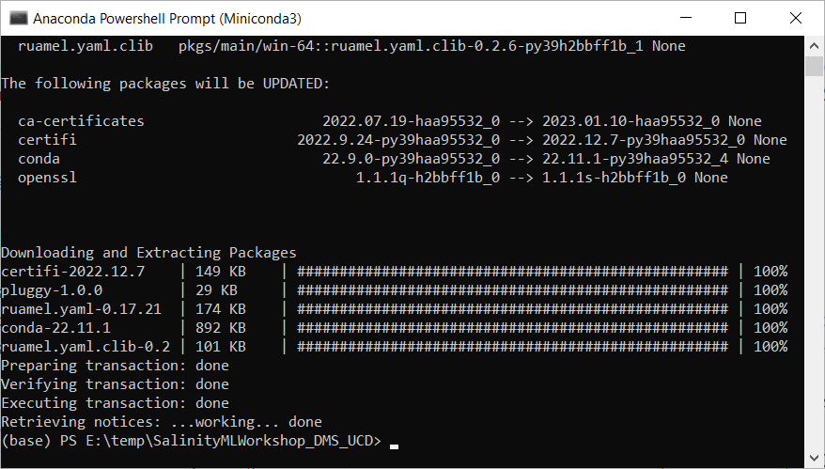
Install nb_conda_kernels
To have access to the new conda environment in a Jupyter Notebook, you need to install “nb_conda_kernels” into the base environment:
conda install -y -n base nb_conda_kernels

Slide 17
Open Jupyter Notebook
jupyter notebook
If the above command fails, try these two commands:
call conda activate jupyter
start jupyter notebook

Slide 18
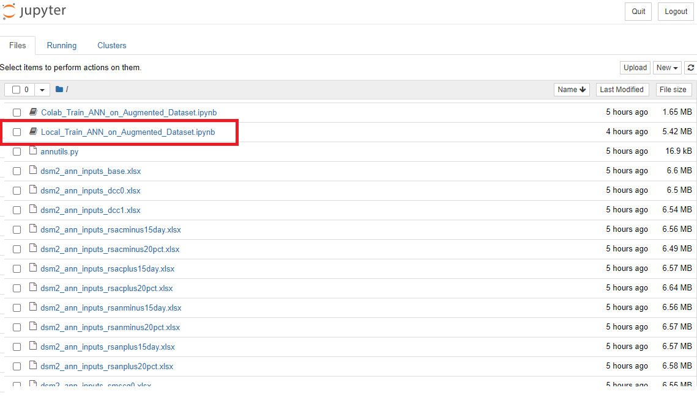
Open the ANN Jupyter Notebook
click on
Local_Train_ANN_on_Augmented_Dataset.ipynb

Slide 19
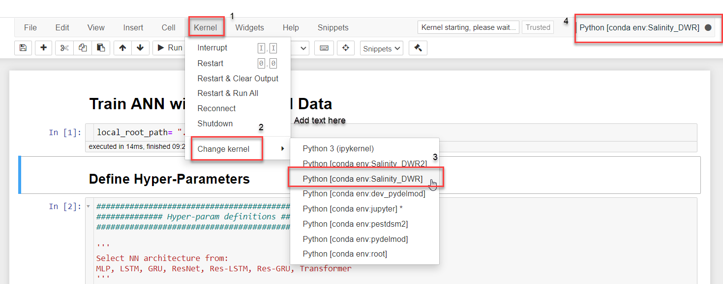
Select notebook kernel
A notebook kernel is a “computational engine” that executes the code contained in a Notebook document.

Slide 20
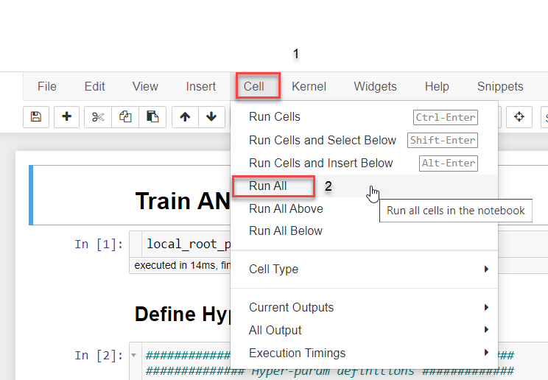
Run the notebook code

Slide 21
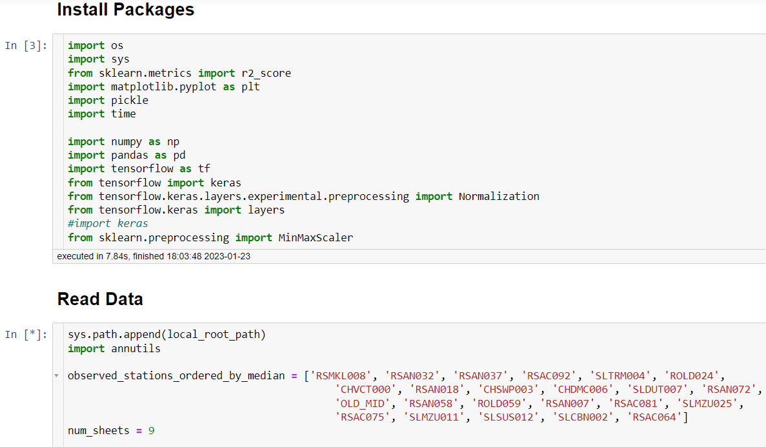
Completed cell vs running cell

Slide 22
Questions?
Kevin.He@water.ca.gov

