Slide 1

DSM2 Simulation Input and Output
DSM2 Training
September 21, 2009
Lianwu Liu PhD PE
Delta Modeling Section
California Department of Water Resources
Notes:
By Simulation Input and Output we mean boundary and initial conditions and some of the runtime I/O files.
You have already seen this a little bit getting the simple model running.

Slide 2
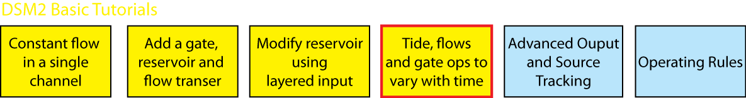
Topics
Boundary Conditions for HYDRO/QUAL
Other Time Series (gates, sources)
Initial Conditions (default, restart)
Tidefile
Time Series Output
Notes:
Here we get away from the grid and talk about the scenario specific inputs that really differentiate DSM2 runs.
The main topic is going to be time series input and output, but we are also going to touch on initial conditions and the connectivity between HYDRO and QUAL both the transfer of flow information through the tidefile and the other is the way flows and concentrations are paired.

Slide 3
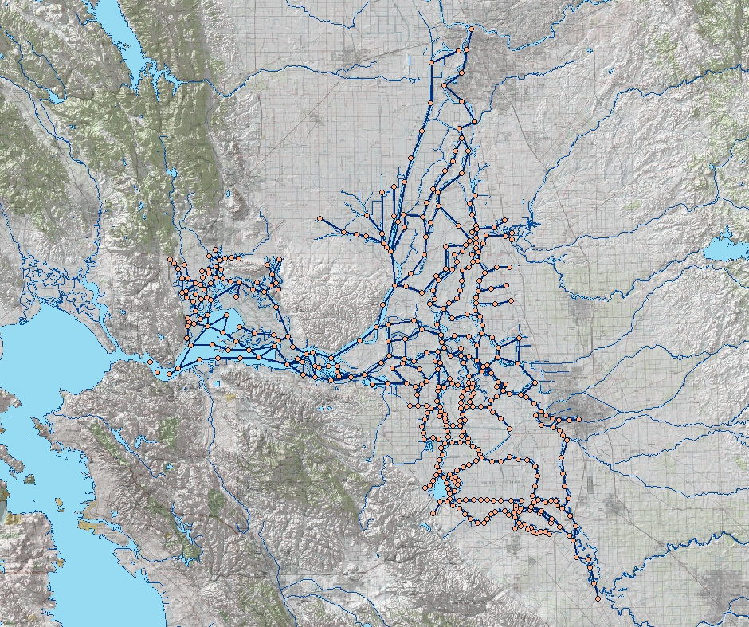
Boundary Conditions and Sources
Sacramento River
Sacramento
Inflow & water quality
Export flow
Tributaries
Delta Island Consumptive Use
Martinez
Tidal Stage & Water Quality
Stockton
Exports
San Joaquin River
Image from USBR GIS Group
Notes:
Mention Initial Conditions first, then add BC

Slide 4
Hydro Boundary Conditions
BOUNDARY_STAGE
BOUNDARY_FLOW
SOURCE_FLOW
INPUT_TRANSFER_FLOW
SOURCE_FLOW_RESERVOIR
Also:
INPUT_GATE for gate timing
Notes:
HYDRO and QUAL are numerical models and require boundary data.

Slide 5
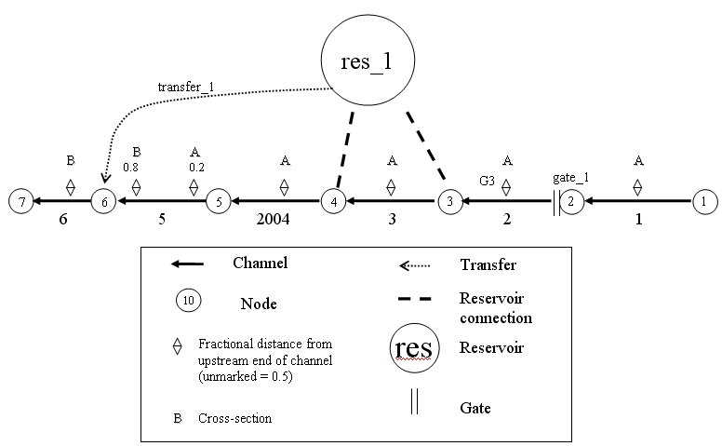
Tutorial Time Series Inputs
Notes:
For the tutorial, we have already created boundaries, but we are going to change them from constants to time series. We are also going to add the source at node 5.

Slide 6
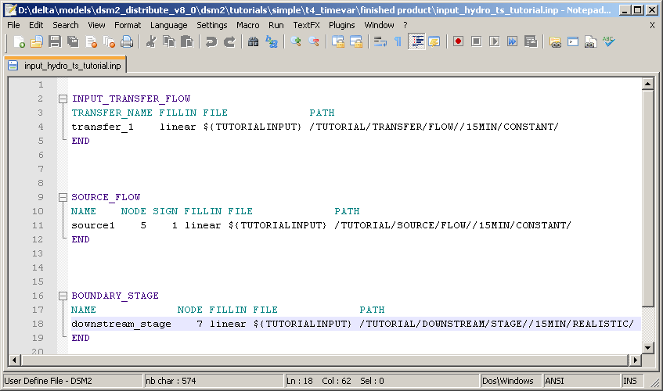
Time Series Input
Notes:
Now we know what the model needs, how do we get it in there?
In this table we are really doing two things. We are creating a boundary and we are assigning the time series that will be used to supply values (at least at the beginning).
Introduce the idea of DSS. You can mention the text format.

Slide 7
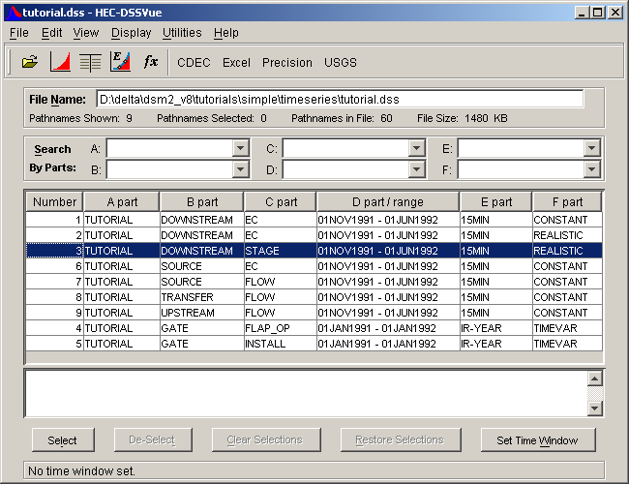
HEC-DSS file
Notes:
For most of the time series I/O we use HEC-DSS format. This is a tool produced by HEC that shows the time series stored in one file (tutorial.dss). Each row is a time series, and the data are referenced by 6 parts called a “path”

Slide 8
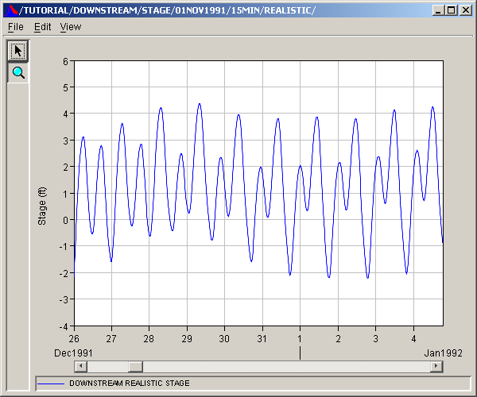
HEC-DSS file
Downstream stage time series example

Slide 9

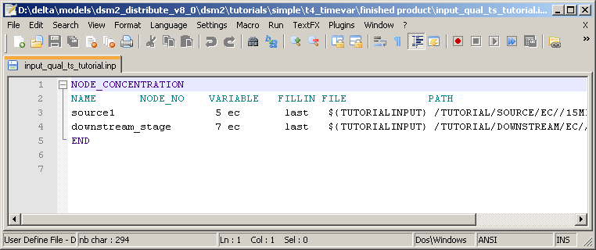
QUAL Boundary Conditions
Concentration for every inflow
Concentration for tidal boundary (inflow)
Default zero with warning
Link QUAL to HYDRO using name
Notes:
Two main interesting things:
1. Link between Hydro and QUAL
2. Only inflow matter for QUAL (if tidal like Martinez, assigned time series may be ignored part of the time)

Slide 10
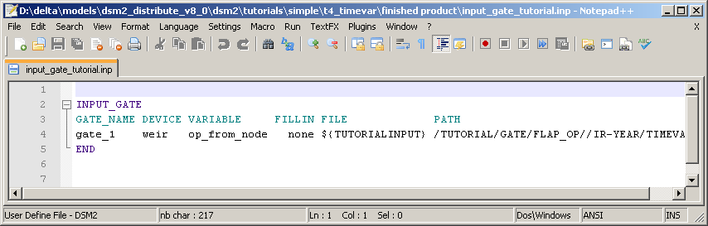
Other TS Input: Gates
Can change operational parameters
Are superseded by op rules

Slide 11
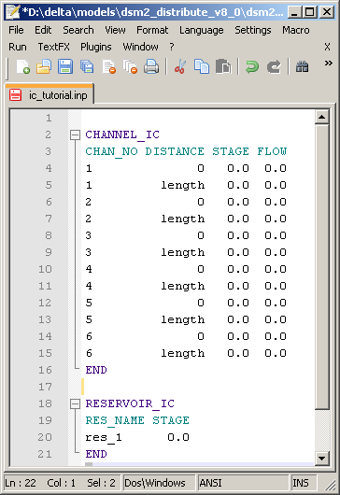
HYDRO Initial Condition Input
HYDRO Default:
CHANNEL_IC
RESERVOIR_IC
Restart file has priority

Slide 12
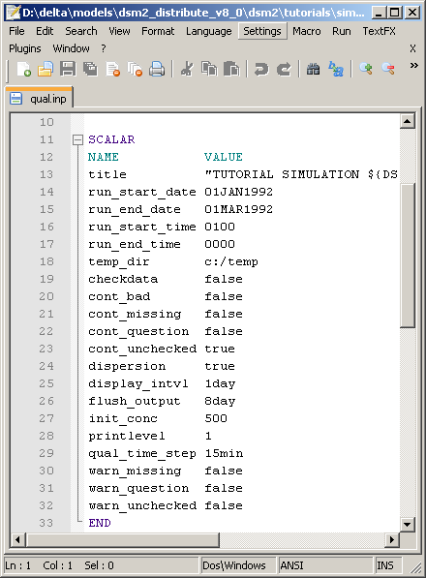
QUAL Initial Condition Input
Default:
Scalar init_conc
(cold start)
Restart files
replace the default
(warm start)
Affects source
tracking
Notes:
Single value for all locations and for all constituents. This can be really bad for DO or non-conservative runs, because there isn’t necessarily a single number that works well for all the different constituents.
Also can interfere with source tracking if it isn’t zero

Slide 13
Initial Conditions + Memory
memory
QUAL
HYDRO
days
months

Slide 14
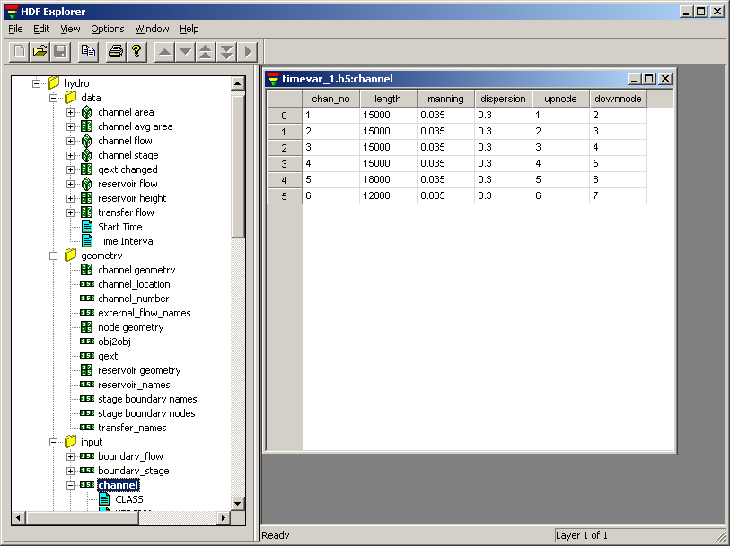
Tidefile
GRID data for QUAL (from HYDRO)
Flow field for every time step
Has own time step, spatial step (often 1hr)
HDF5 Viewer to view
Matlab
Python
Etc.
Notes:
The grid data for QUAL comes from HYDRO (this is new!!!!)
The format can be opened and looked at using off the shelf tools
The time step is less of an issue now. In version 6 it causes gross errors in PTM to use step > 15MIN

Slide 15
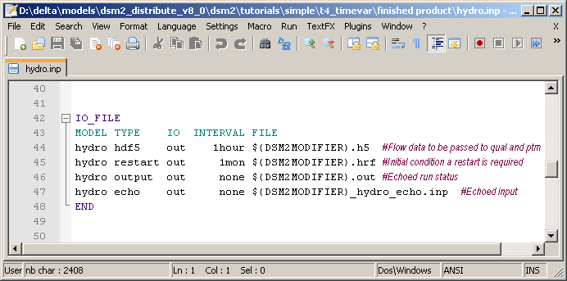
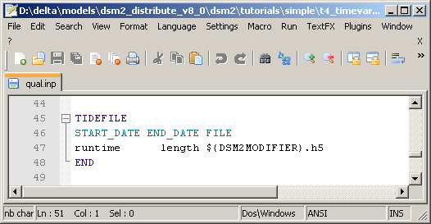
Tidefile Specifications
Create
Pass GRID and flow data
to QUAL and PTM
Use

Slide 16
Time Series Output
What can we output?
flow, stage, vel, and the name of any constituent (ec, do…)
Check out the documentation!
Formats: text and DSS
Tables
OUTPUT_CHANNEL (HYDRO and QUAL)
OUTPUT_RESERVOIR (HYDRO and QUAL)
OUTPUT_GATE
OUTPUT_CHANNEL_SOURCE_TRACK
OUTPUT_RESERVOIR_SOURCE_TRACK
Covered later
Notes:
You can find all the output possibilities in the documentation. That is how we created this slide.

Slide 17
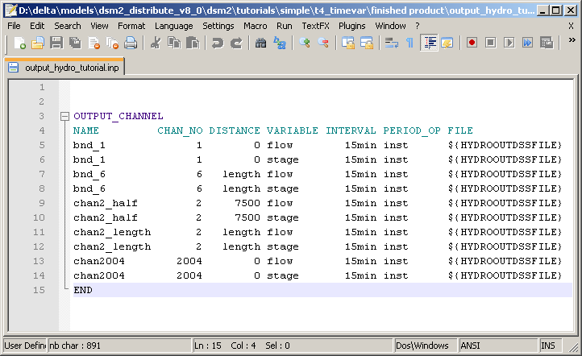
Example 1: Channel Output

Slide 18
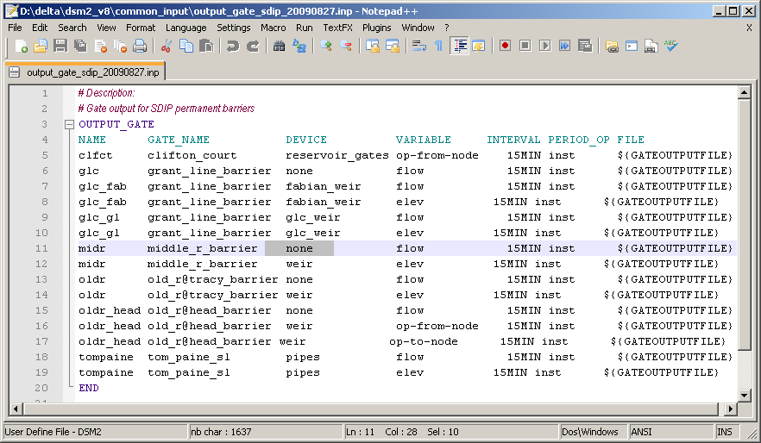
Example 2: Gate Output

Slide 19
Tutorial 4: Time Series
Replaces constant inputs with time series data, e.g. a realistic tide.

