Slide 1

Moving and Archiving Studies
DSM2 Training
September 2009
Eli Ateljevich, PhD, PE
Delta Modeling Section
California Department of Water Resources
Notes:
DSM2 Users Group: "EXAMPLE: Filling in Martinez Stage"
2004.04.27

Slide 2
Topics
Revisit configuration files and how to change them.
Get some ideas about how to save studies and make the replicable.

Slide 3
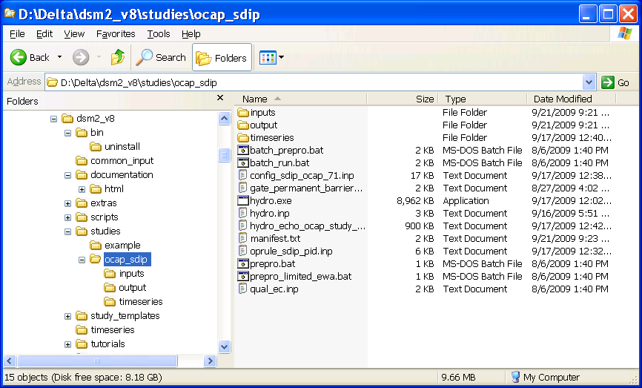
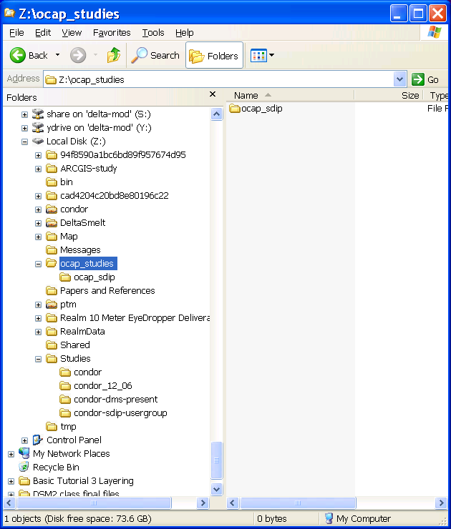
Moving a Study

Slide 4
Move Study: Configuring for New Location
In configuration file: write absolute path or use ${DSM2_HOME} for:
    TSINPUTDIR ${DSM2_HOME}\timeseries
    DSM2INPUTDIR ${DSM2_HOME}\common_input
DSM2_HOME was set by installer
To find how DSM2_HOME is currently set:
    >echo %DSM2_HOME%

Slide 5
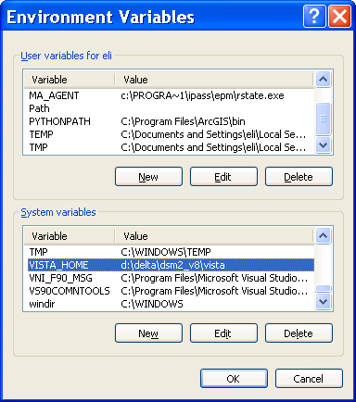
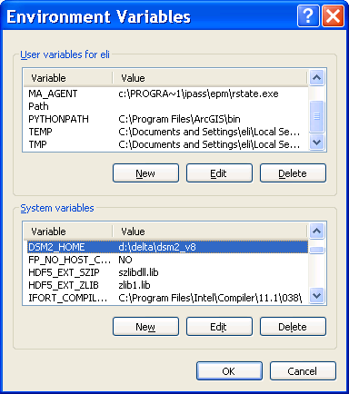
What DSM2 Installer Set
Path plus two Environment Variables
(My Computer -> Properties->Advanced->Environment Variables)

Slide 6
Moving/Changing Planning Study CalSim Input
CALSIMNAME
  (CalSim output file minus “.dss” extension)
CALSIMDIR
  (CalSim file directory)
DSM2MODIFIER for scenarios

Slide 7
Reorganizing/Scenarios
Input system points to role-specific files:
BOUNDARY_STAGE
NAME NODE … FILE PATH
mtz 361 … ${STAGEFILE} /CHAN/RSAC054/STAGE//15MIN/${STAGE_VERSION}/
END
Configuration files consolidate by default:
BOUNDARYFILE ${TSINPUTLOCAL}/${DSM2MODIFIER}.dss
STAGEFILE ${BOUNDARYFILE}
GATEFILE ${BOUNDARYFILE}
DICUFILE ${BOUNDARYFILE}
Specific studies redefine as needed:
STAGEFILE ${SEA_LEVEL_RISE_FILE}
STAGE_VERSION ${CLIMATE_SCENARIO}

Slide 8
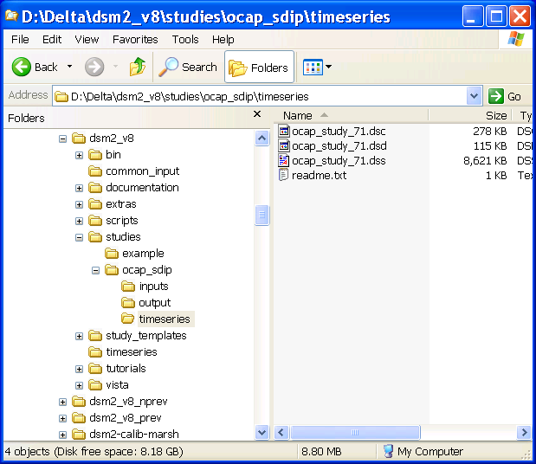
Local vs General Time Series
TSINPUTLOCAL:
Study (preprocessed CalSim scenario)
TSINPUTDIR:
General (historical or core data for preprocessing)

Slide 9
Archiving Your Work
Keep an echoed input file
Save preprocessed inputs (or protect against scripts changing)
Tidefiles (include version numbers + echo)
Use the manifest utility to list/copy all inputs:
  > manifest echofile destinyfile [copydir]
Consider copying all/most of the installation
  Learn Robocopy or RichCopy!!!!
    e.g., “move everything except folders called ‘output’ ”

Slide 10
Reviving an Archived Study
Make sure to point to the original executables (copying locally will do)
If you want to start from scratch, set DSM2_HOME at command prompt or My Computer:
>SET DSM2_HOME=z:\archive\dsm2_v8
Protect the original echo file for comparison

