Slide 1

Non-conservative Constituents Modeling
An Overview
DSM2 (v8) Class
September 15-17, 2009
Hari Rajbhandari, Ph.D., P.E.
Delta Modeling Section
California Department of Water Resources
Notes:
Hello,
For the past 2 years, I’ve been actively involved in modeling water quality using DSM2 for several of the In-Delta Storage studies that have passed through our shop.
Now in that time, each study has been more refined than the previous. This morning I’m going to present the results of my most recent DSM2 simulation (which I just completed this weekend).
But instead of focusing on this one study, if you only remember two things from my presentation, I’d like it to be:
That DSM2 uses hydrologic input from other models (CALSIM or spreadsheet based operations models). Changing the operations will change the water quality results.
Generally, water released from the project islands heads south. Key Words: Water heads south.

Slide 2
Overview
Background and Processes
Example Validation Results
Input

Slide 3
DISSOLVED OXYGEN ETC.
Adequate DO necessary for good water quality
As DO levels drop below 5 mg/l, aquatic life is put under stress: Lower the concentration, greater the stress.
O2 levels that remain below 1-2 mg/l for a few hours can result in large fish kills.
High ammonia can be toxic

Slide 4
DO, T Modeling Basics
Processes affecting mass balance
  Advection
  Diffusion / Dispersion
  DO Kinetics / Interaction
    Details in next slide
Heat Exchange

Slide 5
DO Sources and Sinks
Heat Exchange
Atmospheric Reaeration
Air-Water Interface
Organic-N
DISSOLVE
D
OXYGEN
B
BS
B
NH3
CBOD
O
B
NO2
Organic-P
O
B
B
NO3
Dissolved-P
R
P
M
G
G
Algae
R
BS
R
s
s
s
BD
Sediment

Slide 6
Heat Exchange Process
Longwave back
radiation
Longwave atmospheric
radiation
Solar radiation
Loss due to evaporation
Conduction
Channel or
Reservoir
Inflow
Outflow

Slide 7
Boundary Conditions
Martinez: Hourly data from 1983-1991 (IEP)
Sac River: Hourly data at Freeport (1999-) (IEP)
San Joaquin: Hourly data at Mossdale from 1984-1991 (IEP)
SJR TMDL Studies
National Weather Service
DWR
USGS Reports
City of Stockton

Slide 8
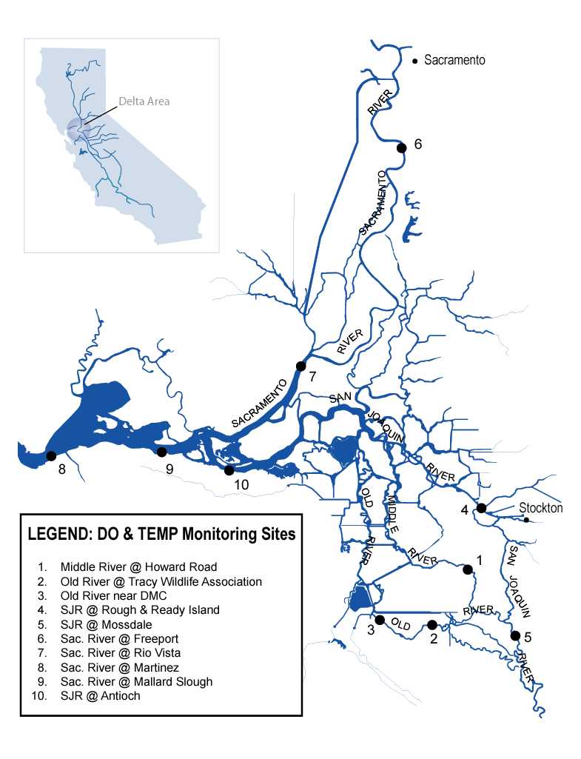
DO, Temperature Monitoring Sites

Slide 9
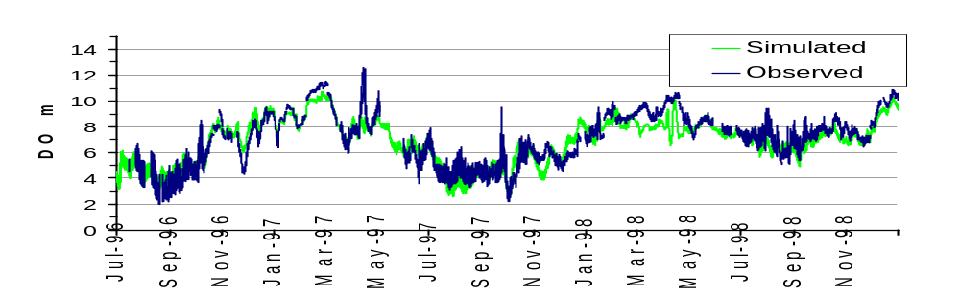
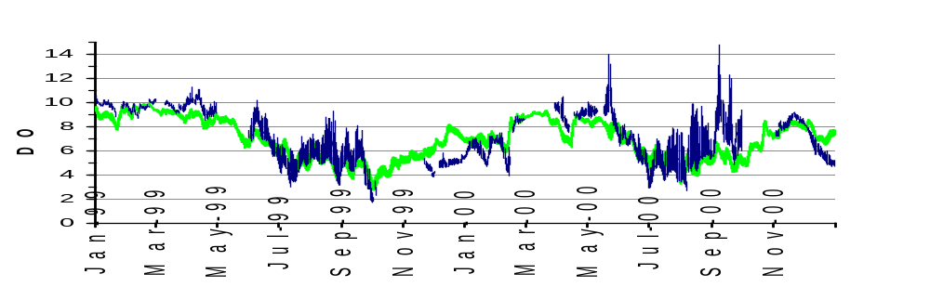
Dissolved Oxygen, Ship Channel (RRI)
3/36

Slide 10
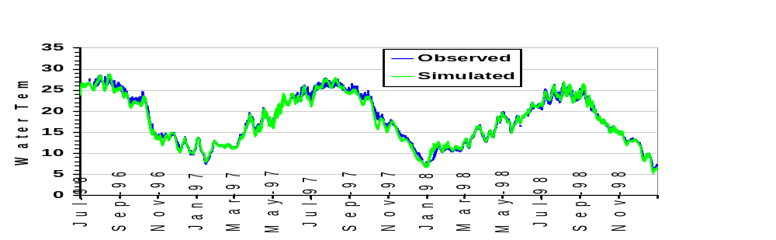
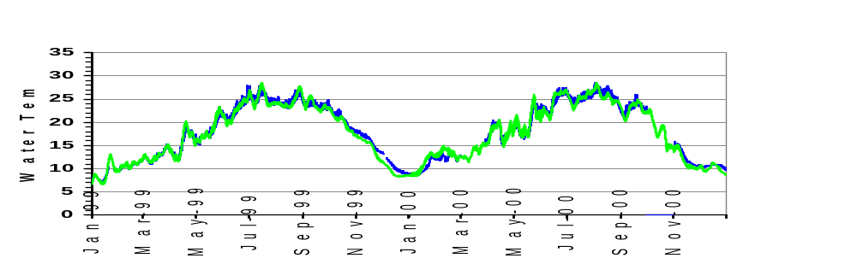
Temperature, Ship Channel (RRI)
3/36

Slide 11
Boundary Flows
DSM2-HYDRO
Delta Barriers
Martinez Tide
Ag Flows &
Returns
DSM2-QUAL
River T, DO
nutrients
Ag DO, T, nutrient
Climate data
DO, Temperature at channels

Slide 12
REACTION RATE COEFFICIENTS
Rates that can vary by location are given in
RATE_COEFFICIENT Tables
---algal growth rate
---BOD decay rate
Rates that do not vary by location are given in SCALAR Tables.
---O2 produced per unit of algal growth
---O2 used in oxidization of NH3 to NO2

Slide 13
RATE COEFFICIENT Table
RATE_COEFFICIENT
GROUP_NAME CONSTITUENT VARIABLE VALUE
chan_10_15 algae alg_die 0.2
chan_10_15 algae alg_grow 1.5
chan_10_15 algae alg_resp 0.15
chan_10_15 algae settle 0.2
chan_10_15 bod decay 0.12
chan_10_15 bod settle 0.0
…
END

Slide 14
SCALAR Entries for NCC
# qual global parameters
# nutrients & algae related
algaefract_n 0.09 # fraction of algae as Nitrogen
algaefract_p 0.012 # fraction of algae as Phosphorus
# oxygen related
oxy_photo 1.60 # Oxygen produced per unit of algal growth
oxy_resp 2.0 # O2 uptake per unit of algal respiration
oxy_nh3 3.0 # Oxygen used in oxidation of NH3 to NO2
oxy_no2 1.14 # Oxygen used in oxidation of NO2 to NO3
# algae related
alg_chl_ratio 10.0 # Chlorophyll to biomass ratio
pref_factor 0.5 # algal pref. factor for NH3
klight_half 0.085 # MM half-saturation constant for light
knit_half 0.05 # MM half-saturation constant for nitrogen
kpho_half 0.04 # MM half-saturation const. for phosphorus 199,200
kpho_half 0.01 # MM half-saturation const. for phosphorus
lambda0 0.26 # Non algal light extinction coefficient
…
See scalar_qual_do_parameters .inp

Slide 15
Info on DSM2 DO Validation and Kinetics
http://modeling.water.ca.gov/delta/reports/annrpt/1998/1998Ch3.pdf
http://modeling.water.ca.gov/delta/reports/annrpt/2001/2001Ch6.html
http://modeling.water.ca.gov/delta/reports/annrpt/2003/2003Ch3.pdf

Slide 16
Contact Information
hari@water.ca.gov
(916) 657-5171
Modeling Support Website:
http://baydeltaoffice.water.ca.gov/modeling/

