Slide 1
DSM2UG

Slide 2

DSM2 User Group Intro and Support
DSM2 Training
September 22, 2009
Min Yu, P.E.
Delta Modeling Section
California Department of Water Resources

Slide 3
Outline
Overview
DSM2UG objective
DSM2UG activities
Technical support
Questions
Issues
Features

Slide 4
Overview
DSM2UG initiated in Jan. 2004
A well-established model user group with 50⁺ members
Becoming a member

Slide 5
DSM2UG Objective
To promote the exchange of ideas, information, and issues involving the use of DSM2 and/or the development of any newer version of DSM2 in the future.

Slide 6
DSM2UG Activities
Three
meetings
a year
One
summer
newsletter
Website
&
DSM2-User mailing list

Slide 7
DSM2UG Website
http://baydeltaoffice.water.ca.gov/modeling/deltamodeling/dsm2usersgroup.cfm

Slide 8
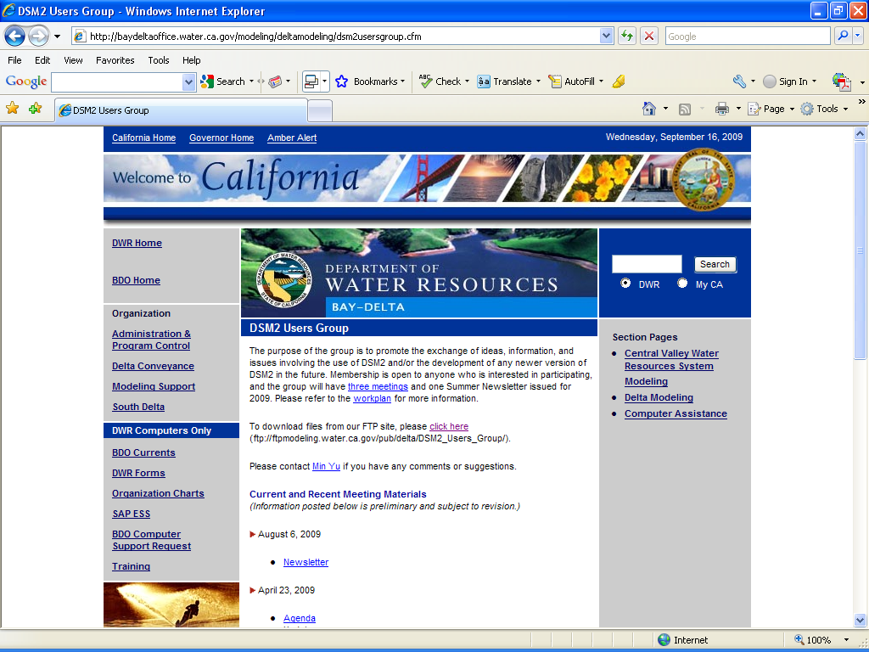
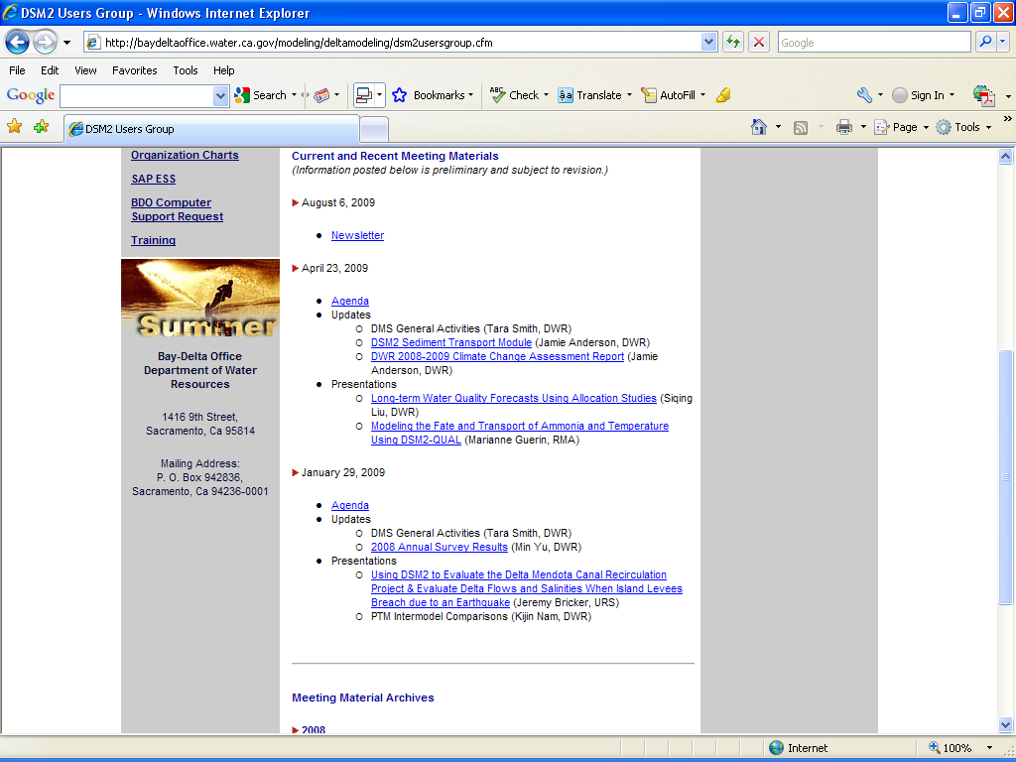
DSM2UG Website

Slide 9
DSM2-User Mailing List
To subscribe
http://listhost2.water.ca.gov/mailman/listinfo/dsm2-user
To view archived messages
http://listhost2.water.ca.gov/pipermail/dsm2-user/
To post a message
Type dsm2-user@water.ca.gov in the "To:" line.
To reply
Click "Reply" to send the msg to the original poster
Click "Reply All” to send the msg to everyone on the list

Slide 10
Technical Support
Email questions to Min directly
Questions will be assigned to a staff member
Send an email to DSM2-User mailing list
Staff members and other users will review and respond
Min will email you back with an answer
Questions

Slide 11
Technical Support
Issues
How to report issues

Slide 12
Technical Support
Issues
How to report issues
Email Min (minyu@water.ca.gov);
Issues will be assigned &
go into the issue tracking system
Report version of DSM2 module
Use command “mark, copy, paste” rather than a screen shot
Provide background, especially how your work alters standard templates

Slide 13
Technical Support
Features
How to request features
Email Min (minyu@water.ca.gov);
Requested features will get put in a cue
in the issue tracking system

Slide 14
Contact
Min Yu
Delta Modeling Section
minyu@water.ca.gov
916.653.5225

