Slide 1

Channels
DSM2 Training
Fall, 2009
Eli Ateljevich, PhD
Delta Modeling Section
California Department of Water Resources

Slide 2
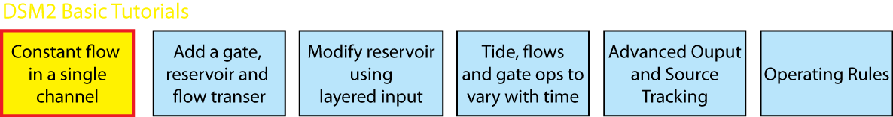
Topics
Channel networks and geometry
Computational grid
Geometry nuances
Model setup and parameters
New in version 8
Gotchas
Tutorial 1 Intro

Slide 3
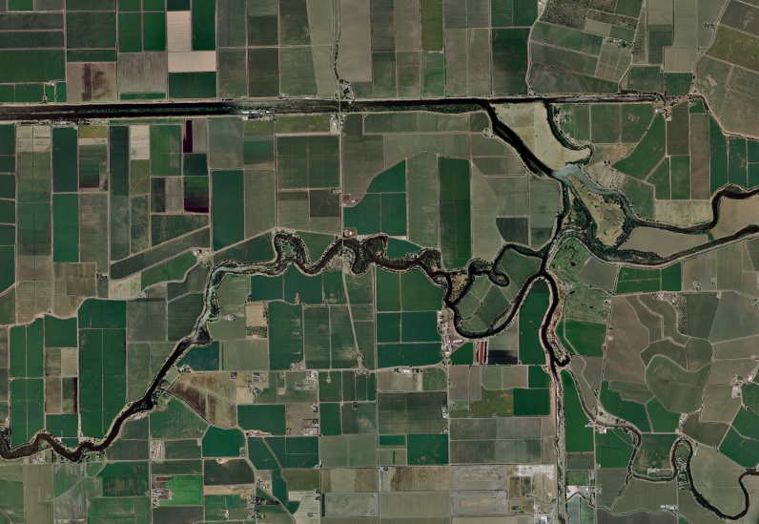
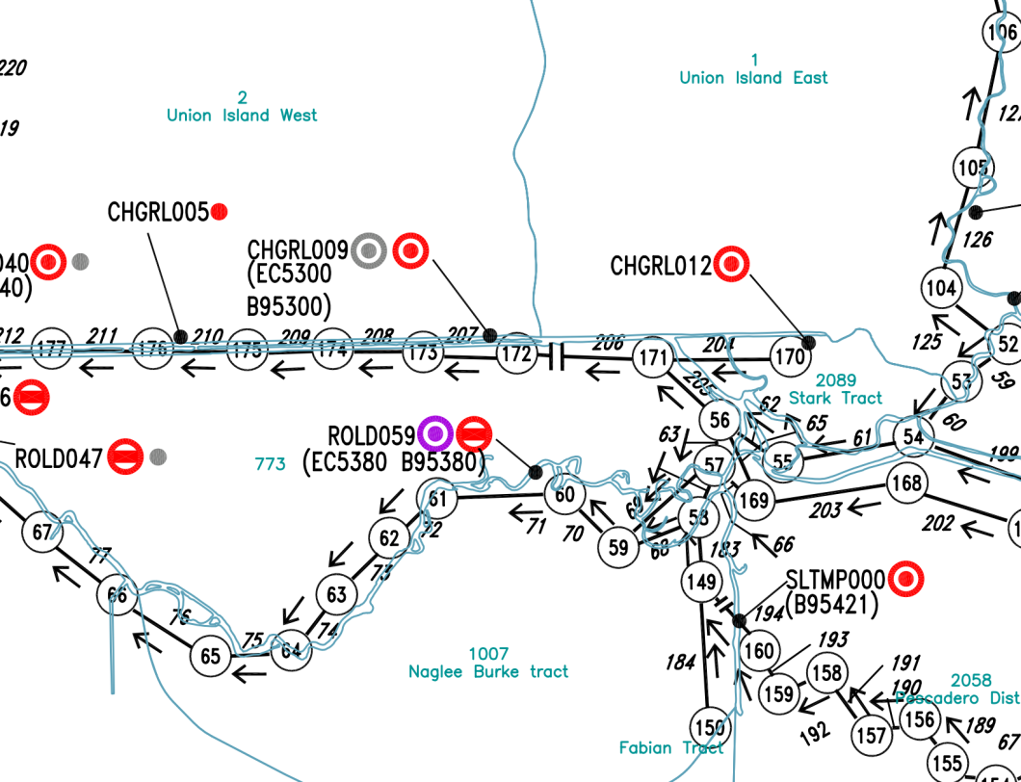
Channel Network

Slide 4
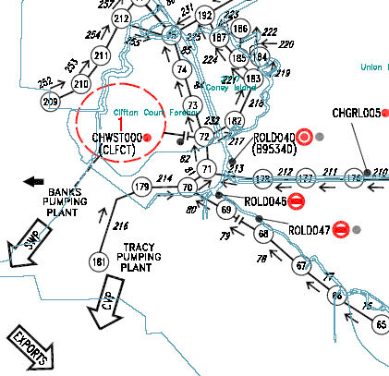
Channel Network
Channels and nodes
Direction “mostly” seaward/downstream
Node
68
Channel
Down
78
67
Up

Slide 5
CHANNEL Table
Network connectivity
Friction and Dispersion
CHANNEL
CHAN_NO LENGTH MANNING DISPERSION UPNODE DOWNNODE
1 15000 0.035 0.3 1 2
2 15000 0.035 0.3 2 3
3 15000 0.035 0.3 3 4
2004 15000 0.035 0.3 4 5
5 18000 0.035 0.3 5 6
6 12000 0.035 0.3 6 7
END

Slide 6
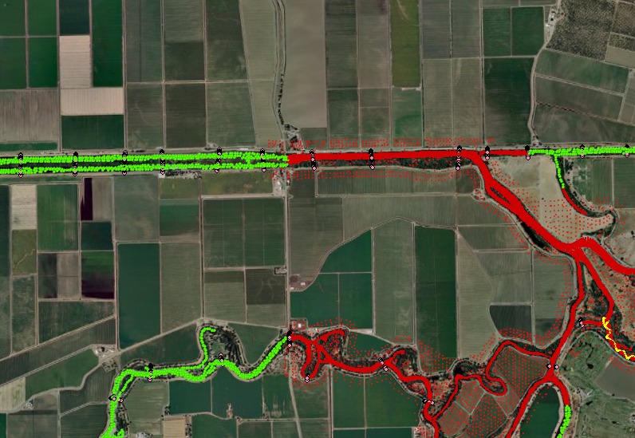
Channel Geometry
Distance along Channel
Cross-section

Slide 7
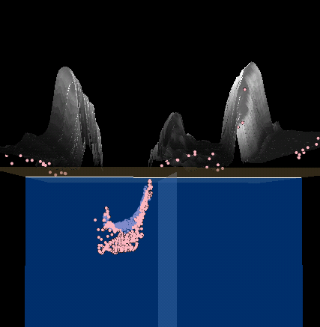
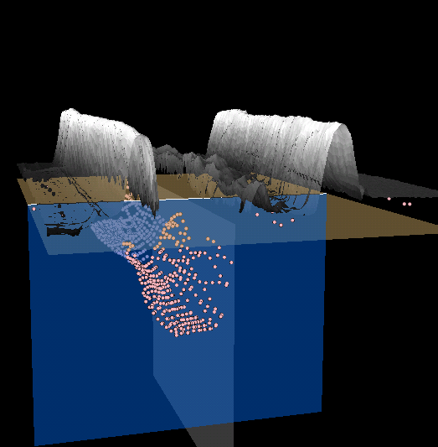
Channel Geometry

Slide 8
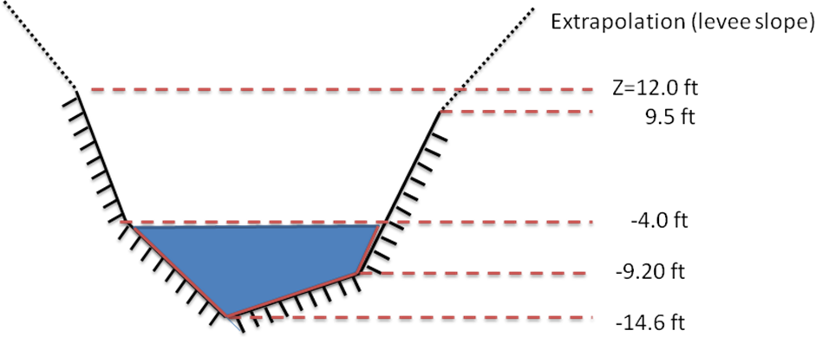
How DSM2 Depicts Geometry
XSECT_LAYER
CHAN_NO DIST ELEV AREA WIDTH WET_PERIM
123 0.5 -14.6 0.0 0.0 0.0
123 0.5 -9.2 216.0 80.0 102.5
123 0.5 -4.0 736.0 120.0 141.0
123 0.5 9.5 2410.0 160.0 182.3
123 0.5 12.0 3028.5 162.0 198.0
END

Slide 9

Discretization in HYDRO
User requests a spatial step ΔX
Nodes/reach length affect ΔX :
Actual ΔX smallest subdivision ≥ requested
Computational points
Geometry interpolated to comp points and centers

Slide 10
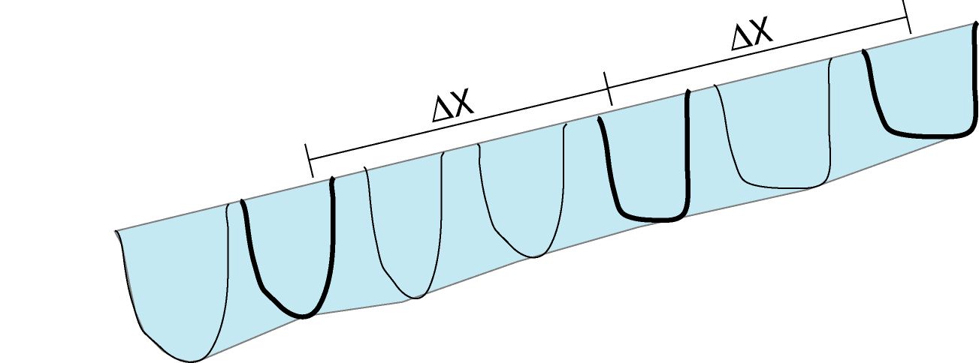
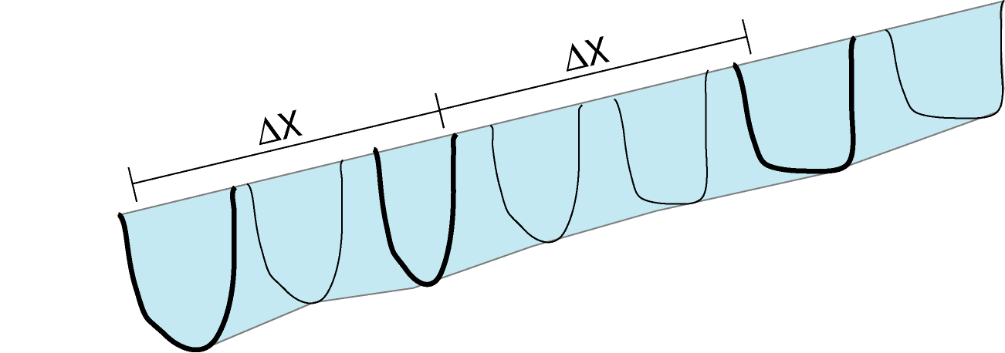
User vs Computational

Slide 11
Interpolation Rules?
Every channel must have one x-sect.
Interpolation is done between x-sects.
If dead end or multi-channel node, the last available X-sect is extended.
Interpolation is linear and based on height from bottom

Slide 12
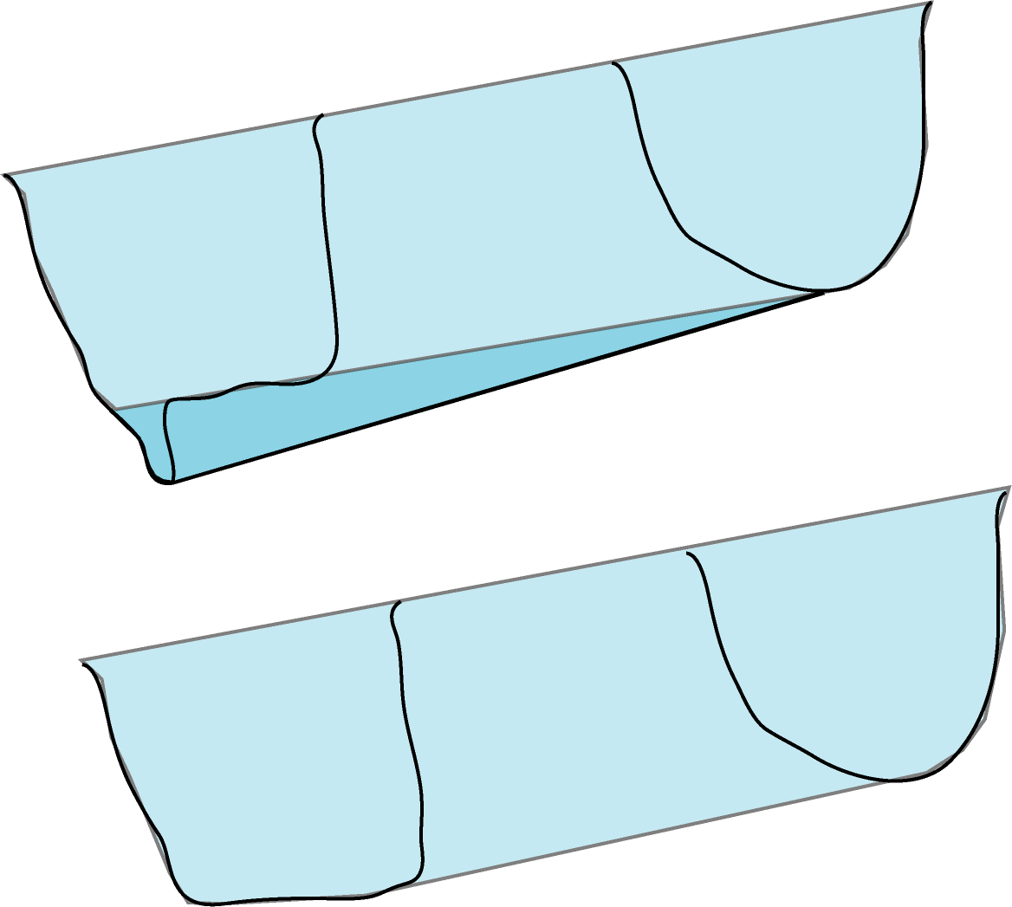
Height-based Interpolation
Desired bottom elevation
Interpolated elevation
Adjusted Xsect
Similar volume

Slide 13
Geometry Gotchas
Providing more x-sects than the model can use.
Including unusual x-sects instead of representational
Uneven bottom elevations due to “pits”

Slide 14
Other Channel Data
Friction (Mannings n)
Dispersion (out of scope for this class)
IS flow dependent
Is NOT classic Dispersion
See Annual Report Chapter

Slide 15

DSM2 Cool Tip
Annual Reports to SWRCB
http://baydeltaoffice.water.ca.gov/modeling/deltamodeling/annualreports.cfm
QUAL dispersion coefficients 2008 CH2
82-year planning tide 2007 CH4
SDIP gates 2006 CH6
PTM for fish entrainment 2006 CH10
Fingerprinting 2005 CH6, 2002 CH14
Net Delta Outflow calcs using DSM2 & CalSim 2003 CH4
Adjusted astronomical tide 2001 CH10
SWRCB = State Water Resources Control Board SDIP=South Delta Improvements Program PTM = Particle Tracking Model

Slide 16

Model Setup for Channels
Specify connectivity in CHANNEL table
Also Manning and dispersion
Two allowed formats for X-sects
Xsect-Layer (single file format)
Cross Section Development Program
(references to csdp files)
Default initial condition (CHANNEL_IC table) required

Slide 17
For Version 6 Users
QUAL reads geometry from tidefile
Geometry precision issues fixed
Model runs MUCH faster
No “regular” and “irregular” formats
They were inconsistent
Don’t convert standard Delta grid
Adapt your boundary conditions
We will cover how to convert your other geometry

Slide 18
Loose Ends: Boundaries
Hydro requires a flow or stage boundary condition at every external node
Silent default is Q=0: no flow
Qual: concentration for every inflow
Internal node compatibility conditions: continuity and water surfaces match
We will return to this topic!!

Slide 19
Tutorial 1: Channels
Basic model setup for HYDRO and QUAL
Introduction to channel and cross section formats
Easy intro to the model TABLE syntax and structure
Boundary conditions are steady

