Slide 1

SDIP Permanent Operable Gates
DSM2 Training
Fall 2009
Subir Saha, PE
Department of Water Resources
Delta Modeling Section
Notes:
DSM2 Users Group: "EXAMPLE: Filling in Martinez Stage"
2004.04.27

Slide 2
SDIP Permanent Operable Gates
Objectives
Minimize movement of in and out-migrating salmon towards the export pumps.
Maintain adequate water levels for South Delta Agricultural irrigation diversions.
Improve water quality in South Delta channels by providing better circulation
Notes:
DSM2 Users Group: "EXAMPLE: Filling in Martinez Stage"
2004.04.27

Slide 3
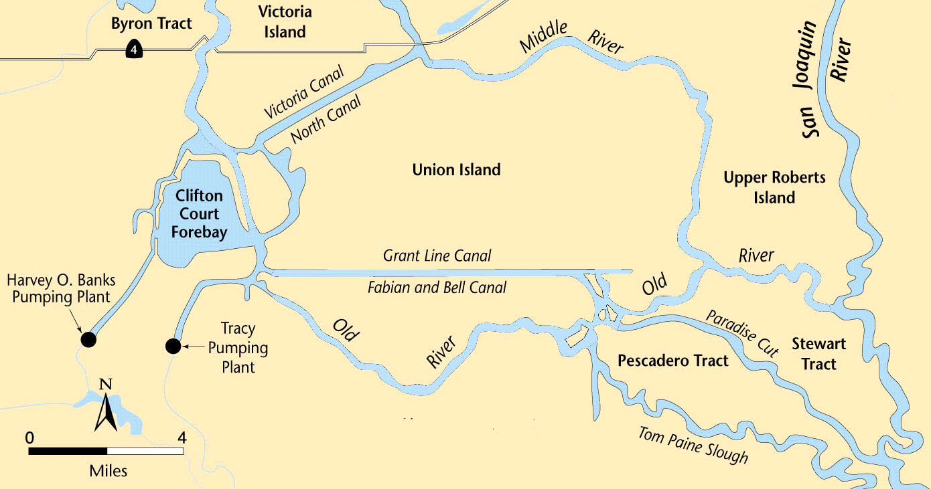
SDIP Permanent Operable Gates Location
Middle River
Grant Line
Canal
Old River at Tracy Bridge
Head of
Old River
Permanent Operable Gate
Water Level Target
Water Quality Standard
Notes:
DSM2 Users Group: "EXAMPLE: Filling in Martinez Stage"
2004.04.27

Slide 4
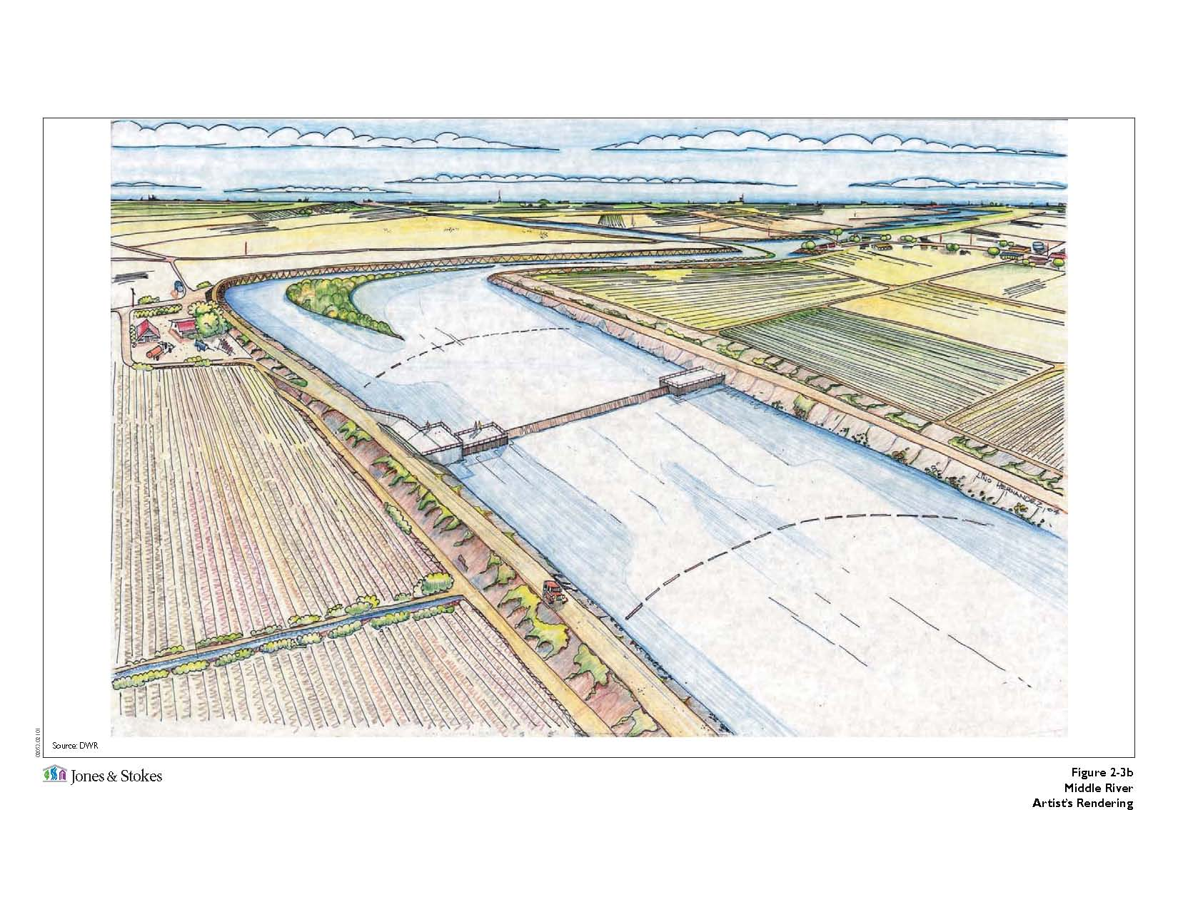
Middle River Gate
Notes:
DSM2 Users Group: "EXAMPLE: Filling in Martinez Stage"
2004.04.27

Slide 5
Middle River Gate
Type:
Flow Control
Purpose:
Assist in maintaining water levels and water quality for south Delta agricultural users.
Operation:
San Joaquin River flow at Vernalis and water level in Middle
River near Undine Road Bridge control the closing and
opening of the gate.
Open on the flood tide and close on the ebb tide.
Seasonal closing and opening of the gate.
Notes:
The Middle River (MR) Gate is designed to capture higher quality Sac R. water and force flows up MR & down GLC
DSM2 Users Group: "EXAMPLE: Filling in Martinez Stage"
2004.04.27

Slide 6
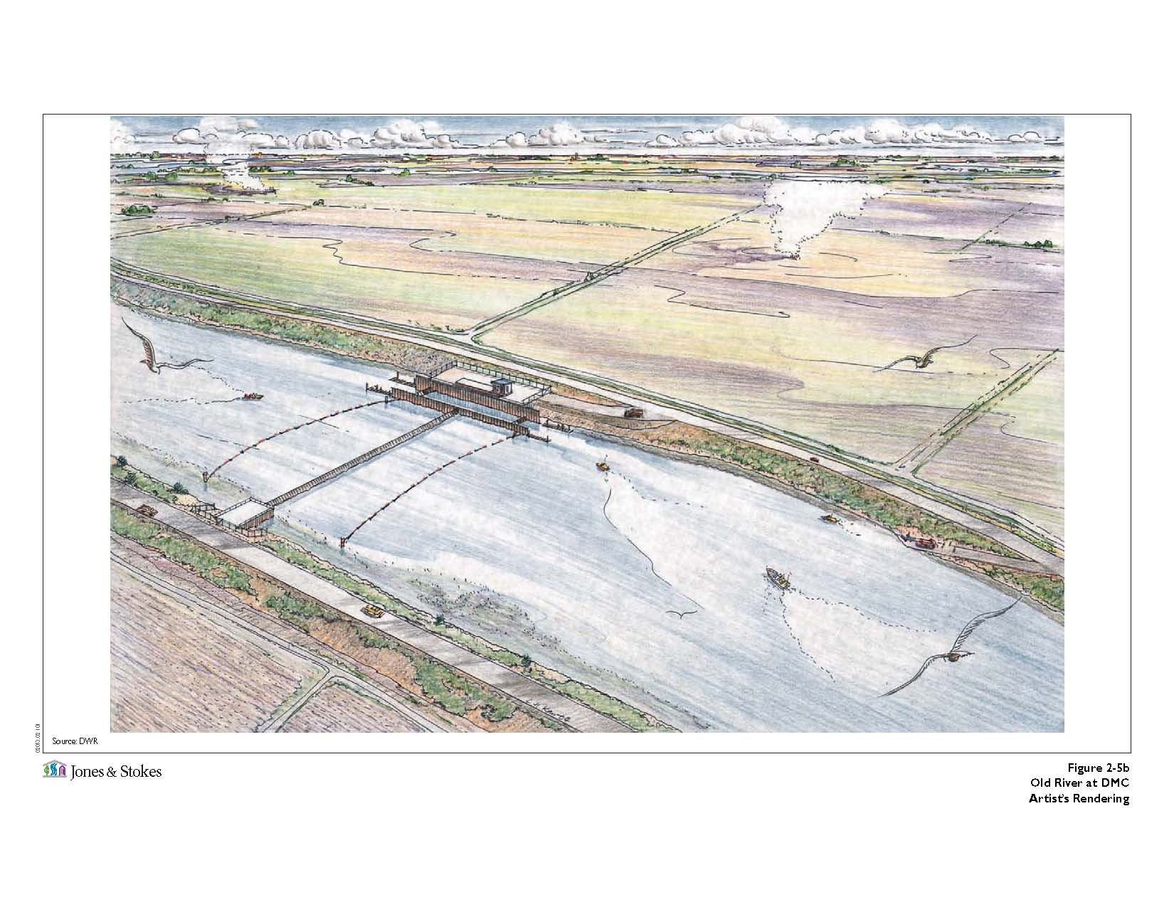
Old River at Tracy Gate

Slide 7
Old River at Tracy Gate
Type:
Flow Control
Purpose:
Assist in maintaining water levels and water quality for south Delta agricultural users.
Operation:
San Joaquin River flow at Vernalis and water level in Old
River near Tracy Road Bridge control the closing and
opening of the gate.
Open on the flood tide and close on the ebb tide.
Seasonal closing and opening of the gate.
Notes:
Similar to MR but flood tide has lower quality. The Old River (OR) Gate forces water u/s and down GLC thus improving circulation OR near Tracy Rd Bridge (is not regularly met).
DSM2 Users Group: "EXAMPLE: Filling in Martinez Stage"
2004.04.27

Slide 8
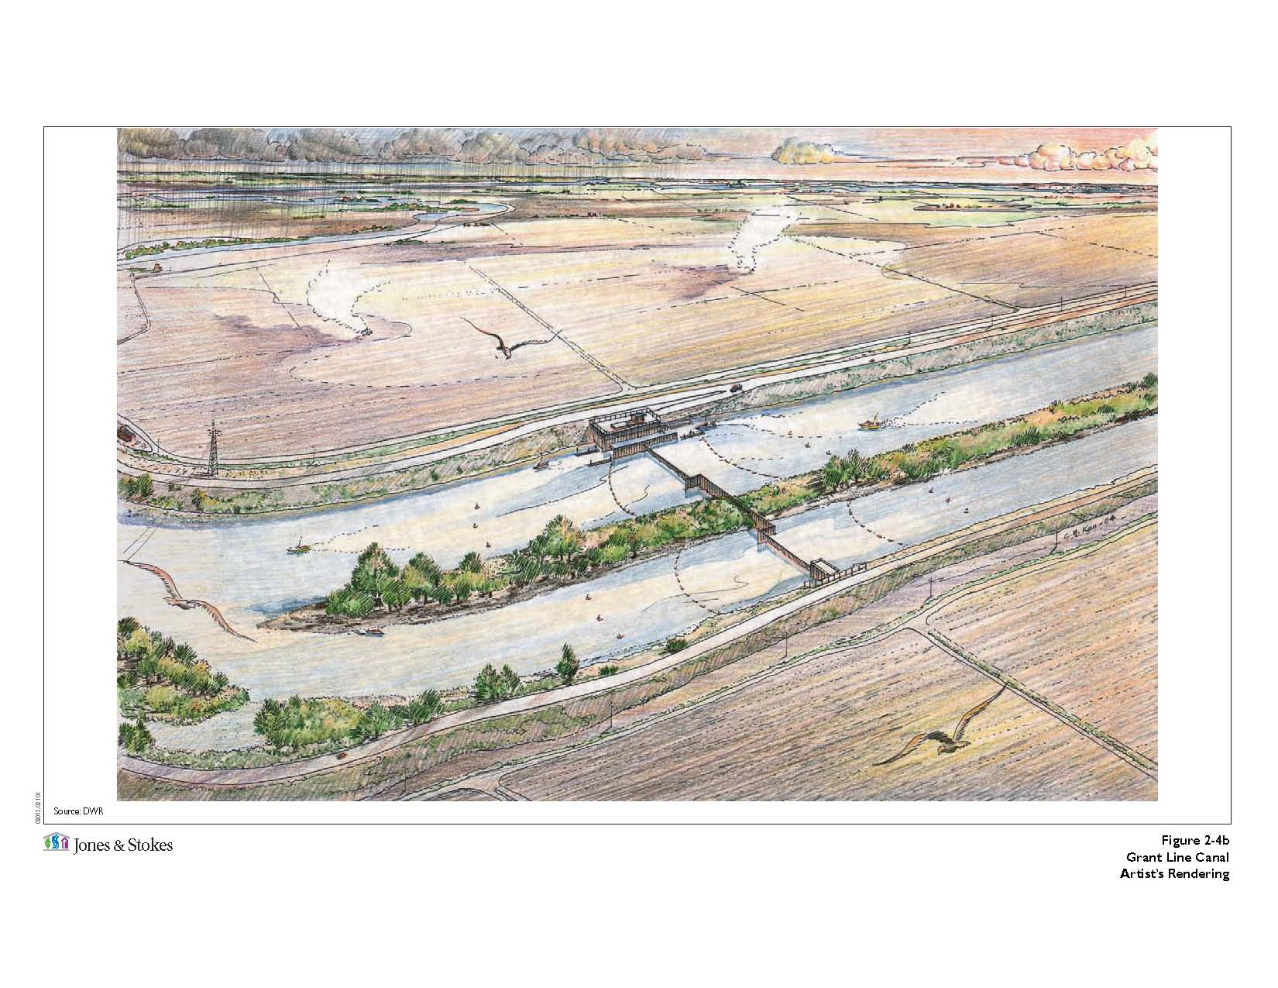
Grant Line Canal Gate

Slide 9
Grant Line Canal Gate
Type:
Flow Control
Purpose:
Assist in maintaining water levels and water quality for south Delta agricultural users.
Operation:
San Joaquin River flow at Vernalis and water level in Grant
Line Canal near Tracy Road Bridge control the closing and
opening of the gate.
Open on the flood tide and also allow water to leave during
the ebb tide. Close when necessary to protect minimum
water level targets.
Inducing circulation to improve water quality.
Seasonal closing and opening of the gate.
Notes:
GLC Gate crest is held 1 ft lower to cause gradient. The gate is closed (later than others) when stage needs to be protected.
DSM2 Users Group: "EXAMPLE: Filling in Martinez Stage"
2004.04.27

Slide 10
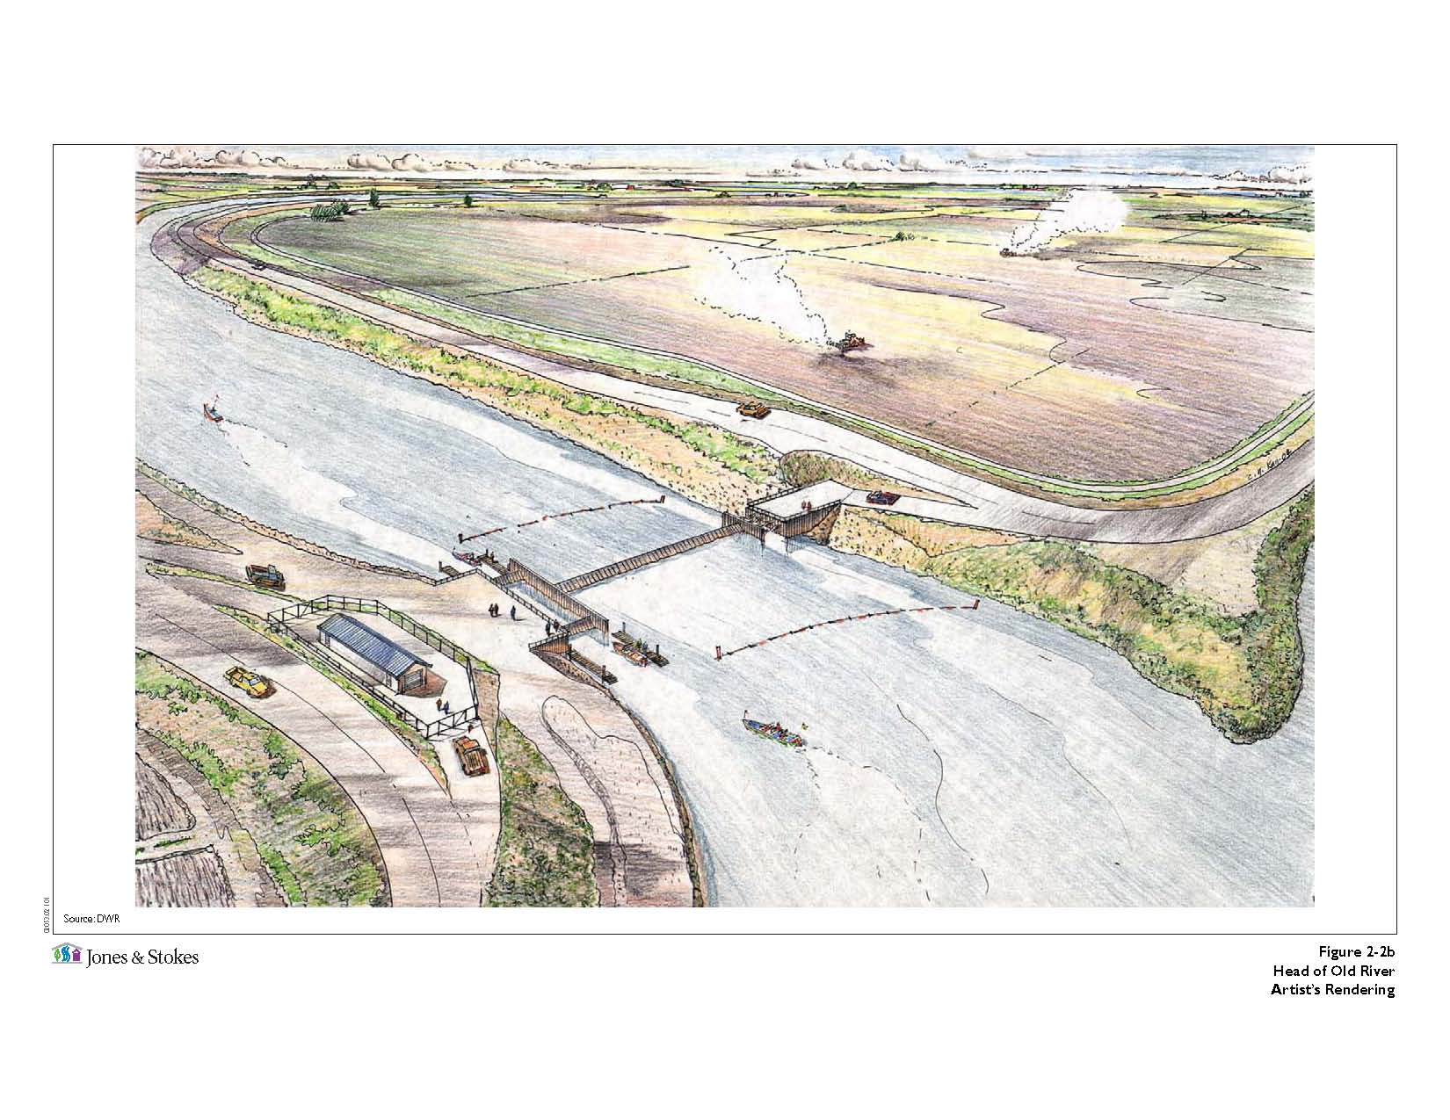
Head of Old River Gate

Slide 11
Head of Old River Gate
Type:
Fish Control
Purpose:
Prevent migrating and out migrating salmon from entering Old River from the San Joaquin River, thus minimizing exposure to the SWP and CVP pumping facilities.
Operation:
San Joaquin River flow at Vernalis control the closing and
opening of the gate.
Seasonal closing and opening of the gate.
Notes:
Increase flow on SJR thus improving DO in the Stockton Deepwater Ship Channel.
Spring VAMP flows & Fall attraction flows are when gate is in place.
DSM2 Users Group: "EXAMPLE: Filling in Martinez Stage"
2004.04.27

Slide 12
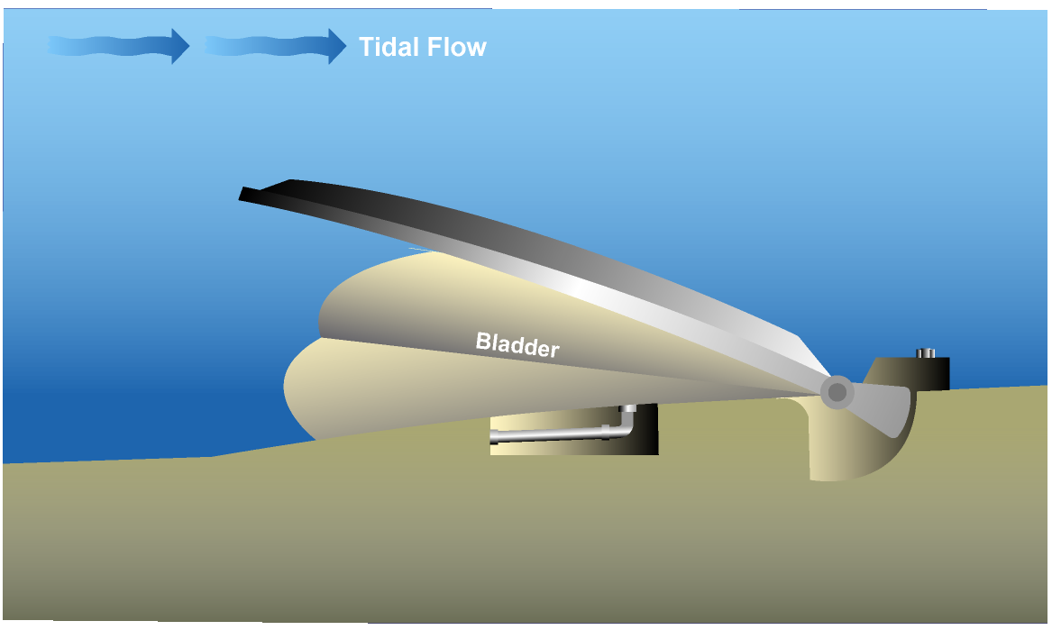
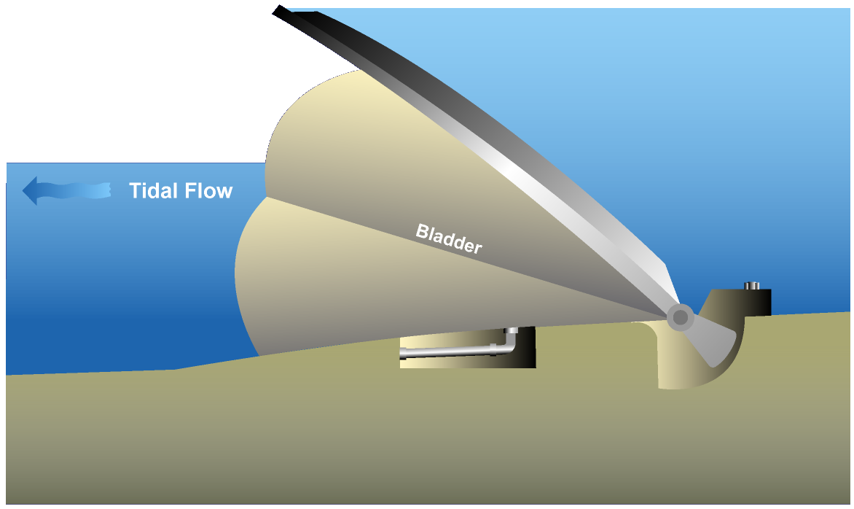
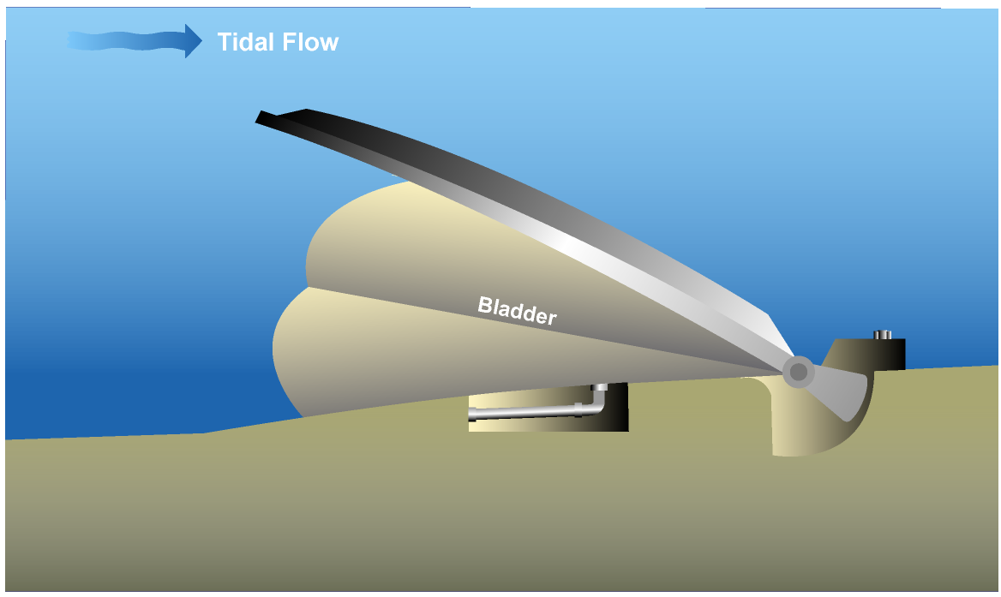
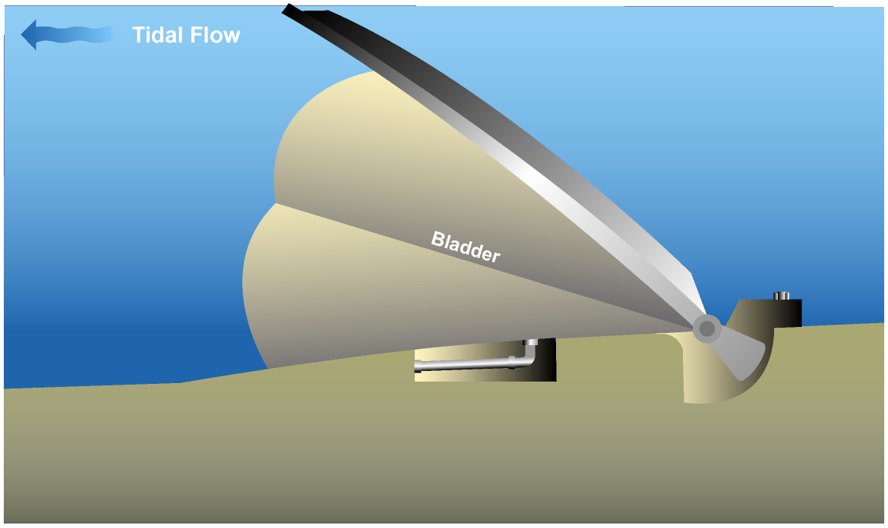
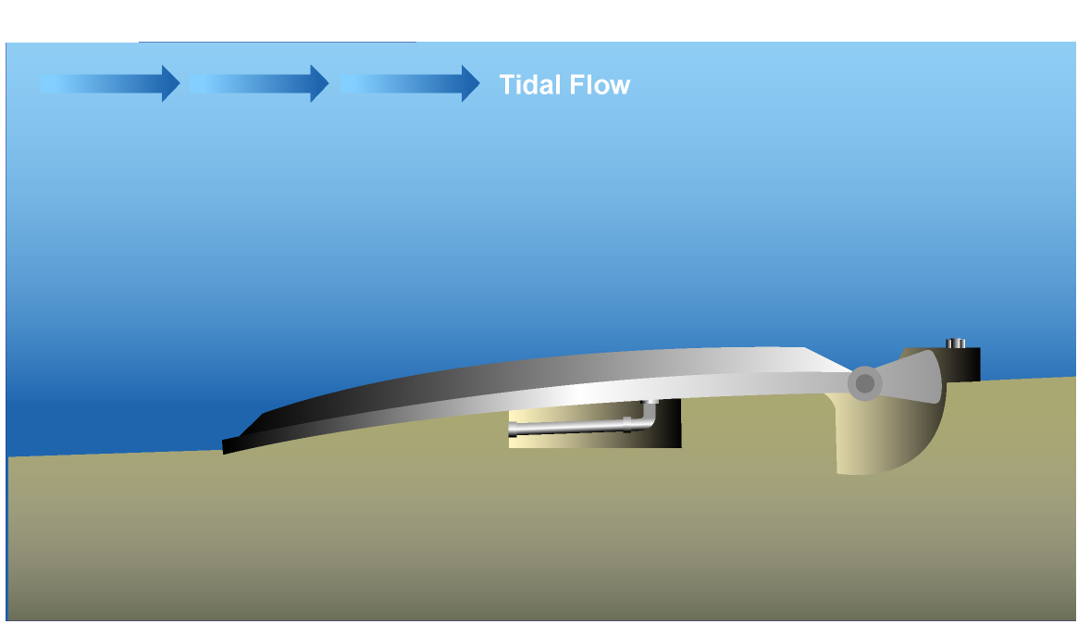
SDIP Permanent Gates Operating Rules
Action: “SET gate_elev (gate=……) TO …..”
Trigger: “chan_stage (chan=100, dist=0) < 0.0”
Notes:
Obermeyer Gate: a) Better conveyance for bottom hinged gate: better for flood flow, less debris hung up, good navigation (no overhead obstruction)
b) cheaper than Radial gate
c) control water level elevation in the detail like Radial gate.
d) Operation and Maintenance is comparable or less than Radial gate.
DSM2 Users Group: "EXAMPLE: Filling in Martinez Stage"
2004.04.27

Slide 13
Operating Rule for Head of Old River Gate
Name:
orh_open (Head of Old River Open Position)
Action:
“SET gate_op (gate=old_r@head_barrier, device=weir, direction=to_from_node) TO OPEN RAMP 60MIN”
Trigger:
“sjr_high OR a_winter OR a_summer OR (a_late_summer
AND (NOT orh_partial_sjr_flow))”
Notes:
Input File: Oprule_sdip_20090917.inp
DSM2 Users Group: "EXAMPLE: Filling in Martinez Stage"
2004.04.27

Slide 14
Operating Rule Expression
Name → Definition
sjr_high → “ts(name=vernalis_flow) > ${SJR_HIGH_FLOW}”
a_winter → “SEASON > ${FALL_END} OR SEASON < ${VAMP_START}”
a_summer → “SEASON > ${VAMP_END} AND SEASON <= ${SUMMER_END}”
a_late_summer → “SEASON > ${SUMMER_END} AND SEASON < ${FALL_START}”
orh_partial_sjr_flow → “ts (name=vernalis_flow) > ${LO_ORH_PARTIAL_FLOW} AND ts (name=vernalis_flow) < ${HI_ORH_PARTIAL_FLOW}”
Notes:
Input File: Oprule_sdip_20090917.inp
DSM2 Users Group: "EXAMPLE: Filling in Martinez Stage"
2004.04.27

Slide 15
Configuration File
SJR_HIGH_FLOW → 10,000.
FALL_END → 01DEC
VAMP_START → 15APR
VAMP_END → 16MAY
SUMMER_END → 16JUL
FALL_START → 01OCT
LO_ORH_PARTIAL_FLOW → 800.
HI_ORH_PARTIAL_FLOW → 2,500.
Notes:
Input File: config_sdip_ocap_71.inp
DSM2 Users Group: "EXAMPLE: Filling in Martinez Stage"
2004.04.27

Slide 16
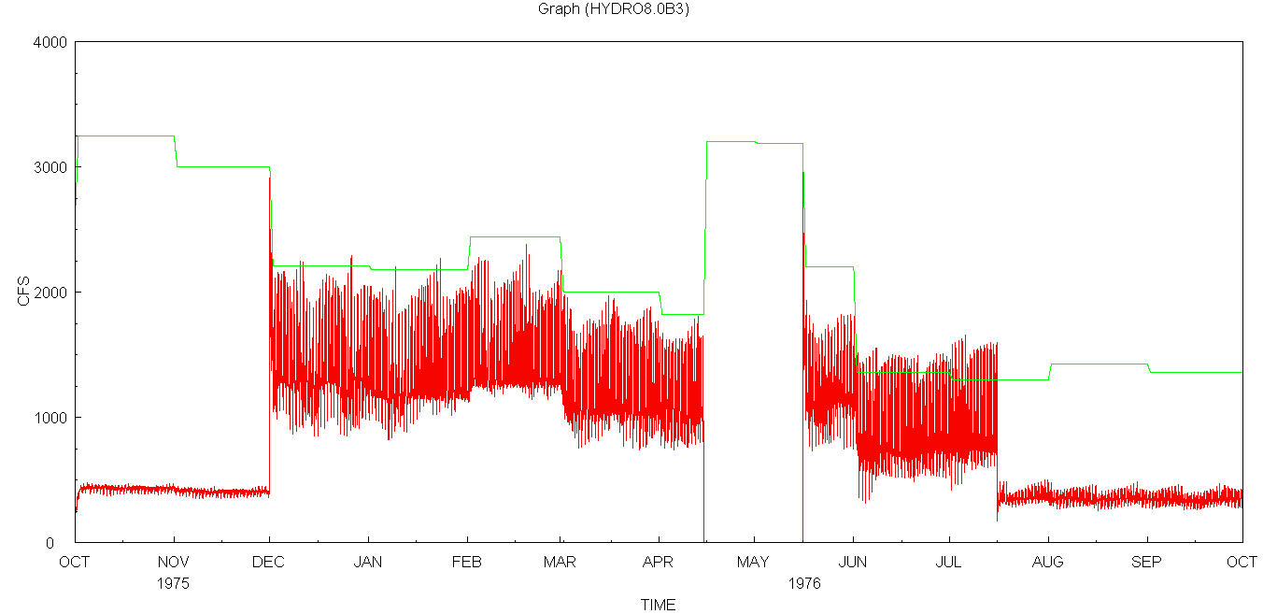
Flow at Old River d/s of Head of Old River Gate
Vernalis (SJR)
d/s of gate
Fall
SJR>10,000; Open
SJR<10,000; Partially Close for 10~15% Leakage
Winter
Open
VAMP
SJR>10,000; Open
SJR<10,000; Close
Summer
Open
Late Summer
800<SJR<2,500;
Partially Close

Slide 17
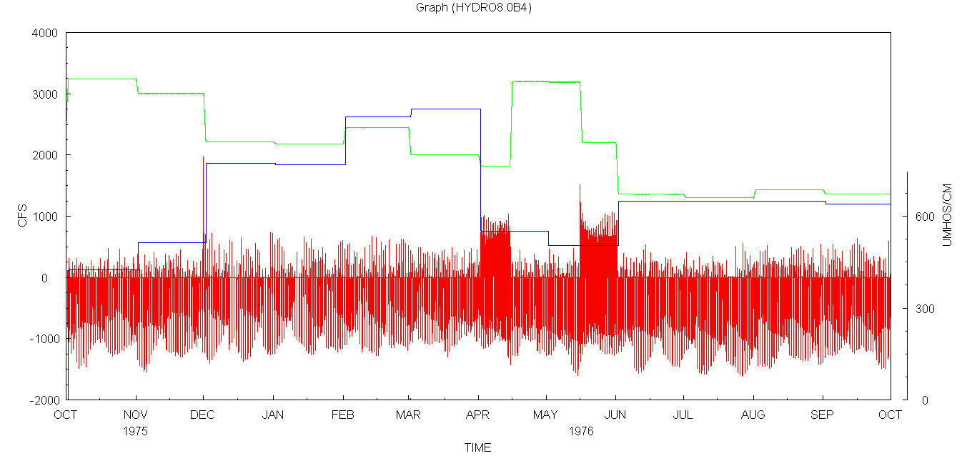
Flow at d/s of Middle River Gate
Vernalis Flow (SJR)
d/s of gate Flow
Vernalis EC (ECV)
EC=600 (Umhos/cm)
Fall
SJR<10,000; U
SJR>10,000; T
Winter
ECV<600 OR
SJR>4,000; T
SJR<4,000; U
VAMP
SJR<10,000; U
SJR>10,000; T
Summer
ECV<600 OR
SJR>4,000; T
SJR<4,000; U
Late Summer
SJR<4,000; U
SJR>4,000; T
U → Flood Open & Ebb Close ; T → Gate is only closed when necessary to protect water level targets.
Notes:
For Winter and Summer: Vernalis Clean is the first Trigger for operation.
DSM2 Users Group: "EXAMPLE: Filling in Martinez Stage"
2004.04.27

Slide 18
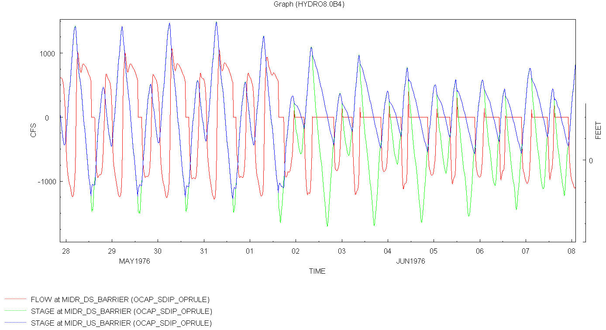
Flow and Stage around Middle River Gate
Notes:
T mode till Jun02: Stage Trigger; Gate is only closed when necessary to protect minimum water level targets.
U mode from Jun 02 to end: Unidirectional flow; Operated for unidirectional flow by opening the gates on flood tides and closing them on ebb tides.
DSM2 Users Group: "EXAMPLE: Filling in Martinez Stage"
2004.04.27

Slide 19
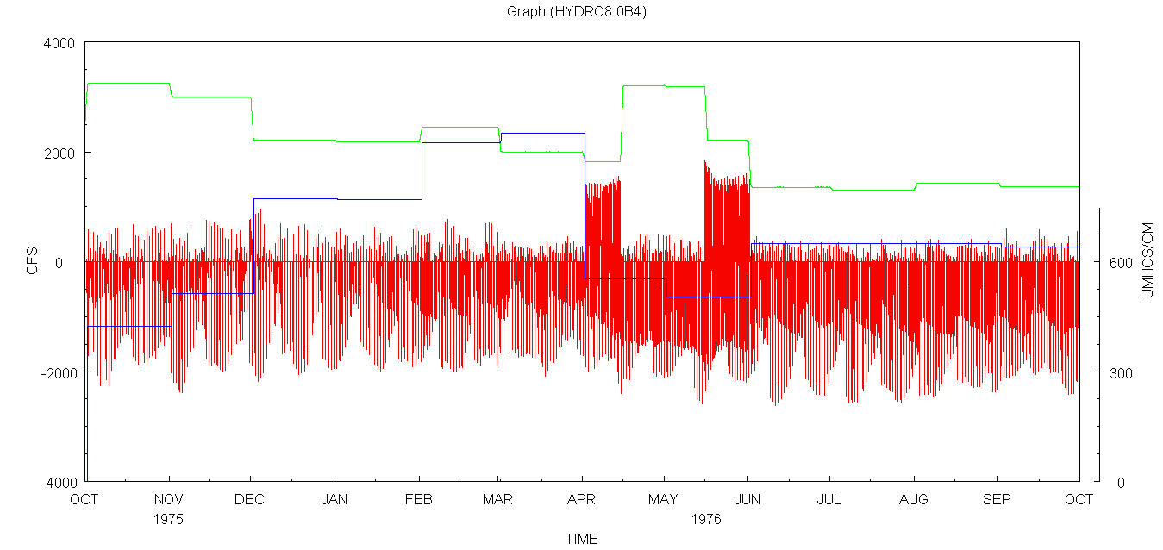
Flow at d/s of Old River at Tracy Gate
Vernalis Flow (SJR)
d/s of gate Flow
Vernalis EC (ECV)
EC=600 (Umhos/cm)
Fall
SJR<10,000; U
SJR>10,000; T
Winter
ECV<600 OR
SJR>2,500; T
SJR<2,500; U
VAMP
SJR<10,000; U
SJR>10,000; T
Summer
ECV<600 OR
SJR>2,500; T
SJR<2,500: U
Late Summer
SJR<2,500; U
SJR>2,500; T
U → Flood Open & Ebb Close ; T → Gate is only closed when necessary to protect water level targets.

Slide 20
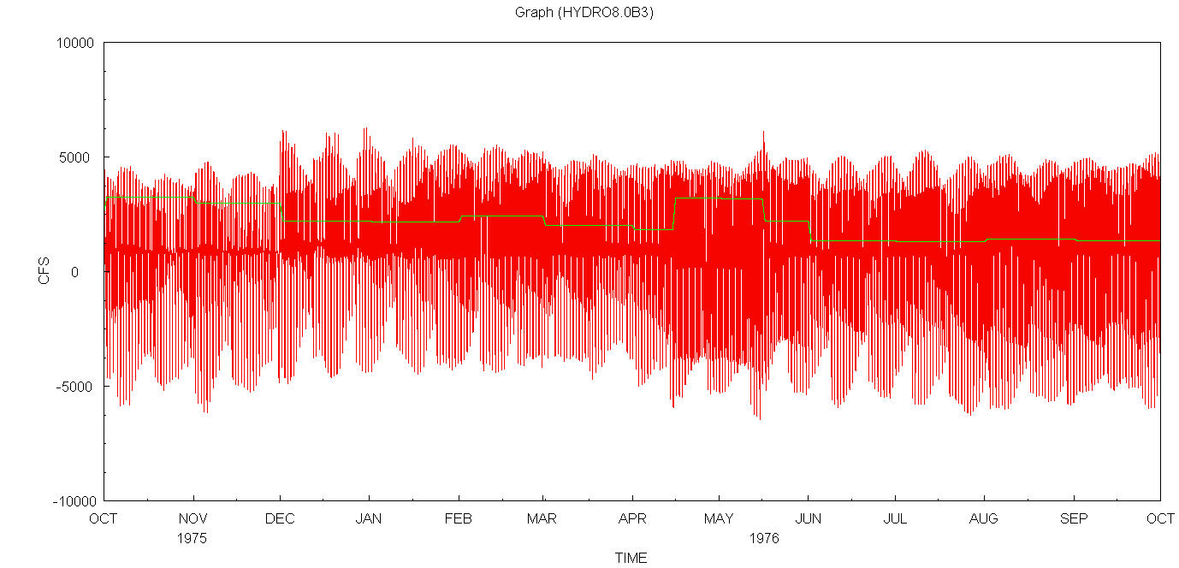
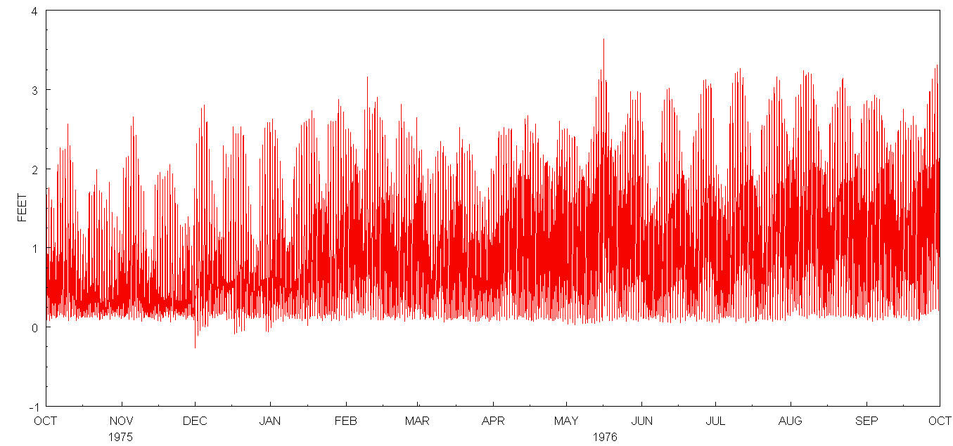
Flow at d/s of Grant Line Canal Gate
Stage near Tracy Road Bridge
Vernalis
d/s of gate
Fall
Stage Trigger (T)
Winter
Stage Trigger (T)
VAMP
Stage Trigger (T)
Summer
Stage Trigger (T)
Late Summer
Stage Trigger (T)
T → Gate is only closed when necessary to protect water level targets.

Slide 21
Operating Rule for Head of Old River varying RAMP
Name:
orh_open (Head of Old River Open Position)
Action:
“SET gate_op (gate=old_r@head_barrier, device=weir, direction=to_from_node) TO OPEN RAMP 30MIN”
Trigger:
“sjr_high OR a_winter OR a_summer OR (a_late_summer
AND (NOT orh_partial_sjr_flow))”

Slide 22
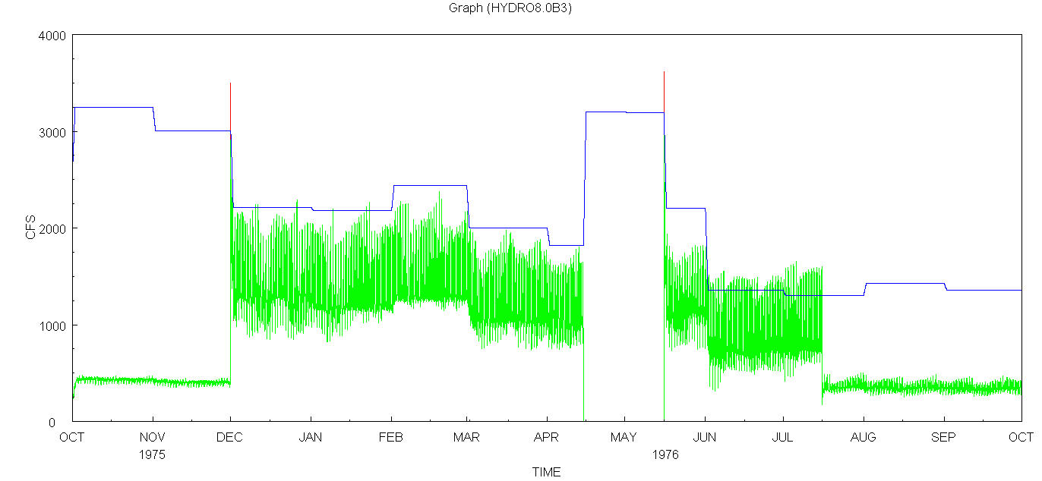
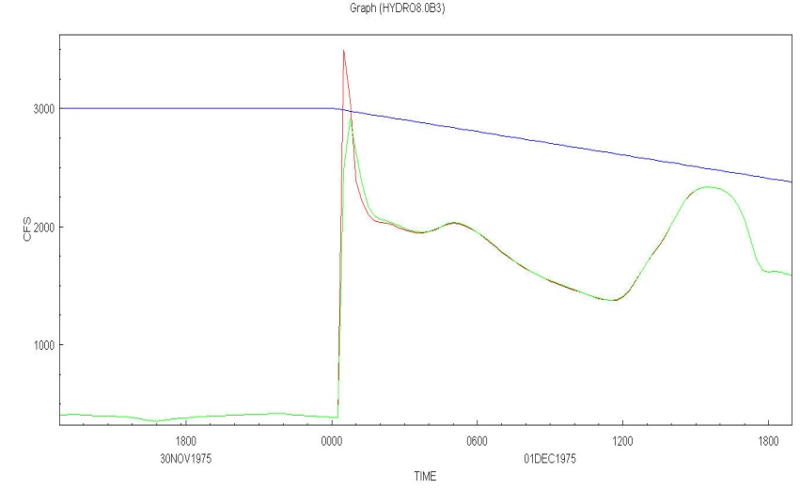
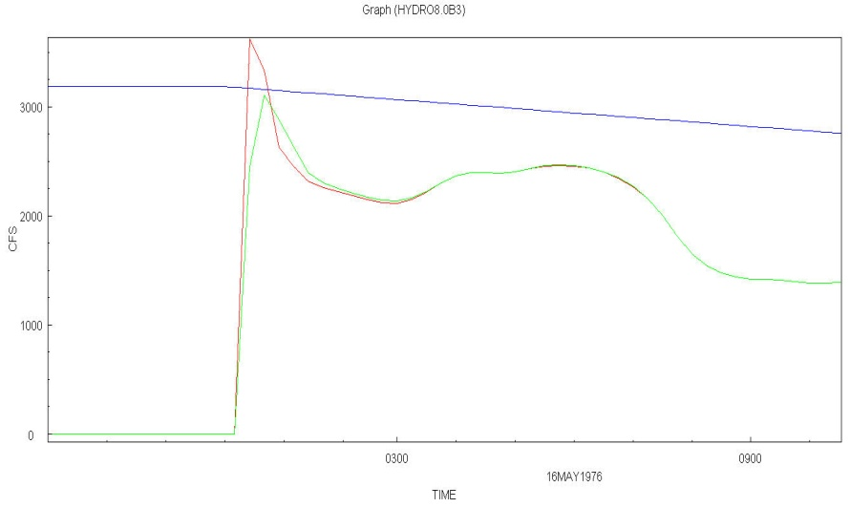
Flow at Old River d/s of Head of Old River Gate
with varying OPEN RAMP
Vernalis (SJR)
d/s of gate open RAMP 60 Min
d/s of gate open RAMP 30 Min
Fall
SJR>10,000; Open
SJR<10,000; Partially Close for 10~15% Leakage
Winter
Open
VAMP
SJR>10,000; Open
SJR<10,000; Close
Summer
Open
Late Summer
800<SJR<2,500;
Partially Close

