Slide 1

DSM2: Historical Simulation
DSM2 Training
Fall, 2009
Lan Liang, Ph.D., P.E.
Delta Modeling Section
California Department of Water Resources

Slide 2
Outline
Applications of DSM2 historical simulation
Required data and its sources for flow and EC modeling
Preprocessing data
File structure of DSM2 historical simulation
How to start model simulation
Possible problems running historical simulation
2
Notes:
DSM2 Users Group: "EXAMPLE: Filling in Martinez Stage"
2004.04.27
2
How to start model simulation (update boundaries, update inp files, and use launch script)

Slide 3
Applications of DSM2 historical simulation
Replication of historical Delta conditions to help interpretation of biological data
Support short term planning
Fingerprints to track sources
Simulating impact of flooded islands
Nonconservative QUAL

Slide 4
Simulating impact of flooded islands
June 3, 2004 Upper Jones Tract levee failed
No Winds / Storm
Mid to Low Flows
DMS conducted simulation of long term forecast of
projected DOC from pump out reaching Clifton Court
Forebay

Slide 5
Hydro Data Requirements
Scalars
Fixed data
Geometry data
Permanent gates and reservoirs
Inflows: SAC, SJR,
YOLO, Eastside
hydro
data
Exports: SWP, CVP,
CCC, and NB
Boundaries
Time-variable data, update needed
Stage: Martinez
Inland sources
DICU generates
Gate timing

Slide 6
EC Data Requirements
Inflows: SAC, SJR,
YOLO, Eastside
Boundaries
EC time-variable data, update needed
Inland sources
DICU generates

Slide 7
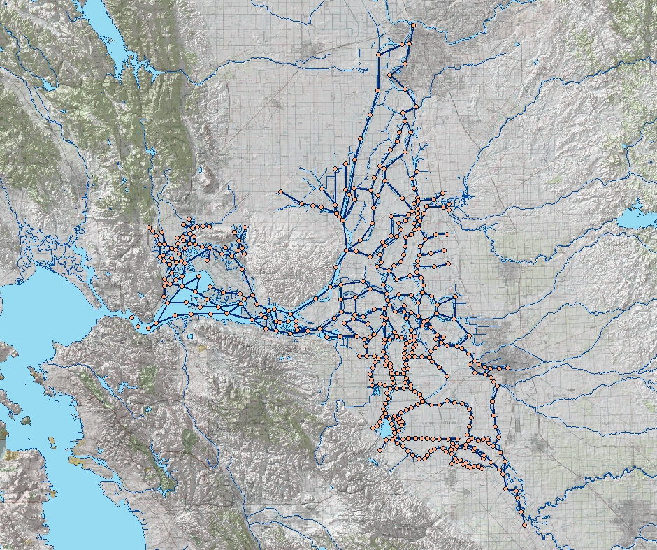
DSM2 Boundary Conditions for Historical Simulations
Sacramento River
Sacramento
Flows from gauge data
Sac & SJR EC from gauge data
Tributary EC constant values
Yolo Bypass gauge flow, Sac EC
Jones Tract flow from filled data
Inflow & water quality
Export flow
Tributaries
Stage & EC from gauge data
Delta Island Consumptive Use
Based on long term average data
Flow: monthly values that vary by year
EC: monthly values repeated every year
Martinez
Tidal Stage & Water Quality
Stockton
Exports from gauge data
Exports
San Joaquin River
Image from USBR GIS Group
Note: gauge data are filled for missing values

Slide 8
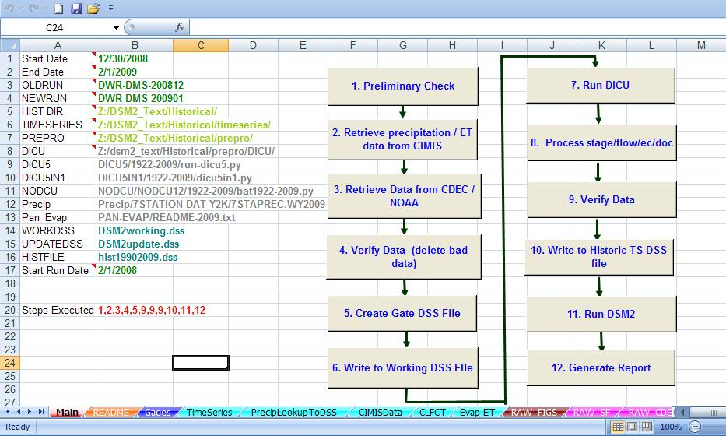
Historical Data update tool by Siqing Liu

Slide 9
File structure of DSM2 Historical
configuration_historical.inp
ENVVARs, run time, input dss file names, output file names
historical_hydro.inp
IO files, launch files (.inp) of parameter, grid, initial condition, boundary condition, gate operation, and output time series
historical_qual_ec.inp
IO files, launch files of parameter, groups, boundary condition, and output time series

Slide 10
How to start model simulation
Modify data as needed
Use preprocess tool to update timeseries
Modify configuration file
Adjust scalars, tidefile and output in the launch files
Use historical model template
Run DSM2 historical models

Slide 11
Configuration File
Really just an extra ENVVARS section
Can comment out a variable if you supply it in the environment
Defines runtime, historical version, output file names
Defines DSM2MODIFIER
Defines tidefile name
Allows you to move things around

Slide 12
Launch Files
Applies config for particular model:
e.g. HYDROTIDEFILE: hydro output, qual input
The IO_FILES section:
Define tidefile
Use/disable restart files
Name your echoed output file
Extra output
Changes in SCALAR (print level, time step, qual initial concentration)

Slide 13
Historical Model Template
Historical Simulations
Oct.,1989 - current, available timeseries
Data updated
Monthly, by O&M, Delta Compliance & Modeling section for MWQI
Perhaps annually, by BDO

Slide 14
Study templates for historical:
Typical change is updated data
Config file for small changes/alternatives
New Simulations for major changes:
New geometry
New constituents

Slide 15
Historical Setup
Use a launch script to run dsm2 models
> hydro historical_hydro.inp
> qual qual_ec.inp
> qual qual_do.inp
> ptm historical_ptm.inp

Slide 16
Possible problems running historical simulation
Time series setting problems
Flow transfer
Using tide file
Restart run
Channel dried up

Slide 17
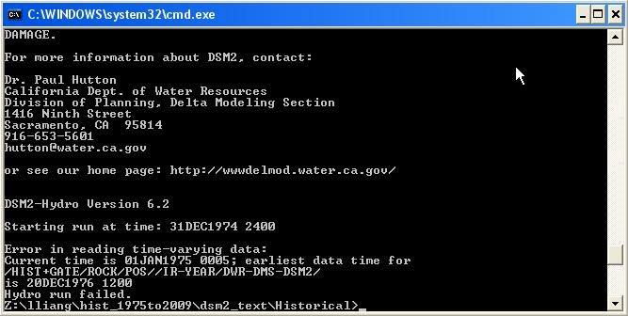
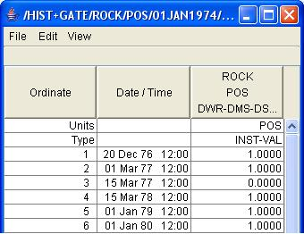
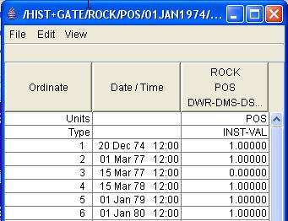
Time series setting problem 1

Slide 18
Time series should cover the simulation time period.
For example:
Simulate 10/01/1990 – 06/01/2009
Time series can be
~09/25/2009 - ~06/05/2009
Jones Tract timeseries has this kind of problem.
Gate timeseries meets this problem frequently.

Slide 19
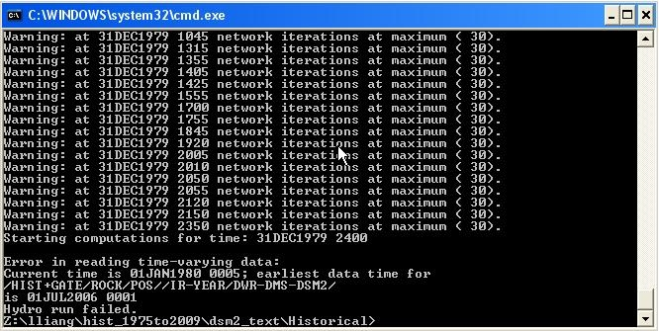
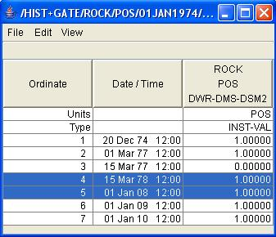
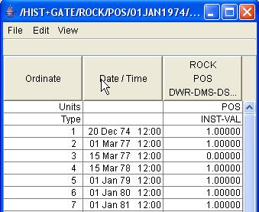
Time series setting problem 2

Slide 20
In each Irregular timeseries, time interval between two values must be less than two years.

Slide 21
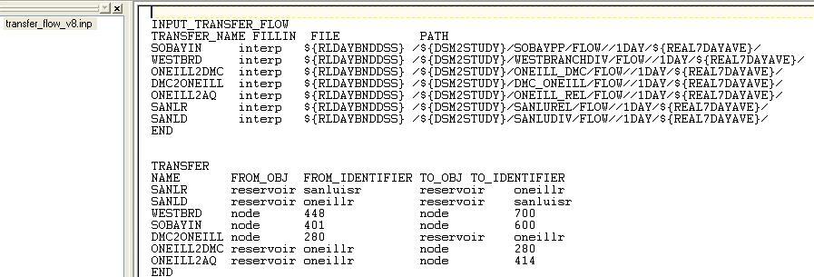
Transfer flow
Step 1: Make a transfer flow time series
Step 2: Create a transfer flow .inp file
Step 3: Add .inp file in the historical _hydro.inp file

Slide 22
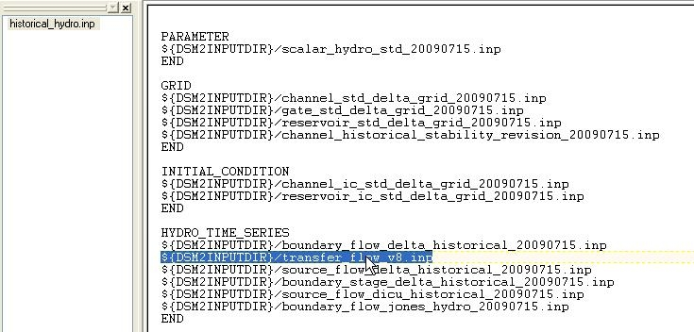

Slide 23
Using tide file
Tide file: historical.h5 in the ./output folder
It saves the flow and stage for all the channels and nodes of DSM2.
It can be used for many qual runs w/o repeat hydro run.

Slide 24
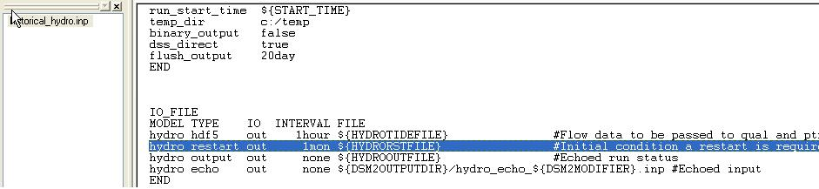
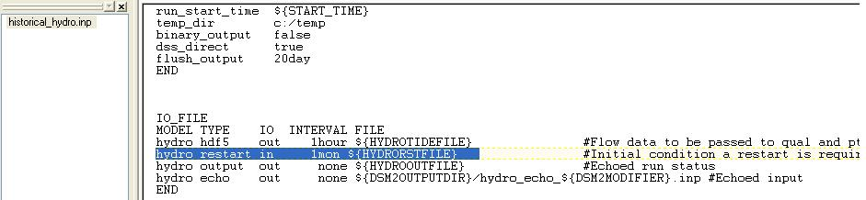
Restart hydro run
Step 1: Save the restart file
Step 2: Use the restart file as the initial condition

Slide 25
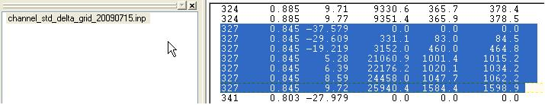
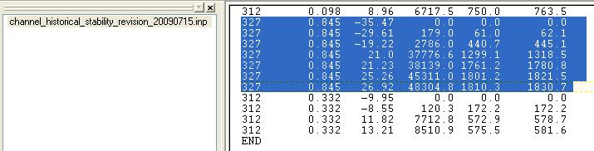
Channel dried up
Old cross-section :
Updated cross-section :

