Slide 1

SDIP Permanent Operable Gates
DSM2 Training
Fall 2009
Subir Saha, PE
Department of Water Resources
Delta Modeling Section

Slide 2
SDIP Permanent Operable Gates
Objectives
Minimize movement of in and out-migrating salmon towards the export pumps.
Maintain adequate water levels for South Delta Agricultural irrigation diversions.
Improve water quality in South Delta channels by providing better circulation

Slide 3
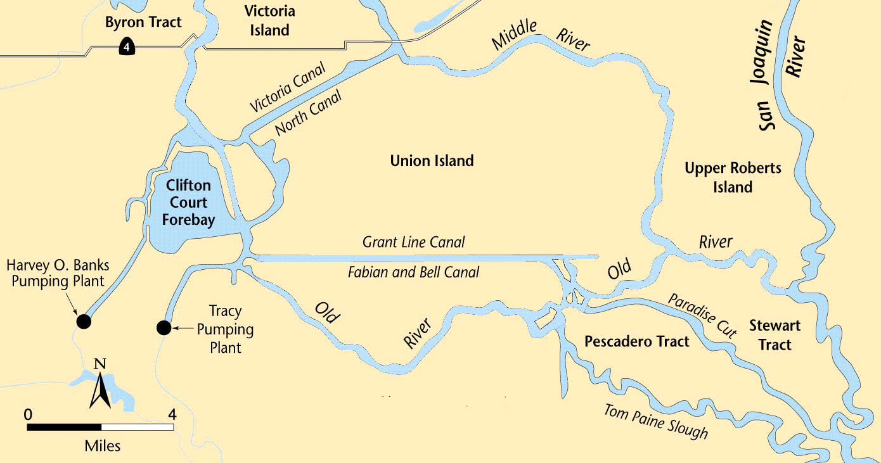
SDIP Permanent Operable Gates Location
Middle River
Grant Line
Canal
Old River at Tracy Bridge
Head of
Old River
Permanent Operable Gate
Water Level Target
Water Quality Standard

Slide 4
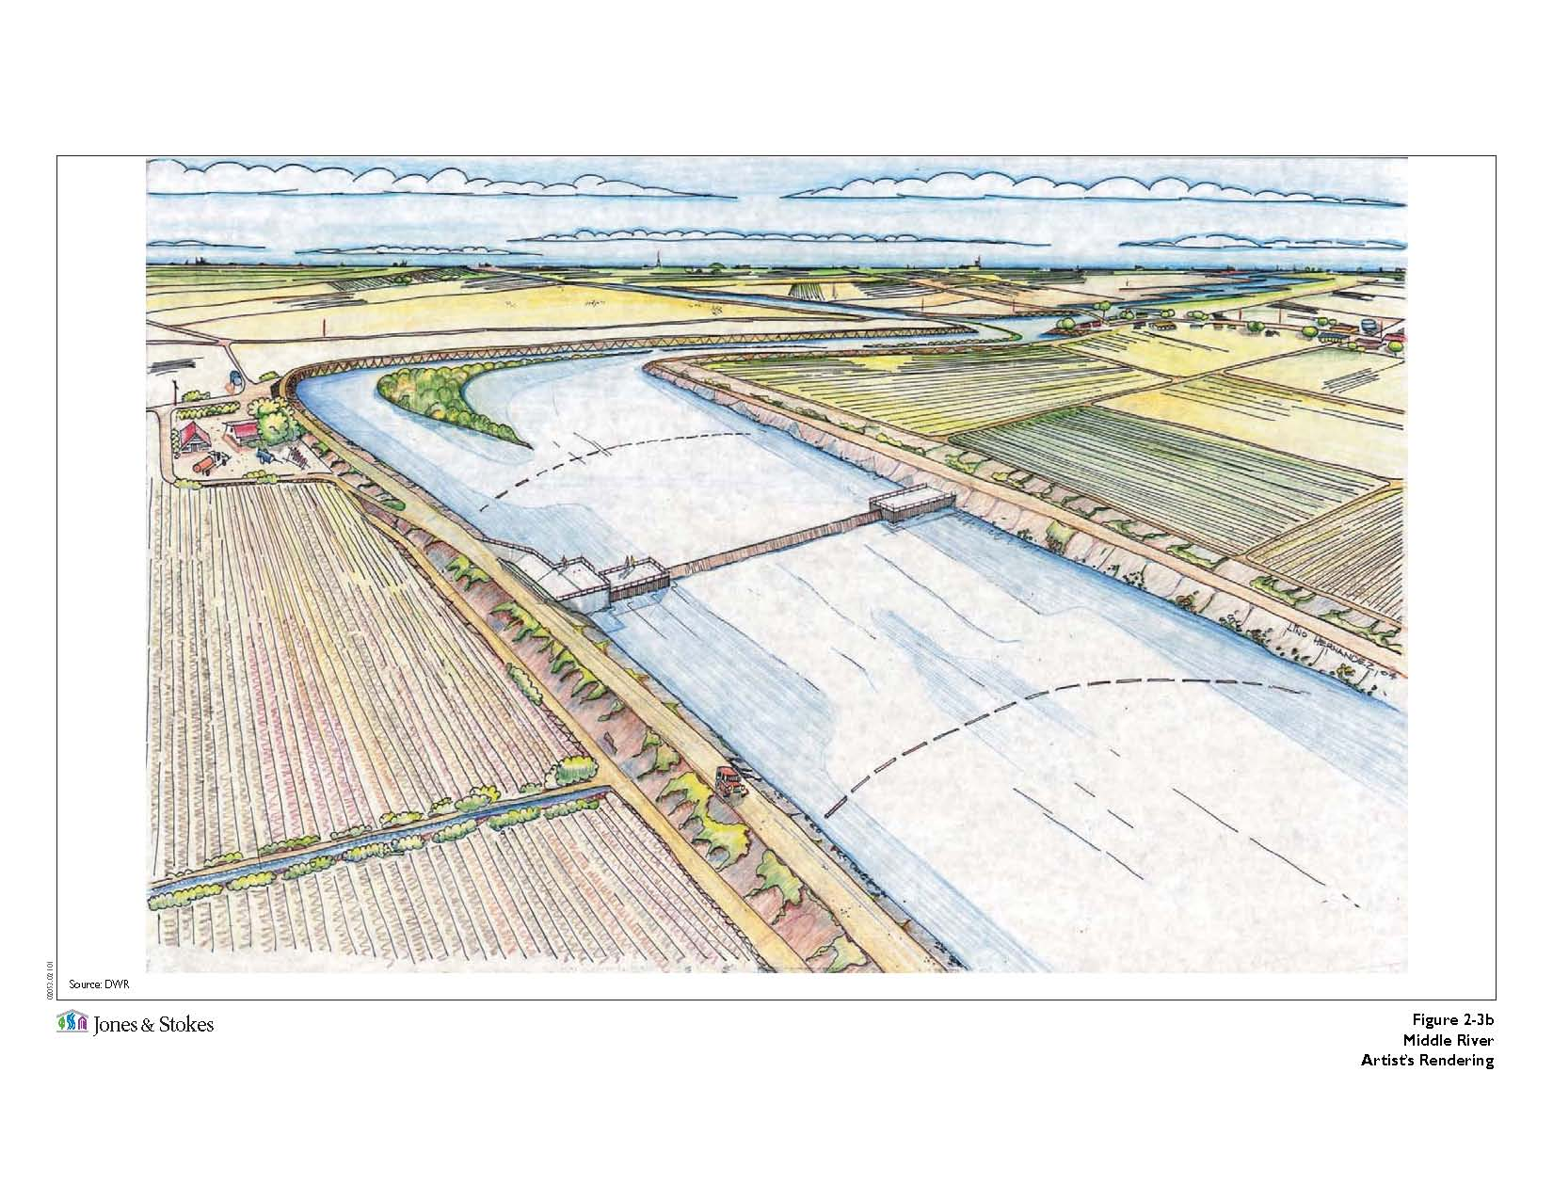
Middle River Gate

Slide 5
Middle River Gate
Type:
Flow Control
Purpose:
Assist in maintaining water levels and water quality for south Delta agricultural users.
Operation:
San Joaquin River flow at Vernalis and water level in Middle
River near Undine Road Bridge control the closing and
opening of the gate.
Open on the flood tide and close on the ebb tide.
Seasonal closing and opening of the gate.

Slide 6
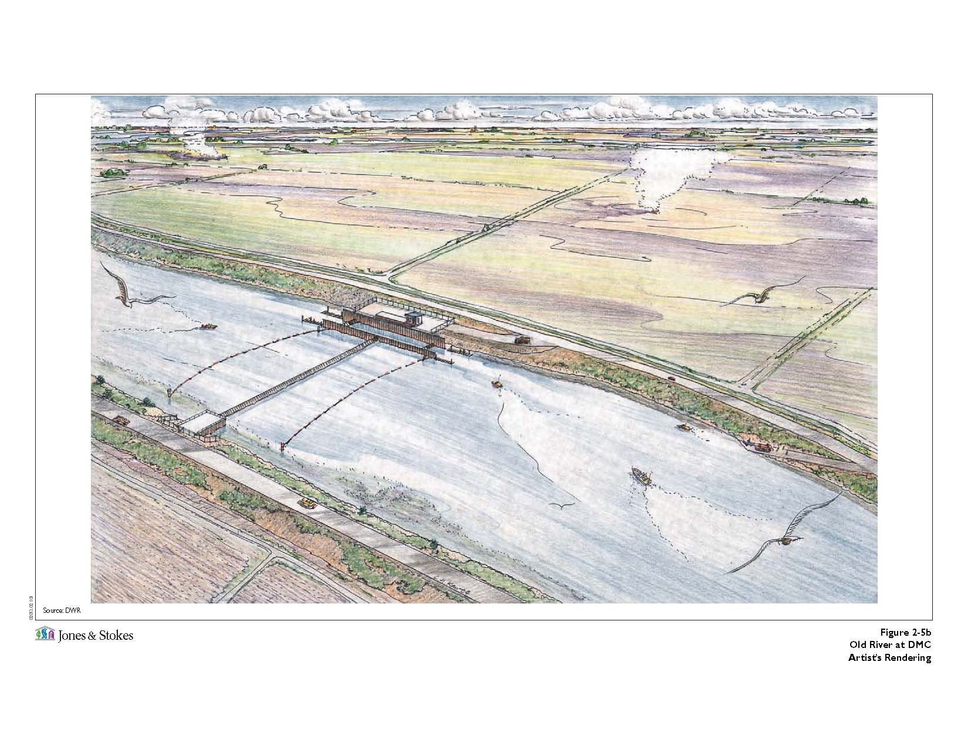
Old River at Tracy Gate

Slide 7
Old River at Tracy Gate
Type:
Flow Control
Purpose:
Assist in maintaining water levels and water quality for south Delta agricultural users.
Operation:
San Joaquin River flow at Vernalis and water level in Old
River near Tracy Road Bridge control the closing and
opening of the gate.
Open on the flood tide and close on the ebb tide.
Seasonal closing and opening of the gate.

Slide 8
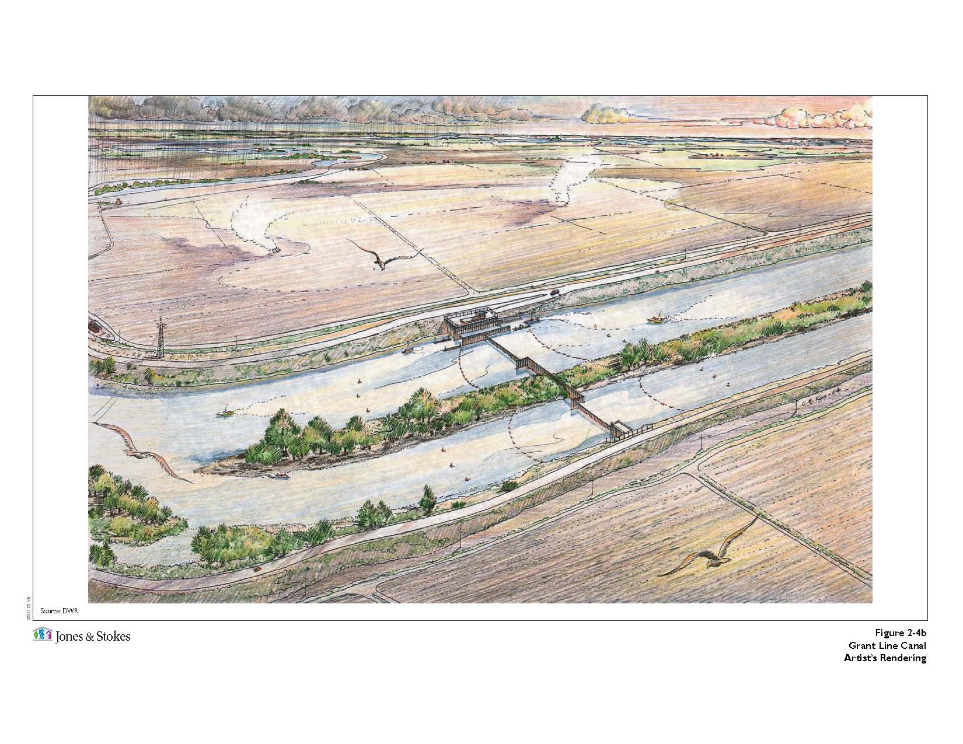
Grant Line Canal Gate

Slide 9
Grant Line Canal Gate
Type:
Flow Control
Purpose:
Assist in maintaining water levels and water quality for south Delta agricultural users.
Operation:
San Joaquin River flow at Vernalis and water level in Grant
Line Canal near Tracy Road Bridge control the closing and
opening of the gate.
Open on the flood tide and also allow water to leave during
the ebb tide. Close when necessary to protect minimum
water level targets.
Inducing circulation to improve water quality.
Seasonal closing and opening of the gate.

Slide 10
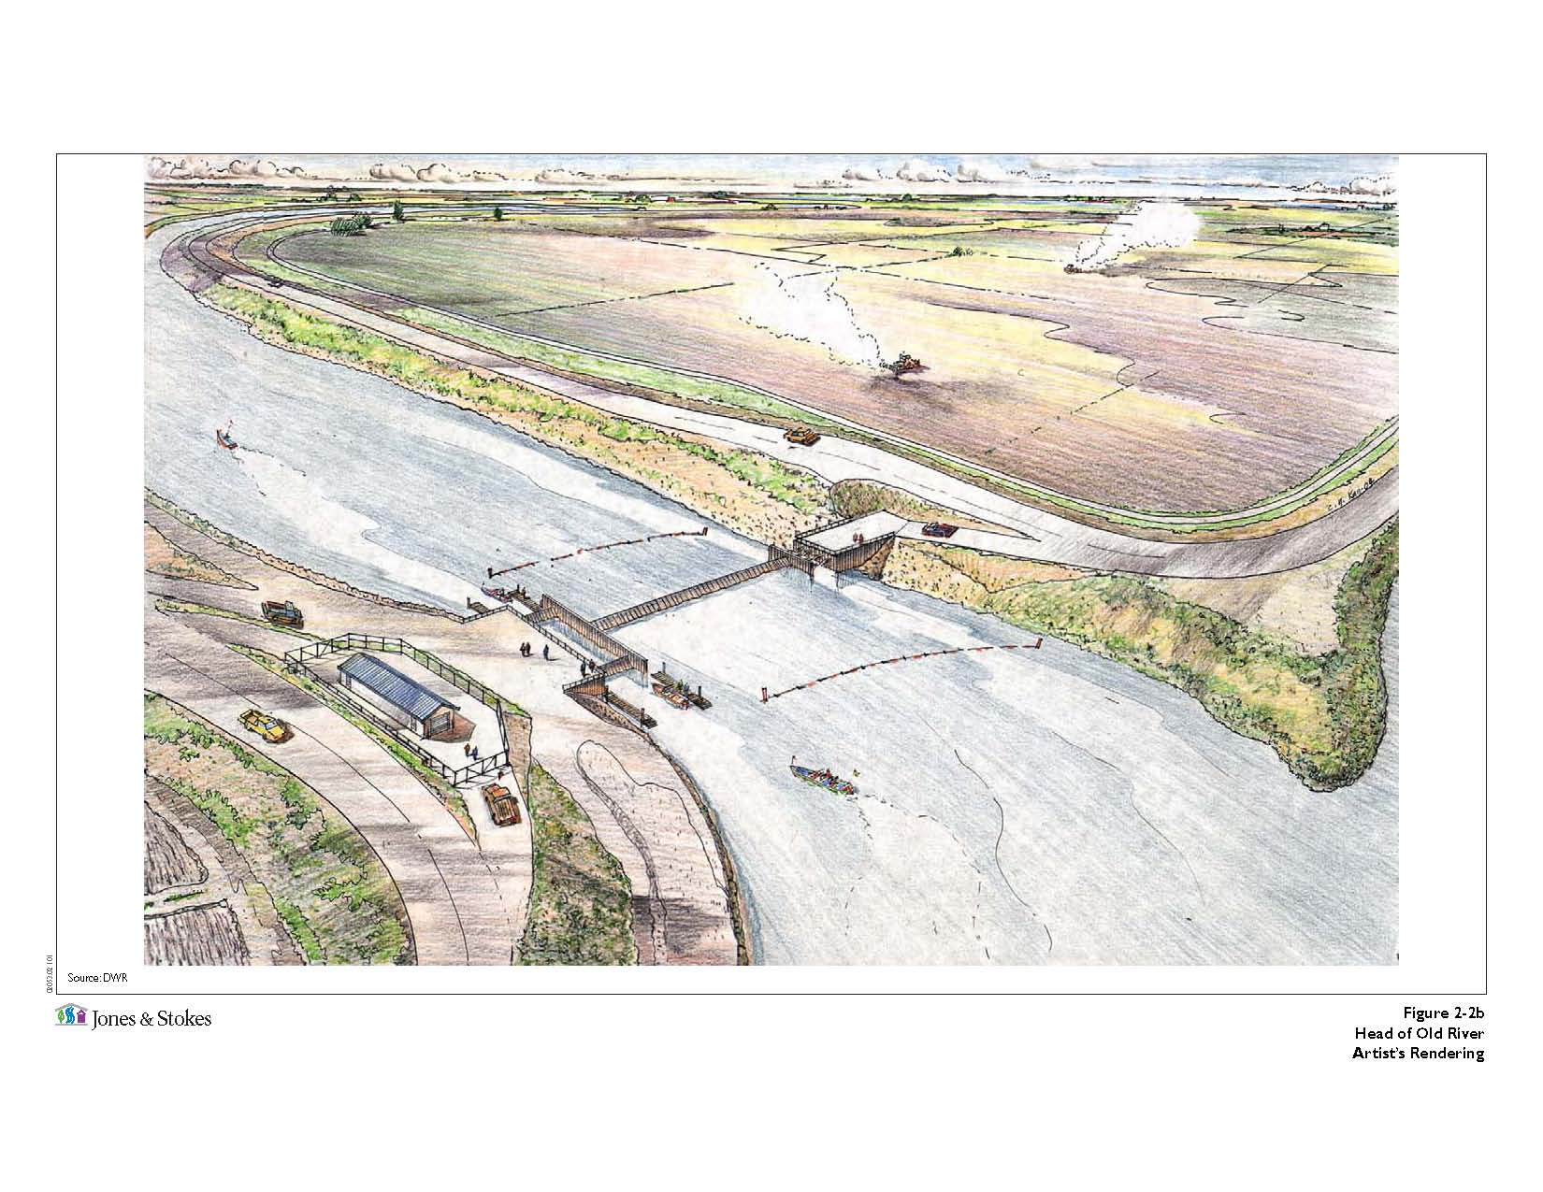
Head of Old River Gate

Slide 11
Head of Old River Gate
Type:
Fish Control
Purpose:
Prevent migrating and out migrating salmon from entering Old River from the San Joaquin River, thus minimizing exposure to the SWP and CVP pumping facilities.
Operation:
San Joaquin River flow at Vernalis control the closing and
opening of the gate.
Seasonal closing and opening of the gate.

Slide 12
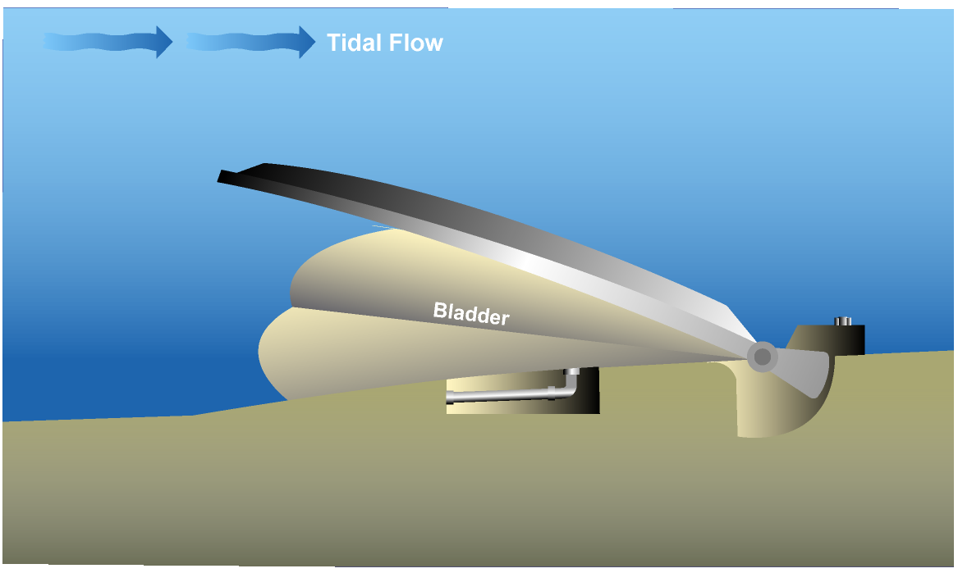
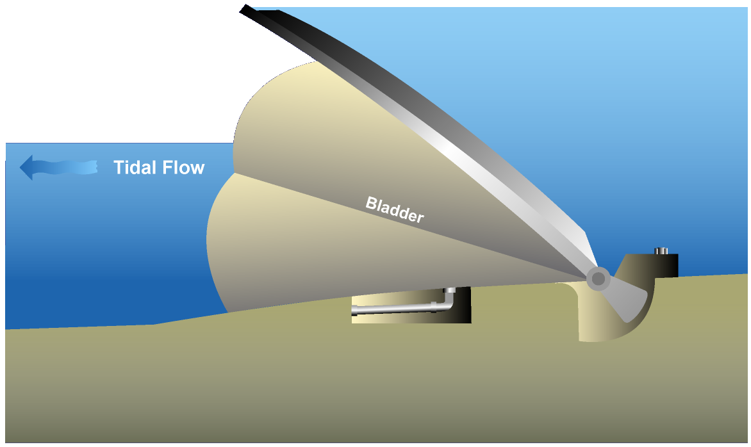
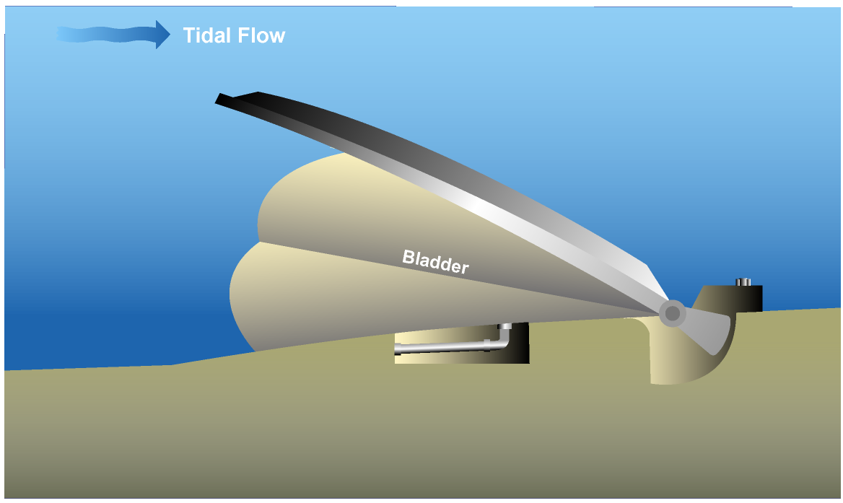
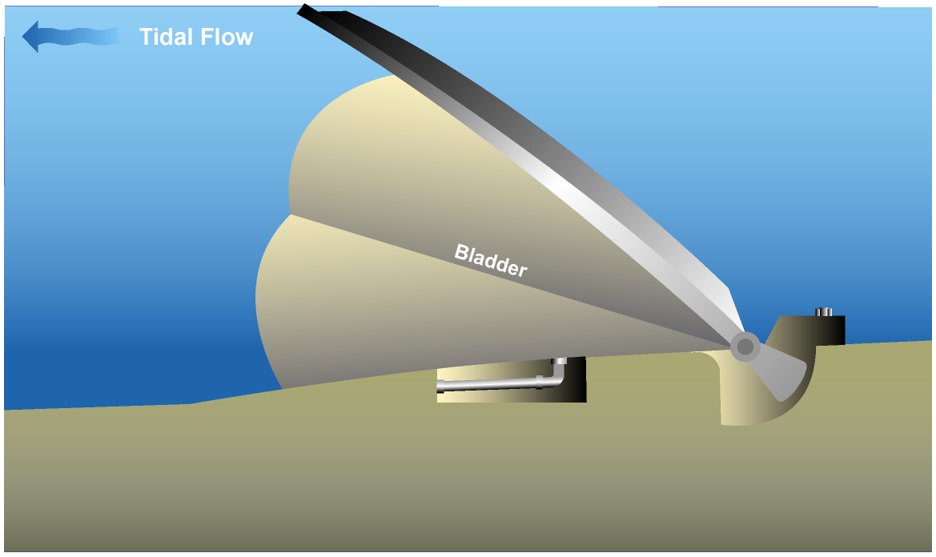
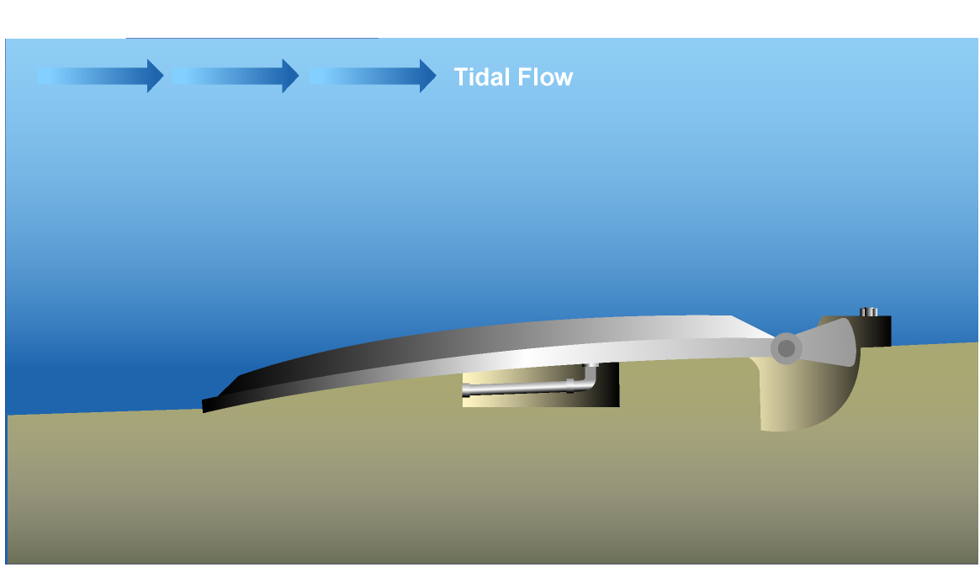
SDIP Permanent Gates Operating Rules
Action: “SET gate_elev (gate=……) TO …..”
Trigger: “chan_stage (chan=100, dist=0) < 0.0”

Slide 13
Operating Rule for Head of Old River Gate
Name:
orh_open (Head of Old River Open Position)
Action:
“SET gate_op (gate=old_r@head_barrier, device=weir, direction=to_from_node) TO OPEN RAMP 60MIN”
Trigger:
“sjr_high OR a_winter OR a_summer OR (a_late_summer
AND (NOT orh_partial_sjr_flow))”

Slide 14
Operating Rule Expression
Name → Definition
sjr_high → “ts(name=vernalis_flow) > ${SJR_HIGH_FLOW}”
a_winter → “SEASON > ${FALL_END} OR SEASON < ${VAMP_START}”
a_summer → “SEASON > ${VAMP_END} AND SEASON <= ${SUMMER_END}”
a_late_summer → “SEASON > ${SUMMER_END} AND SEASON < ${FALL_START}”
orh_partial_sjr_flow → “ts (name=vernalis_flow) > ${LO_ORH_PARTIAL_FLOW} AND ts (name=vernalis_flow) < ${HI_ORH_PARTIAL_FLOW}”

Slide 15
Configuration File
SJR_HIGH_FLOW → 10,000.
FALL_END → 01DEC
VAMP_START → 15APR
VAMP_END → 16MAY
SUMMER_END → 16JUL
FALL_START → 01OCT
LO_ORH_PARTIAL_FLOW → 800.
HI_ORH_PARTIAL_FLOW → 2,500.

Slide 16
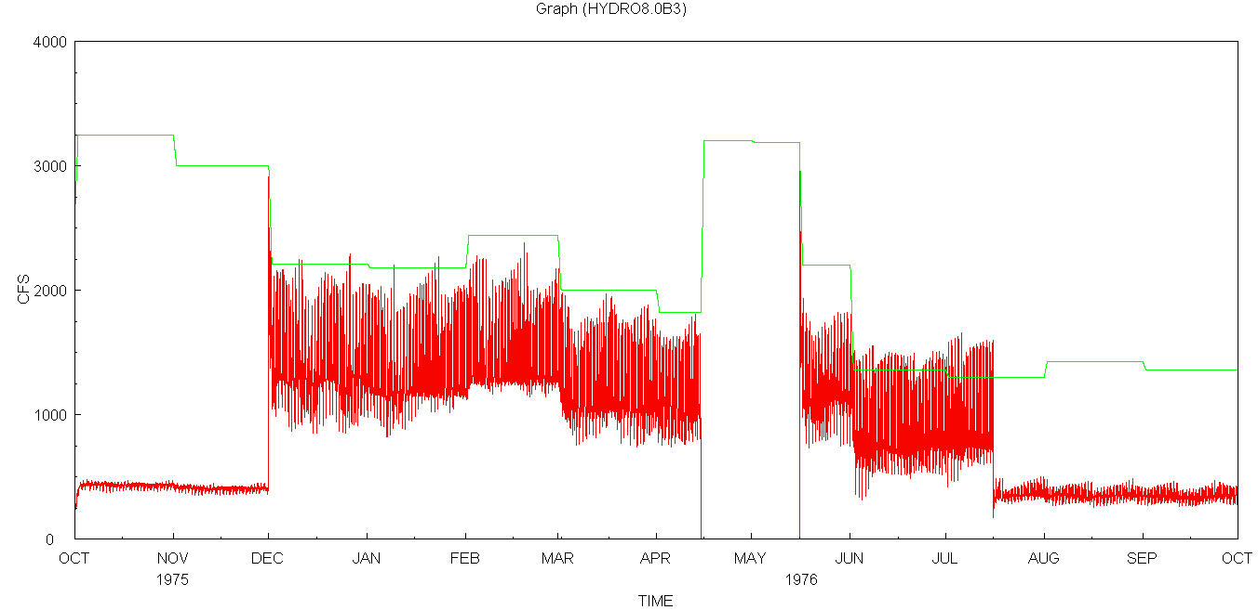
Flow at Old River d/s of Head of Old River Gate
Vernalis
d/s of gate
Fall
SJR>10,000; Open
SJR<10,000; Partially Close for 10~15% Leakage
Winter
Open
VAMP
SJR>10,000; Open
SJR<10,000; Close
Summer
Open
Late Summer
800<SJR<2,500;
Partially Close

Slide 17
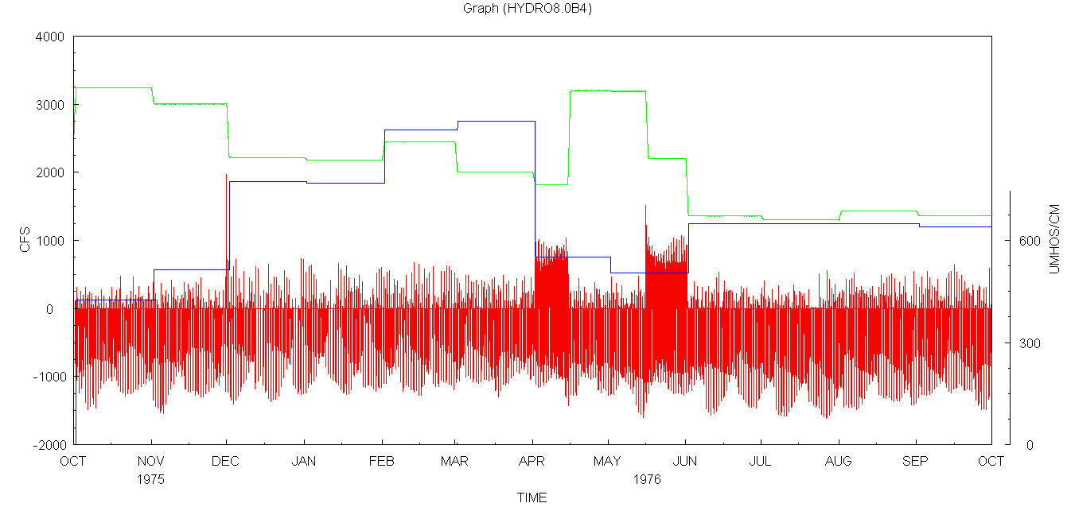
Flow at d/s of Middle River Gate
Vernalis Flow
d/s of gate Flow
Vernalis EC
EC=600 (Umhos/cm)
Fall
SJR<10,000; U
SJR>10,000; T
Winter
ECV<600 OR
SJR>4,000; T
SJR<4,000; U
VAMP
SJR<10,000; U
SJR>10,000; T
Summer
ECV<600 OR
SJR>4,000; T
SJR<4,000; U
Late Summer
SJR<4,000; U
SJR>4,000; T
U → Flood Open & Ebb Close ; T → Gate is only closed when necessary to protect water level targets.

Slide 18
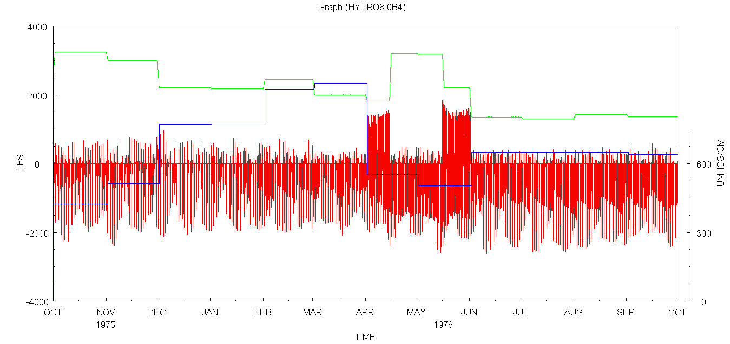
Flow at d/s of Old River at Tracy Gate
Vernalis Flow
d/s of gate Flow
Vernalis EC
EC=600 (Umhos/cm)
Fall
SJR<10,000; U
SJR>10,000; T
Winter
ECV<600 OR
SJR>2,500; T
SJR<2,500; U
VAMP
SJR<10,000; U
SJR>10,000; T
Summer
ECV<600 OR
SJR>2,500; T
SJR<2,500: U
Late Summer
SJR<2,500; U
SJR>2,500; T
U → Flood Open & Ebb Close ; T → Gate is only closed when necessary to protect water level targets.

Slide 19
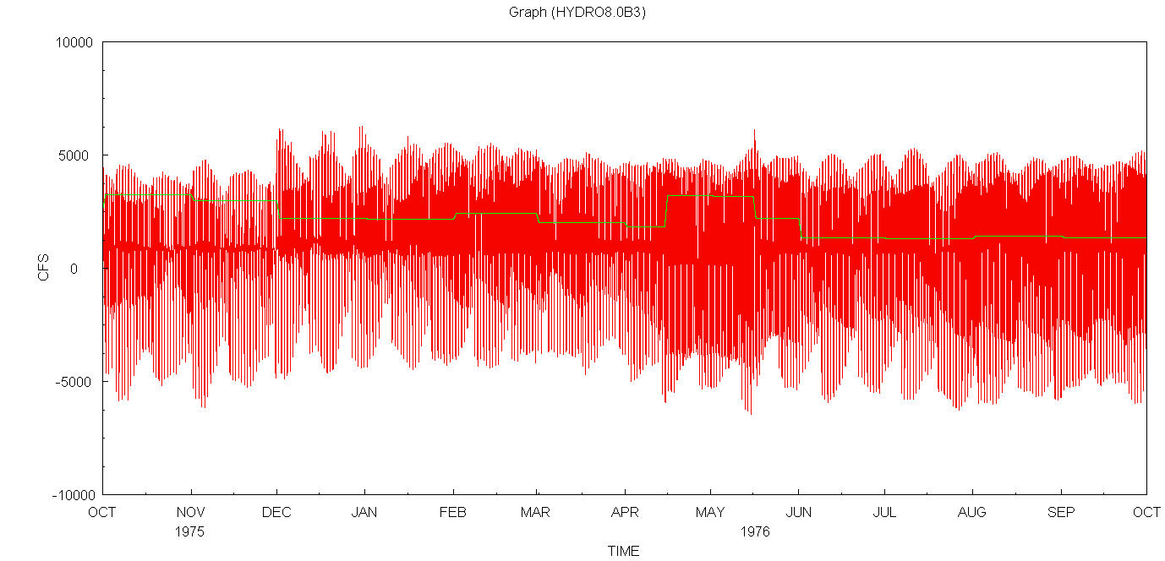
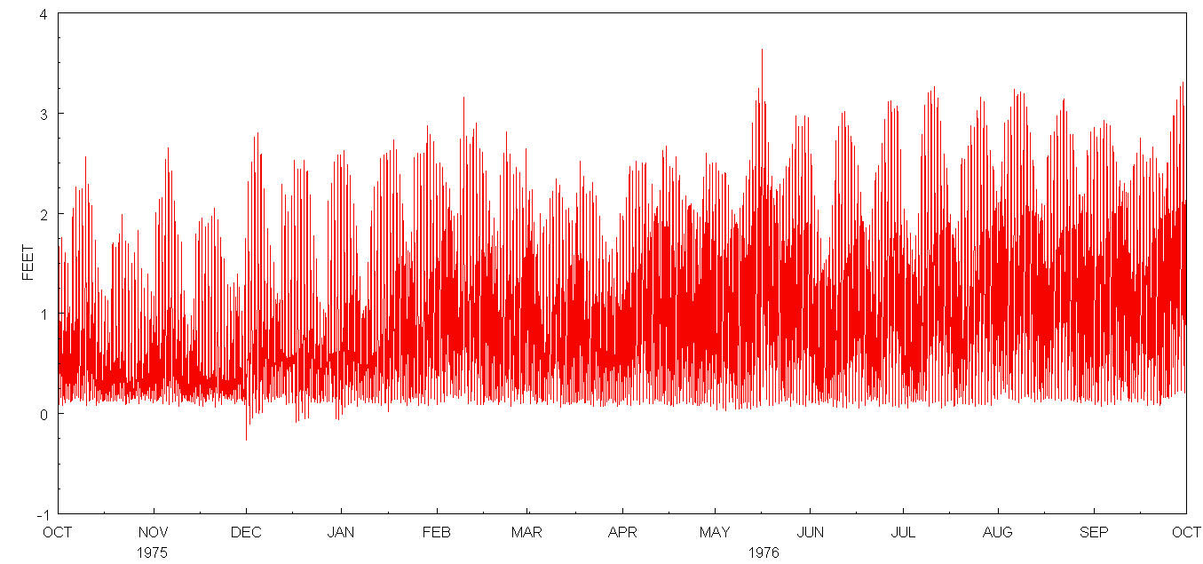
Flow at d/s of Grant Line Canal Gate
Stage near Tracy Road Bridge
Vernalis
d/s of gate
Fall
Stage Trigger (T)
Winter
Stage Trigger (T)
VAMP
Stage Trigger (T)
Summer
Stage Trigger (T)
Late Summer
Stage Trigger (T)
T → Gate is only closed when necessary to protect water level targets.

Slide 20
Operating Rule for Head of Old River varying RAMP
Name:
orh_open (Head of Old River Open Position)
Action:
“SET gate_op (gate=old_r@head_barrier, device=weir, direction=to_from_node) TO OPEN RAMP 30MIN”
Trigger:
“sjr_high OR a_winter OR a_summer OR (a_late_summer
AND (NOT orh_partial_sjr_flow))”

Slide 21
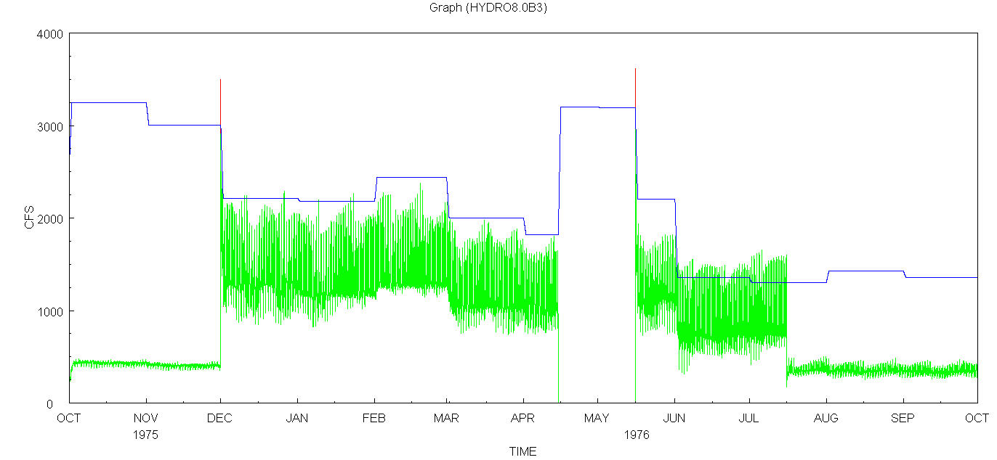
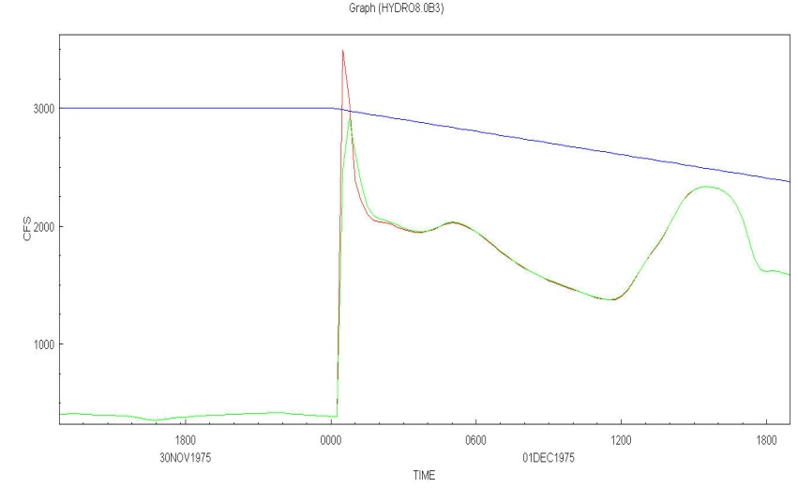
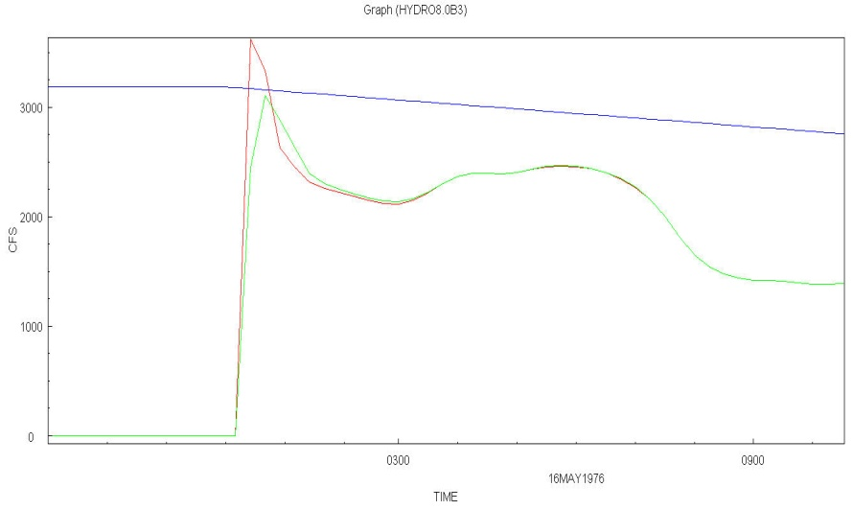
Flow at Old River d/s of Head of Old River Gate
with varying open RAMP
Vernalis
d/s of gate open RAMP 60 Min
d/s of gate open RAMP 30 Min
Fall
SJR>10,000; Open
SJR<10,000; Partially Close for 10~15% Leakage
Winter
Open
VAMP
SJR>10,000; Open
SJR<10,000; Close
Summer
Open
Late Summer
800<SJR<2,500;
Partially Close

