Slide 1
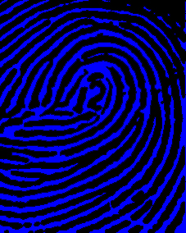
Delta Simulation Model 2 (DSM2) Fingerprinting

Slide 2
What is fingerprinting?
Fingerprinting tells us how much water at a given Delta location came from each inflow source.

Slide 3

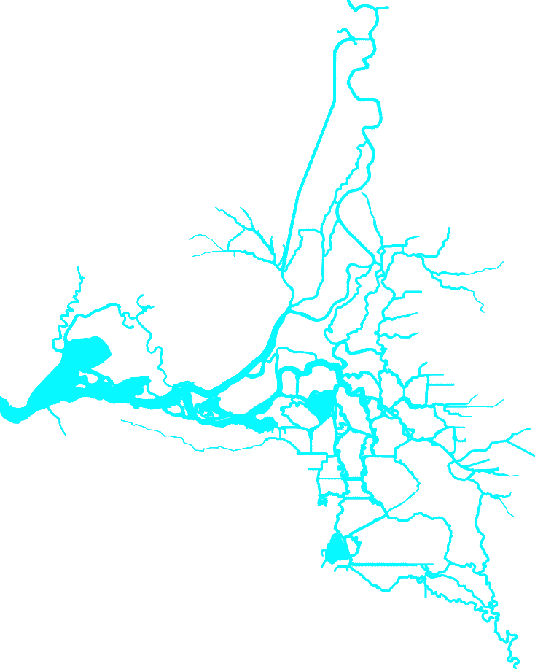
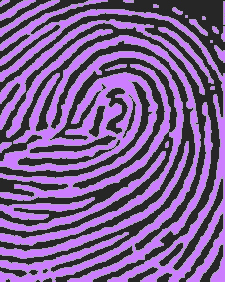
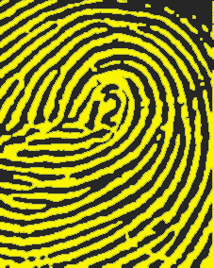
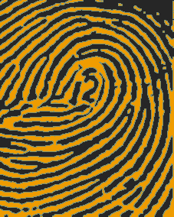
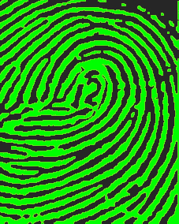
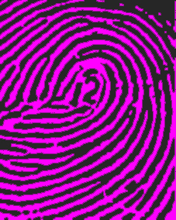
Fingerprinting Source Locations
Sacramento River
Area of Detail
• Sacramento
Yolo
Bypass
Eastside
Streams
Agricultural
Drainage
(>250 locations)
• Martinez
Ocean
•
Stockton
San Joaquin River

Slide 4
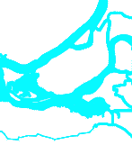

Fingerprinting Conceptualization
Where did the water at Emmaton come from?
?
?
●
?
Emmaton
?
?
?

Slide 5
Fingerprinting Conceptualization
Where did the water at Emmaton come from?
?
?
●
?
Emmaton
Sacramento River
?
?
San Joaquin River
?
Ocean
Eastside Streams
Ag Drains
Yolo Bypass

Slide 6
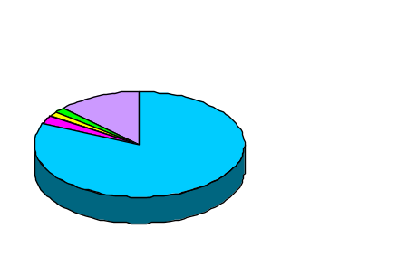
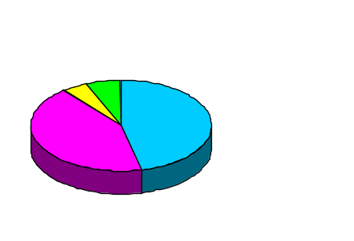
Average Monthly Flow Contributions in March for 1991-1998
Sacramento River
Emmaton
82% Sacramento River
13% Yolo Bypass
2% Agricultural Drains
2% San Joaquin
1% Eastside Streams
Yolo
Bypass
Eastside
Streams
Agricultural
Drainage
(>250 locations)
Ocean
Old River at Rock Slough
47% Sacramento River
43% San Joaquin
6% Agricultural Drains
4% Eastside Streams
San Joaquin River

