Slide 1
Developing Irregular Cross-sections for DSM2-Hydro
Brad Tom
Department of Water Resources
Suisun Marsh Planning Section
btom@water.ca.gov

Slide 2
Acknowledgements
Ralph Finch
Nicky Sandhu
Parviz Nader-Tehrani

Slide 3
Problem Statement
to describe 3D bathymetry data to hydro, a 1D model

Slide 4
Use CSDP to create model geometry
Create a minimal representative data set based on the bathymetry data set
place less emphasis on unreliable or less representative data
evaluate the effects of proposed changes

Slide 5
Outline
Introduction to CSDP
Problems to avoid
Demonstration of CSDP
CSDP Example problem(?)

Slide 6
CSDP
replaces BDD
written in Java
  also an object-oriented language
  platform independent
  easier to maintain than C++
available on DMS web page
  http://baydeltaoffice.water.ca.gov/modeling/deltamodeling/models/csdp

Slide 7
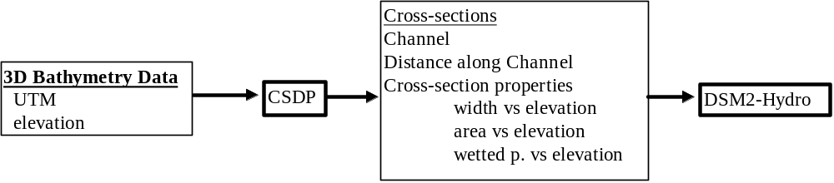
Geometry Development

Slide 8
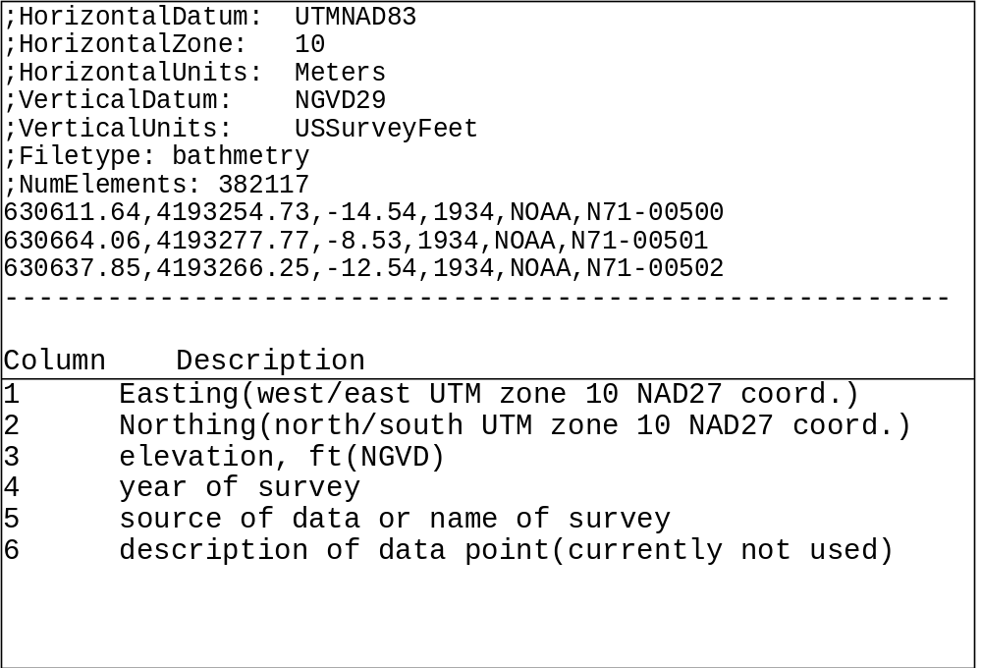
3D Bathymetry Data

Slide 9
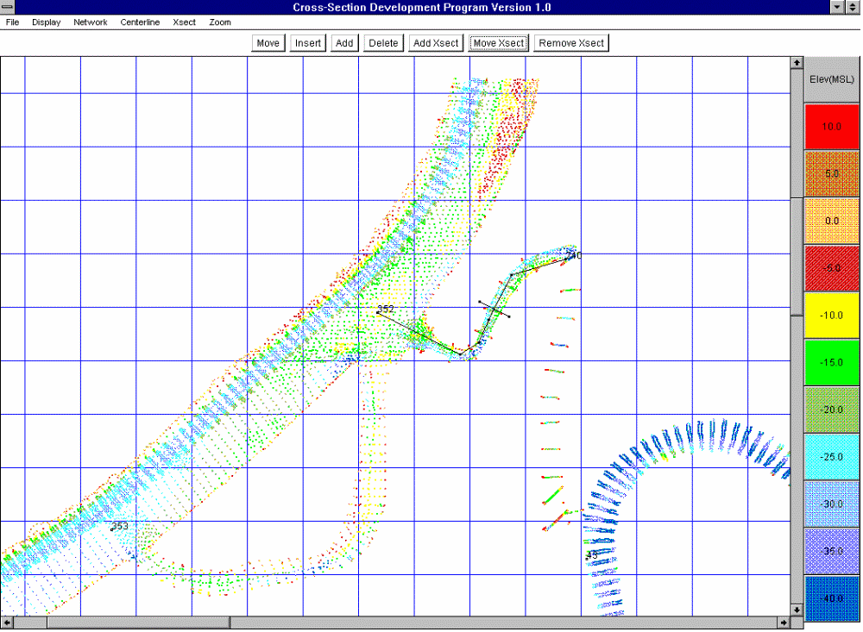
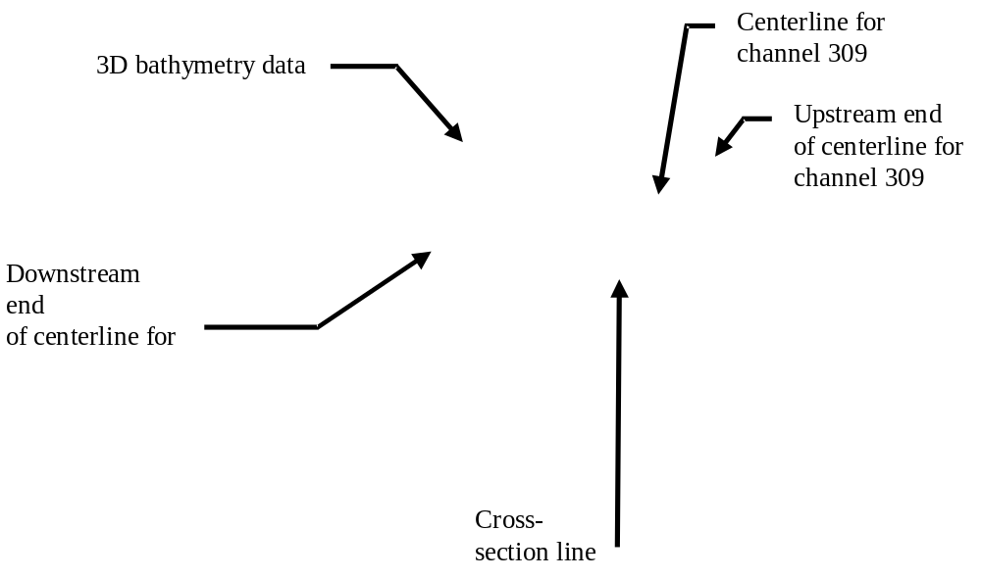
CSDP

Slide 10
Cross-section Normalized Distance
U
C=Centerline length
D=Dist. From upstream end
to cross-section line
D
N=D/C

Slide 11
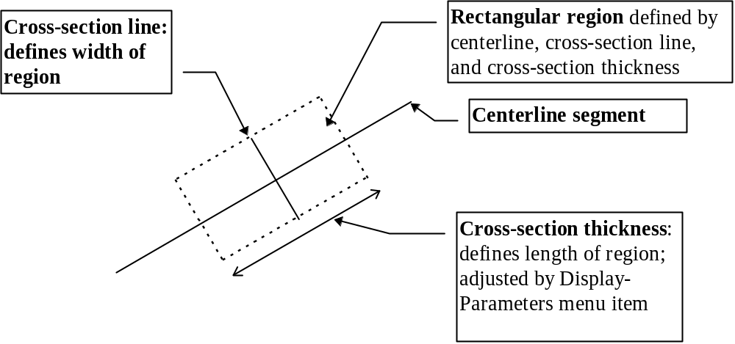
Data selection

Slide 12
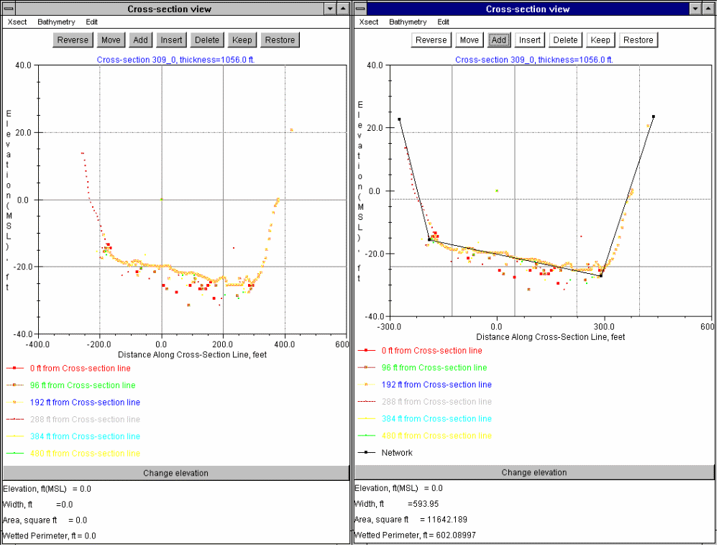
Drawing Cross-sections

Slide 13
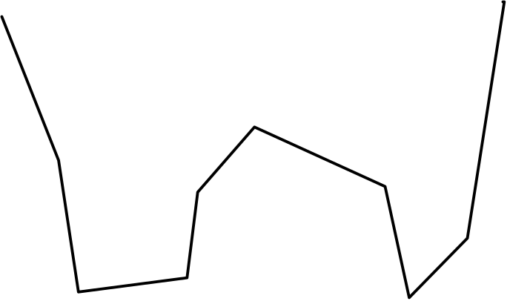
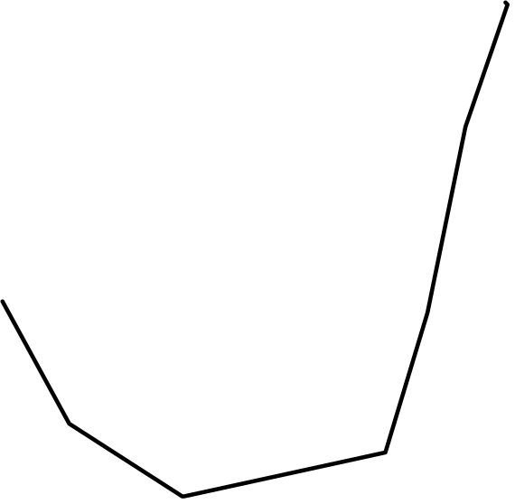
“W” shaped cross-section
OK
“J” shaped cross-section
NOT OK

Slide 14
Calculation of Conveyance Characteristics
W1
W2
W3
W4
W5
A1
A5
A2
A4
P1
P5
A3
P2
P4
P3
W=W1+W2+W3+W4+W5
A=A1+A2+A3+A4+A5
P=P1+P2+P3+P4+P5

Slide 15
Why J-Shaped cross-section is a bad idea
W1
W2
W3
W4
Area is not much smaller,
But wetted perimeter is!
Result: inaccurate estimation of conveyance characteristics
A1
A2
A4
P1
A3
P2
P4
P3

Slide 16
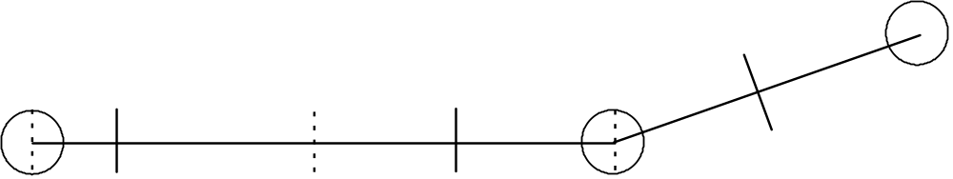
Cross-section Interpolation
results in a virtual (interpolated) cross-section at every computational point
done automatically by Hydro
limits the use of rectangular cross-sections

Slide 17
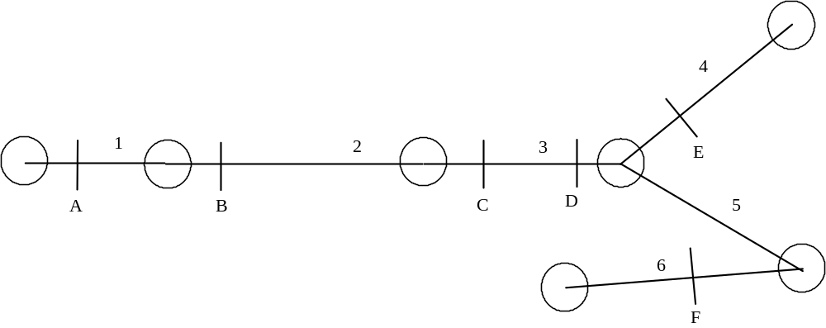
Cross-section Interpolation Example

Slide 18
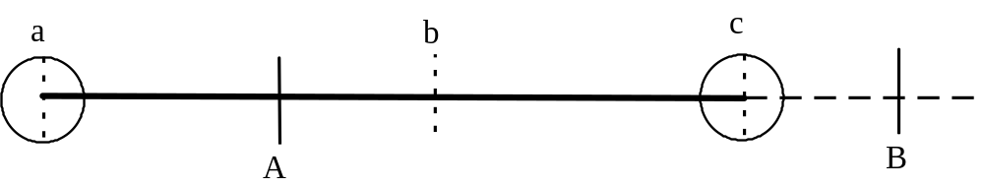
Channel 1

Slide 19
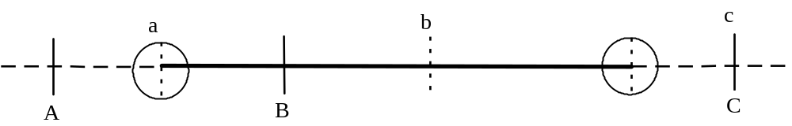
Channel 2

Slide 20
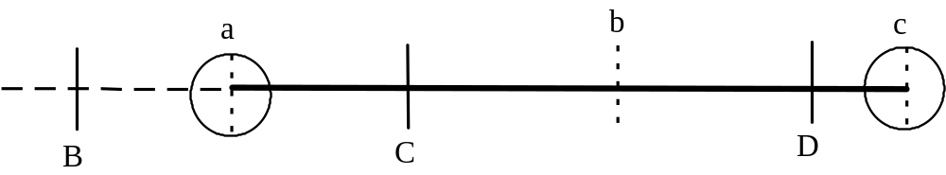
Channel 3

Slide 21
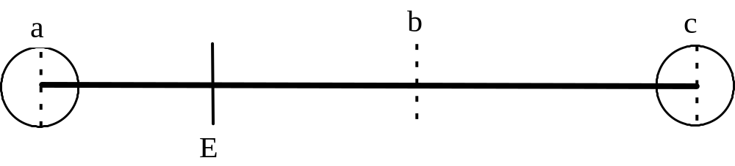
Channel 4

Slide 22
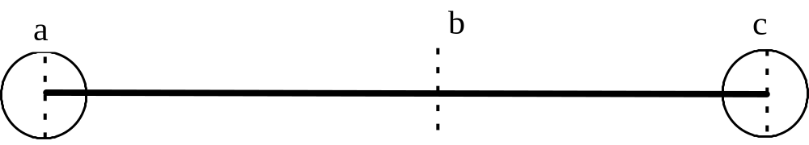
Channel 5

Slide 23
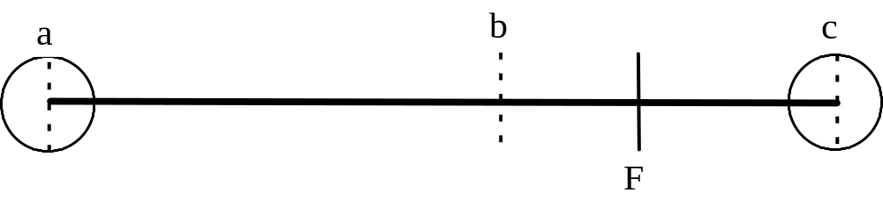
Channel 6

Slide 24
DSM2 Virtual Cross-Sections
VIRTUAL CROSS-SECTION LOOKUP TABLE
Channel 1,Virtual Section 1
Height Width Area Wet_p Z Centroid min_elev
---------------------------------------------------------------------------
0.00 192.00 0.00 192.00 0.00 -5.10
5.10 192.00 979.20 202.20 2.55 -5.10
100.00 192.00 19200.00 392.00 50.00 -5.10
Channel 1,Virtual Section 2
Height Width Area Wet_p Z Centroid min_elev
---------------------------------------------------------------------------
0.00 192.00 0.00 192.00 0.00 -5.10
5.10 192.00 979.20 202.20 2.55 -5.10
100.00 192.00 19200.00 392.00 50.00 -5.10
Channel 1,Virtual Section 3
Height Width Area Wet_p Z Centroid min_elev
---------------------------------------------------------------------------
0.00 192.00 0.00 192.00 0.00 -5.10
5.10 192.00 979.20 202.20 2.55 -5.10
100.00 192.00 19200.00 392.00 50.00 -5.10

Slide 25
Problems to avoid
  Convergence Failures-big changes within channel
  negative dConveyance
  interpolated negative dConveyance

Slide 26
Convergence Failures
model will not converge if large changes in NGVD area within a channel
max NGVD area >= 2 * min NGVD area
If a channel dries up or overflows, could be the result of a convergence failure
to find channels with potential convergence problems, run Hydro with printlevel 5
to correct: adjust cross-sectional areas or assign cross-sections to ends of channels to prevent interpolation

Slide 27
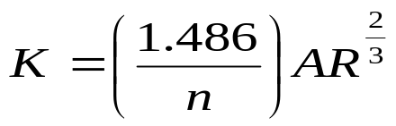
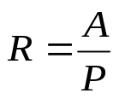
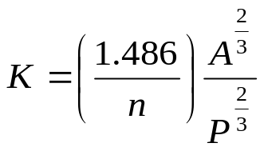
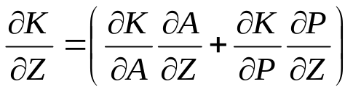
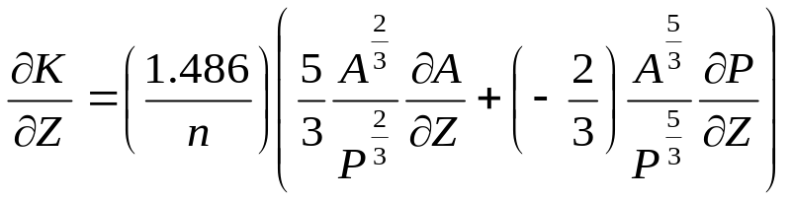
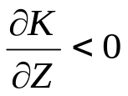
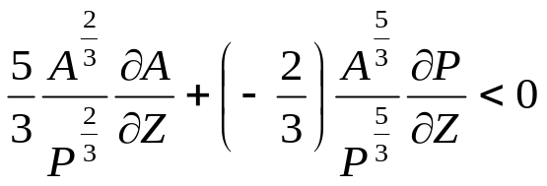
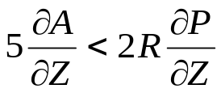
Negative dConveyance
since
If
, then
Or

Slide 28
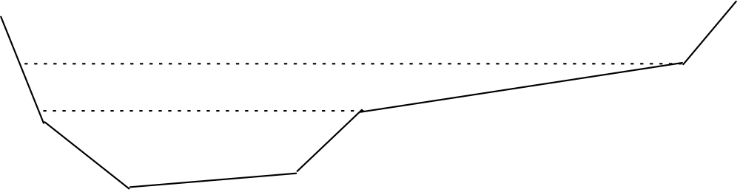
Negative dConveyance
derivative of conveyance wrt height
caused by small line segment slopes
model run will fail if water level enters a portion of any cross-section with –dk
identify by running Hydro with printlevel 5
try to remove -dk in -5 ft < Z > 15 ft NGVD
A convergence failure could cause water level to go outside of its normal range, cause a –dk error.
eliminate by changing slope

Slide 29
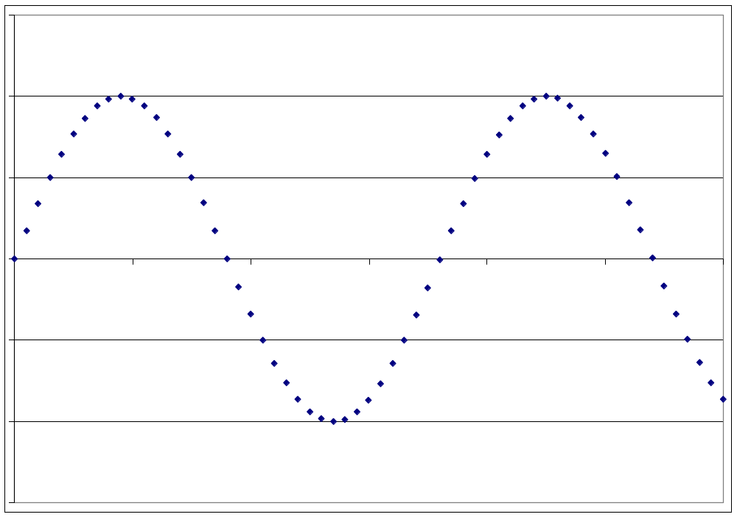
Negative dConveyance

Slide 30
Interpolated Negative dConveyance
occurs in virtual(interpolated) cross-sections
usually caused by differences in bottom elevation
to correct:
  change bottom elevation(s)
  assign cross-section to end(s) of channel to
    prevent interpolation from adjacent channel(s)

Slide 31
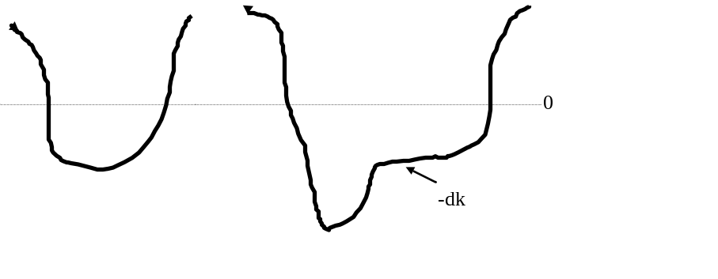
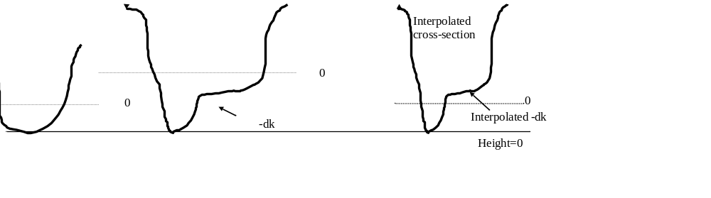
Interpolated Negative dConveyance

Slide 32
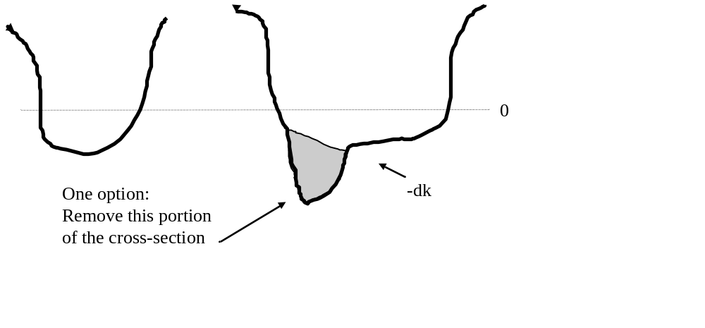
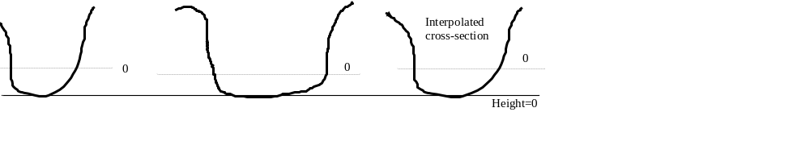
Correcting Interpolated Negative dConveyance

Slide 33
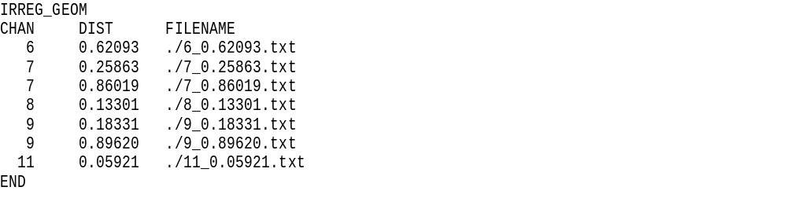
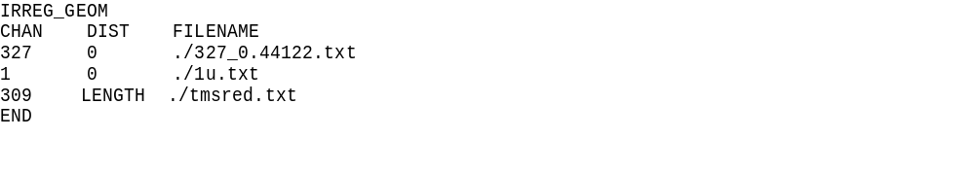
CSDP Output files--DSM2 irregular cross-section input
irregular_xsects.inp
Don’t edit this file!
irregular_xsects_copy.inp

Slide 34
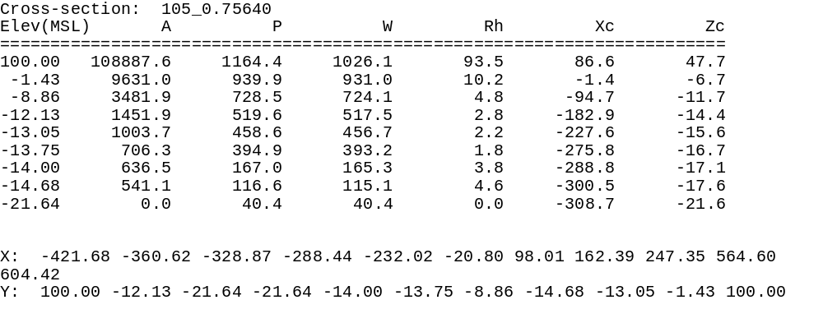
DSM2 irregular cross-section input

Slide 35
What to do if you get a –dk error
Use the “H” value and bottom elevation to calculate the elevation of the –dk
Do any of the irregular cross-sections have –dk at this elevation? If no, it’s interpolated –dk.
If it’s not interpolated –dk: should the water be entering this part of the cross-section?
  If yes, then determine which cross-section(s) are used to create the virtual cross-section, and edit cross-section(s).
  If no, then it’s really a convergence failure

Slide 36
What to do if a channel dries up
Check all input for errors (fixed and time-varying)
What is the H value?
  If large negative value, it’s definitely a convergence problem.
  If small, possibilities are:
    Is it early in the run? May need to adjust initial conditions. An initial stage that is too high or too low can cause a channel to dry up.
Does this channel dry up in reality?
  If yes, then options are:
    remove channel from grid
    Make cross-section(s) deeper, either by removing irregular cross-sections or by editing them
  If no:
    Does the channel almost dry up in reality? Consider making the cross-sections deeper.
    Does the channel never come close to drying up in reality? If initial conditions are ok, consider modifying geometry to remove large cross-sectional area changes.

Slide 37
What to do if a channel overflows
Check all input (fixed and time-varying)
Check virtual cross-sections for large changes in cross-sectional area and adjust.

Slide 38
CSDP Installation
Download and execute the csdpsetup.exe file from http://baydeltaoffice.water.ca.gov/modeling/deltamodeling/models/csdp/index.html
The setup program creates c:\semms.env and c:\semmsconLib\. Do not rename or remove these.
Cross-Section Development Program Version 2.53
---------- Semmscon Test Results -----------
Input: utm27x, utm27y=629355.0,4199384.0
NOTE: the following values should be
629258.5972470464 and 4199579.604951745
If they are not, there may be a problem
with the installation of the coordinate
conversion routines
result of utm27ToUtm83:
utm83x, utm83y=629258.5972470464,4199579.604951745
--------------------------------------------
These numbers should match these numbers

Slide 39
CSDP Demonstration
Add bathymetry data to database
select data
  centerline
  cross-section line
draw and edit cross-sections
create DSM2 input files
run Hydro
-dConveyance & convergence failures

