Slide 1

Delta Planning Simulations
DSM2 Training
September 2009
Jamie Anderson, PhD, PE
Delta Modeling Section
California Department of Water Resources
Notes:
DSM2 Users Group: "EXAMPLE: Filling in Martinez Stage"
2004.04.27

Slide 2
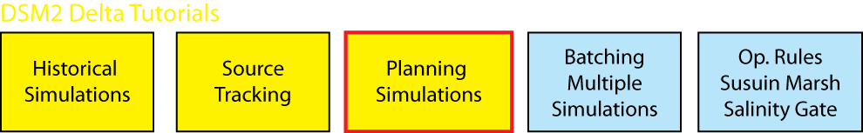
What We Will Cover
What is a DSM2 planning simulation
  Boundary conditions
  Adjusted astronomical tide
  Delta Island Consumptive Use (DICU)
Questions to ask CalSim modelers
Other planning run considerations
Notes:
DSM2 Users Group: "EXAMPLE: Filling in Martinez Stage"
2004.04.27

Slide 3
DSM2 Applications
DSM2
Modes of Application
Historical
Replicate historical conditions
Forecasting
(Real-Time)
Project conditions for the near future
Planning
Hypothetical Delta changes

Slide 4
DSM2 Planning Simulations
Used to evaluate hydrodynamic, water quality, and sometimes ecological impacts of future alternatives
Typically run for 16-year period
  Water year 1976-1991 (Oct1975-Sept 1991)
  Warm up water year 1975
Inflow and export boundary conditions typically provides by CalSim simulations

Slide 5
Example DSM2 Planning Studies
Bay Delta Conservation Plan (BDCP)
Pelagic Organism Decline (POD)
South Delta Improvements Project (SDIP)
In-Delta Storage

Slide 6
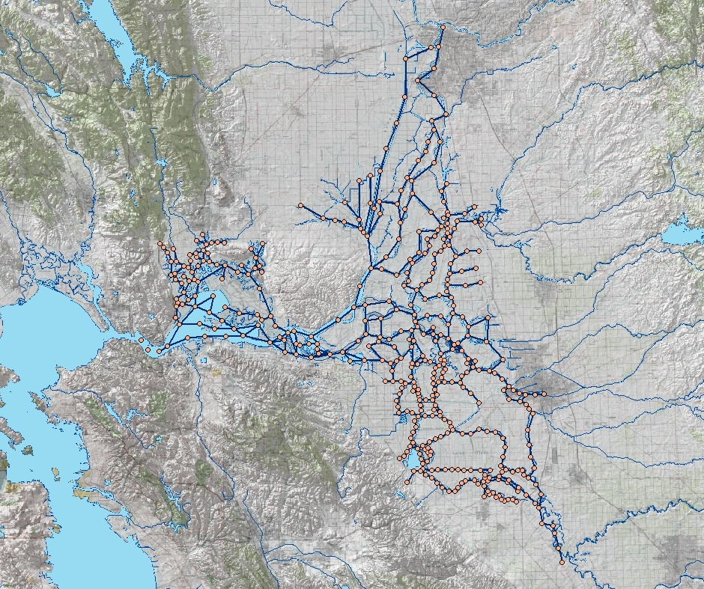
DSM2 Boundary Conditions for Planning Simulations
Sacramento River
Sacramento
Flows from CalSim
SJR EC from CalSim
Sac & Tributary EC constant
Inflow & water quality
Export flow
Tributaries
Stage from Adjusted Astronomical Tide
may be further adjusted for sea level rise
EC based on Net Delta Outflow from CalSim
Delta Island Consumptive Use
Based on CalSim Level of Development
may be modified by climate change
Converted to DSM2 using ADICU model
Flow: monthly values that vary by year
EC: Monthly values repeated every year
Martinez
Tidal Stage & Water Quality
Stockton
Exports from CalSim
may need to adjust for VAMP
Exports
Exports
VAMP=Vernalis Adaptive Management Plan
San Joaquin River
Image from USBR GIS Group

Slide 7

CalSim in a nutshell
Water allocation model that simulates operations of SWP and CVP facilities
  Includes Delta salinity and operations
Accounts for system operational objectives, physical constraints, legal and institutional agreements and/or statutes
Uses historical hydrological conditions, as modified, to reflect a given level of development
  Typically run for 82 years (wy1922-2003)
SWP = State Water Project CVP= Central Valley Project

Slide 8
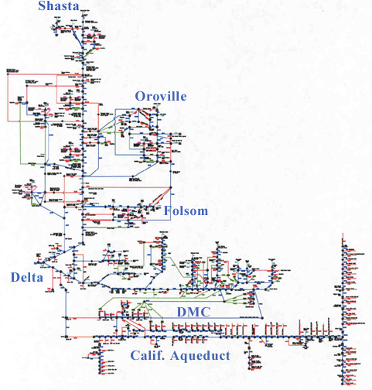
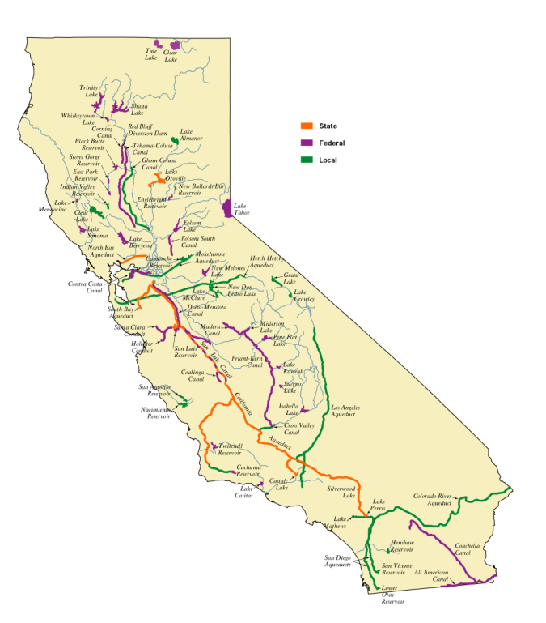
Statewide CVP & SWP
Water Allocation Model
CALSIM
State Water Project
Central Valley Project (Federal)
Local

Slide 9
CalSim Input/Output Naming Conventions
Input/Output DSS files
  SV state variables ⇨ input
  DV decision variable ⇨ output
Variable Names
  C channel flow
  D diversion flow
  I inflow
  R return flow
  S storage volume

Slide 10
DSM2 and CalSim
Boundary Condition Nodes
Location | DSM2 Node | CalSim ID
Sac | 330 | C169
Vernalis (SJR) | 17 | C639
Calaveras | 21 | C508
Cosumnes | 446 | C501
Mokelumne | 447 | I504
Yolo Bypass | 316 | C157

Slide 11
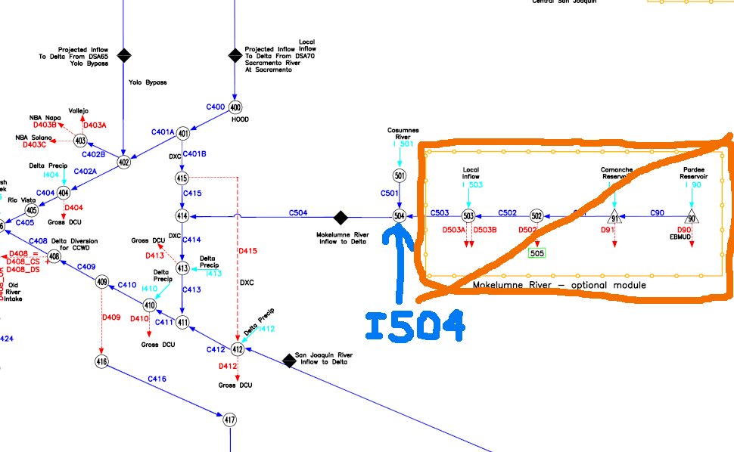
Mokelumne River in CalSim
I504 from EBMUDSIM

Slide 12
DSM2 and CalSim
Export Nodes
Location | DSM2 Node | CalSim ID
SWP | Clifton_Court | D419
CVP | 181 | D418
CCC | 206 | D408
North Bay Aq. | 273 | D403B
Vallejo | 320 | D403A
SWP = State Water Project CVP= Central Valley Project CCC=Contra Costa Canal

Slide 13
Questions to ask CalSim Folks
Time Step & Level of Development
Affects BCs
What was the time step?
  typically monthly but it can be daily
What was the level of development
 | Sacramento | San Joaquin
Current 2005-2011 | 2005 | 2005
Future 2020-2035+ | 2020 | 2020
Affects DICU

Slide 14
Questions to ask CalSim Folks
Regulations
May Affect BCs
VAMP
Gates
What regulations (regulatory environment) was used in the CalSim study?
  D1641 (no VAMP)
  EWA Environmental Water Account (includes VAMP)
  Other (e.g. Wanger)
VAMP Vernalis Adaptive Management Plan
  Increase (pulse) SJR flows for 31 days (April 15-May 15)
  Decrease export pumping
  In DSM2 change Sac, SJR, SWP and CVP exports, and head of Old River gate operations

Slide 15
Questions to ask CalSim Folks
Infrastructure
Were there any infrastructure changes included in the CalSim run?
  Storage (e.g. reservoirs)
  Conveyance (e.g. Peripheral Canal)
May affect DSM2 setup or may just be reflected in inflows and exports

Slide 16
Questions to ask CalSim Folks
CCWD Exports and Infrastructure
What exports were used for Contra Costa Water District?
  Pumping Plant #1
  Los Vaqueros
Were there any infrastructure changes included in the CalSim run?
  Storage (e.g. reservoirs)
  Conveyance (e.g. Peripheral Canal)
Affects CCWD exports
May affect DSM2 setup or may just be reflected in inflows and exports

Slide 17
Questions to ask CalSim Folks
Delta Salinity ANN
Artificial Neural Networks (ANNs) are used in CalSim to quickly represent Delta salinity for assessing compliance with standards

Slide 18
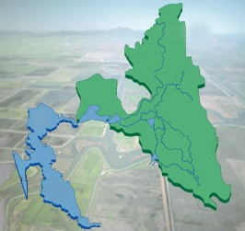
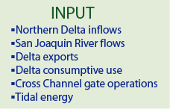
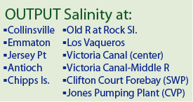
Developing Delta Salinity ANNs
Use DSM2 to simulate Delta Salinity
Using DSM2 results, “train” ANN
to replicate Delta salinity
For sea level rise scenarios
DSM2 Domain
Sacramento
Sacramento
River
Delta Salinity ANN
Stockton
San
Joaquin
River
San
Francisco
At Martinez change
  Water level
  Salinity
  Possibly tidal amplitude
ANN=Artificial Neural Network

Slide 19
Questions to ask CalSim Folks
Delta Salinity ANN
Artificial Neural Networks (ANNs) are used in CalSim to quickly represent Delta salinity for assessing compliance with standards
What Delta salinity ANN was used?
  Current conditions
  Sea level rise
    Currently available for 1ft and 2ft scenarios
    May include tidal amplitude change as a surrogate for increased dispersion
    Were water levels the only change for the SLR scenario or were tidal amplitudes and/or other variables changed?
  Other?
May affect Martinez Boundary Condition

Slide 20
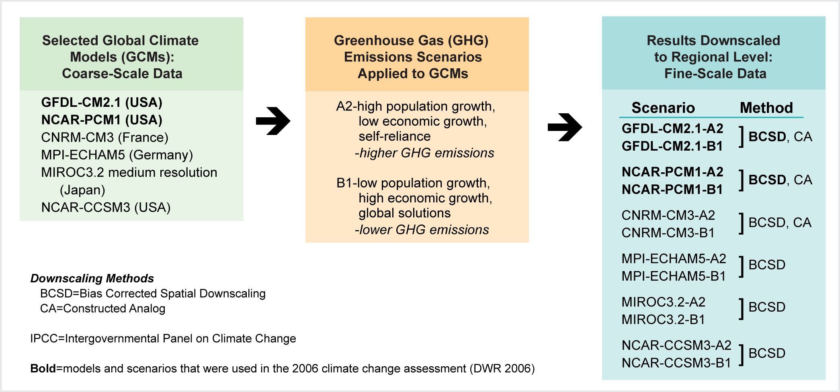
Questions to ask CalSim Folks
Climate Change
What climate change scenario was used?
  typically Global Climate Model + green house gas emissions scenario + downscaling method (GCM+GHG+downscaling)
Reflected in CalSim output

Slide 21
Questions to ask CalSim Folks
Climate Change
What was the future projection period
  typically a 30 year interval
    2030-2059 mid-century
    2070-2099 end of the century
Were water year designations changed
Were any water demands changed?
Reflected in CalSim output
Affects analysis of water quality standard compliance
May affect DICU

Slide 22
Questions to ask CalSim Folks
Things that typically don’t change but should be checked ocassionally
What are the Delta Cross Channel gate operations
  Typically a percent time open/closed per month
  In DSM2 implemented as open at beginning of month for specified portion of the month

Slide 23
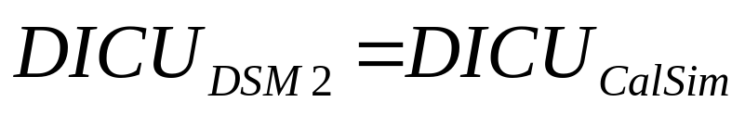
DICU in CalSim and DSM2
DSM2 simulations keep the same volume of DICU as CalSim
ADICU model distributes DICU to DSM2 nodes
2004 Annual Report Ch5 Section 5.4.3
DICU = Delta Island Consumptive Use

Slide 24

Annual Reports to SWRCB
DSM2 Cool Tip
http://baydeltaoffice.water.ca.gov/modeling/deltamodeling/annualreports.cfm
QUAL dispersion coefficients 2008 CH2
82-year planning tide 2007 CH4
SDIP gates 2006 CH6
PTM for fish entrainment 2006 CH10
Fingerprinting 2005 CH6
Net Delta Outflow calcs using DSM2 & CalSim 2003 CH4
Adjusted astronomical tide 2001 CH10
SWRCB = State Water Resources Control Board SDIP=South Delta Improvements Program
PTM = Particle Tracking Model

Slide 25

CalSim Gotchas
CalSim DSS output files often have the same name and F-part
  Differentiated by folder name
  Recommend renaming CalSim output DSS file if you are comparing several alternatives
  Change F-Part in DSM2 using
  DSM2-Modifier
Sea level rise ANNs may include tidal amplitude changes

Slide 26
DSM2 Considerations
Does DICU need to be adjusted?
  ADICU model
Do boundary conditions need to be adjusted for VAMP?
  Sac, SJR, SWP and CVP exports
Does Martinez boundary need to be adjusted for sea level rise
Are there any physical changes to the Delta or its infrastructure to consider?
  Dredging (requires a new grid)
  Flooded islands
  Peripheral canal or other storage/conveyance
How are gates implemented in this scenario?

Slide 27
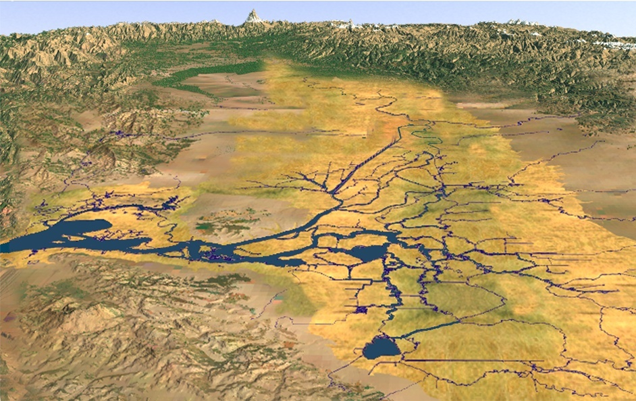
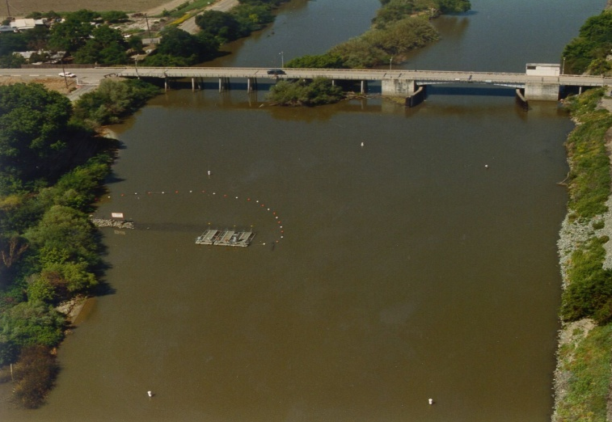
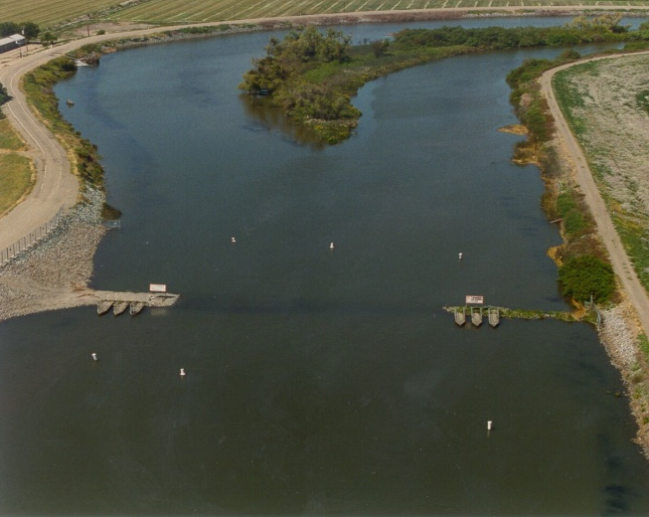
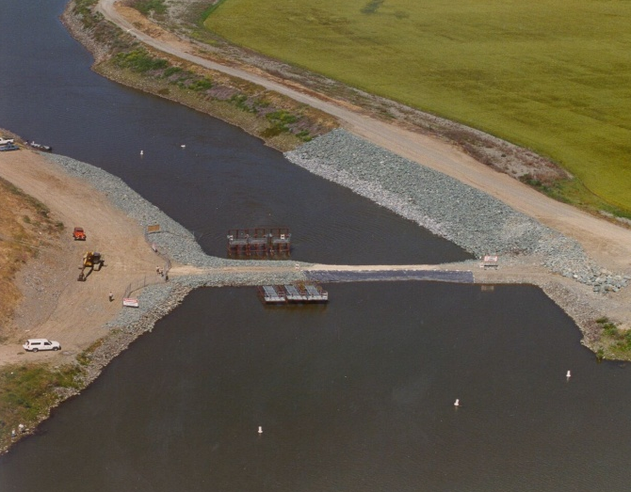
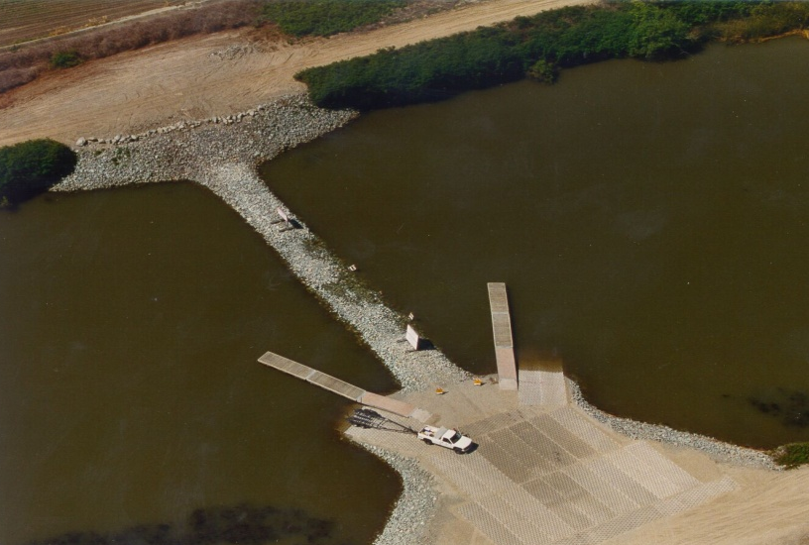
South Delta Temporary Barriers
Grant Line Canal
Middle River
Head of Old River
Stockton
Jones Tract
Roberts
Island
●
Clifton Court Forebay
Union Island
Old River at Tracy
Fabian Tract

Slide 28
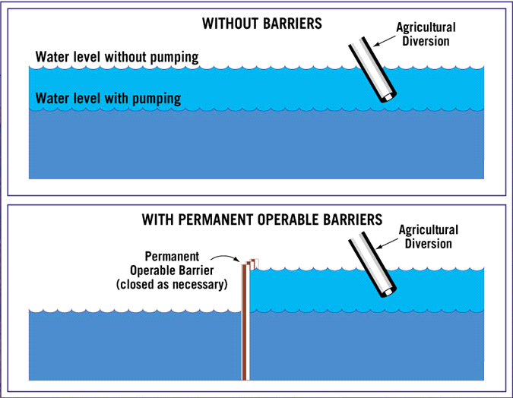
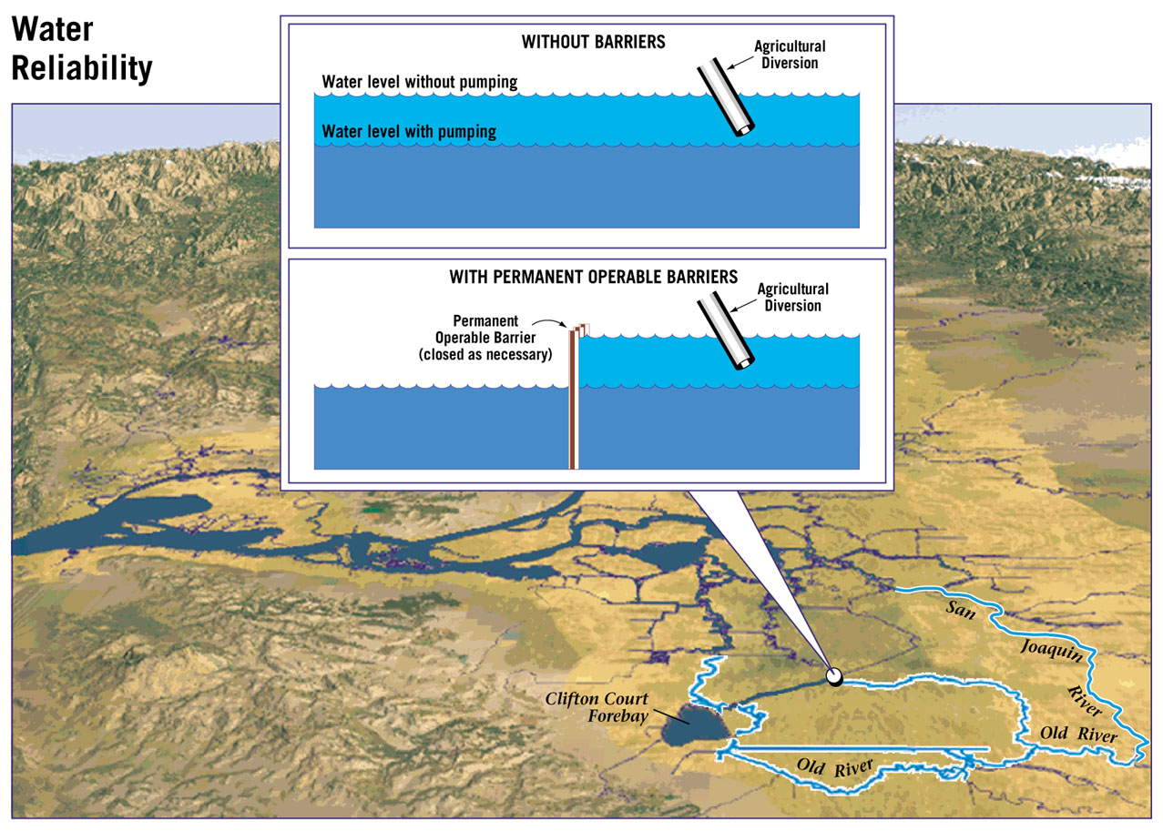
WITHOUT BARRIERS
Scale exaggerated for illustration purposes
WITH BARRIERS

Slide 29
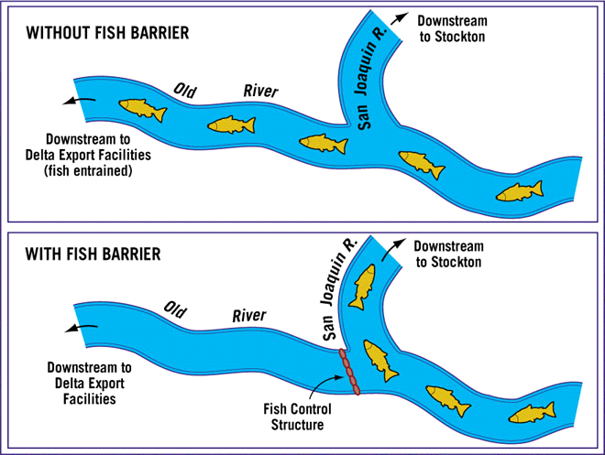
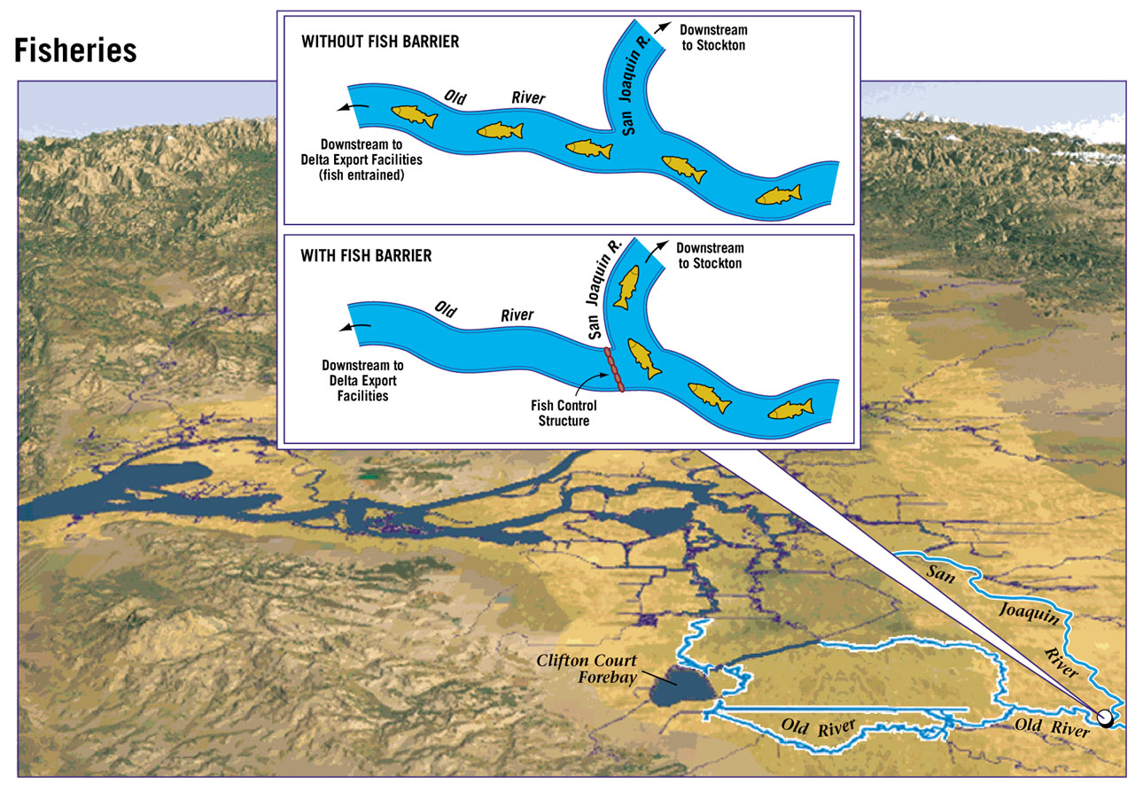


Slide 30
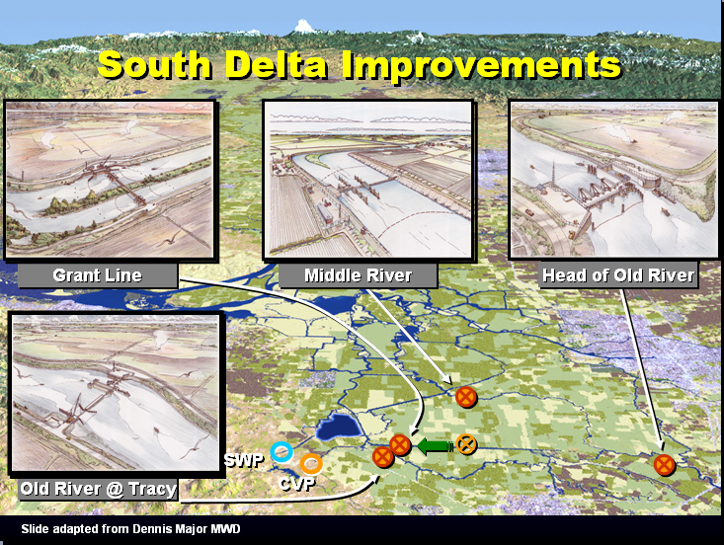

Slide 31
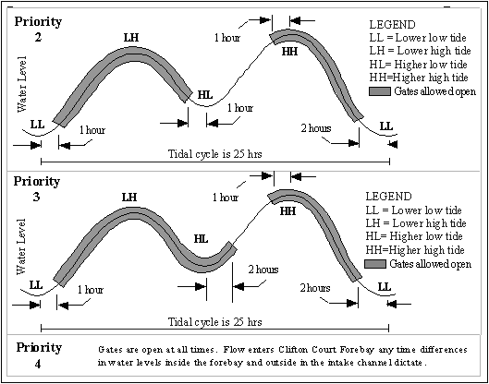
Clifton Court Operating Priorities
Can be used in planning studies to represent highest impact operations

Slide 32
Analyzing Planning Study Results
Depends on objectives of the study
Often includes compliance with D1641 water quality standards
  Simulated EC converted to chloride for Contra Costa
    Cl<250 mg/l
    Cl<150 mg/l for a specified # days/yr depending on water year type
  EC standard at four Delta locations
Location | Jan | Feb | Mar | Apr | May | Jun | Jul | Aug | Sep | Oct | Nov | Dec
SJR at Vernalis SJR at Brandt Bridge Old R near Middle R Old R at Tracy Bridge | Maximum 30 day running average of mean daily EC 1000uS/cm |  |  | Maximum 30 day running average of mean daily EC 700uS/cm |  |  |  |  | Maximum 30 day running average of mean daily EC 1000uS/cm

Slide 33

Background materials and references
DSM2 Cool Tip
http://baydeltaoffice.water.ca.gov/modeling/
deltamodeling/models/misc/background.cfm
Or get to link from
DSM2 or Delta Evaluation Tools websites

Slide 34

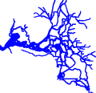
Now it’s time to do
the planning tutorial

