Slide 1

DSM2 Installation
Kevin Kao
Delta Modeling Section
California Department of Water Resources

Slide 2
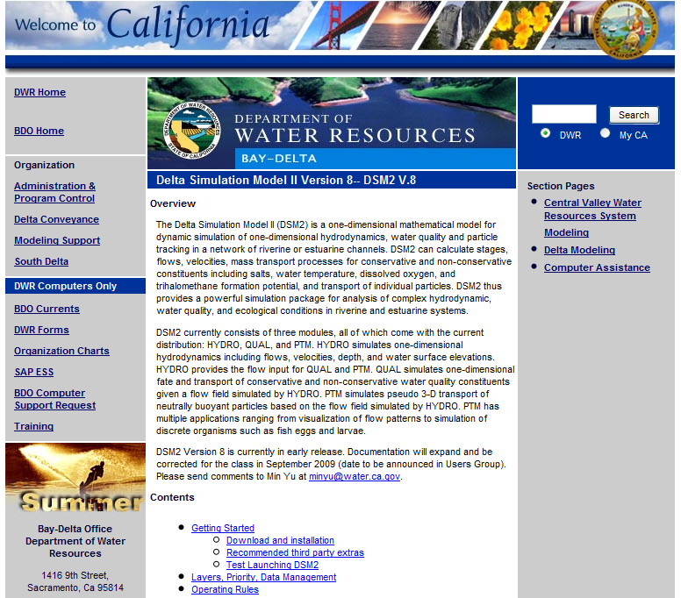
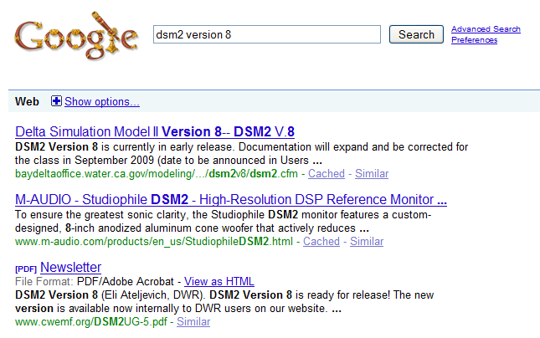
DSM2 Website
http://baydeltaoffice.water.ca.gov/modeling/deltamodeling/models/dsm2v8/dsm2.cfm
Google “DSM2”
Notes:
The information I am going to talk about for the next 10 mins can be found on the DSM2 website. And if you can remember the link, then just Google DSM2. There is another good search engine called BING, that’s developed by Microsoft, that one should work too. I heard that the BING search engine is an acronym for “But, it’s not Google”

Slide 3
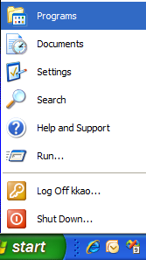

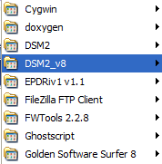
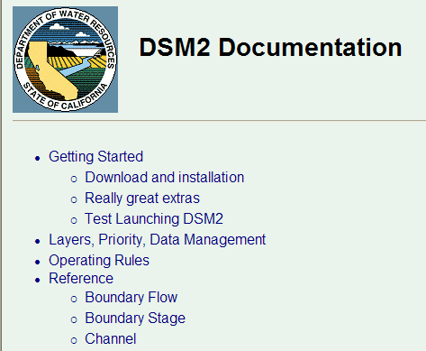
DSM2 Documentation
Notes:
In additional to the DSM2 website, another source for the information is the documentation file after you installed DSM2, it can be launched from the start menu.

Slide 4

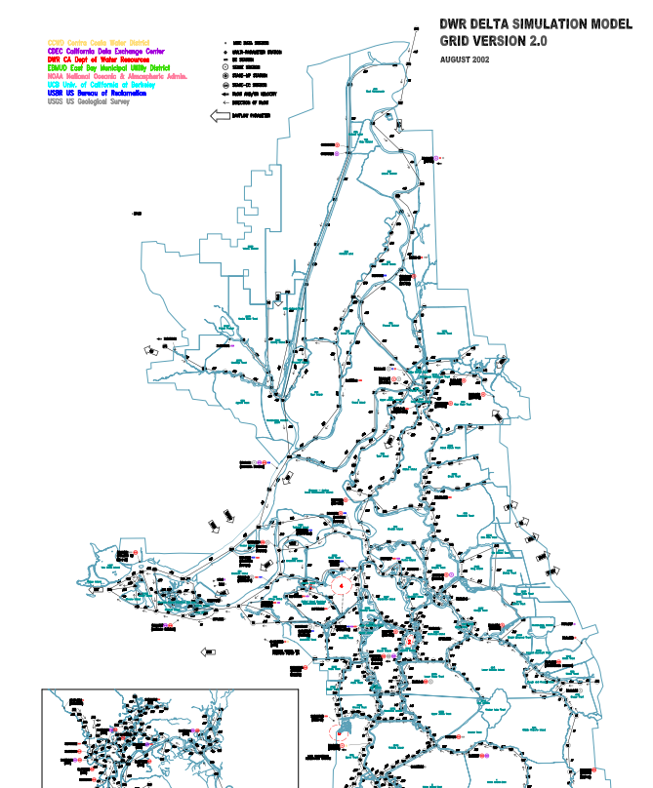
DSM2 Grid
Notes:
The DSM2 grid for the Delta in PDF format is also included in the installation, and the shortcut is also in the start menu.

Slide 5
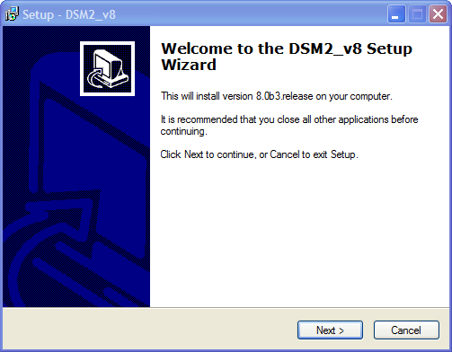
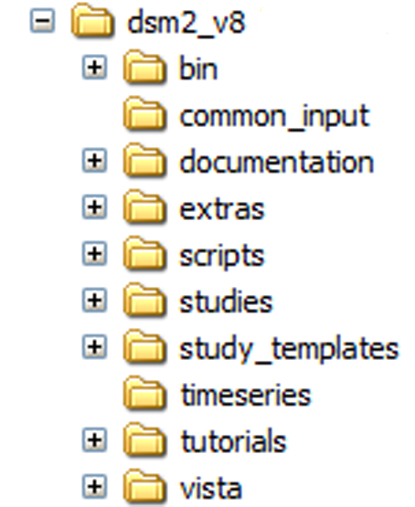
Install DSM2
Notes:
The installation of DSM2 should be pretty straight-forward. You just need to agree on the general public license and select the installation folder.
The directory structure reflects how we would like to manage the distribution and data files
The bin directory stores the executables and useful batch files. Eli will talk about these batch files later.
The common_input directory stores the commonly used input files, this folder attribute is set to be read-only.
The documentation folder, it has the documentation in html format, and also the DSM2 grid for the Delta is also here.
The extras folder, have some useful files for 3rd party software. Currently we have the syntax highlighting configuration for notepad++.
The scripts folder has some useful scripts, for example, preprocessing CALSIM files, and etc. Eli will explain this in more details.
The studies folder is the user area, you can build and run your own simulation here, and this folder will not be over-written if you upgrade to newer version of DSM2.
The study_templates has some example studies, currently we have a historical run and two planning runs.
The timeseries folder has the time series data, for example, the boundary conditions for the Delta simulation, the stage, flow, DICU, and etc, and they are in HEC DSS format.
The vista folder has a software called vista that can open and visualize DSS file. And also it has some essential libraries for the scripts to run, for example, the CALSIM preprocessing scripts require the libraries in VISTA.

Slide 6
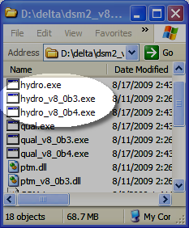
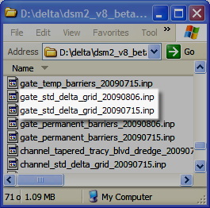
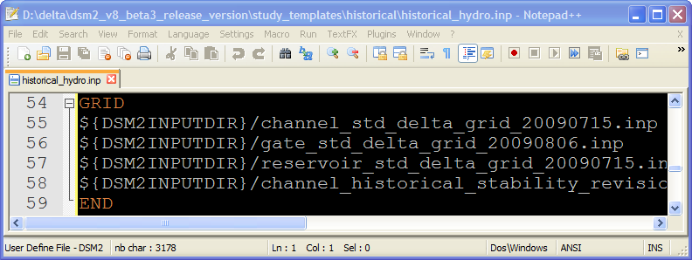
DSM2 Versioning
Notes:
Eli is going to talk about archiving and multiple installation strategies later and this version stuff is going to come up again

Slide 7
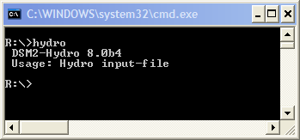
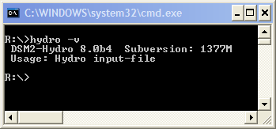
Check DSM2 version

Slide 8
3rd Party Software
Notes:
We are going to use introduce other tools in class for viewing DSS and HDF5 files. Instructions for getting these should be on the web page

Slide 9
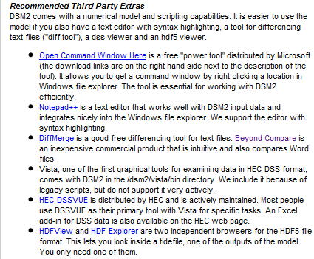
3rd Party Software
http://baydeltaoffice.water.ca.gov/modeling/deltamodeling/models/dsm2v8/dsm2.cfm

Slide 10
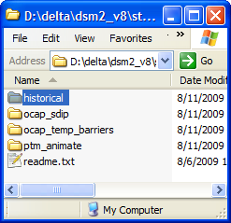
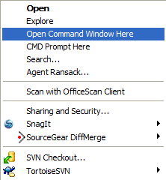
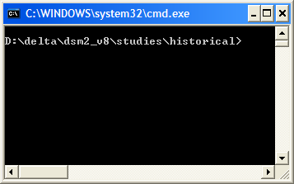
Open Command Here
Google “Open Command Here”
This is a built-in feature for VISTA
Notes:
Jamie mentioned that this “Open Command Window Here” is a built-in feature in the newer Windows version Vista. You need to press the Shift key and then right click the folder to see this feature. You can also change the registry to make it appear by default without pressing the Shift key.

Slide 11
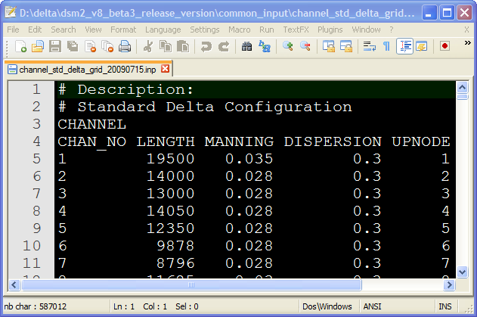
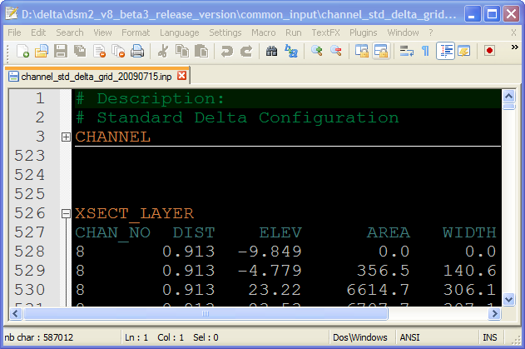
Notepad++ syntax highlighting
Notes:
Instructions for syntax highlighting configurations are in Readme.txt in the installed folder \dsm2_v8\extras\notepad++

Slide 12
FAQ

Slide 13
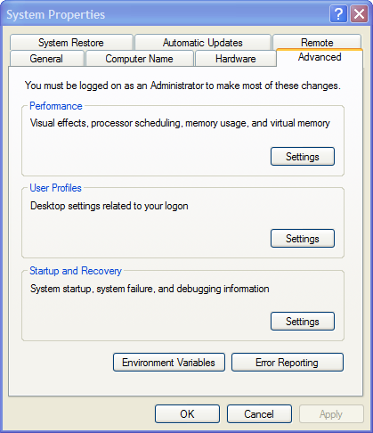
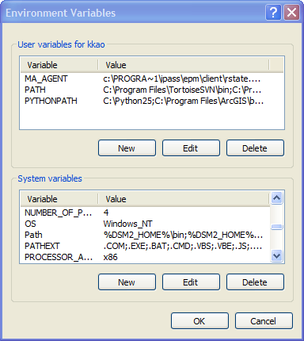
Question: Can I just move my installation?
Yes, but you will have to change some Environment variables.
%DSM2_HOME%\bin
%DSM2_HOME%\vista\bin
%VISTA_HOME%
Notes:
Eli will cover this in detail.

Slide 14
Question: What happened if Installing over previous install?
Hydro.exe & Qual.exe overwritten
Version control exe retained
Augmented. Nothing changed
User’s studies unchanged
Replaced
Notes:
Eli will cover this in detail.
Hydro.exe and Qual.exe overwritten
/common_input augmented, nothing will be changed
/scripts replaced
/study_templates replaced
/study unchanged

Slide 15
Question: What happened if Installing over previous install?
Notes:
New input files are added but old files are not changed. Eli is going to talk about archiving and multiple installation strategies later and this version stuff is going to come up again

Slide 16
DSM2 Website
http://baydeltaoffice.water.ca.gov/modeling/deltamodeling/models/dsm2v8/dsm2.cfm
Google “DSM2”

