Slide 1

Source Tracking
DSM2 Training
September 2009
Siqing Liu, Ph.D., P.E.
Delta Modeling Section
California Department of Water Resources
Notes:
DSM2 Users Group: "EXAMPLE: Filling in Martinez Stage"
2004.04.27

Slide 2
Source Tracking and Fingerprinting
What is source tracking?
  determines the amount of flow or of a constituent at one location that originated from a specified DSM2 boundary location
What are the types of source tracking?
  Volumetric Fingerprinting
  EC (constituent) Fingerprinting

Slide 3

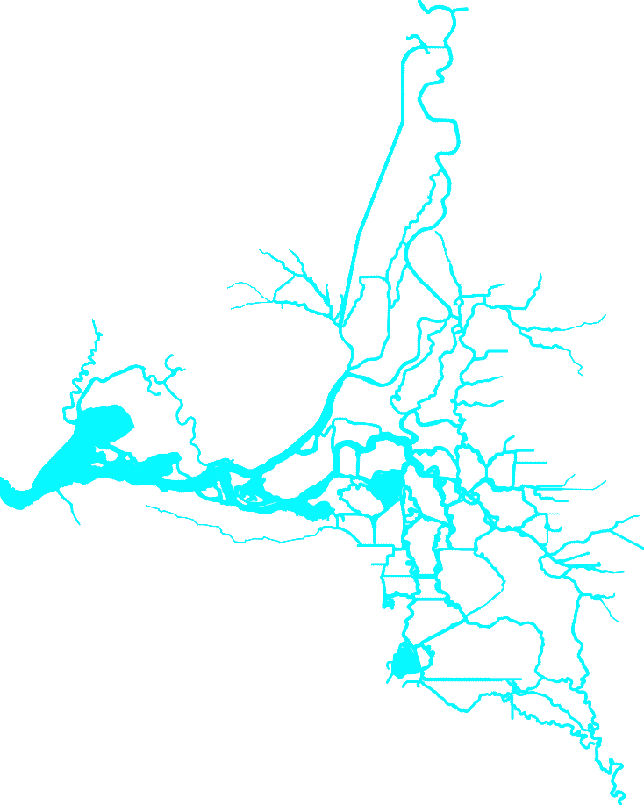





Fingerprinting Source Locations
Sacramento River
Area of Detail
• Sacramento
Yolo
Bypass
Eastside
Streams
Agricultural
Drainage
(>250 locations)
• Martinez
Ocean
•
Stockton
San Joaquin River

Slide 4

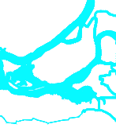






Example: How much of the water and EC at Emmaton came from each source?
?
?
●
?
Emmaton
?
?
?

Slide 5
Example: How much of the water and EC at Emmaton came from each source?
Source | Volumetric Fingerprint | Constituent Fingerprint
Sac R | 75% | 100 uS/cm
SJR | 5% | 200 uS/cm
Ocean | 2% | 1000 uS/cm
Eastside | 1% | 40 uS/cm
Ag Drains | 1% | 85 uS/cm
Yolo Bypass | 16% | 75 uS/cm
Total | 100% | 1500 uS/cm
Sacramento River
San Joaquin River
Ocean
Eastside Streams
Ag Drains
Yolo Bypass
All numbers are for illustration only.

Slide 6
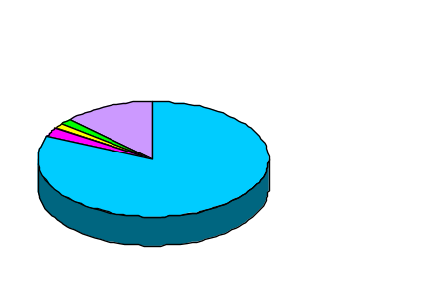
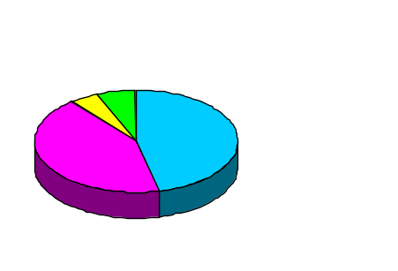
Volumetric Fingerprint for March 1991-1998
Flow contribution
from each source
Sacramento River
Emmaton
82% Sacramento River
13% Yolo Bypass
2% Agricultural Drains
2% San Joaquin
1% Eastside Streams
Yolo
Bypass
Eastside
Streams
Agricultural
Drainage
(>250 locations)
Ocean
Old River at Rock Slough
47% Sacramento River
43% San Joaquin
6% Agricultural Drains
4% Eastside Streams
San Joaquin River

Slide 7
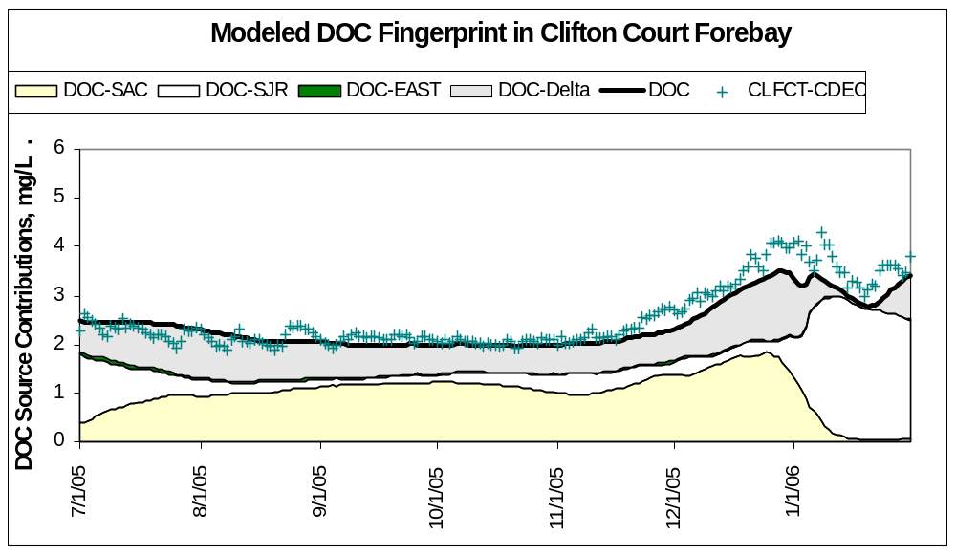
Constituent Fingerprinting
Difference measured and simulated
Eastside Stream Contribution
SJR Contribution
Delta Contribution
Historical Data
Sac River Contribution

Slide 8
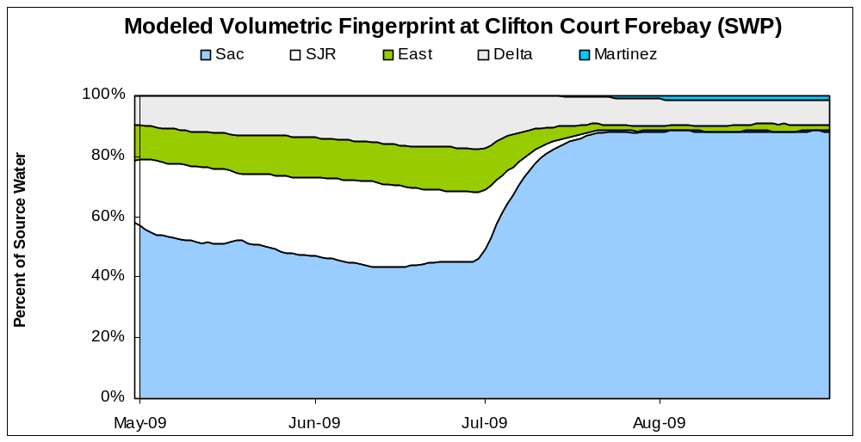
Why Fingerprinting ?
  Understand how operations affect residence, circulation, mixing at different locations

Slide 9
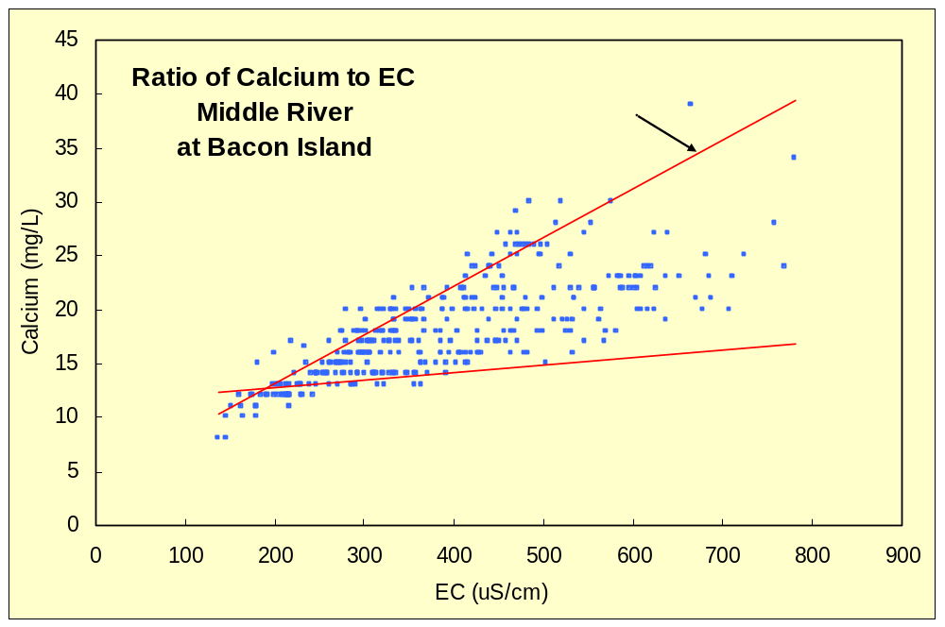
Why Fingerprinting? Cont
Help understand complex relationships among constituents by examining sources of constituents

Slide 10
Source Tracking in QUAL v8
No special
constituent
needed
Constituent fingerprinting
  Set up a group example
  Request output from source group (up to 12) example
Volumetric Fingerprinting
  Create fingerprinting constituent and set value equal to 100 at all boundaries example
  Set up a group
  Request output from a source group example

