Slide 1
Model input for Banks Pumping Plant
Notes:
This one is easy!

Slide 2
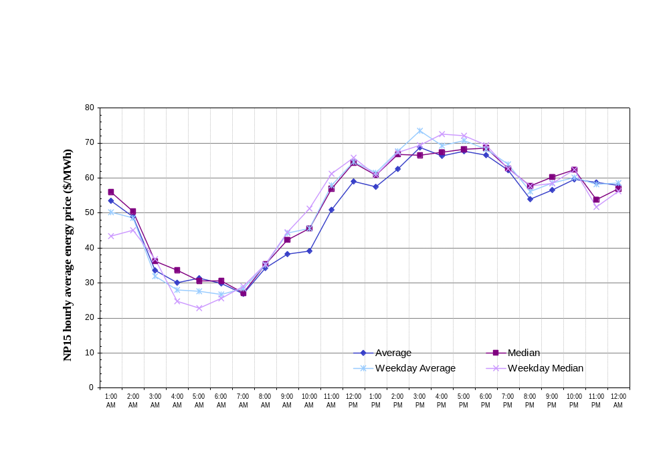
Figure III.2.iii-1. Energy wholesale price in July 2005.
Notes:
An illustration of the price fluctuation in electricity cost in the summer. Factor of almost 3 between high and low rate.

Slide 3
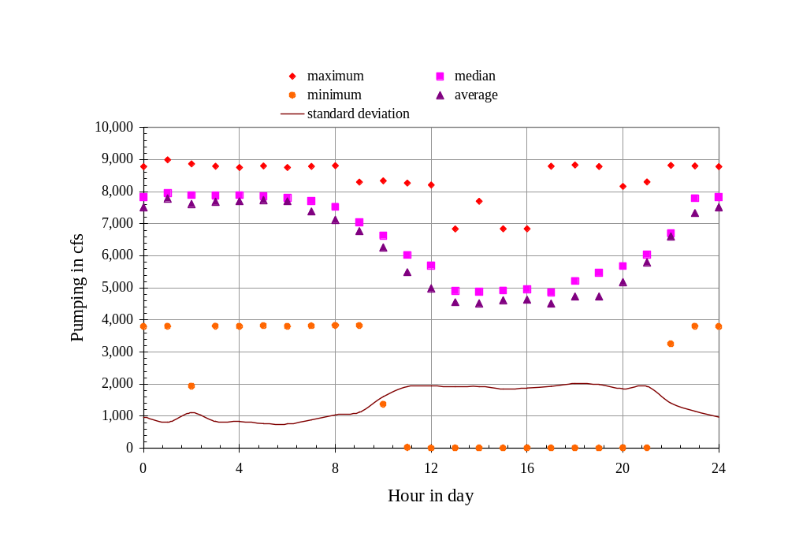
Figure III.2.iii-3. Statistics of hourly variation in Banks pumping in July and August 2004.
Notes:
Diurnal variation in pumping is more pronounced in the summer

Slide 4
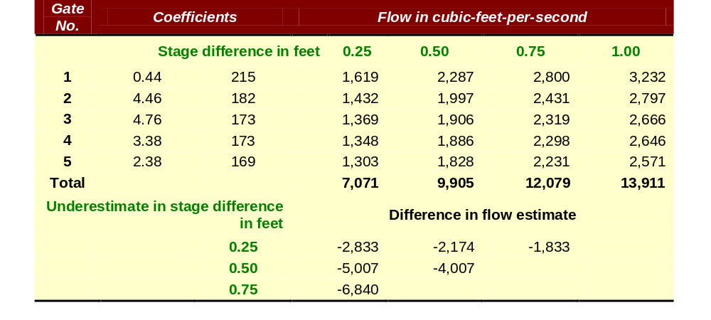
Table III.2.iii-2. Error in flow estimates corresponding to error in stage differences estimated between Clifton Court Forebay and West Canal. Gate equations from Hills (1988). A gate position of 15 is assumed.
3000 cfs ≈ 250 AF/hour CCFB surface area ≈ 2100 acres Difference of 3000 cfs in pumping ≈ 1.4”/hour or 0.7’ in 6 hours
Tidal amplitude in Old River near Santa Fe Cut ≈ 15,000 cfs
Notes:
Flow estimates are based on gate equations with coefficients developed by DWR. DWR is in the process of re-evaluating the flow-stage difference regression.
3000 cfs ≈ 250 AF/hour CCFB surface area ≈ 2100 acres Difference of 3000 cfs in pumping ≈ 1.4”/hour or 0.7’ in 6 hours

Slide 5
Observations – Banks pumping
Banks pumping varies considerably over a day
Use of daily average could lead to error in CCFB stage estimate by many inches
Estimate of flow into CCFB could be thousands of cfs, significant %’s of flow in S Delta channels
Incorporate hourly pumping as input

