Slide 1
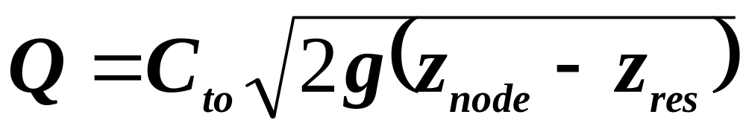
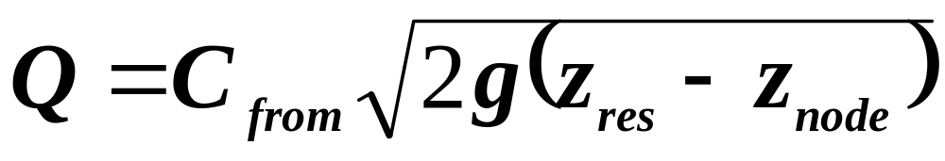
Reservoir Equations
When Z_{res}<Z_{node}
Flow direction
Reservoir Node
When Z_{res}>Z_{node}
Reservoir Node
Where:
C_{to} and C_{from} = coefficients representing the hydraulic efficiency
of the reservoir connection and the nominal
area perpendicular to flow
g = gravity
z_{res} and z_{node} = water surface elevations at the reservoir and node
(node surface is assessed by means of a reference
channel that has no reservoirs attached to it)

Slide 2
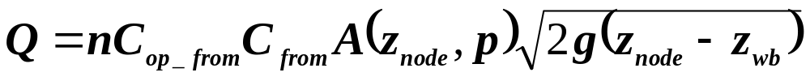

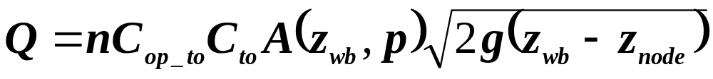
Gate Equations
When Z_{wb}<Z_{node}
Flow direction
Water Body Gate Node
When Z_{wb}>Z_{node}
Water Body Gate Node
Where:
n = number of duplicate devices, g=gravity,
C_{op_to} and C_{op_from} = operating coefficient for controls, e.g. flap valves
C_{to} and C_{from} = coefficients representing gate’s hydraulic efficiency
A = area of flow depending on higher water surface and position p
z_{res} and z_{node} = water surface elevations at the reservoir and node

