Slide 1

DSM2 Simulation Input and Output
DSM2 Training
September 15-17, 2009
Lianwu Liu PhD PE
Delta Modeling Section
California Department of Water Resources
Notes:
By Simulation Input and Output we mean boundary and initial conditions and some of the runtime I/O files.

Slide 2
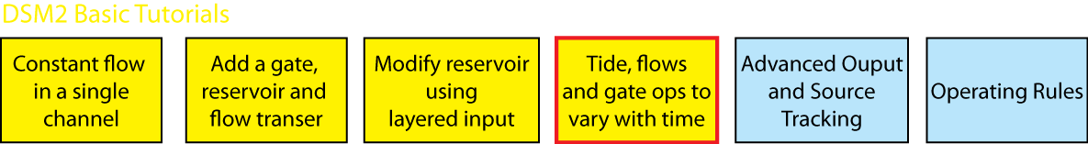
Topics
Boundary Conditions for HYDRO/QUAL
Other Time Series (gates, sources)
Initial Conditions (default, restart)
Tidefile
Time Series Output

Slide 3
DSM2 Input
Configuration
Grid
Boundary Conditions
Initial Conditions
Output specifications
Operation
Notes:
To model a

Slide 4
Boundary Conditions
Boundary Conditions for Hydro
is stage or flow (including source/sink)
Default is no-flow
‘Constant’ flow or stage (used in simple tutorials)
Time series data (in real applications)
Format: DSS or DSS-like text
Notes:
In reality

Slide 5
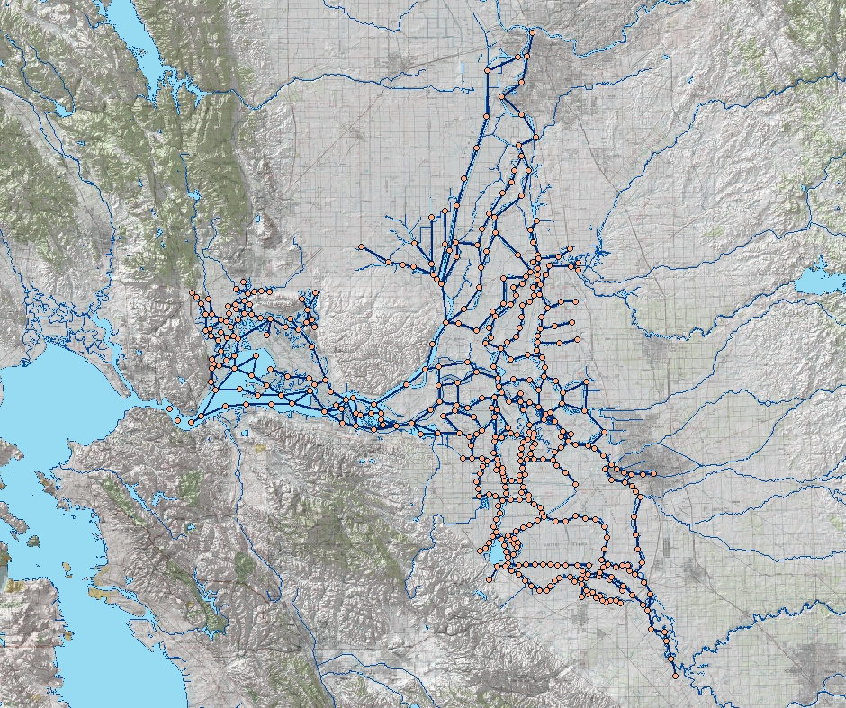
DSM2 Boundary Conditions
Sacramento River
Sacramento
Inflow & water quality
Export flow
Tributaries
Delta Island Consumptive Use
Martinez
Tidal Stage & Water Quality
Stockton
Exports
San Joaquin River
Image from USBR GIS Group

Slide 6
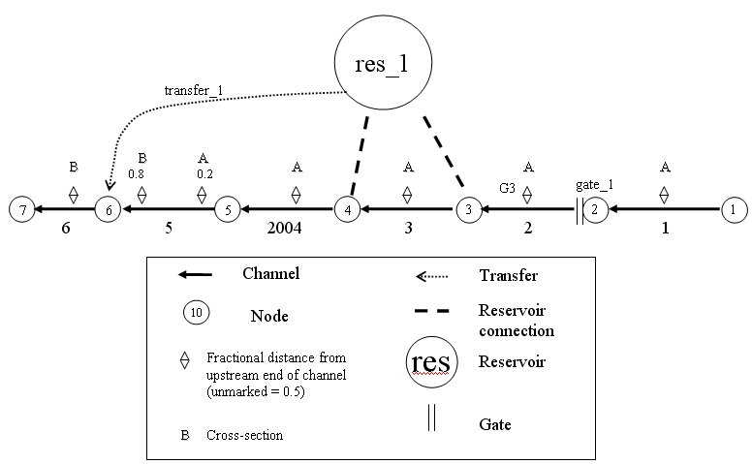
Notes:
Animate flow stage boundary

Slide 7
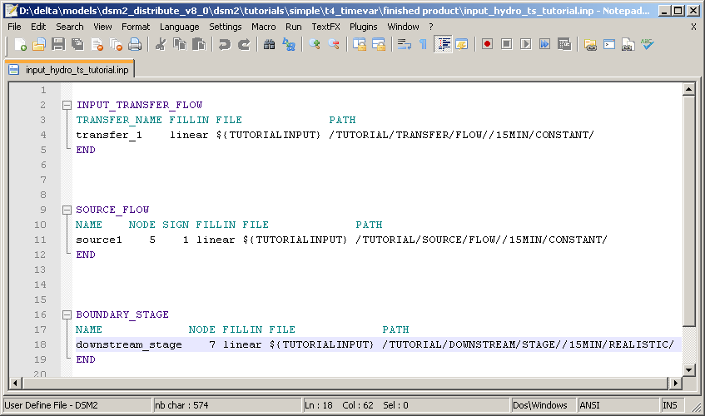
Time Series Input
Notes:
In reality, you will have to specify boundary conditions with time series data.

Slide 8
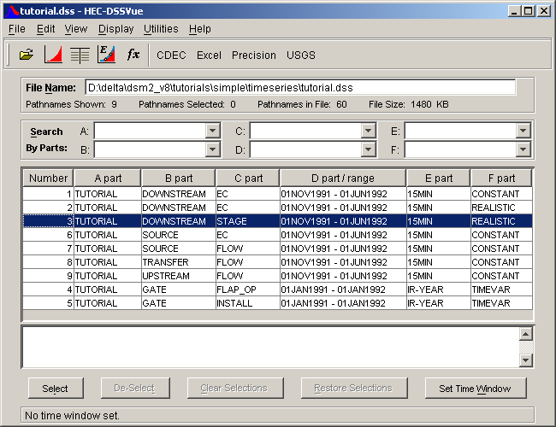
HEC-DSS file
Notes:
To model a

Slide 9
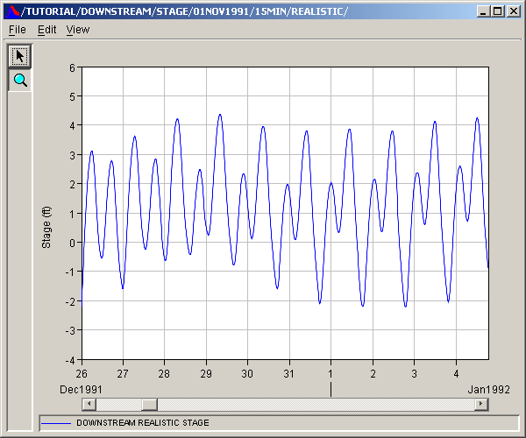
HEC-DSS file
Downstream stage time series example
Notes:
To model a

Slide 10

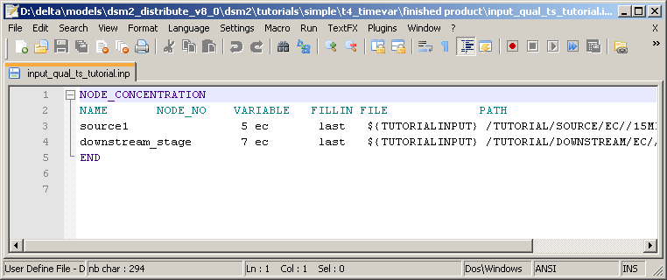
Boundary Conditions
Boundary Conditions for Qual
Concentration for every inflow
Concentration for tidal boundary
Default zero with warning
Linking qual to hydro (use same name )
Notes:
To model a

Slide 11
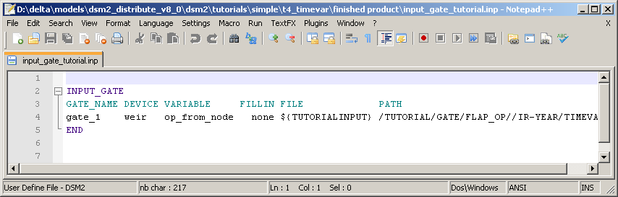
Other TS input (gates)
Notes:
Only inflow matter for QUAL (if tidal like Martinez, assigned time series may be ignored part of the time)

Slide 12
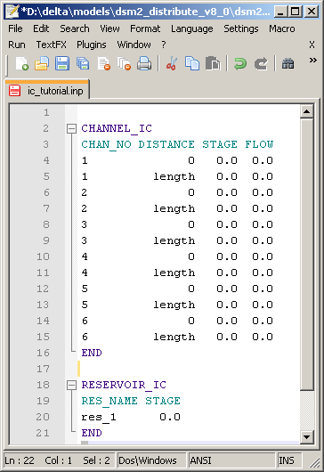
Initial Condition Input
HYDRO Default:
CHANNEL_IC
RESERVOIR_IC
Restart file has priority

Slide 13
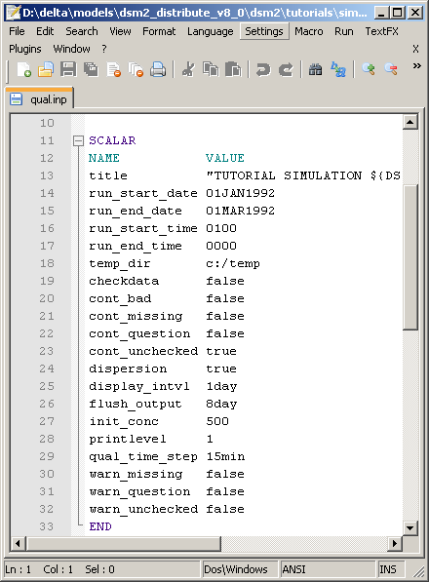
Initial Condition Input
QUAL Default
Scalar init_conc
(cold start)
Restart files
replace the default
(warm start)

Slide 14
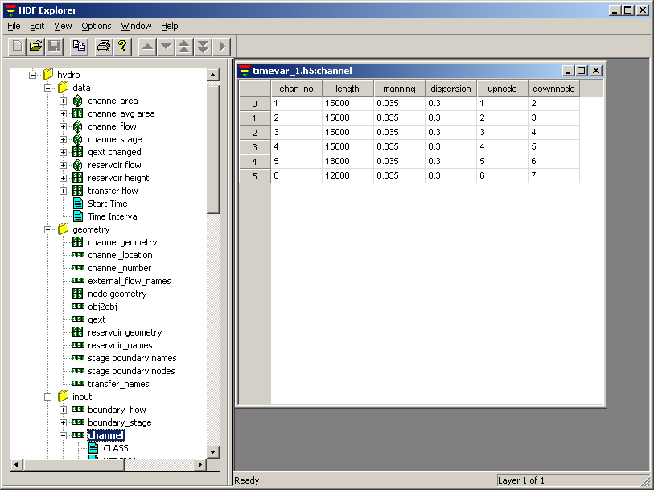
Tidefile
GRID data for QUAL (from HYDRO)
Flow field
Has own time step, spatial step (often 1hr)
HDF5 Viewer to view

Slide 15
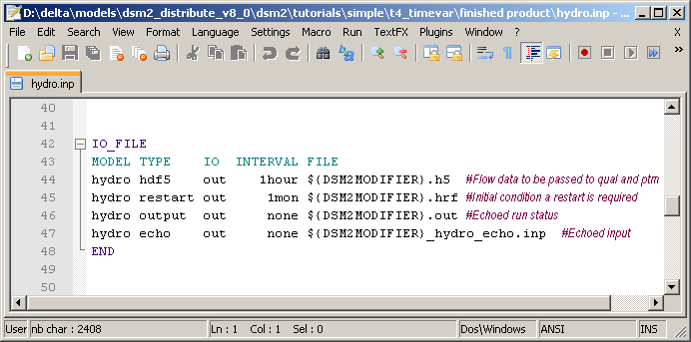
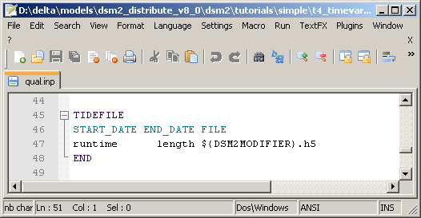
Tidefile
Pass GRID and flow data
to Qual and PTM

Slide 16
Time Series Output
What can we output?
flow, stage, vel, and the name of any constituent (ec, do…)
Check out the documentation!
Formats: text and DSS
Tables
OUTPUT_CHANNEL
OUTPUT_RESERVOIR
OUTPUT_GATE
OUTPUT_CHANNEL_SOURCE_TRACK
OUTPUT_RESERVOIR_SOURCE_TRACK
Covered next

Slide 17
Time Series Output
OUTPUT_GATE
Device physical data (width, height, elev),
operational data (op_to_node, op_from_node)
flow from water body to node.
From a gate with device=none you can request the variables install, or total flow oriented from water body to node.

Slide 18
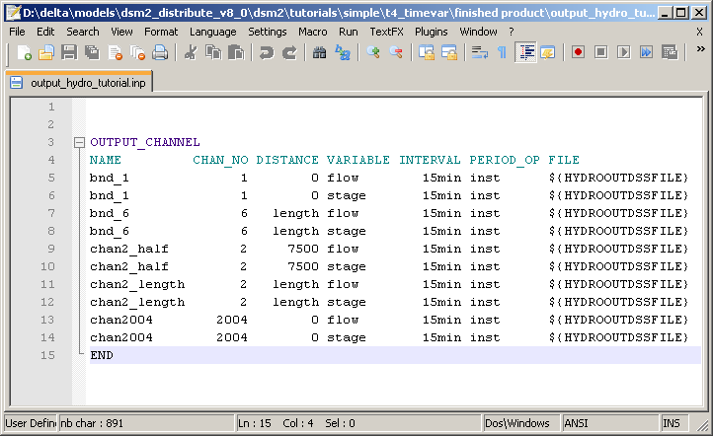
Time Series Output

Slide 19
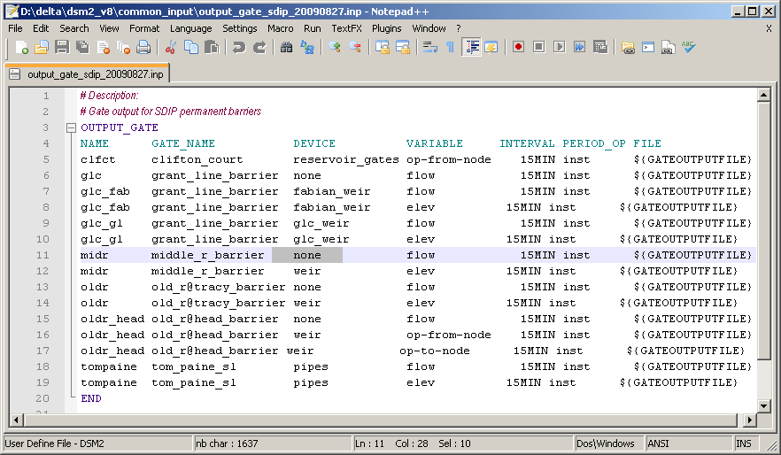
Time Series Output

Slide 20
Echo Input File
Archive of run
QA/QC: single-file view of multiple sources
Can be used as an input file

Slide 21
Tutorial 4: Time Series
Replaces constant inputs with time series data, e.g. a realistic tide.

