Slide 1

Input System and Layering
DSM2 Training
September 15-17, 2009
Eli Ateljevich, PhD
Delta Modeling Section
California Department of Water Resources

Slide 2
Topics
Data management and layering
Input system: tables and include blocks
Syntax and style

Slide 3
Data Management
Input batched in files based on type (gate) and theme (sdip)
Versioned input ( /common_input )
Simulations “diff”-able
Archivable
Modifications easy to see

Slide 4
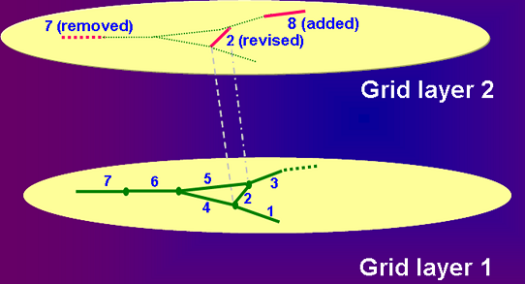
Layering System

Slide 5
Include Blocks
Each line inserts file or “layer”
Later listings higher priority
Launch file (e.g. hydro.inp is highest)
Include blocks are thematic
(grid, oprule, etc. See docs and examples)
1
<file3.inp>
CHANNEL
CHAN_NO LENGTH MANNING
1 5000 0.035
2 15000 0.035
3 15000 0.035
4
GRID
file1.inp
file2.inp
file3.inp
END
2
3

Slide 6
Tables
Table Name
Identifier
CHANNEL
CHAN_NO LENGTH MANNING DISPERSION UP_NODE DOWN_NODE
18000 0.030 0.80 1 2
8000 0.040 0.80 2 3
18000 0.040 0.80 3 4
18000 0.040 0.80 4 5
18000 0.040 0.80 3 5
22000 0.040 0.80 5 6
14000 0.040 0.80 6 7
END
XSECT
CHAN_NO DISTANCE FILE
0.200 1_0_200.txt
1 0.800 1_0_800.txt
0.500 2_0_500.txt
...
0.900 7_0_900.txt
END
Header
(field
names)
Parent Table
Parent Identifier
Child Table

Slide 7
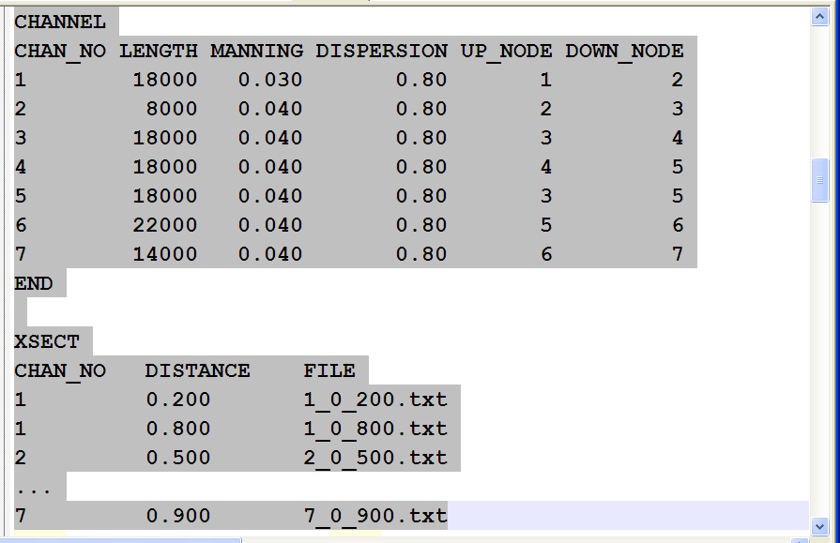
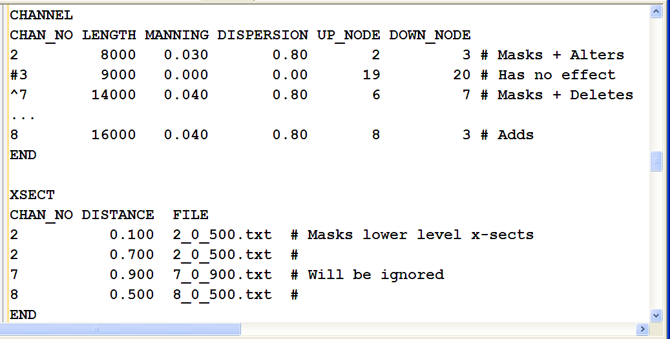
Tables + Layering

Slide 8
Layering Best Practices
Keep things thematic
Don’t put your stuff in common_input
Make up something like /user_common
Only override things you are changing
Check the echoed input file
Make sure you understand identifiers
The output ones are sneaky

Slide 9
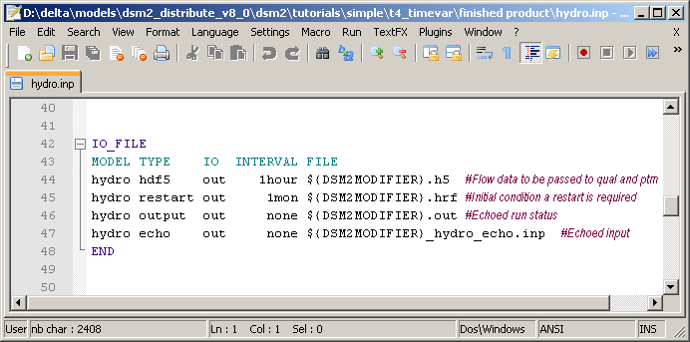
Echo Input File
Archive of run
QA/QC: combined view of multiple input files
Can be used as an input file

Slide 10
ENVVAR: Text Substitution
Used for flexibility…avoids multiple files and erasing
Define in ENVVAR table (or OS environment):
Subject to layering
Use anywhere else using ${ }:
Nesting and interdependency allowed.
ENVVAR
NAME VALUE
DSM2INPUTDIR ${DSM2_HOME}/common_input
START_DATE 01JAN1990
STUDYDIR .
OUTPUT ${STUDYDIR}/output
END
${DSM2INPUTDIR}

Slide 11
Configuration Files
Really just an ENVVAR section
Contains study/ cross-module data
Production templates all have them!
<ptm.inp>
<hydro.inp>
CONFIGURATION
config.inp
END
<config.inp>
<qual.inp>
ENVVAR
NAME VALUE
STUDYDIR .
DSM2MODIFIER base
END
<ptm.inp>
Reused

Slide 12
Style
Use Upper Case:
Table/Include Block Names and Headers
ENVVAR substitution ${LIKE_THIS}
Constants in op rules
Use lower_case everywhere else
Set your text editor for spaces, not tabs

Slide 13

DSM2 Cool Tip
dsm2_tidy
Although spaces or tabs can be used in DSM2, columns with spaces tend to look better when opened in a different viewer.
The dsm2_tidy utility cleans up columns and spaces.
Type dsm2_tidy --help at a command prompt for more info.

Slide 14
For Version 6 Users
Files must contain parent + child items
Cannot redefine same item in same file
Use comments
Table structure is fixed
Configuration files are include blocks
Check out the echo.inp files!
Also echoed in QUAL

