Slide 1
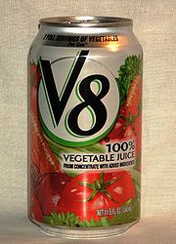

What is New: Version 8
DSM2 Training
Fall 2009
Eli Ateljevich, PhD
Department of Water Resources
Delta Modeling Section
Notes:
2001.10.30

Slide 2
Talk Outline
Data management
Speed and robustness
Gates
Op Rules
Issues for v6 users
Notes:
2001.10.30

Slide 3
Database Information Management Goals
Version control
Scenario management
Extensibility and reuse of common items
Transparency of modifications
Archive
Notes:
2001.10.30

Slide 4
Layer Based Input
7 (added)
2 (revised)
Grid layer 2
6
5
3
4
2
1
Grid layer 1
Notes:
2001.10.30

Slide 5


Performance
Speedup 3-8x
Elimination of closure errors in HYDRO
Time centered velocities in PTM
  eliminates inconsistencies of up to 80%
Mass balance standard at nodes ~0.0001cfs
  Was 20 cfs
Increasingly rigorous testing
Issue tracking for bugs

Slide 6
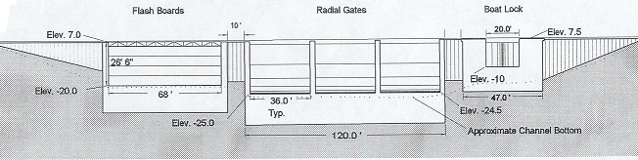
Gates With Multiple Structures
Notes:
2001.10.30

Slide 7
Physical Gate Positions
Variable weir crest
elev
Radial/sluice
height
elev
Notes:
2001.10.30

Slide 8
Operating Rules
observation
Model
Steering
decision
Input
Notes:
2001.10.30

Slide 9
Example – Operate a Gate Based on Water Levels
Upper Stage Trigger
Stage (ft)
Open Gate
Lower Stage Trigger
Close Gate
Time
Notes:
2001.10.30

Slide 10
HDF5 Tidefile
As efficient as raw binary files
You can look inside with free tools
Compatible with Matlab/TecPlot/Python
QUAL HDF5 coming soon
Notes:
2001.10.30

Slide 11
Gotchas for Version 6 Users
Input system changes
  Fixed tables, layering, use of echo+hdf5 files
Linkages between HYDRO and QUAL
  HDF5
  QUAL gets grid from Tidefile
Deprecated features:
  Monthly output
  Repeating tides
  Translations (may reappear for output)

Slide 12
Do They Give The Same Answer?
Solutions in identical cases same
Some production items have been “translated”:
  Geometry: v8 has one kind of cross-section
  Gates: make use of the new features
Testing includes:
  Isolated calculations (e.g. gate equations)
  Identical runs using common features
  Production runs
Notes:
2001.10.30

Slide 13
The Next Six Months
Stable, non-beta release in one week
HDF5 Output for QUAL
Better restart files
Source release
Notes:
2001.10.30

Slide 14
Notes:
2001.10.30

Slide 15
Notes:
2001.10.30

