Slide 1
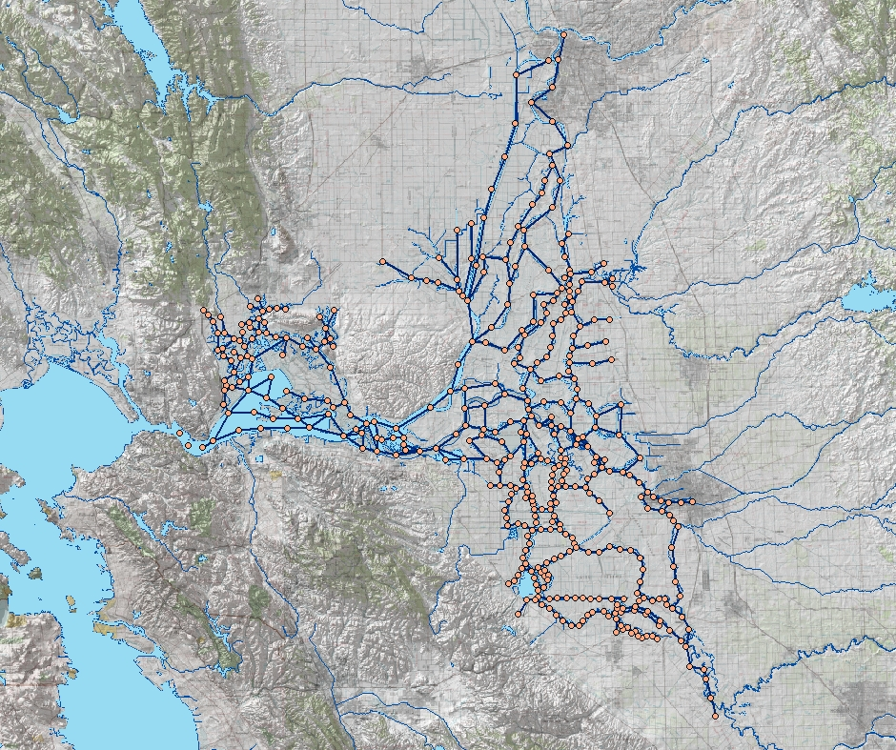
DSM2 Boundary Conditions
Sacramento River
Sacramento
Inflow & water quality
Export flow
Tributaries
Delta Island Consumptive Use
Martinez
Tidal Stage & Water Quality
Stockton
Exports
San Joaquin River
Image from USBR GIS Group

Slide 2
DSM2 Boundary Conditions for Historical Simulations
Sacramento River
Sacramento
Flows from gauge data
Sac & SJR EC from gauge data
Tributary EC constant values
Yolo Bypass gauge flow, Sac EC
Jones Tract flow from filled data
Inflow & water quality
Export flow
Tributaries
Stage & EC from gauge data
Delta Island Consumptive Use
Based on long term average data
Flow: monthly values that vary by year
EC: monthly values repeated every year
Martinez
Tidal Stage & Water Quality
Stockton
Exports from gauge data
Exports
San Joaquin River
Image from USBR GIS Group
Note: gauge data are filled for missing values

Slide 3
DSM2 Boundary Conditions for Planning Simulations
Sacramento River
Sacramento
Flows from CalSim
SJR EC from CalSim
Sac & Tributary EC constant
Inflow & water quality
Export flow
Tributaries
Stage from Adjusted Astronomical Tide
may be further adjust for sea level rise
EC based on Net Delta Outflow from CalSim
Delta Island Consumptive Use
Based on CalSim Level of Development
may be modified by climate change
Converted to DSM2 using ADICU model
Flow: monthly values that vary by year
EC: Monthly values repeated every year
Martinez
Tidal Stage & Water Quality
Stockton
Exports from CalSim
may need to adjust for VAMP
Exports
Exports
VAMP=Vernalis Adaptive Management Plan
San Joaquin River
Image from USBR GIS Group

