Slide 1

Operating Rules
DSM2-DB Training
Fall, 2009
Eli Ateljevich, PhD
Delta Modeling Section
California Department of Water Resources
Notes:
DSM2 Users Group: "EXAMPLE: Filling in Martinez Stage"
2004.04.27

Slide 2
What is an operating rule?
A way to guide a running model
observation
Model
Rule
decision
Input
Notes:
DSM2 Users Group: "EXAMPLE: Filling in Martinez Stage"
2004.04.27

Slide 3
Example – Operate a Gate Based on Water Levels
Upper Stage Trigger
Stage (ft)
Open Gate
Lower Stage Trigger
Close Gate
Time
Notes:
DSM2 Users Group: "EXAMPLE: Filling in Martinez Stage"
2004.04.27

Slide 4
Can we do this w/o op rules?
Code specific rules into model
  e.g.: Montezuma, Clifton Court scouring
  Requires programming
  Too specific
  Version/quality problems
Make offline adjustments
  e.g.: South Delta barriers
  Requires scripting and multiple runs
  No feedback between rule and model
    OFTEN fails to do anything rational or convergent
Notes:
DSM2 Users Group: "EXAMPLE: Filling in Martinez Stage"
2004.04.27

Slide 5
Offline Rules
Water surface in Channel X (preliminary simulation)
Weir position in Gate Y (offline)
Elev (ft)
Gate open
Time
Notes:
DSM2 Users Group: "EXAMPLE: Filling in Martinez Stage"
2004.04.27

Slide 6
Offline Rules: Result
Stage (water surface elevation) in Channel X
Weir position of Gate Y (offline)
Stage (ft)
Unnecessary gate ops?!
Time
Notes:
DSM2 Users Group: "EXAMPLE: Filling in Martinez Stage"
2004.04.27

Slide 7
How Operating Rules Work
Pair a “trigger” with an “action”
Rule applies when trigger becomes True (e.g., stage dips below -1ft)
Action starts (e.g. open a gate gradually)
Action finishes, rule finalizes/deactivates
Notes:
DSM2 Users Group: "EXAMPLE: Filling in Martinez Stage"
2004.04.27

Slide 8
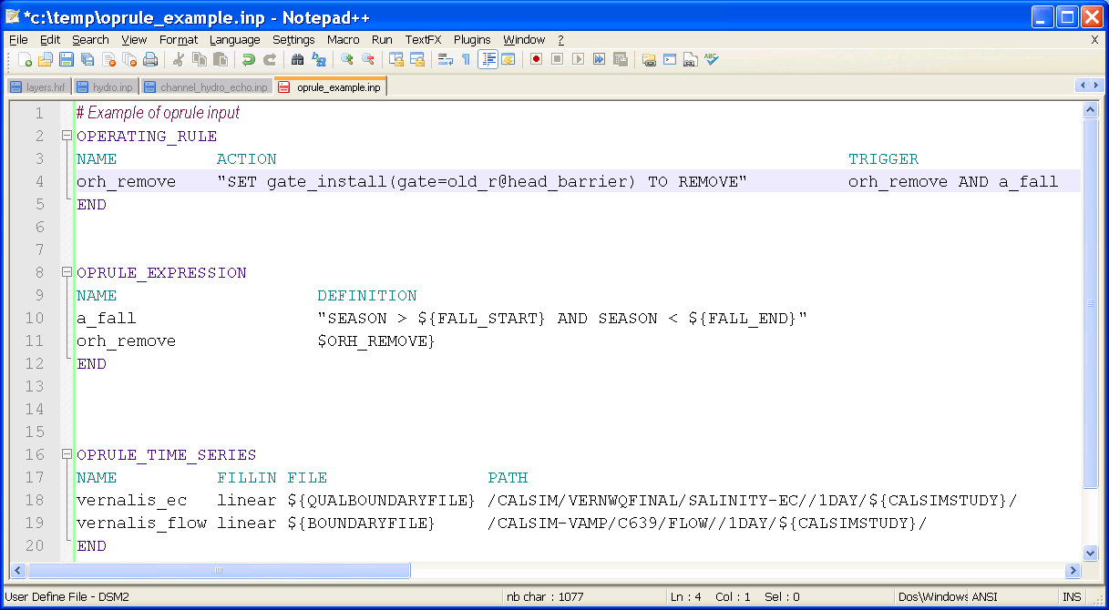
Defining Operating Rules
sSupporting expressions (not child)

Slide 9
Expressions
Boolean (True/False):
  vamp_shoulder := SEASON > 01APR AND SEASON <= 30MAY
  Mostly used in triggers
  The “vamp := “ part means “vamp is defined as”. You won’t write the := part… it just makes this presentation easier.
Numeric:
  stage_diff := chan_stage(channel=134,dist=0) - chan_stage(channel=133,dist=length)
  Mostly for actions, sub-expressions in boolean triggers
Notes:
DSM2 Users Group: "EXAMPLE: Filling in Martinez Stage"
2004.04.27

Slide 10
Op Rule Language Components
Name: middle_river_gate_control
Expressions:
  critical_stage := chan_stage(channel=132, dist=1000) < (ts(name=tide_level)-1.0)
  ebb := chan_flow(channel=132, dist=1000) > 0.01
  vamp := (month == Apr) OR (month == May)
Trigger: vamp AND ebb AND critical_stage
Action: SET weir_op(gate= “Middle River Barrier”, device = ”Radial Gate”) TO OPEN
Model variables
Time series
Season
Notes:
DSM2 Users Group: "EXAMPLE: Filling in Martinez Stage"
2004.04.27

Slide 11

Action Conflicts
Two rules activate and act on the same model component at same time
First rule tested will activate
The second is deferred, eligible for triggering
  (ie, considered to have been “False” previously).
Not a issue unless your rule is over-triggered.
An “ungotcha”
Notes:
DSM2 Users Group: "EXAMPLE: Filling in Martinez Stage"
2004.04.27

Slide 12
Things You Can Set
gate_op(gate=textname, device=text,direction=[to_node|from_node|to_from_node])
ext_flow( name=textname)......external flow (boundary flows, source/sink)
transfer_flow(transfer=textname)
gate_width(gate=textname, device=textname)
gate_height(gate=textname, device=textname)
gate_elev(gate=textname, device=textname)
gate_nduplicate(gate=textname, device=textname)
gate_install(gate=textname)
Notes:
DSM2 Users Group: "EXAMPLE: Filling in Martinez Stage"
2004.04.27

Slide 13
Things You Can Observe
chan_flow(channel=number, dist=[number|length])
chan_vel(channel=number, dist=[number|length])
chan_stage(channel=number,
  dist=[number|length])
res_stage(res=textname)
res_flow(res=textname, node=number)
ts(name=time_series_name)
Notes:
DSM2 Users Group: "EXAMPLE: Filling in Martinez Stage"
2004.04.27

Slide 14
Op Rule Gotchas
Expressions using dates
  Use SEASON
Not understanding triggers
  The TRUE trigger only activates once
  FALSE-TRUE transition is what matters
  STARTUP and TRUE are the same thing
Unnecessary triggering
Using one expression in another
  Can be done, but dependencies have to be in alphabetical order: a_vamp a_spring, etc.
Notes:
DSM2 Users Group: "EXAMPLE: Filling in Martinez Stage"
2004.04.27

Slide 15
Op Rules and Other Input
Op Rule
(replaces)
Time Series
(replaces)
Default
(e.g. GATE table)

Slide 16
Ramping
Syntax:
SET (….) TO 1.0 RAMP 45MIN
Effect: The action gradually takes effect
  Use only if this makes sense (not for gate_install, for instance)
Notes:
DSM2 Users Group: "EXAMPLE: Filling in Martinez Stage"
2004.04.27

Slide 17
Time
Date, time and season:
  YEAR >= 1991
  MONTH + 1 < MAY
  DATETIME > 04FEB1990 00:00 (date plus time)
  DATE >= 11OCT1992 (no time part)
  SEASON > 15APR AND SEASON <01MAY (no year)
Use SEASON whenever applicable – the equivalent rule with DATE is unintuitive and long.
Notes:
DSM2 Users Group: "EXAMPLE: Filling in Martinez Stage"
2004.04.27

Slide 18
Math
Basic arithmetic:
+, -, *, / (standard precedence rules)
Powers, roots and exponents:
x^3 is x cubed, x^y is x to the power of y
SQRT(x) ... square root of x
EXP(x) ... exponent function (e to the power of x)
LN(x) ... natural log of x
LOG(x) ... base 10 log of x
Notes:
DSM2 Users Group: "EXAMPLE: Filling in Martinez Stage"
2004.04.27

Slide 19
Special Functions: LOOKUP
LOOKUP(expression, lookup_array,value_array)
  Table lookup of expr to arrays of lookup values
    LOOKUP(1000.,[1000.,2000.,3000.], [1.,2.]) returns 1.
    LOOKUP(2000.,[1000.,2000.,3000.], [1.,2.]) returns 2 (<= is used for bottom of bracket)
    LOOKUP(3000.,[1000.,2000.,3000.], [1.,2.]) is an error (strict < is used for top of bracket
Arrays components must be numbers, not expressions.
Notes:
DSM2 Users Group: "EXAMPLE: Filling in Martinez Stage"
2004.04.27

Slide 20
Special Functions: IFELSE
IFELSE(boolexpr, trueval, falseval)
.... if boolexpr returns true, returns the value given by trueval; else falseval
Expressions trueval and falseval can be time series. Careful!
Just like the Excel function
Notes:
DSM2 Users Group: "EXAMPLE: Filling in Martinez Stage"
2004.04.27

Slide 21
Special Functions:
ACCUMULATE
ACCUMULATE(expression, initval [,resetcond]) ..... Accumulates the value of expression with initval as the initial value and resetting anytime the resetcond evaluates to true.
Example: cumulative flow in channel 100 that resets daily:
ACCUMULATE(chan_flow(chan=100,dist=0), 0, HOUR=0 AND MIN=0)
Notes:
DSM2 Users Group: "EXAMPLE: Filling in Martinez Stage"
2004.04.27

Slide 22
Groups of Actions
Series: SET (….) THEN SET (….)
Parallel SET (….) WHILE SET (….)
Use judiciously
Notes:
DSM2 Users Group: "EXAMPLE: Filling in Martinez Stage"
2004.04.27

Slide 23
Special Functions: PREDICT
PREDICT(valexpr, method, numMIN)
Predicts the value of valexpr numMIN forward in time using method = LINEAR or QUAD
Why? Because then the rules can address the REAL issue, not an arbitrary threshold + fudge factor
Notes:
DSM2 Users Group: "EXAMPLE: Filling in Martinez Stage"
2004.04.27

Slide 24
Notes:
DSM2 Users Group: "EXAMPLE: Filling in Martinez Stage"
2004.04.27

