Slide 1

Welcome and DSM2v8 Introduction
DSM2 Training
September 21, 22, 24, 2009
Tara Smith
Chief, Delta Modeling Section
California Department of Water Resources

Slide 2
Welcome
Introductions
Housekeeping
Course Outline
Overview of DSM2 with Modes of Application

Slide 3
Some Lunch Options
Hitomi Cafe & Dining 1201 R St
Dad's 1310 S St
Cafe Bernardo - R15 1431 R Street
Fox & Goose Public House 1001 R St

Slide 4
Course Outline

Slide 5
Course Outline Day 1
Introduction (Tara Smith)
Version 8: What is New? (Eli Ateljevich)
Installation (Kevin Kao)
Channels (Eli Ateljevich)
Basic Tutorial 1
Gates and Reservoirs (Jamie Anderson)
Basic Tutorial 2

Slide 6
Course Outline Day 1 (cont)
Lunch
Input System (Eli Ateljevich)
Basic Tutorial 3
Simulation Data and Boundary Conditions(Lianwu Liu)
Basic Tutorial 4
Source Tracking (Siqing Liu)
Basic Tutorial 5

Slide 7
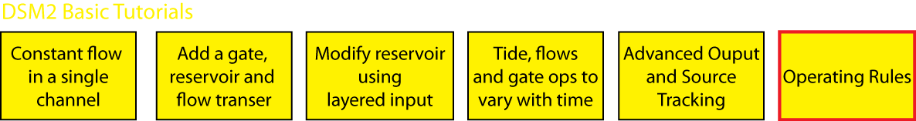
Course Outline Day 2
User Group Introduction and Support (Min Yu)
Operating Rules (Eli Ateljevich)
Basic Tutorial 6

Slide 8
Course Outline Day 2 (cont)
Delta Overview (Jamie Anderson)
Historical Delta Simulations (Lan Liang)
Dissolved Oxygen Simulations (Hari Rajbhandari)
Delta Tutorial 1 (up to PTM)
Delta Tutorial 2
Particle Tracking (Kijin Nam)
Delta Tutorial 1 (PTM

Slide 9
Course Outline Day 2 (cont)
Lunch
Planning Simulations - (Jamie Anderson)
Delta Tutorial 3
Archiving and Batching (Eli Ateljevich)
Delta Tutorial 4 (optional)

Slide 10
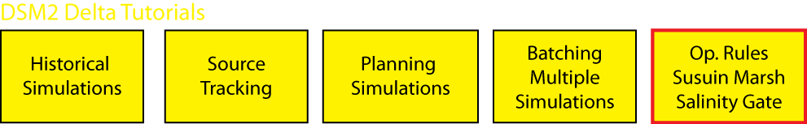
Course Outline Day 3
Operating Rules: Review of Concepts- Marsh Example (Eli Ateljevich)
South Delta Gate Example (Subir Saha)
Delta Tutorial 5
Delta Tutorial 6
Lunch
Design Round Table:
Users bring in Questions

Slide 11
Overview of DSM2

Slide 12
Overview of DSM2
Introduction
Modes of Application
DICU
Calibration Validation

Slide 13
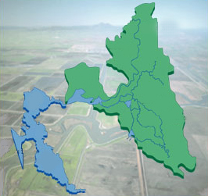
Bay-Delta System
DSM2 Domain
Sacramento
Sacramento
River
Redding
Stockton
San
Joaquin
River
San
Francisco
San
Francisco
Los Angeles
San Diego
Bay-Delta detail image from CALFED

Slide 14
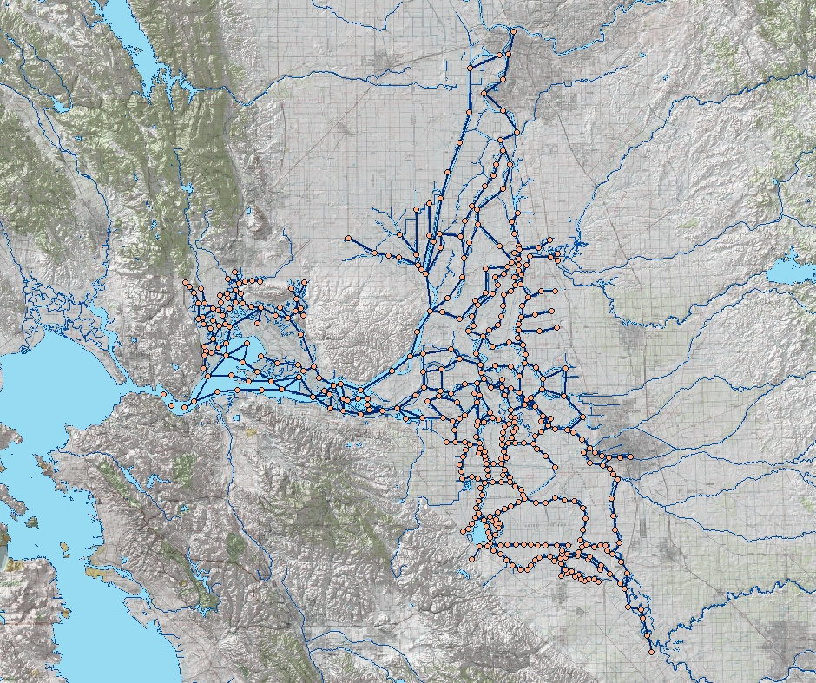
DSM2 Grid
Image from USBR
GIS Group

Slide 15
DSM2 Boundary Conditions
Sacramento River
Sacramento
Inflow & water quality
Export flow
Tributaries
Delta Island Consumptive Use
Martinez
Tidal Stage & Water Quality
Stockton
Exports
San Joaquin River
Image from USBR GIS Group

Slide 16
DSM2 Applications
DSM2
Applications
Historical
Replicate historical conditions
Forecasting
(Real-Time)
Project conditions for the near future
Planning
Hypothetical Delta changes

Slide 17
DSM2 Applications
DSM2
Applications
Historical
Replicate historical conditions
Forecasting
(Real-Time)
Project conditions for the near future
Planning
Hypothetical Delta changes

Slide 18
DSM2 Historical Simulation
Replication of historical hydrodynamic
and water quality conditions
Calibration/verification
Fill in historical data gaps
Historical Data
Inflows, Exports,
Concentrations
Tide: Historic or
Astronomical
DSM2
Currently can
simulate
1990-present
Output
Historical flows,
water stages,
concentrations,
and fingerprints

Slide 19
RTDF Weekly Report

Slide 22
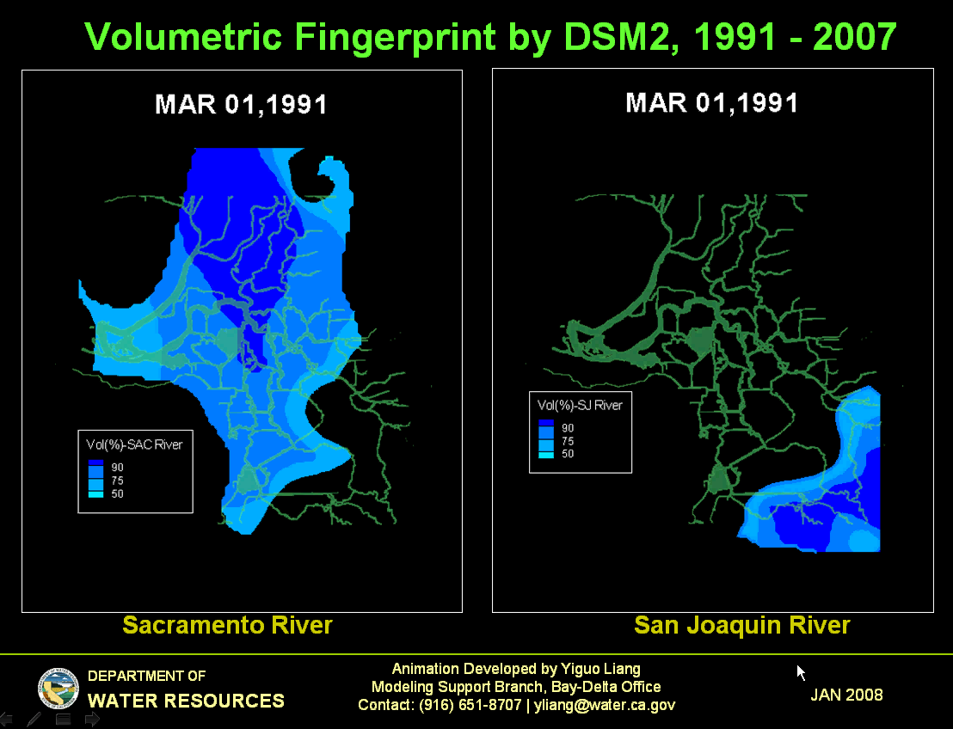

Slide 23
DSM2 Applications
DSM2
Applications
Historical
Replicate historical conditions
Forecasting
(Real-Time)
Project conditions for the near future
Planning
Hypothetical Delta changes

Slide 24
DSM2 Forecast (Real-Time) Simulation
Use of recent field data to project future Delta
hydrodynamic and water quality conditions
Operations
Endangered species
Recent Data
Inflows, Exports,
Concentrations
Tide: Historic and
Astronomical Projection
DSM2
Simulate
into the future
Output
Forecast flows,
water stages,
concentrations,
and particle fate

Slide 25
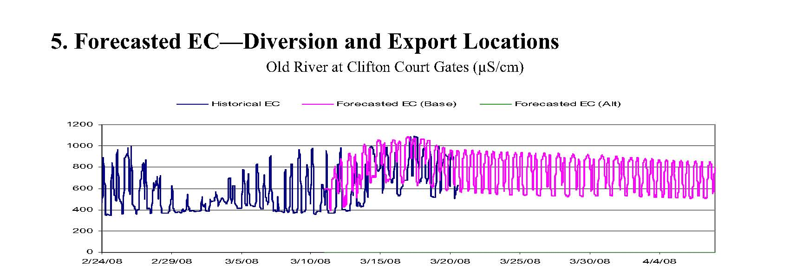
RTDF Weekly Report
DWR O&M

Slide 26
DSM2 Applications
DSM2
Applications
Historical
Replicate historical conditions
Forecasting
(Real-Time)
Project conditions for the near future
Planning
Hypothetical Delta changes

Slide 27
DSM2 Planning Simulation
Simulation of hypothetical changes in the Delta
Operations
Hydrology/Water Quality
Delta Configuration
Historical and
Hypothetical Data
Delta Configuration
CALSIM Inflows,
Exports, and
Concentrations
Tide: Historic
DSM2
Simulate
hypothetical
conditions
over a 16, 73 or 82
year period
Output
Hypothetical flows,
water stages,
concentrations,
particle tracking,
and
fingerprints

Slide 28
Distribution of Daily Average EC
1995 LOD with Projects, 1923 – 1994
Lower San Joaquin River
Values correspond to 5%, 25%, median, 75%, and 95% by rank

Slide 29
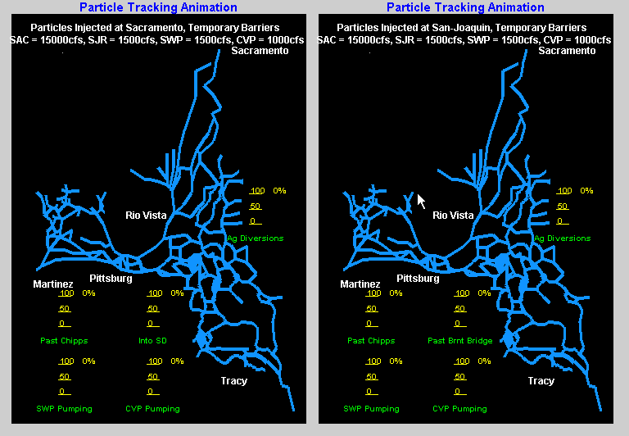
Example PTM Animation

Slide 30
Delta Island Consumptive Use (DICU)
Input for DICU Needed to Compute Monthly Average Delta Island Diversions, Seepage, and Return Flows
Land Use and Irrigation Practices (does not change from year to year)
Water Year Type (Sacramento River 40-30-30 Index)
Atmospheric data ( monthly average precipitation and pan evaporation)
Diversions, Seepage and Return Flow Occur only at Nodes

Slide 31
Delta Island Return Quality
Monthly Average Values
Vary Month to Month but not Year to Year

Slide 32
DSM2 Qual and Hydro Calibration and Validation
Calibration: Adjust Model parameters to get the best match with field observations (stage, flow, EC)
Validation: With no more adjustment to the model parameters, compare model predictions to field observations for different periods
Current Calibration can be Found at http://wwwiep.water.ca.gov/dsm2pwt/dsm2pwt.html
“Mini” Calibration for Bay Delta Conservation Plan (CH2M Hill)

