Slide 1

DSM2 Simulation Input and Output
DSM2 Training
September 15-17, 2009
Lianwu Liu Ph.D. P.E.
Delta Modeling Section
California Department of Water Resources
Notes:
By Simulation Input and Output we mean boundary and initial conditions and some of the runtime I/O files.

Slide 2
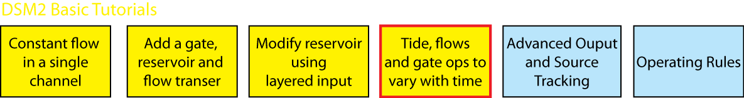
Topics
Boundary Conditions for HYDRO/QUAL
Other Time Series(gates, sources)
Gate Op: Default, Time Series, Op Rule
Initial Conditions (default, restart)
Tidefile
Echoed input
Time Series Output

Slide 3
Basic Input
Configuration
Grid
Boundary Conditions
Initial Conditions
Operation
Notes:
To model a

Slide 4
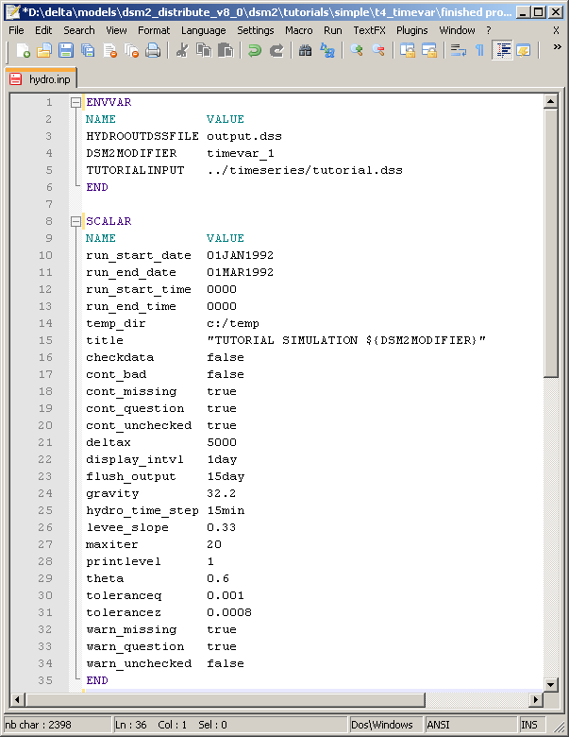
Input
Configuration
ENVVAR
SCALAR
IO_FILE
Notes:
To model a

Slide 5
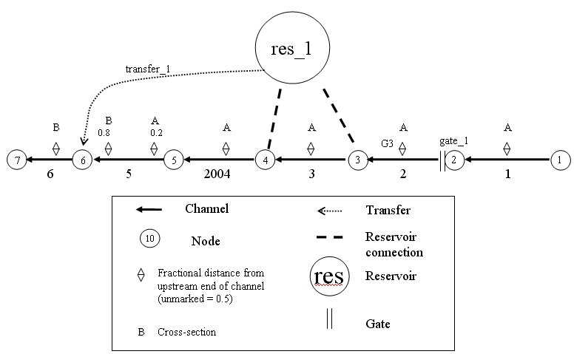
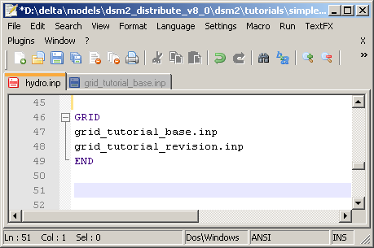
Basic Input
Grid
Channel
Reservoir
Gate
Transfer
Notes:
To model a

Slide 6
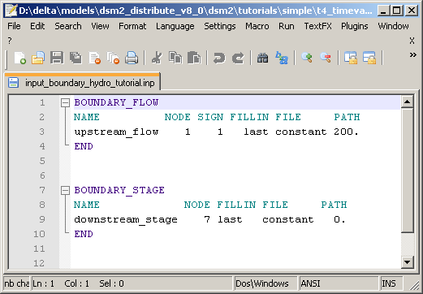
Basic Input
Boundary Conditions
Hydro is stage or flow (including source/sink)
Default is no-flow
Example with
constant flow
and stage
Notes:
To model a

Slide 7
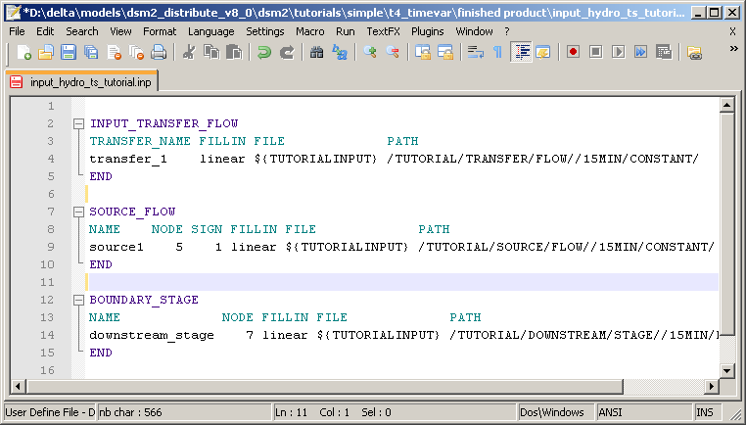
Basic Input
Boundary Conditions
Specifying flow and stage in time series
Notes:
In reality, you will have to specify boundary conditions with time series data.

Slide 8
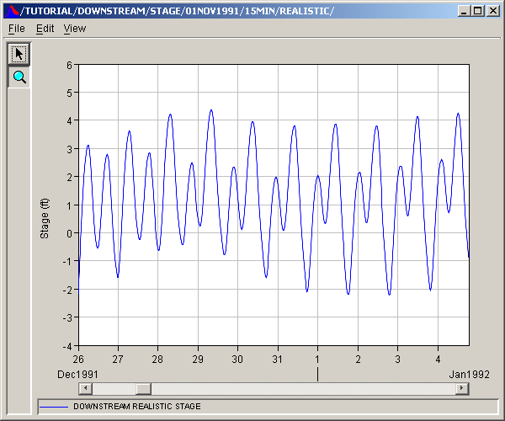
Basic Input
Downstream stage time series example
Notes:
To model a

Slide 9

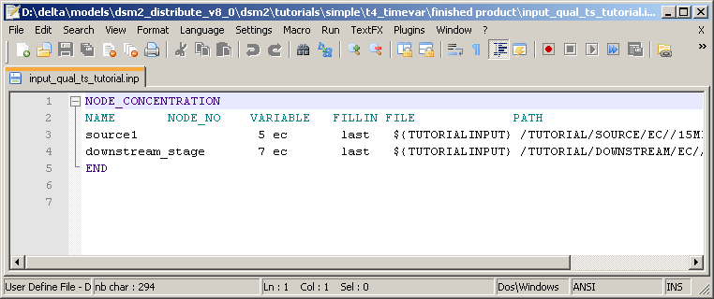
Basic Input
Boundary Conditions for Qual
Concentration for every inflow
Concentration for tidal boundary
Default zero with warning
Linking qual to hydro (use same name )
Notes:
To model a

Slide 10
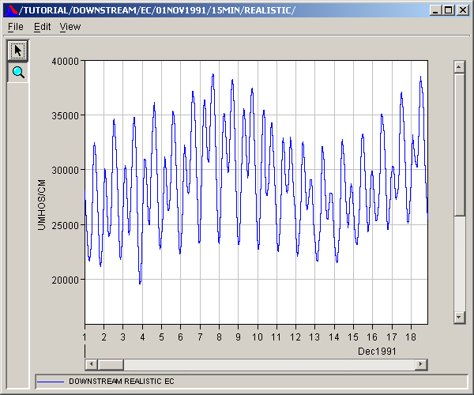
EC at
downstream
Notes:
Only inflow matter for QUAL (if tidal like Martinez, assigned time series may be ignored part of the time)

Slide 11
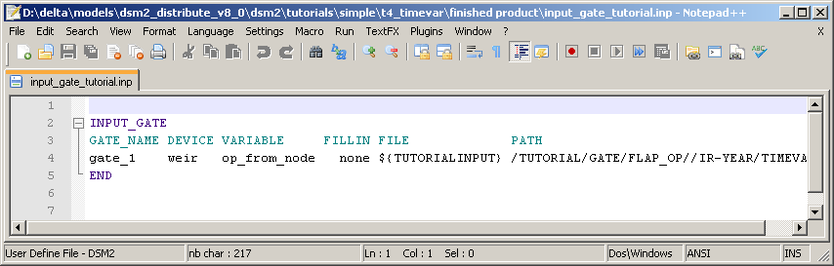
Other TS input (gates)
Notes:
Only inflow matter for QUAL (if tidal like Martinez, assigned time series may be ignored part of the time)

Slide 12
Gate Control
Default value -> time series -> oprule

Slide 13
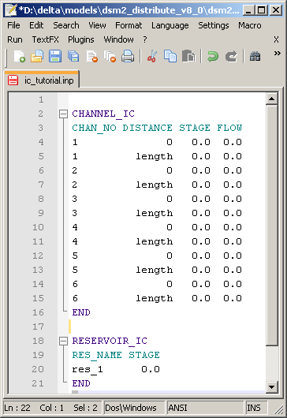
Initial Condition Input
HYDRO Default:
CHANNEL_IC
RESERVOIR_IC

Slide 14
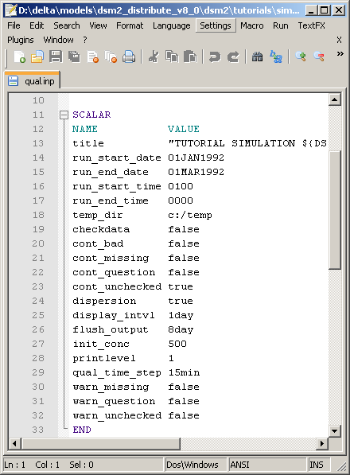
Initial Condition Input
QUAL Default
Scalar init_conc
(cold start)
Restart files
replace the default
(warm start)

Slide 15
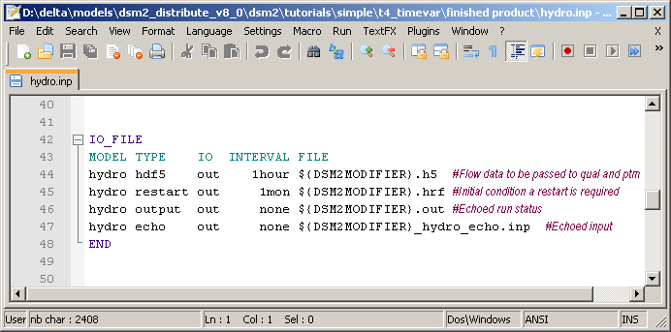
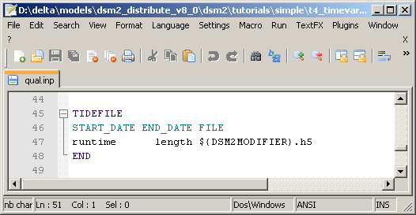
Tidefile
Pass GRID and flow data
to Qual and PTM

Slide 16
Tidefile
GRID input for QUAL (record of all HYDRO input)
Flow Field
Has own time step, spatial step
HDF5 Viewer to view

Slide 17
Time Series Output
What can we output?
Flow, Stage, Vel, and the name of any constituent (ec, do…)
How?
Formats text and DSS
Block
OUTPUT_CHANNEL
OUTPUT_RESERVOIR
OUTPUT_CHANNEL_SOURCE_TRACK
OUTPUT_RESERVOIR_SOURCE_TRACK
OUTPUT_GATE

Slide 18
Time Series Output
OUTPUT_GATE
Device physical data (width, height, elev),
operational data (op_to_node, op_from_node)
flow from water body to node.
From a gate with device=none you can request the variables install, or total flow oriented from water body to node.

Slide 19
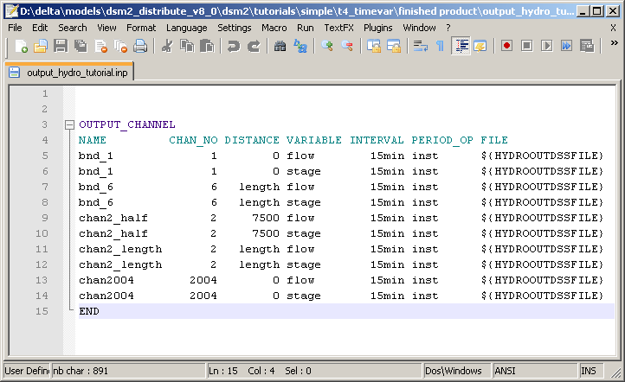
Time Series Output

Slide 20
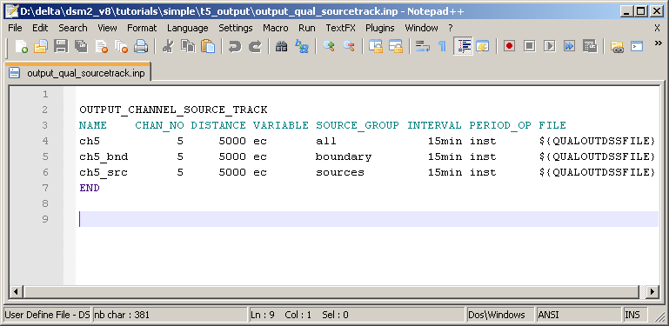
Time Series Output

Slide 21
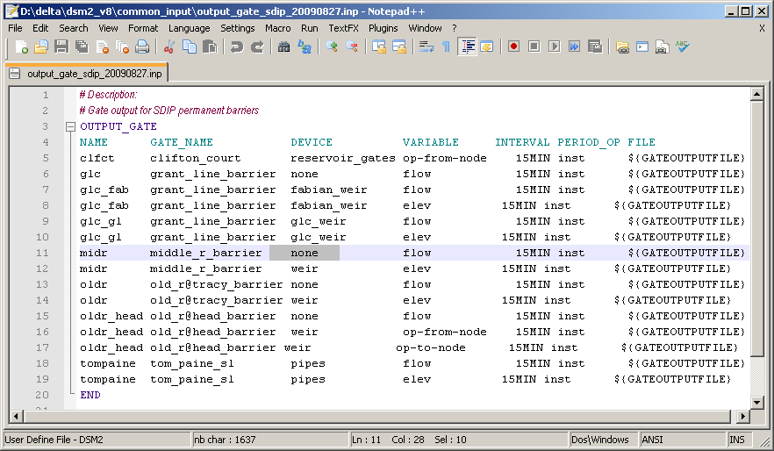
Time Series Output

Slide 22
Echo Input File
Archive of run
QA/QC: single-file view of multiple sources
Can be used as an input file

Slide 23
For v6 Users
No “priorities” in DSS
Link between Hydro and Qual different

Slide 24
Tutorial 4: Time Series
Replaces some constant inputs with time series data, e.g. a realistic tide.

