Slide 1

DSM2-PTM and Historical Run
DSM2 Training
September 15-17, 2009
Kijin Nam
Delta Modeling Section
California Department of Water Resources

Slide 2
Why Particle Tracking?
Tracking discrete matter in fluid
Possibility of adding behaviors
Substitute of contaminant modeling
Intuitive and simple (faster)
Not suffered from numerical oscillation problems

Slide 3
Theory behind DSM2-PTM
Purely kinematic particles with dispersion
Drifting along flow with dispersion
No force, no mass
No buoyancy, etc
No behavior
Forward Euler Integration
Quasi 3D velocity profile

Slide 4
Quasi-3D Velocity Profile
Hydrodynamic Information from DSM2-Hydro
Quasi Velocity profile inside of DSM2-PTM
Quadratic polynomial
Von Karman Logarithmic

Slide 5
Dispersion
Random movement
1
Vertical View
σ
−
σ
0
2
E
V
Δ
t
-
1
Transverse View
1
σ
−
σ
0
2
E
T
Δ
t
-
1

Slide 6
PTM in DSM2
Flows/Stage
Particle Information
Hydro
PTM
Hydrodynamic
Information
Particle
Information

Slide 7
Output Items
Particle in a region
Form a group of waterbodies using regular expressions
Particle flux
From a group of waterbedies to another
Accumulative or instantaneous
Numbers or percentage
Animation
1
2
3
4
6
5

Slide 8
Output Formats
DSS format
Simple
Item by item
Text format
Used for animation
Animation binary file

Slide 9
New in Version 8
Time centered flow
Slight changes in the input file
Grid information from a tide file
Minor bugs are fixed.

Slide 10
Gotchas
Release particles at least a few days later after the start time of hydrodynamics.
Do not use a group name ‘all’ to define a new group. It is a reserved already.
Limitations in the numbers of groups and outputs.
Wrong group names in fluxes and group output lines
Too many particles may crash a simulation.
Increase the memory of the Java virtual machine.
Turn off animation output to save running time.

Slide 11
Examples of PTM Applications
Fish-related studies (Delta smelt, Longfin smelt, Salmon): limited to larvae
Wanger decision
OCAP
Temporary and permanent barriers
DCC
Migration studies
Sediment and Mercury

Slide 12
Limitations
Quasi 3-D based on 1-D Model
Many assumptions
Rectangular channels
Reservoirs
Flow splits (Junctions)
Neutrally buoyant particles
No behavior

Slide 13
Historical Example
Based on a historical hydro tutorial
Particles are injected at Mossdale (Node 7) continously.
Outputs are in-delta particles and accumulated particles at the exports and Martinez downstream boundary.

Slide 14
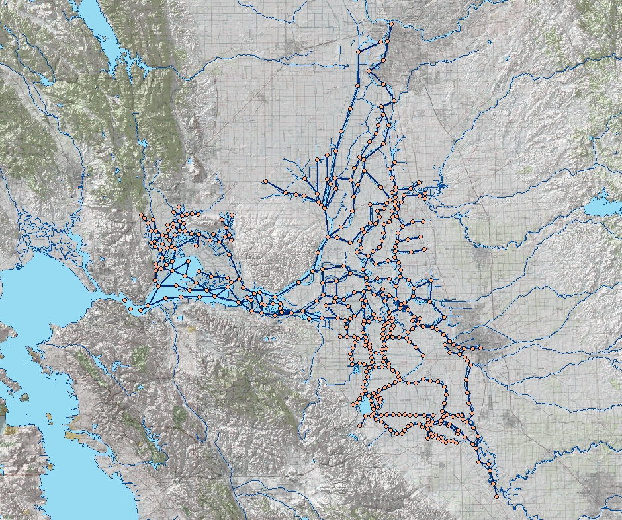
Group:
In-Delta
Mossdale:Particle
Release
Martinez:
Flux
SWP & CVP: Flux
Image from USBR GIS Group

Slide 15
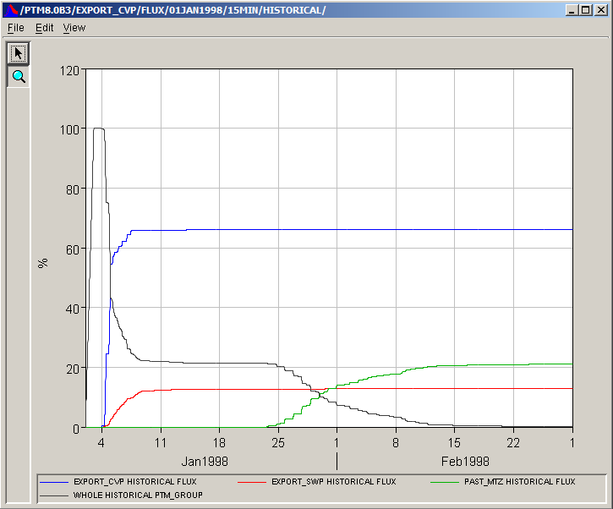
Results of the Example

Slide 16
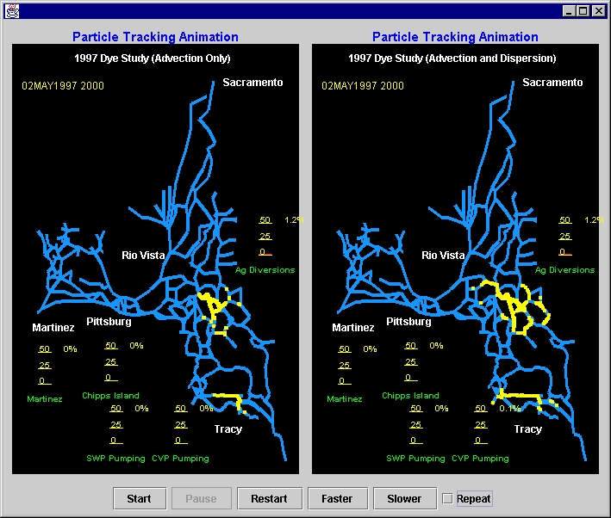
Animation of DSM2-PTM
DSM2-PTM provides an animation tool.
Two side-by-side panes
Use text output and animation output.

Slide 17

Questions?

Slide 18

Supplementary

Slide 19
Transverse Profile

Slide 20
Vertical Profile

Slide 21
3D Profile

Slide 22
Numerical scheme
Euler Forward
The constant velocity in one time step
Particles are bounced at the surface, bottom, and wall.
Random transverse and vertical dispersions are added.

Slide 23
Assumption for Channels
Assume a rectangular channel based on hydrodynamic information from DSM2-Hydro, which are depth and area at each end of a channel.
The shape of cross-sectional area is ignored.
The mid-section of a channel is linearly interpolated.

Slide 24
Flow Split Management
DSM2 does not provide junction configurations.
When a particle hits a node, a next waterbody is determined only by the ratio of the outflows at the node.
Does not preserve position information.

Slide 25
Assumption for Reservoirs
A reservoir in DSM2 is represented as a completely mixed tank.
No flow information in a reservoir.
PTM uses a similar technique to the flow split for reservoir.
Once a particle enters into a reservoir, a next waterbody is determined randomly by the ratio of outflows and the volume of the reservoir.

Slide 26
Real-Time Forecast
Real-time
Flows/Stage
Forecast
Flows/Stage
Particle/Fish Information
Hydro
PTM
Hydrodynamic
Information
Particle
Information

Slide 27
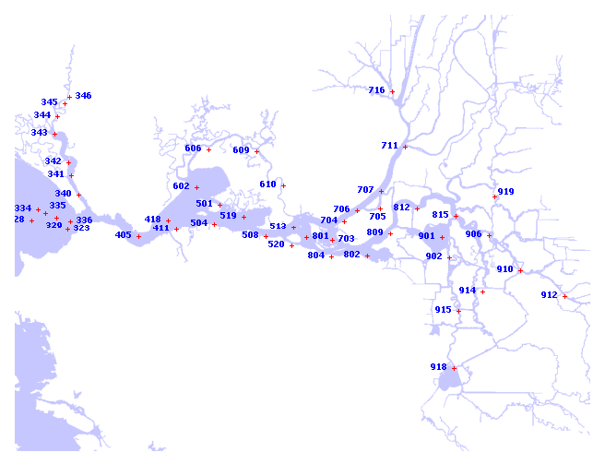
20mm Survey Locations
From DFG website

