Slide 1

DSM2 Simulation Input and Output
DSM2 Training
September 15-17, 2009
Lianwu Liu
Delta Modeling Section
California Department of Water Resources
Notes:
By Simulation Input and Output we mean boundary and initial conditions and some of the runtime I/O files.

Slide 2
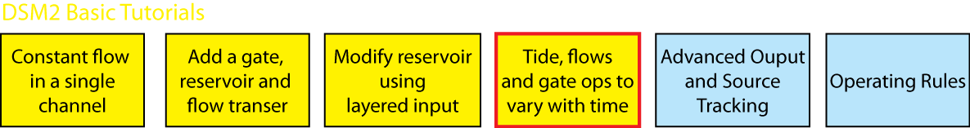
Topics
Boundary Conditions for HYDRO/QUAL
Other TS (gates, sources)
Default, Time Series and Op Rule Control
Time series formats: text, HEC-DSS
Time Series Output
Initial Conditions (default, restart)
Tidefile
Echoed input

Slide 3
Basic Input
Configuration
Grid
Boundary Conditions
Initial Conditions
Operation
Notes:
To model a

Slide 4
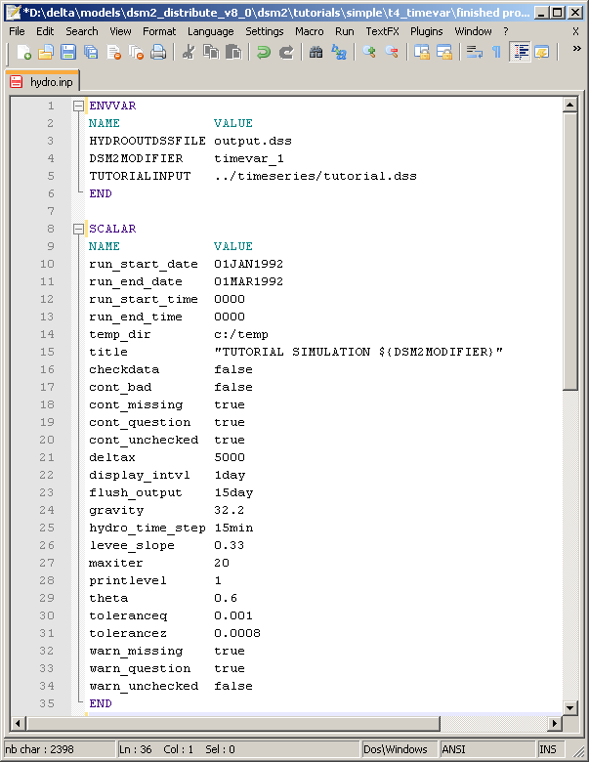
Input
Configuration
ENVVAR
SCALAR
IO_FILE
Notes:
To model a

Slide 5
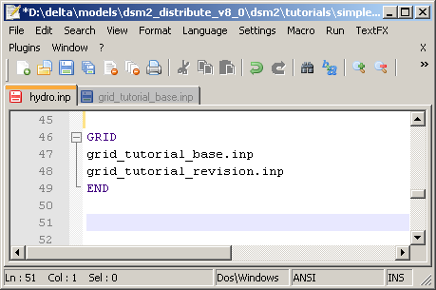
Basic Input
Grid
Channel
Reservoir
Gate
Transfer
Notes:
To model a

Slide 6
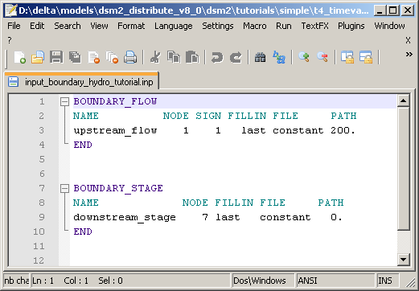
Basic Input
Boundary Conditions
Hydro is stage or flow
Default is no-flow
Notes:
To model a

Slide 7
Basic Input
Boundary Conditions (Continue)
Qual concentration for every inflow
Default zero with warning
Notes:
To model a

Slide 8
Input
Configuration
ENVVAR
SCALAR
Grid
Boundary Conditions (Upstream, Downstream, flow, stage, source/sink)
Initial Conditions

Slide 9
Boundary Conditions
What required
Hydro is stage or flow
Default is no-flow
Qual concentration for every inflow
Default zero with warning
Tidal boundary may not always be used
Other TS input (gates)
Linking qual to hydro (name of input)
Notes:
Only inflow matter for QUAL (if tidal like Martinez, assigned time series may be ignored part of the time)

Slide 10
Time Series Control
Default value -> time series -> oprule
Graphic with example (probably gate op)

Slide 11
Initial Condition Input
HYDRO Default:
CHANNEL_IC
RESERVOIR_IC
QUAL Default
Scalar init_conc
Hard to find single number for DO constituents
Restart files replace the default

Slide 12
Initial Conditions
HYDRO and QUAL require initial…
System Memory of hydro vs qual
Practices (cold start, warm)

Slide 13
Time Series Output
What can we output?
How? Formats text and DSS

Slide 14
Tidefile
GRID input for QUAL (record of all HYDRO input)
Flow Field
Has own time step, spatial step
IO_FILE section
HDF5 Viewer (they can watch along)

Slide 15
Echo Input File
Archive of run
QA/QC: single-file view of multiple sources
Can be used as an input file

Slide 16
For v6 Users
No “priorities” in DSS
Link between Hydro and Qual different

Slide 17
Tutorial 4: Time Series
Introduce 4 and a bit of 5
Replaces some constant inputs with a time series that is constant, but also has a realistic tide

