Slide 1

Reservoirs, Gates and Flow Transfers
DSM2 Training
September 2009
Jamie Anderson, PhD, PE
Delta Modeling Section
California Department of Water Resources
Notes:
DSM2 Users Group: "EXAMPLE: Filling in Martinez Stage"
2004.04.27

Slide 2
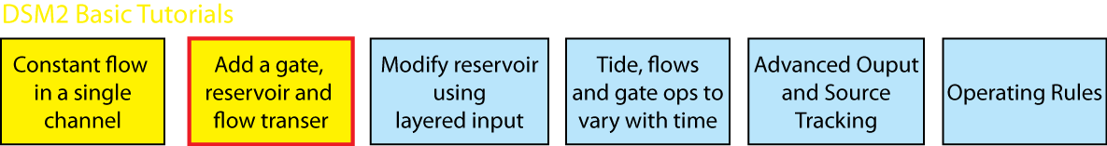
What We Will Cover
What are:
  Reservoirs
  Gates
  Flow Transfers
Adding them in DSM2 input
Differences in version 8
Notes:
DSM2 Users Group: "EXAMPLE: Filling in Martinez Stage"
2004.04.27

Slide 3
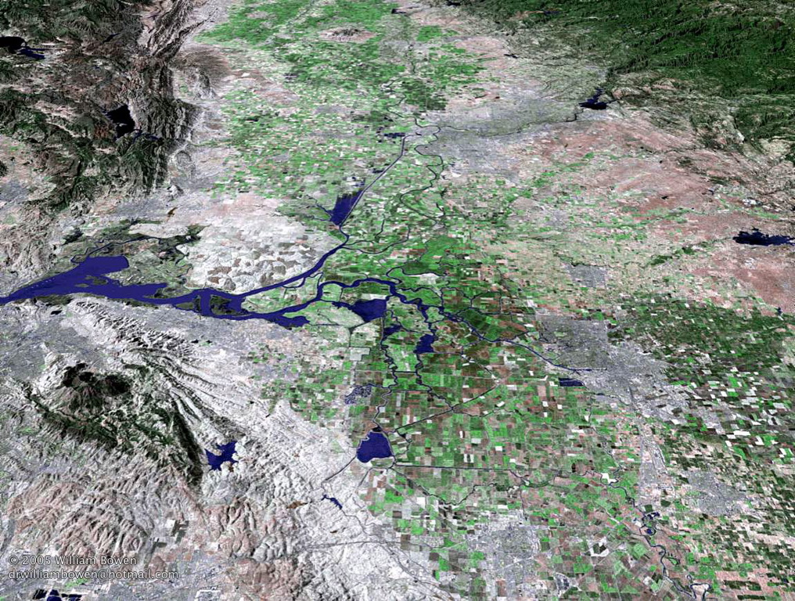
Reservoirs
Notes:
DSM2 Users Group: "EXAMPLE: Filling in Martinez Stage"
2004.04.27

Slide 4
What is a reservoir in DSM2?
Open bodies of water that store flow
Connected to nodes by means of an energy-based equation
Instantly well-mixed
DSM2 input for reservoirs
  Reservoirs table
  identity and physical properties of the reservoir
  Reservoir Connections table
  connections to nodes

Slide 5
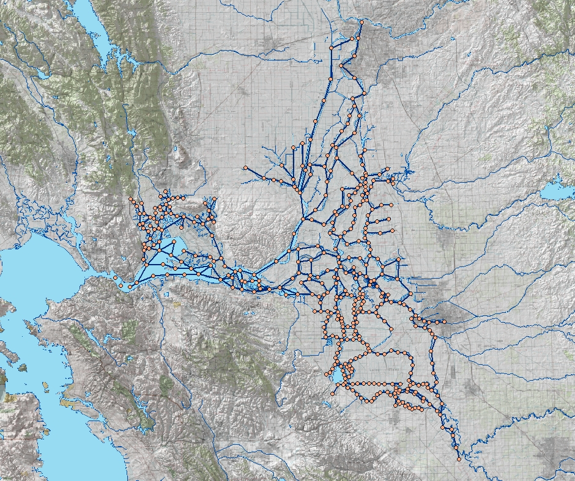
Reservoirs in DSM2 Delta Application
Sacramento
1. Clifton Court Forebay
2. Mildred Island
3. Bethel Island
4. Frank’s Tract
5. Discovery Bay
3
4
Martinez
2
5
Stockton
1
Image from USBR GIS Group

Slide 6

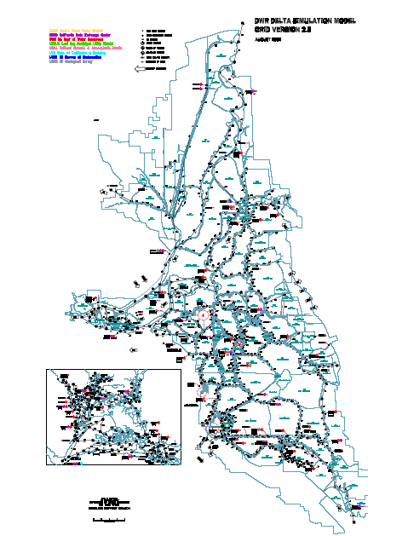
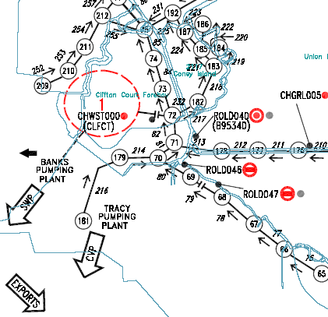
DSM2 Cool Tip
DSM2 Grid
C:\delta\dsm2_v8\documentation\DSM2_Grid2.0.pdf

Slide 7
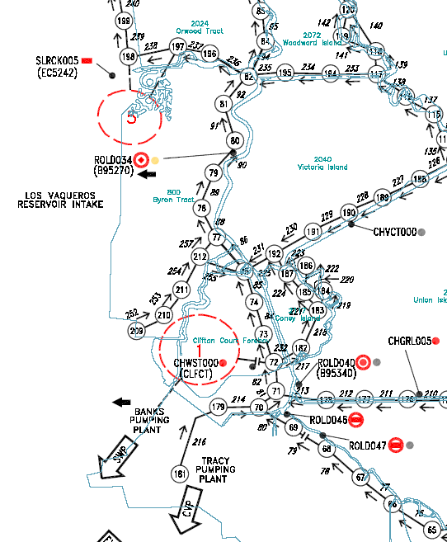
Clifton Court Forebay and Discovery Bay in DSM2
Discovery Bay
  Connects to two nodes
Clifton Court Forebay
  Connects with a gate
CCF Gate

Slide 8
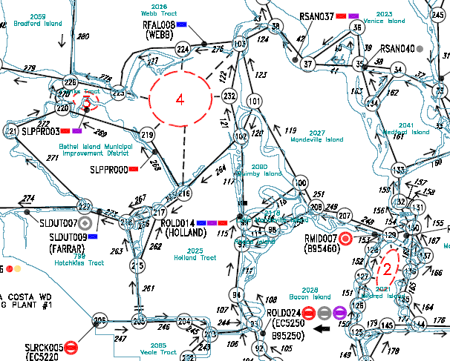
Bethel Island, Frank’s Tract and Mildred Island in DSM2
Bethel Island
  Connects to 1 node
Frank’s Tract
  Connects to 6 nodes
Mildred Island
  Connects to 4 nodes

Slide 9
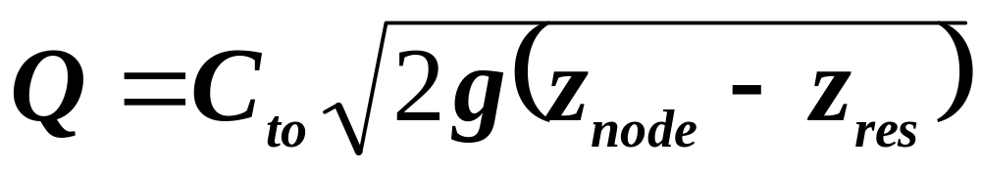
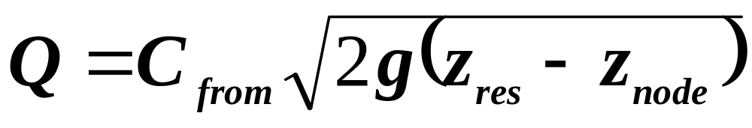
Reservoir Equations
When Z_{res}<Z_{node}
Flow direction
Reservoir Node
When Z_{res}>Z_{node}
Reservoir Node
Where:
C_{to} and C_{from} = coefficients representing the hydraulic efficiency
of the reservoir connection and the nominal
area perpendicular to flow
g = gravity
z_{res} and z_{node} = water surface elevations at the reservoir and node
(node surface is assessed by means of a reference
channel that has no reservoirs attached to it)

Slide 10
Reservoir Changes in v8
Coefficient not attenuated by 0.75 like in text version
  Different coefficients than text version (text values/0.75)
  Coefficients are expected values from reservoir equation
No reservoir connection when a gate is used
(e.g. Clifton Court)
Default Initial Condition required for HYDRO
  Set in Reservoir Initial Conditions table, not Reservoirs table
  Overridden by restart file
  Reservoir IC should be consistent w/surrounding channels. Recommend zero flow and no water surface difference across reservoir connection
Reservoir specs otherwise same
Solver improved, continuity at connected node
Notes:
DSM2 Users Group: "EXAMPLE: Filling in Martinez Stage"
2004.04.27

Slide 11
Reservoir Output
A basic reservoir
  “stage” in HYDRO or QUAL
  “flow-net” in HYDRO
  Concentration of constituent in QUAL
    use constituent name
With named connection to node
  “flow” in HYDRO or QUAL
Notes:
DSM2 Users Group: "EXAMPLE: Filling in Martinez Stage"
2004.04.27

Slide 12
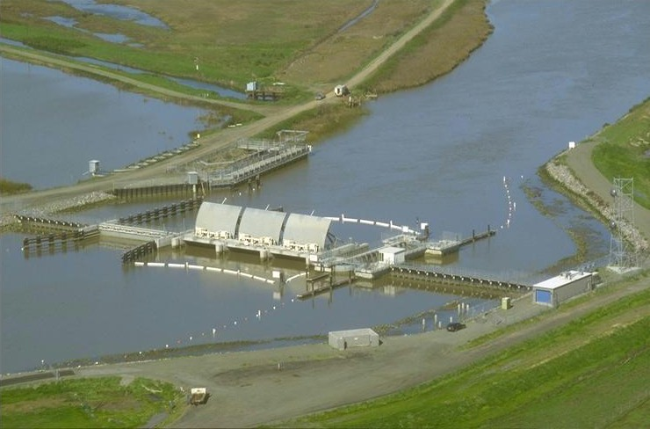
Gates
Notes:
DSM2 Users Group: "EXAMPLE: Filling in Martinez Stage"
2004.04.27

Slide 13
What is a gate in DSM2?
Single site that present a barrier or control on flow
Arbitrary number of associated hydraulic devices
  pipes and weirs
  each of device can be operated independently to control flow
DSM2 input for gates
  Gates table
  Name of gate
    Used for overriding and time series control
  Connection between water body and node
    Less confusing if connected from a water body to downstream node
  Gate Devices table
  Details about pipes and weirs for that gate
  Default gate operations (open, closed) or use operating rules

Slide 14
Gates in DSM2
1. Delta Cross Channel
Connected to channel
Connected to reservoir
2. Goodyear Slough
3. Morrow Island Intake
4. Morrow Is. C-line outfall
5. Morrow Is. M-line outfall
6. Roaring River Sl. Intake
7. Montezuma Slough
salinity control gate
Sacramento
1
8. 7-Mile Sl. @ 3-Mile Sl.
9. 7-Mile Sl. @ SJR
10. Sandmound Slough
3
5
4
6
7
8
9
2
Temporary Barriers
11. Middle River
12. Grant Line Canal
13. Old River at Tracy.
14. Head of Old River
Martinez
10
Stockton
11
15. Tom Paine Slough
16. Paradise Cut Weir
17
12
14
13
15
16
17. Clifton Court Forebay
Image from USBR GIS Group

Slide 15
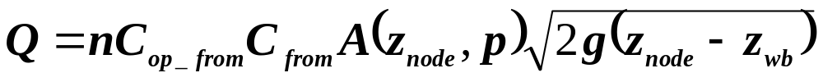

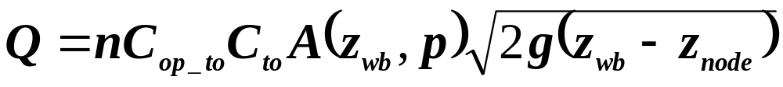
Gate Equations
When Z_{wb}<Z_{node}
Flow direction
Water Body Gate Node
When Z_{wb}>Z_{node}
Water Body Gate Node
Where:
n = number of duplicate devices, g=gravity,
C_{op_to} and C_{op_from} = operating coefficient for controls, e.g. flap valves
C_{to} and C_{from} = coefficients representing gate’s hydraulic efficiency
A = area of flow depending on higher water surface and position p
z_{res} and z_{node} = water surface elevations at the reservoir and node

Slide 16
Gate Default Operations in the GATE table
gate_open
  C_{op_to}=1.0 C_{op_from}=1.0
gate_close
  C_{op_to}=0.0 C_{op_from}=0.0
unidir_to
  C_{op_to}=1.0 C_{op_from}=0.0
unidir_from
  C_{op_to}=0.0 C_{op_from}=1.0

Slide 17
Pipe Configuration
nduplicate = 2
radius
Elev
0 msl
Notes:
DSM2 Users Group: "EXAMPLE: Filling in Martinez Stage"
2004.04.27

Slide 18
Weir Configuration
nduplicate = 1
Max width
Elev
0 msl
Notes:
DSM2 Users Group: "EXAMPLE: Filling in Martinez Stage"
2004.04.27

Slide 19
Radial gate
Gated at the top
  Use “height” as operation
height
elev
Notes:
DSM2 Users Group: "EXAMPLE: Filling in Martinez Stage"
2004.04.27

Slide 20
Crest-Operated Gate
Gated at the bottom
  Use “elev” as operation
elev
Notes:
DSM2 Users Group: "EXAMPLE: Filling in Martinez Stage"
2004.04.27

Slide 21
Major Gate Changes in v8
Reservoir gates designation no longer exists
Directionality based on “water body” and “node”, not up/downstream
Multiple devices at one gate
Both gate ops and physical gate position:
  elev, width, height, op, op_to/from_node, install
Control based on op rules
Notes:
DSM2 Users Group: "EXAMPLE: Filling in Martinez Stage"
2004.04.27

Slide 22
Sample INPUT_GATE table
Sample input file
INPUT_GATE
GATE_NAME DEVICE VARIABLE FILLIN FILE PATH
tutorial_gate1 weir1 op last ${GATEFILE} file_path
tutorial_gate2 weir2 open last ${GATEFILE} file_path
tutorial_gate3 weir3 close last ${GATEFILE} file_path
tutorial_gate4 weir4 op-from-node last ${GATEFILE} file_path
tutorial_gate5 weir5 op-to-node last ${GATEFILE} file_path
tutorial_gate6 none install last ${GATEFILE} file_path
END
Example File Paths
/PLANNING+GATE/CHWST000/OP-FROM-NODE//IR-YEAR/${CLIFTONCT_GATEOP}/
/CALSIM-PROCESSED/DCC/OP//IR-YEAR/${CALSIMSTUDY}/
Notes:
DSM2 Users Group: "EXAMPLE: Filling in Martinez Stage"
2004.04.27

Slide 23
Gate Operations in VARIABLE column
Op is magic that modulates gate flow by a factor between 0.0 and 1.0
  Good for open/close/flap gates
Default open means multiply by 1.0
Default close means multiply by 0.0 (device closed)
Operate the gate using an op rule or a time series
  “op-to-node” or “op-from-node” with values between 0.0 and 1.0
Notes:
DSM2 Users Group: "EXAMPLE: Filling in Martinez Stage"
2004.04.27

Slide 24
Gate Installation
INPUT_GATE
GATE_NAME DEVICE VARIABLE FILLIN FILE PATH
tutorial_gate6 none install last ${GATEFILE} file_path
END
Used to completely install/remove gates
  Node reverts to “equal stage” condition
  Devices not relevant when gate is removed
    DSM2 continues calculations related to the devices, but they do not affect the simulation results until gate is restored.
Requires time series or op rule
  1.0 = install gate and use time series or op rule
  for controlling devices (default)
  0.0 = remove gate – ordinary channel
Notes:
DSM2 Users Group: "EXAMPLE: Filling in Martinez Stage"
2004.04.27

Slide 25
Gate Time Series
Operations: op, op-to-node, op-from-node
  Values between 0.0 and 1.0
Installation: install
  Whole gate (gate+devices)
  Values of 0.0 (out) or 1.0 (in)
Physical params: width, elev, height
  Use height for radial gate, elev for variable crest
  Flow coefficients should not be used for ops
Seems to be a trend towards operating rules instead of time series
Notes:
DSM2 Users Group: "EXAMPLE: Filling in Martinez Stage"
2004.04.27

Slide 26

Gate Gotchas
Make sure orientation is intended
Always verify operations visually
Notes:
DSM2 Users Group: "EXAMPLE: Filling in Martinez Stage"
2004.04.27

Slide 27
Gate Output
HYDRO only
With gate only:
  install
  flow (oriented with gate, not channel)
With gate and device:
  op-to-node
  op-from-node
  position, height, elev, width
  flow
Notes:
DSM2 Users Group: "EXAMPLE: Filling in Martinez Stage"
2004.04.27

Slide 28
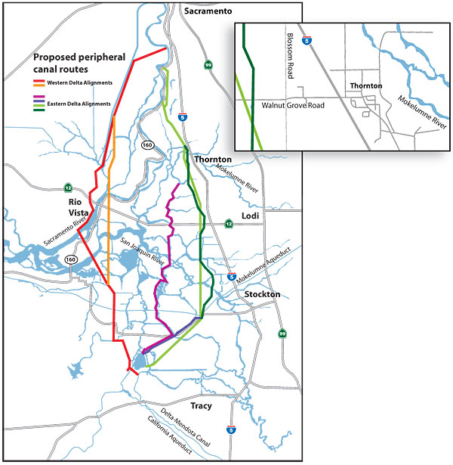
Water Transfers
Notes:
DSM2 Users Group: "EXAMPLE: Filling in Martinez Stage"
2004.04.27

Slide 29
What is a flow transfer in DSM2?
Direct water connections from a reservoir or node to another reservoir or node
Instantaneous movements of water (and its constituents and particles) without any detailed description of physics or storage
DSM2 input for flow transfers
  Transfer table
  Identifies transfer source node/reservoir and destination nodes/reservoir
  Input Transfer Flow table
  specifies constant flow or time series of flow to be transferred

Slide 30


Flow Transfers in DSM2

Slide 31
Flow Transfers
These are obj2obj transfers in version 6
From one node/reservoir to another
Transferred flow can be
  Constant
  Based on a time series
Only transfers with specified flow are supported
Notes:
DSM2 Users Group: "EXAMPLE: Filling in Martinez Stage"
2004.04.27

Slide 32

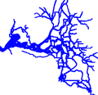
Now it’s time to do
Tutorial 2

