Slide 1








2017 CAD Contest at ICCAD
Myung-Chul Kim, Shih-Hsu Huang, Rung-Bin Lin, Shigetoshi Nakatake
Notes:
Good evening, I am Myung-Chul from IBM,
I personally was a contestant back in 2012 since then I’ve started serving as a topic chair and general co chair
This year I am the general chair of the ICCAD 2017 contest.
I will give you a brief updates on this year’s status.

Slide 2
2017 CAD Contest
2017 Contest – 6th edition of the CAD contest at ICCAD since 2012
Largest worldwide EDA research and development contest
Goal:
Boost academic research in real-world EDA problems
Foster a working relationship between members of academia and industry
Find new insights, approaches to the problems, and new talents
Sponsorship
Financial Sponsorship : - IEEE Council on Electronic Design Automation (CEDA) - Ministry of Education (MOE), Taiwan - Taiwan IC Design Society (TICD) Synopsys, Inc. - Cadence, Inc. - MediaTek, Inc.
Technical Sponsorship: - National Chip Implementation Center (CIC), Taiwan
Notes:
Industry experts in the various areas set forth topics what matter now, including Realistic benchmarks and common evaluation frameworks:
WE also
to advance the state-of-the-art in EDA,
This also enables us to find new insights and approaches to problems. Find new talents from interntional univer

Slide 3
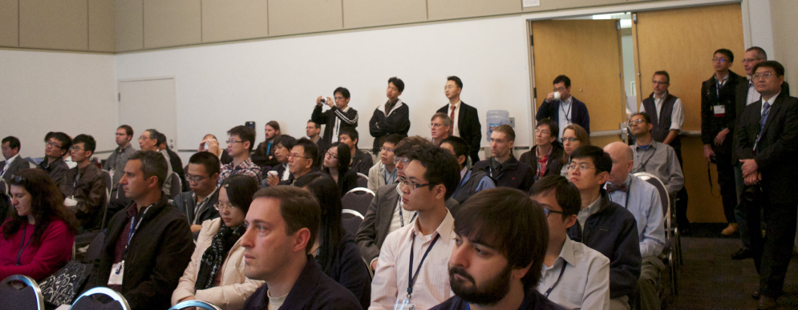
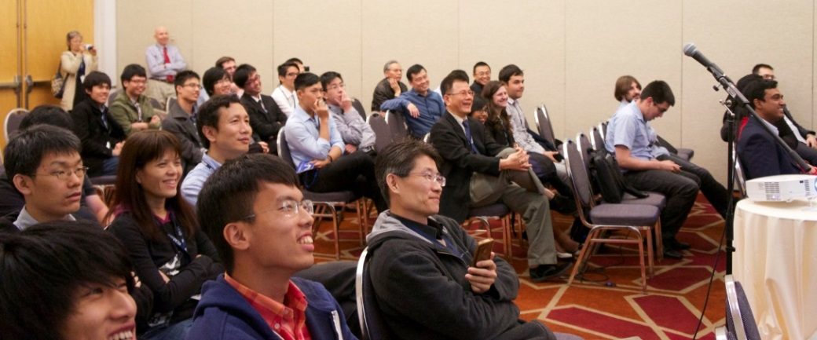
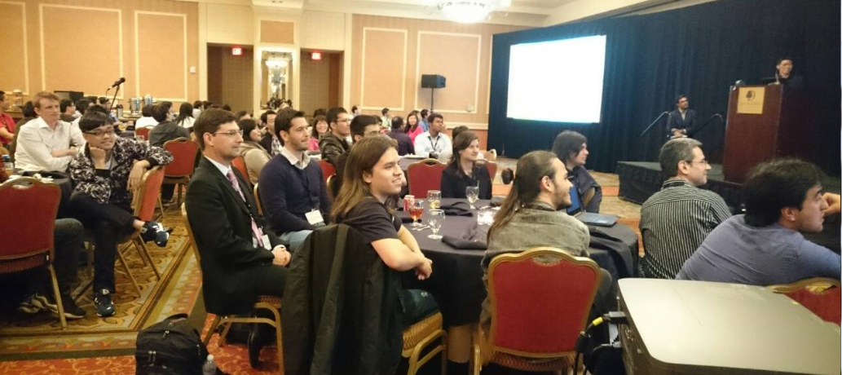
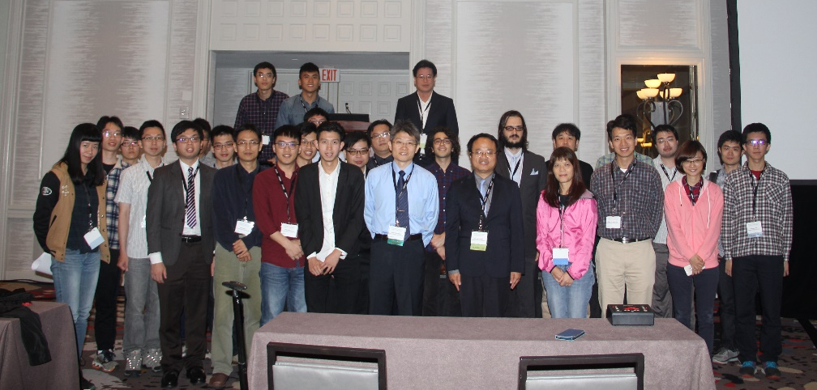
Contest Sessions at ICCAD
CAD contest sessions at ICCAD has drawn big crowds!
Highest attendance over all regular sessions at ICCAD since 2012.
Venue to present contest problems and winning teams’ technologies
2013
2014
2015
2016
Notes:
Over the last five years, the CAD contest special session has been one of the most popular sessions at ICCAD.

Slide 4
CAD Contests Boost EDA Research
Total # of Citations to the past ICCAD contest papers: 130 (Google Scholar / ACM DL Library)
2012 CAD Contest (47)
Finding Minimal Logic Difference for Functional ECO: 2
Fuzzy Pattern Matching for Physical Verification: 18
Design Hierarchy-aware Routability-driven Placement: 27
2013 CAD Contest (33)
Technology Mapping for Macro Blocks: 1
Mask Optimization: 19
Placement Finishing: 13
2014 CAD Contest (14)
Simultaneous CNF Encoder Optimization: 2
Design for Manufacturability Flow: 5
Incremental Timing-driven Placement: 7
2015 CAD Contest (32)
Large-scale Equivalence Checking and Function Correction: 3
3D Interlayer Cooling Optimized Network: 2
Incremental Timing-driven Placement: 27
2016 CAD Contest (4)
Non-exact Projective NPNP Boolean Matching: 1
Large-scale Identical Fault Search: 1
Pattern Classification for IC Design Space Analysis: 2
And more to come …
Notes:
If we quantitatively summarize the impact of CAD contest on EDA research,
Acoording to.. .. The number of citation to the past ICCAD contest papers are totalling 130, right before DAC 2017.

Slide 5
2012-2016 Registration Statistics
d
2012 CAD Contest at ICCAD 56 teams from 7 regions: USA , Japan, Mainland China, Hong Kong, Korea, Italy and Taiwan
2015 CAD Contest at ICCAD 112 teams from 12 regions: USA, Brazil, Belgium, Sweden, Russian, Egypt, Mainland China, Hong Kong, Korea, India, Iran and Taiwan
2013 CAD Contest at ICCAD 87 teams from 9 regions: USA , Canada, Brazil, India, Russia, Japan, Mainland China, Hong Kong and Taiwan
2016 CAD Contest at ICCAD 135 teams from 11 regions: USA, Canada, Brazil, Russia, Mainland China, Hong Kong, Japan, Korea, India, Iran and Taiwan
2014 CAD Contest at ICCAD 93 teams from 9 regions: USA, Canada, Brazil, Russia, India, Singapore, Mainland China, Hong Kong and Taiwan
Notes:
We started with 56 teams from 7 regions in 2012, then then number of participants rapidly increased over the years,
In 2016, 135 teams registered fro the contest. If we assume about 4 people per team on average, that’s easily over 400 people, who were engaged in the contest directly and indirectly

Slide 6
2017 Registration Statistics
2017 CAD Contest
123 teams from 10 regions/countries
North America: USA
South America: Brazil
Asia: Taiwan, Mainland China, Hong Kong, India, Japan, Korea
Europe: Russia, Germany
Notes:
In 2017, we were able to attract 123 teams from 10 regions,

Slide 7
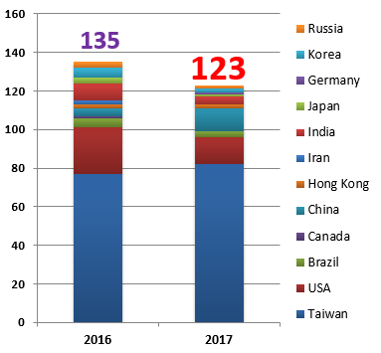
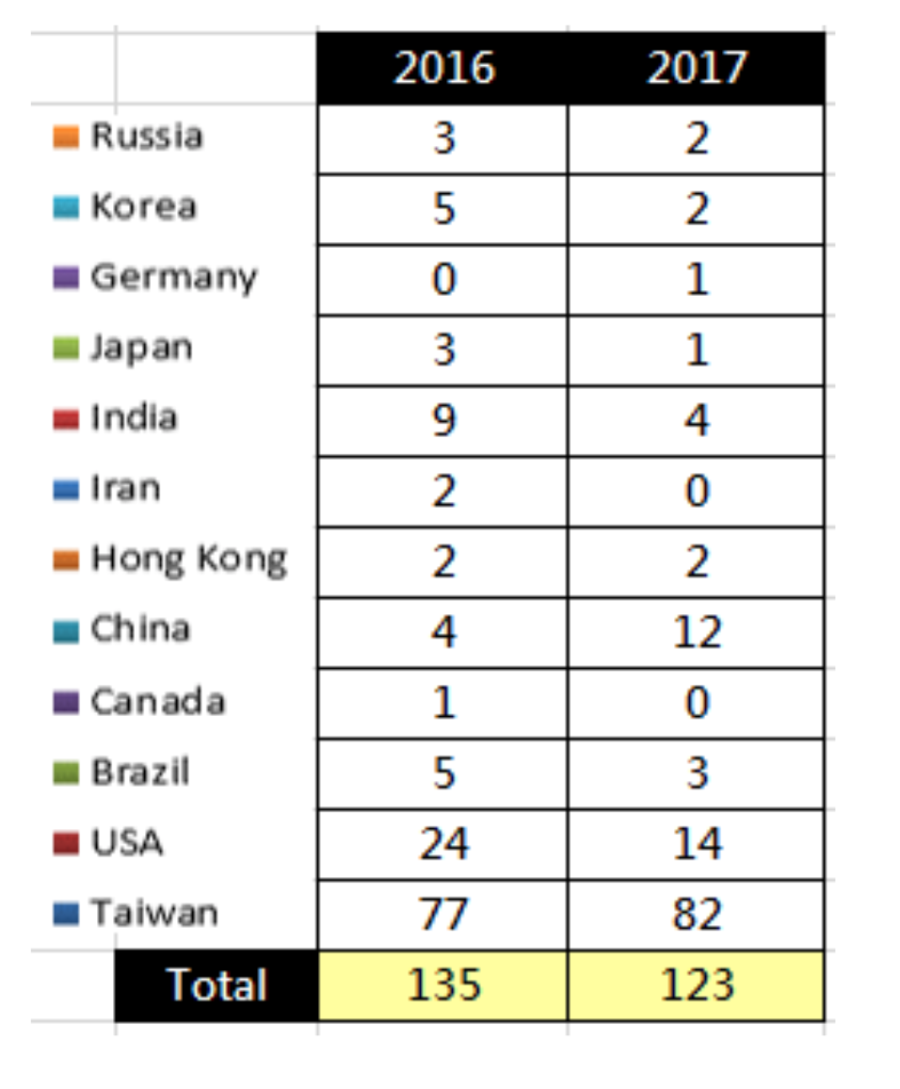
Distribution of Teams
Notes:
Diversity of team changed a bit, participation from china increased quite a bit

Slide 8
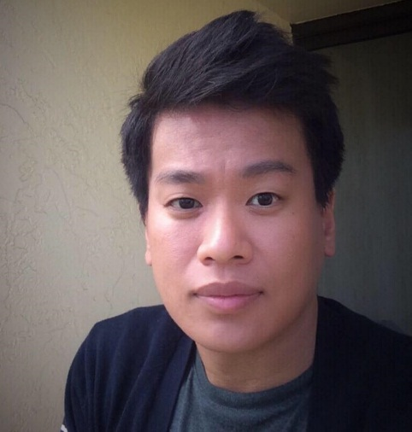
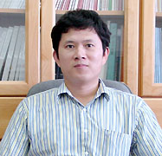
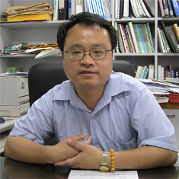
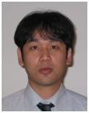
2017 CAD Contest Chairs
Myung-Chul Kim IBM Corporation USA
Rung-Bin Lin Yuan Ze University Taiwan
Shih-Hsu Huang Chung Yuan
Christian University Taiwan
Shigetoshi Nakatake The University of Kitakyushu Japan
Notes:
I’d liked to appreciate our amazing contest cochairs.

Slide 9
Three Contest Problems
Contributor | Topic (area)
Cadence Ching-Yi Huang, Chih-Jen (Jacky) Hsu and Chi-An (Rocky) Wu | Resource-aware Patch Generation (logic synthesis / functional ECO)
Synopsys Kai-Shun Hu and Cindy Shen | Net Open Location Finder with Obstacles (physical design / ECO routing)
Mentor Graphics Nima Karimpour Darav, Ismail Bustany and Andrew Kennings | Multi-Deck Standard Cell Legalization (physical design / legalization for advanced nodes)
Notes:
We presented thee contest problems, this years. One in design verification space, and two in physical design.

Slide 10
Timeline
Contest Call for Participation: Feb 1, 2017
Registration deadline: May 25, 2017
Alpha submission: Jun 25, 2017
Beta submission: Jul 26, 2017
Final submission: August 31, 2017
Announce top X teams: Oct 5, 2017
Final presentation: Nov 2017 (ICCAD)
Notes:
Call for participation was back in Feb.
We have three rounds of evaluations are coming up, alpha, beta, and final starting from Jun 25
We release the best results after alpha/beta evaluation to encourage contestants to further improve their results.

Slide 11
Awards
Winners receive monetary awards (students only) and certificates
Rank | Award
1st Place One team per topic | NTD50,000/team (~ US$1650) Certificate
2nd / 3rd Place Two teams per topic | NTD30,000/team (~ US$1000) Certificate
Notes:
We appreciate our generous sponsors

Slide 12
ICCAD Contest Special Session
Present the three contest problems and evaluation metrics
Release the official contest benchmark suites
Play short video clips from the top-performing teams
Sketch key ideas and algorithms
Introduce teams
Announce the final contest results and award winners
OpenDesign Flow Database 2.0
Notes:
This is a bit of session details at ICCAD session proposal.
Finally, a talk on OpenDesign Flow2.0 will describe the recent progress on building an academic design flow and infrastructure for EDA research, purely composed by the past contest results.
. We expect that the session will have education values and is interesting to the general audience of ICCAD.

Slide 13


