Slide 1
RVE GENERATOR
Oriol Vallmajó Martín
PhD student, UdG
oriol.vallmajo@gmail.com

Slide 2
HOW IT WORKS?
Run the main script RVE_generator.py
Outputs:
A numpy file which save several arrays into a single file in uncrompressed.npz format will be automatically created.
A txt file with the summary of the inputs and some general information of the RVE
Also, a .pdf with the representation of the RVE is created.
>> python RVE_generator.py

Slide 3
HOW IT WORKS?
File npz
To load the file:
To read the inputs and all the parameters of this file:
>> File = numpy.load(file_name.npz))
>> File.files
['Fibre_pos', 'R', 'R1', 'DISTMIN', 'SimNumb', 'delta_width', 'delta_height', 'Fibre_type_1', 'A_total', 'a', 'b', 'hybrid_option', 'Hybrid_type', 'R_STDEV', 'R1_STDEV']
Fibre_pos | Matrix with the fibre coordinates
R | Diameter of population 0
R1 | Diameter of population 1
DISTMIN | Minimum distance multiplier between two consecutive fibres: DISTMIN*Mean_fibre_radius it is the separation. If =0, the fibres touches. If <0, the fibres overlap.
SimNumb | Simulation number
Delta_width | Total RVE width/fibre radius
Delta_height | Total RVE length/fibre radius
Fibre_type_1 | Fibre volume fraction of population 1 over the total fiber volume fraction
A_total | Area total (a x b)
a | Width
b | Height
Hybrid_type | If hybrid_option=1, type of hybrid to make: 0=fiber-by-fiber (intrayarn), 1=layer-by-layer (interlayer), 2=Bundle-by-bundle (intralayer)
R_STDEV | Standard deviation for fibre type 1
R1_STDEV | Standard deviation for fibre type 2

Slide 4

HOW IT WORKS?
To read the position of the fibres
>> Fibre_pos = File[‘Fibre_pos’])
Fiber number | Coord_x | Coord_y | 0: whole fiber 2: ½ fiber (in the edge) 4: ¼ fiber (in the vertice) | 0: population 0 1: population 1 | Radius of the fiber
To know the shape of the matrix:
>> Fibre_pos.shape
(a, b))
Where:
a = correspons to all the fibers that we have
b = corresponds to all the variables for each fiber

Slide 5
SCRIPT BY SCRIPT LIST OF CONTENTS
Rand_fibres_main_mod_OVM → Now called: RVE_generator
Rand_Ustru_f_Loop
RandGen: main function
Rand_uSTRU_f_HardCoreModel
Rand_PER_uSTRU_GEN_3D_LayerBundle
- f_overlap (Rand_uSTRU_f_overlap)
- Rand_Per_uSTRU_FirstHeur (Rand_uSTRU_f_FirstHeur)
- Rand_Per_uSTRU_SecHeur (Rand_uSTRU_f_SecHeur)
Rand_uSTRU_f_ExtendDom
ExtendDomain: to plot the RVE. It creates a larger RVE (periodic RVE).
AdjustArea: to plot the RVE. It enforces the correct area for each fibre.
Rand_uSTRU_f_Plot_Fibres
Circles: to plot the RVE. Make scatter plot of circles.
Rand_uSTRU_f_CheckVfAlongRVE
CheckVfAlongRVE: to calculate the volume fraction in certain given windows along the RVE.
PlotVfAlongRVE: to calculate the volume fraction in certain given windows along the RVE.

Slide 6
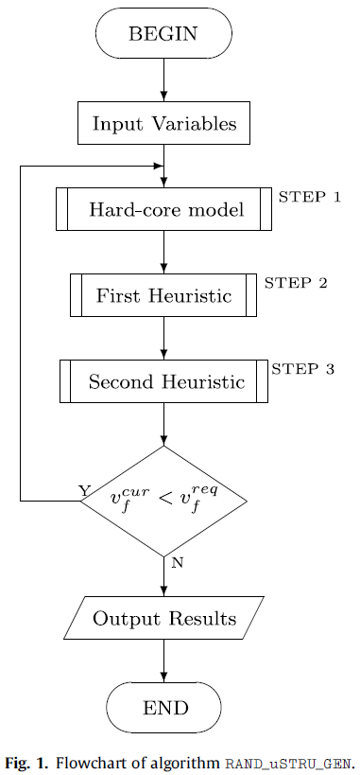
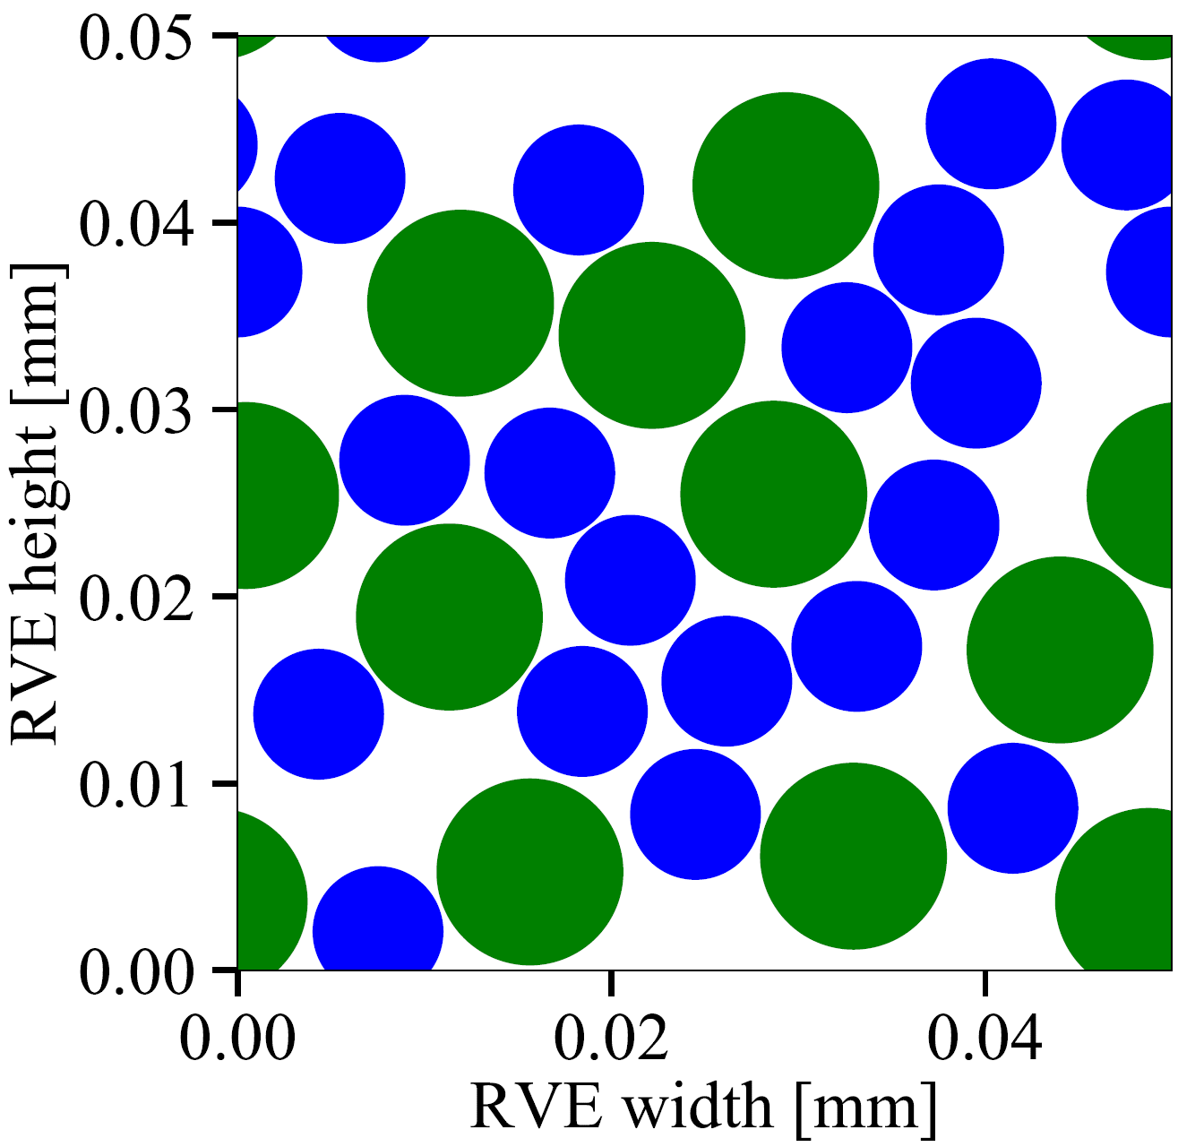
SCRIPT BY SCRIPT LIST OF CONTENTS
Rand_fibres_main_mod_OVM
Rand_Ustru_f_Loop
RandGen: main function
Rand_uSTRU_f_HardCoreModel
Rand_PER_uSTRU_GEN_3D_LayerBundle
- f_overlap (Rand_uSTRU_f_overlap)
- Rand_Per_uSTRU_FirstHeur (Rand_uSTRU_f_FirstHeur)
- Rand_Per_uSTRU_SecHeur (Rand_uSTRU_f_SecHeur)
Rand_uSTRU_f_ExtendDom
ExtendDomain: to plot the RVE. It creates a larger RVE (periodic RVE).
AdjustArea: to plot the RVE. It enforces the correct area for each fibre.
Rand_uSTRU_f_Plot_Fibres
Circles: to plot the RVE. Make scatter plot of circles.
Rand_uSTRU_f_CheckVfAlongRVE
CheckVfAlongRVE: to calculate the volume fraction in certain given windows along the RVE.
PlotVfAlongRVE: to calcualte the volume fraction in certain given windows along the RVE.

Slide 7
SCRIPT BY SCRIPT Rand_fibres_main
Rand_fibres_main_mod_OVM
Rand_Ustru_f_Loop
RandGen: main function
Rand_uSTRU_f_HardCoreModel
Rand_PER_uSTRU_GEN_3D_LayerBundle
- f_overlap (Rand_uSTRU_f_overlap)
- Rand_Per_uSTRU_FirstHeur (Rand_uSTRU_f_FirstHeur)
- Rand_Per_uSTRU_SecHeur (Rand_uSTRU_f_SecHeur)
It is the main script.
It contains:
The inputs to create the RVE
It calls the general function: RandGen (from Rand_uSTRU_f_Loop)
Melro2008generation – Computational_Micromechanics
Generation of random distribution of fibres in long-fibre reinforced composites. Melro, A.R. et al.

Slide 8
SCRIPT BY SCRIPT Rand_Ustru_F_lOOP
Rand_fibres_main_mod_OVM
Rand_Ustru_f_Loop
RandGen: main function
Rand_uSTRU_f_HardCoreModel
Rand_PER_uSTRU_GEN_3D_LayerBundle
- f_overlap (Rand_uSTRU_f_overlap)
- Rand_Per_uSTRU_FirstHeur (Rand_uSTRU_f_FirstHeur)
- Rand_Per_uSTRU_SecHeur (Rand_uSTRU_f_SecHeur)
It contains the main function: RandGen
Calculate different parameters for inter/intra layer RVE
It calls the function: Rand_PER_uSTRU_GEN_3D_LayerBundle (from Rand_uSTRU_f_HardCoreModel). This is the function that collocates and defines the position of the fibers.
Create, edit and save the RVE using, mainly, Matplotlib library
Melro2008generation – Computational_Micromechanics
Generation of random distribution of fibres in long-fibre reinforced composites. Melro, A.R. et al.

Slide 9
SCRIPT BY SCRIPT Rand_uSTRU_f_HardCoreModel
Rand_fibres_main_mod_OVM
Rand_Ustru_f_Loop
RandGen: main function
Rand_uSTRU_f_HardCoreModel
Rand_PER_uSTRU_GEN_3D_LayerBundle
- f_overlap (Rand_uSTRU_f_overlap)
- Rand_Per_uSTRU_FirstHeur (Rand_uSTRU_f_FirstHeur)
- Rand_Per_uSTRU_SecHeur (Rand_uSTRU_f_SecHeur)
It contains the function:
Rand_PER_uSTRU_GEN_3D_LayerBundle
The function is compiled with @jit (from numba import jit)
Determine the region to put a fibre
Determine and initialise the calculus collocating one fibre
Start a loop collocating fibres randomly:
Determine the fibre type, the radius and generate the possible coordinates of the fibre
Check if the fibre overlaps with another one (Rand_uSTRU_f_overlap – f_overlap)
Check if the fibre is in an edge (two fibres will be added) or in a corner (four fibres will be added) and if some of them overlaps with another one
Check the First Heuristic: try to move the fibres around to gain more empty areas (Rand_uSTRU_f_FirstHeur - Rand_Per_uSTRU_FirstHeur)
Check the Second Heuristic: try to compact the fibres on the outskirts of the RVE (Rand_uSTRU_f_SecHeur - Rand_Per_uSTRU_SecHeur)
Optional: Third Heuristic to remove very short fibres in the edges or in the corners for FEM analysis (Rand_uSTRU_f_Thi_Heur - Rand_Per_uSTRU_ThirdHeur)
Melro2008generation – Computational_Micromechanics
Generation of random distribution of fibres in long-fibre reinforced composites. Melro, A.R. et al.

Slide 10
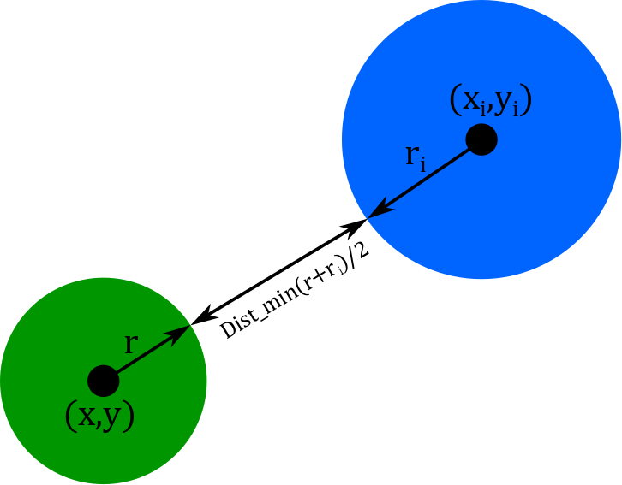
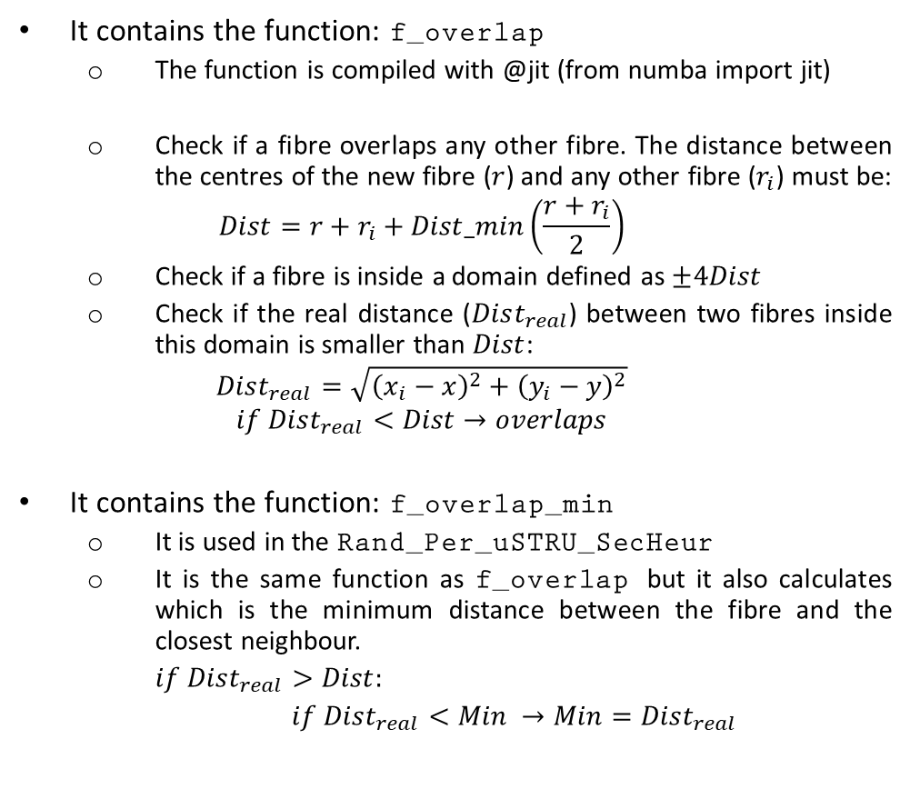
SCRIPT BY SCRIPT Rand_uSTRU_f_OVERLAP
Rand_fibres_main_mod_OVM
Rand_Ustru_f_Loop
RandGen: main function
Rand_uSTRU_f_HardCoreModel
Rand_PER_uSTRU_GEN_3D_LayerBundle
- f_overlap (Rand_uSTRU_f_overlap)
- Rand_Per_uSTRU_FirstHeur (Rand_uSTRU_f_FirstHeur)
- Rand_Per_uSTRU_SecHeur (Rand_uSTRU_f_SecHeur)
It contains the function: f_overlap
The function is compiled with @jit (from numba import jit)
Check if a fibre overlaps any other fibre. The distance between the centres of the new fibre ($r$) and any other fibre ($r_{i}$) must be:
$$Dist=r+r_{i}+Dist_min\left(\frac{r+r_{i}}{2}\right)$$
Check if a fibre is inside a domain defined as $±4Dist$
Check if the real distance ($Dist_{real}$) between two fibres inside this domain is smaller than $Dist$:
$$Dist_{real}=\sqrt{{\left(x_{i}−x\right)}^{2}+{\left(y_{i}−y\right)}^{2}}$$
$$if Dist_{real}<Dist→overlaps$$
It contains the function: f_overlap_min
It is used in the Rand_Per_uSTRU_SecHeur
It is the same function as f_overlap but it also calculates which is the minimum distance between the fibre and the closest neighbour.
$if Dist_{real}>Dist:$
$if Dist_{real}<Min →Min=Dist_{real}$
Three different distances have been defined:
Between fibre
Between fibre and void
Between voids

Slide 11
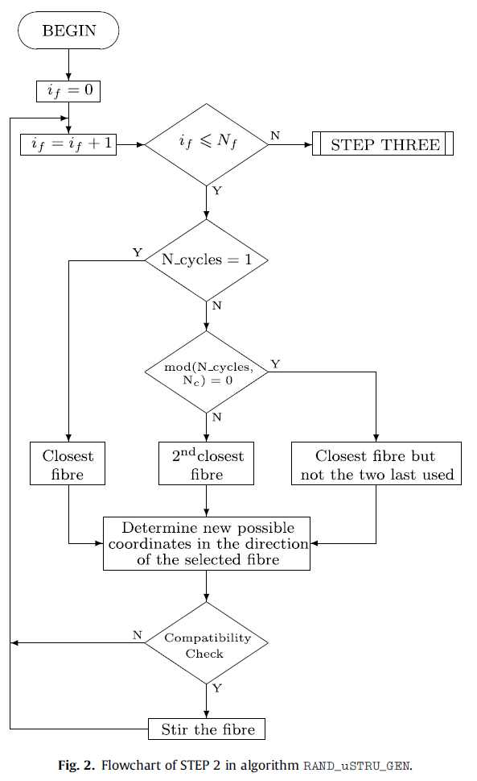
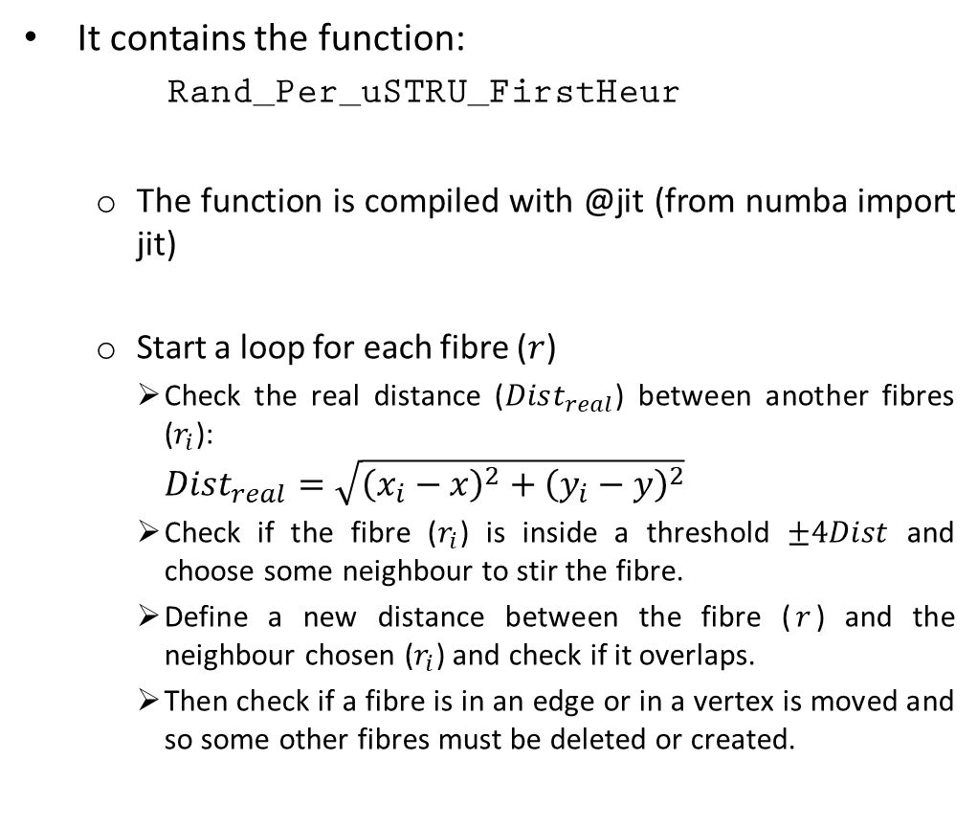
SCRIPT BY SCRIPT Rand_uSTRU_f_FirstHeur
Rand_fibres_main_mod_OVM
Rand_Ustru_f_Loop
RandGen: main function
Rand_uSTRU_f_HardCoreModel
Rand_PER_uSTRU_GEN_3D_LayerBundle
- f_overlap (Rand_uSTRU_f_overlap)
- Rand_Per_uSTRU_FirstHeur (Rand_uSTRU_f_FirstHeur)
- Rand_Per_uSTRU_SecHeur (Rand_uSTRU_f_SecHeur)
It contains the function:
Rand_Per_uSTRU_FirstHeur
The function is compiled with @jit (from numba import jit)
Start a loop for each fibre ($r$)
Check the real distance ($Dist_{real}$) between another fibres ($r_{i}$):
$$Dist_{real}=\sqrt{{\left(x_{i}−x\right)}^{2}+{\left(y_{i}−y\right)}^{2}}$$
Check if the fibre ($r_{i}$) is inside a threshold $±4Dist$ and choose some neighbour to stir the fibre.
Define a new distance between the fibre ($r$) and the neighbour chosen ($r_{i}$) and check if it overlaps.
Then check if a fibre is in an edge or in a vertex is moved and so some other fibres must be deleted or created.
Melro2008generation – Computational_Micromechanics
Generation of random distribution of fibres in long-fibre reinforced composites. Melro, A.R. et al.

Slide 12
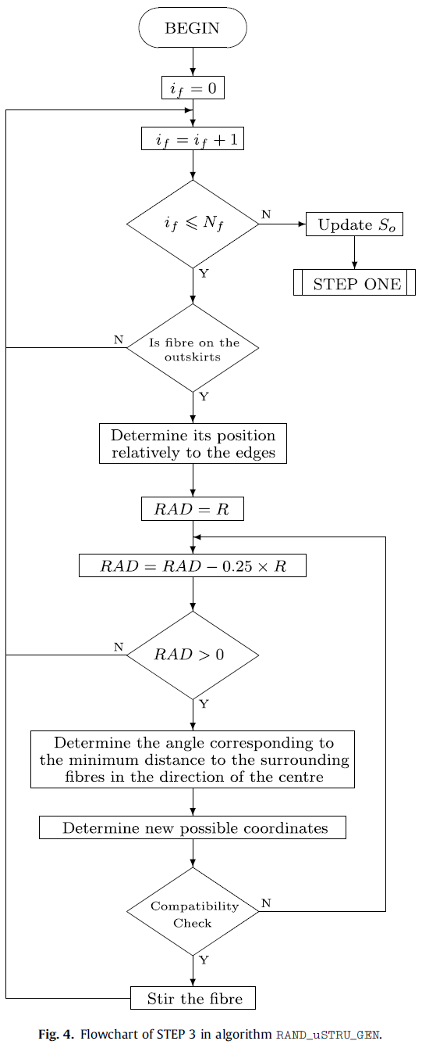
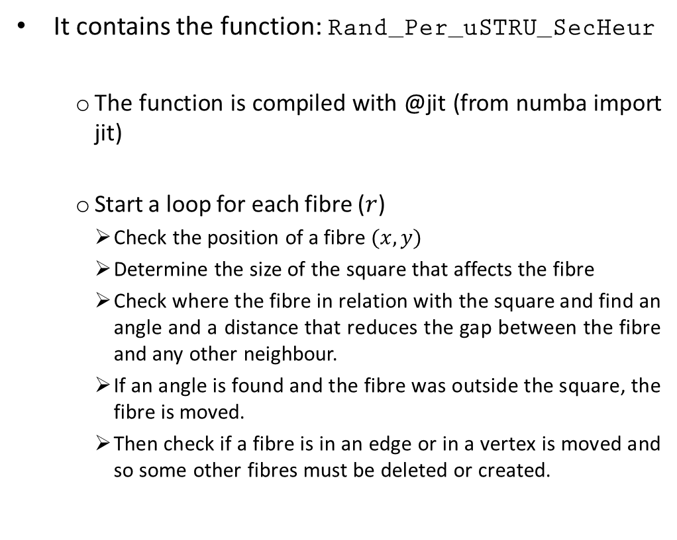
SCRIPT BY SCRIPT Rand_uSTRU_f_SECHeur
Rand_fibres_main_mod_OVM
Rand_Ustru_f_Loop
RandGen: main function
Rand_uSTRU_f_HardCoreModel
Rand_PER_uSTRU_GEN_3D_LayerBundle
- f_overlap (Rand_uSTRU_f_overlap)
- Rand_Per_uSTRU_FirstHeur (Rand_uSTRU_f_FirstHeur)
- Rand_Per_uSTRU_SecHeur (Rand_uSTRU_f_SecHeur)
It contains the function: Rand_Per_uSTRU_SecHeur
The function is compiled with @jit (from numba import jit)
Start a loop for each fibre ($r$)
Check the position of a fibre $(x,y)$
Determine the size of the square that affects the fibre
Check where the fibre in relation with the square and find an angle and a distance that reduces the gap between the fibre and any other neighbour.
If an angle is found and the fibre was outside the square, the fibre is moved.
Then check if a fibre is in an edge or in a vertex is moved and so some other fibres must be deleted or created.
Melro2008generation – Computational_Micromechanics
Generation of random distribution of fibres in long-fibre reinforced composites. Melro, A.R. et al.

Slide 13
END OF THE algorithm
Briefly summary of the algorithm:
Collocates the fibres randomly
Use the First Heuristic to move the fibres together to gain more empty areas
Use the Second Heuristic to compact the fibres on the outskirts of the RVE
The algorithm stops when:
The difference between V_{fibre} desired and the one achieved is lower than Error_V_fibres
The difference between V_{voids} desired and the one achieved is lower than Error_V_voids
The number of cycles is higher than N_cycles_max
Melro2008generation – Computational_Micromechanics
Generation of random distribution of fibres in long-fibre reinforced composites. Melro, A.R. et al.

