Slide 1

4 top consumers of electricity
in 2014
251 GWh
Electricity Consumption
223 GWh
168 GWh
152 GWh
Buildings
Franchise Tax Board (DGS)
Cal Tech
HQ
(CAL TECH)
Richmond
Lab
(CDPH)
Veteran’s Home
(CDVA)
NudgeSMS

Slide 2



Annual Electricity Consumption
Cal Tech HQ
building
(Cal Tech)
246 Homes
NudgeSMS

Slide 3
How can we encourage better conservation and awareness?
NudgeSMS

Slide 4
NudgeSMS
Improve energy conservation through text messages
NudgeSMS

Slide 5
NudgeSMS
People open texts.
98%
22%
Of texts opened
Of emails opened
NudgeSMS

Slide 6

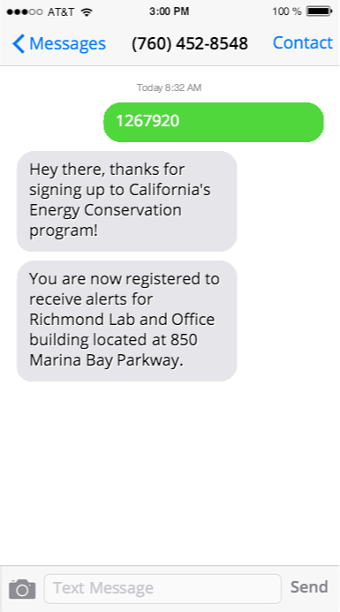
NudgeSMS

Slide 7
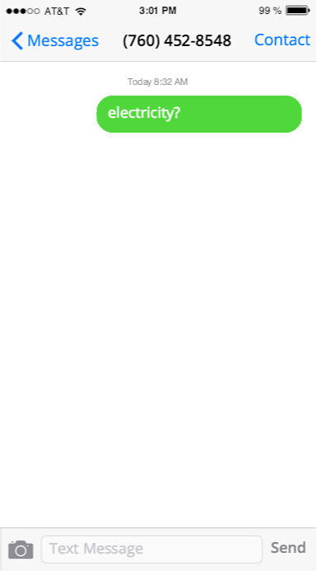
NudgeSMS

Slide 8
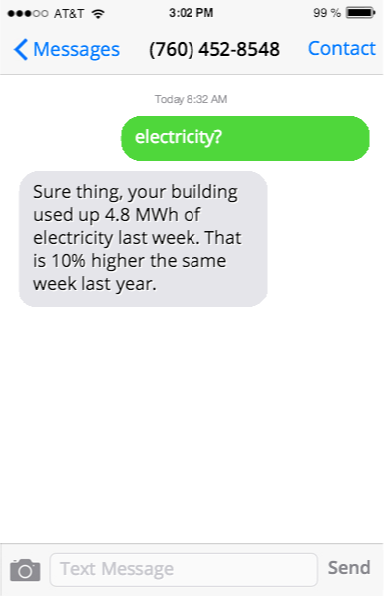
NudgeSMS

Slide 9
Credits
Icons made by Freepik from www.flaticon.com is licensed CC BY 3.0
Plug-In icon by Edward Boatman from the Noun Project
Smartphone by Martin Jordan from the Noun Project
NudgeSMS

