Slide 1

NudgeSMS
Alan Mond Brooks Newberry
NudgeSMS

Slide 2
4 top consumers of electricity
in 2014
251 GWh
Electricity Consumption
223 GWh
168 GWh
152 GWh
Buildings
Franchise Tax Board (DGS)
Cal Tech
HQ
(CAL TECH)
Richmond
Lab
(CDPH)
Veteran’s Home
(CDVA)
NudgeSMS

Slide 3



Annual Electricity Consumption
Richmond Lab
& Office
(CDPH)
246 Homes
NudgeSMS

Slide 4
State of California spent
$113 Million
in electricity bills in 2014
A 5% reduction in usage
$5.65 Million
savings every year!
NudgeSMS

Slide 5
How can we help CA employees reduce electricity consumption by 5%?
NudgeSMS

Slide 6
NudgeSMS
Improve energy conservation through text messages
NudgeSMS

Slide 7
NudgeSMS
Why text messages?
98%
22%
Of texts opened
Of emails opened
NudgeSMS

Slide 8
How does it work?
NudgeSMS

Slide 9

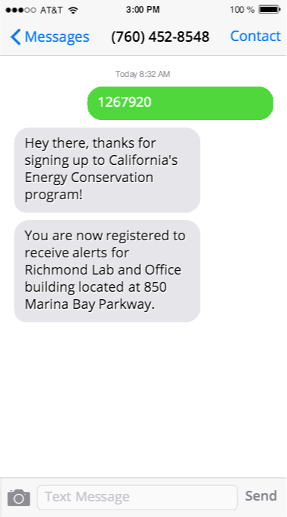
Step 1: Register
NudgeSMS

Slide 10
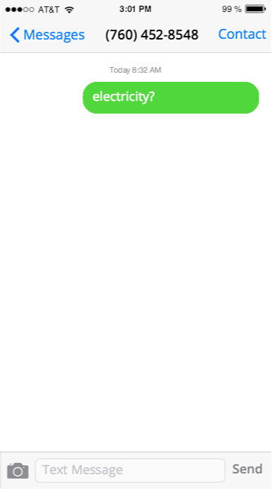
Step 2: Ask
Question
NudgeSMS

Slide 11
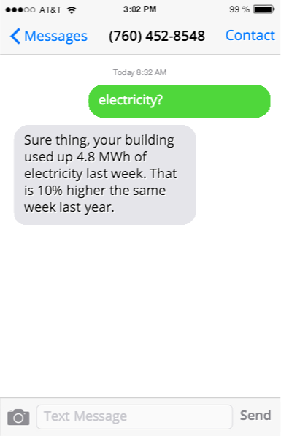
NudgeSMS
Step 3: Get real answers from Open Data portal

Slide 12
What can NudgeSMS do?
Answer questions about building data
Send energy conservation & drought prevention tips
Custom responses based on building metrics
NudgeSMS

Slide 13
NudgeSMS
Try it out!
Could NudgeSMS save CA $5M?: yes or no
Text 1267920
to (760) 452 -8549
NudgeSMS

Slide 14
Credits
Icons made by Freepik from www.flaticon.com is licensed CC BY 3.0
Plug-In icon by Edward Boatman from the Noun Project
Smartphone by Martin Jordan from the Noun Project
NudgeSMS

